Slide 1

Goal Five
Provide Sound Governance & Fiscal Management
FY 2025 Budget Presentation
July 31, 2024
1

Slide 2

Table of Contents
Vision Block Connections
“The City of Midland will be the Premier and Safest City in West Texas by Providing World Class Municipal Services through Operational Excellence and a Culture of Innovation”
World Class Service (Goals 4, 5, 6)
Operational Excellence (Goals 4, 5, 6)
Innovation (Goals 4, 5, 6)
Strategic Alignment & Vision Block Connections
Priorities Focus
Major Variances
Expenses
FY 2024 Key Accomplishments
FY 2025 Key Challenges
FY 2025 Key Deliverables
2
Notes:
Halfway There- this is what we’ve covered so far. Let’s move on to our Key Accomplishments

Slide 3


Departments
Strategic Alignment
5.1 Recruit and Retain a Skilled and Diverse Workforce: Invest in talent and diversity; grow our local pipeline of skilled employees.
5.2 Enhance Citizen Experience: Improve employee working conditions to better serve citizens.
5.3 Hone Public Servant Proficiency: Cultivate a culture of professional growth, skilled mastery, and information exchange.
5.4 Implement Cutting-Edge Practices: Harness automation and Artificial Intelligence technology for efficient resource utilization.
5.5 Promote a Well-Balanced Customer Service Philosophy: Consistently deliver excellent service to residents.
5.6 Deliver Services Timely and Efficiently: Prioritize continuous improvement.
Organizational Alignment
Administrative Services
City Management
City Secretary
Finance
General Services
Legal Department
3
3

Slide 4
Vision Block Connections
Vision Block Connections
“The City of Midland will be the Premier and Safest City in West Texas by Providing World Class Municipal Services through Operational Excellence and a Culture of Innovation”
World Class Service (Goals 4, 5, 6)
Operational Excellence (Goals 4, 5, 6)
Innovation (Goals 4, 5, 6)
“The City of Midland will be the Premier and Safest City in West Texas by Providing World Class Municipal Services through Operational Excellence and a Culture of Innovation”
World Class Service (Goals 4, 5, 6)
Operational Excellence (Goals 4, 5, 6)
Innovation (Goals 4, 5, 6)
4

Slide 5
Goal Five FY 2025 Priorities
FY 2025 Priorities
Recruitment and Retention
Enhance Citizen Experience
Promote a Well-Balanced Customer Service Philosophy
Deliver Services Timely and Efficiently
Ensure Continued Financial Stability and Accountability
Deliver Effective and Efficient Processes
Recruitment and Retention
Enhance Citizen Experience
Promote a Well-Balanced Customer Service Philosophy
Deliver Services Timely and Efficiently
Ensure Continued Financial Stability and Accountability
Deliver Effective and Efficient Processes
5
5

Slide 6
Vision Block Connections
Departments
“The City of Midland will be the Premier and Safest City in West Texas by Providing World Class Municipal Services through Operational Excellence and a Culture of Innovation”
World Class Service (Goals 4, 5, 6)
Operational Excellence (Goals 4, 5, 6)
Innovation (Goals 4, 5, 6)
Organizational Alignment
Administrative Services
City Management
City Secretary
Finance
General Services
Legal Department
6

Slide 7
Provide Sound Governance & Fiscal Management
7
Notes:
We are about 17% of the overall budget which is about $76million

Slide 8
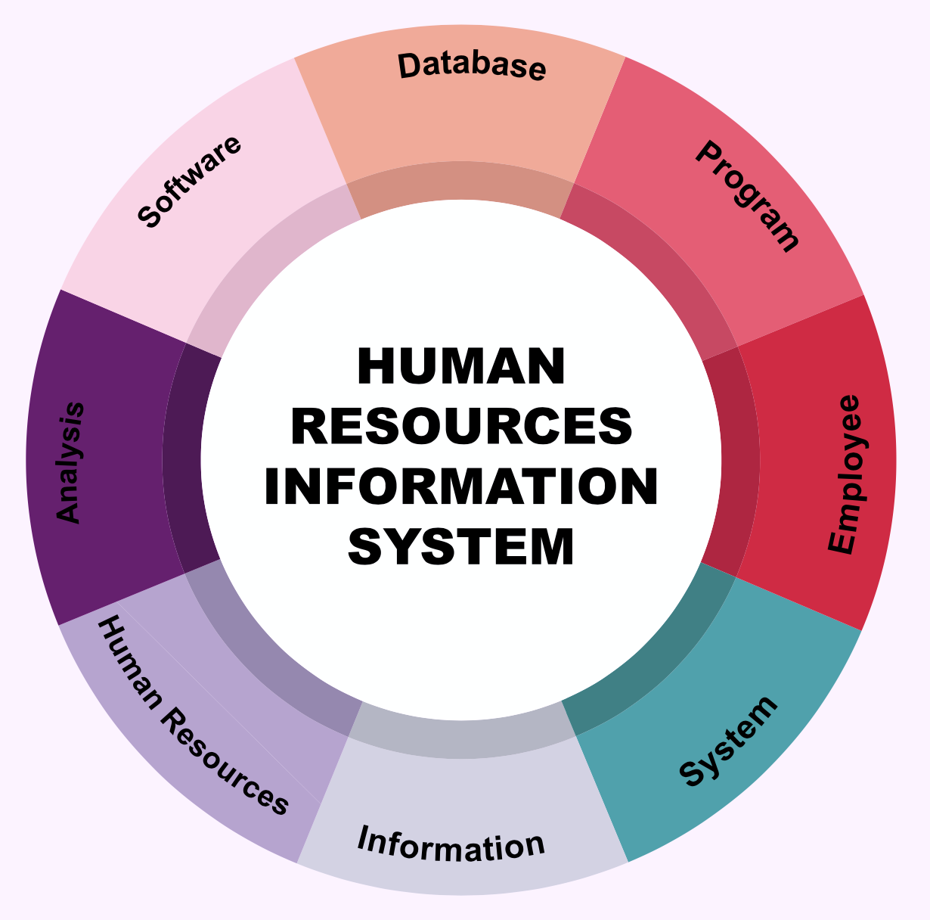
Goal Five
Administrative Services
FY 2025 Priorities
CDL Program Execution
Human Resources Information Systems Project Completion
Professional and Staff Development
Targeted Recruiting for hard to fill positions
Engineers, Mechanics, Airport Operations Agents, Police Officers
Skilled Trade-Focused Hiring
8

Slide 9
Departments
Goal Five
City Management
FY 2025 Priorities
Organizational Development
Process Improvement- Lean Six Sigma Training
Continued Focus on Communication
Succession Planning
Economic Development
Targeted focus on new and existing revenue streams and fee structures
Organizational Alignment
Administrative Services
City Management
City Secretary
Finance
General Services
Legal Department
9
9

Slide 10
Goal Five
Vision Block Connections
City Secretary
FY 2025 Priorities
Continue to improve City Council Meeting process
Maximize our value in our current systems to include Boards and Commissions
November General Election:
Districts 1, 2 and two at-large seats
City Code update in conjunction with Legal
Continued focus on Hotel/Motel Fund Dollar Priorities
“The City of Midland will be the Premier and Safest City in West Texas by Providing World Class Municipal Services through Operational Excellence and a Culture of Innovation”
World Class Service (Goals 4, 5, 6)
Operational Excellence (Goals 4, 5, 6)
Innovation (Goals 4, 5, 6)
10

Slide 11

Goal Five
Finance
FY 2025 Priorities
Expand Transparency:
Software and Regular Budget Presentations
Increase Excellence in Reporting
Annual Comprehensive Financial Report with Zero Findings
Produce the City’s first Popular Annual Financial Report (PAFR) in addition to a revamped annual Budget Book.
20 new HOT audits
Leverage new revenue streams for City
11

Slide 12
Goal Five
Departments
General Services
FY 2025 Priorities
Utilize current data to create meaningful Key Performance Indicators (KPIs).
Introduce automated survey mechanisms.
Improve Response Times for Information Requests.
Provide major equipment analysis and reports for 5 radio tower generators and all back up city generators which play important roles in the City's emergency backup power and communication.
Organizational Alignment
Administrative Services
City Management
City Secretary
Finance
General Services
Legal Department
12
12

Slide 13
Vision Block Connections
Goal Five
Legal Department
FY 2025 Priorities
Increasing online transparency to reduce hours spent on Open Records Requests.
City code update in coordination with the City Secretary’s Office.
Increase interdepartmental coordination for improved efficiency.
“The City of Midland will be the Premier and Safest City in West Texas by Providing World Class Municipal Services through Operational Excellence and a Culture of Innovation”
World Class Service (Goals 4, 5, 6)
Operational Excellence (Goals 4, 5, 6)
Innovation (Goals 4, 5, 6)
13

Slide 14
Major Variances
All Departments:
Increased staffing to accommodate organization
New Software to Improve Transparency and Efficiency
New Employee Programming:
Be the Energy- BTE
Length of Service Awards
360 Degree Wellness
Recruiting/Training
14

Slide 15
Expenses by Department
15

Slide 16
Expenses by Type
16

Slide 17
Staffing
17

Slide 18
Departments
Personnel
Variance Highlights
Administrative Services
Assistant Director
HRIS Analyst/Onboarding
Wellness Coordinator
Finance
Assistant Director
Secondary Payroll Administrator
Organizational Alignment
Administrative Services
City Management
City Secretary
Finance
General Services
Legal Department
18
18

Slide 19
Table of Contents
Vision Block Connections
“The City of Midland will be the Premier and Safest City in West Texas by Providing World Class Municipal Services through Operational Excellence and a Culture of Innovation”
World Class Service (Goals 4, 5, 6)
Operational Excellence (Goals 4, 5, 6)
Innovation (Goals 4, 5, 6)
Strategic Alignment & Vision Block
Priorities Focus
Major Variances
Expenses
FY 2024 Key Accomplishments
FY 2025 Key Challenges
FY 2025 Key Deliverables
19
Notes:
Halfway There- this is what we’ve covered so far. Let’s move on to our Key Accomplishments

Slide 20
Key Accomplishments
Administrative Services
FY 2024
Increased hiring for 911 Communications to a nearly fully staffed Public Safety Communications Center.
Improved and Streamlined Hiring
Developed Community Partnerships with area high schools and colleges to promote a work program for students.
Established a 360 Degree Wellness Program
20

Slide 21
Departments
Key Accomplishments
Administrative Services
FY 2024
Implemented a 360-degree Wellness Program
Developed a more comprehensive Internship Program.
Introduced Be Healthy Days
Improved Employee Recognition Program with BTE and length of service awards
Created a Safety Committee to promote workplace safety and lower workers compensation claims.
Organizational Alignment
Administrative Services
City Management
City Secretary
Finance
General Services
Legal Department
21
21

Slide 22
Key Accomplishments
Vision Block Connections
“The City of Midland will be the Premier and Safest City in West Texas by Providing World Class Municipal Services through Operational Excellence and a Culture of Innovation”
World Class Service (Goals 4, 5, 6)
Operational Excellence (Goals 4, 5, 6)
Innovation (Goals 4, 5, 6)
City Manager’s Office
FY 2024
Strategic Planning Creation and Implementation
Organizational Restructure and Alignment
Customer Service Improvements
Training
SeeClickFix
Employee Info Central
Enhanced Organizational Communication
Internal, Externally and to Council
22
Notes:
Be in the Know, Leadership Message, Council Reports (Bi-weekly, Quarterly, Mid-Year and Annual)

Slide 23
Departments
Key Accomplishments
City Manager’s Office
FY 2024
Planning and Economic Development
Recruitment of a Chief Planning and Development Officer
Downtown Revitalization
Reduce Burden to Businesses/Developers by Streamlining Permits and Inspections Process
Enhanced Coordination with MDC including efforts to attract major businesses and retailers.
Organizational Alignment
Administrative Services
City Management
City Secretary
Finance
General Services
Legal Department
23
23
Notes:
Speak to TIRZ, Downtown Improvements
Cross Functional Team with Developers- Positive Developer Feedback

Slide 24
Key Accomplishments
Vision Block Connections
City Secretary’s Office
FY 2024
Streamlining Boards and Commissions Appointment Process
Council Orientation Process in Coordination with City Management
Free the Files to aid in Data Security Improvements
EasyVote Campaign Finance Reports Process
Records Manager Promotion
“The City of Midland will be the Premier and Safest City in West Texas by Providing World Class Municipal Services through Operational Excellence and a Culture of Innovation”
World Class Service (Goals 4, 5, 6)
Operational Excellence (Goals 4, 5, 6)
Innovation (Goals 4, 5, 6)
24
Notes:
Coordinate 18 Boards

Slide 25
Key Accomplishments
Finance
FY 2024
Zero Findings for Annual audit, first time in over 20 years
Parks Maintenance Fund Established
Provided Financial Information Accessible to Citizens through Online Platform, OpenGov
Regular Budget Updates for transparency to Council and Public
Awarded GFOA awards for Budget and Annual Reports
25

Slide 26
Departments
Key Accomplishments
General Services
FY 2024
Implementation of Electronic Online Bidding/Purchasing system, Bonfire
Fully staffed Garage workforce after years of being understaffed
Preventative Maintenance technician for Solid Waste to help keep refuse trucks in service.
Provided priority support within 2-4 hours.
Organizational Alignment
Administrative Services
City Management
City Secretary
Finance
General Services
Legal Department
26
26

Slide 27
Key Accomplishments
Vision Block Connections
Legal
FY 2024
Provided Contracts and Negotiation for
Future water investments
Economic development endeavors
Planning and Zoning changes
Guided on Pension Fund matters
Supported the development of Substandard and Dangerous Buildings code.
“The City of Midland will be the Premier and Safest City in West Texas by Providing World Class Municipal Services through Operational Excellence and a Culture of Innovation”
World Class Service (Goals 4, 5, 6)
Operational Excellence (Goals 4, 5, 6)
Innovation (Goals 4, 5, 6)
27
Notes:
Coordinate 18 Boards

Slide 28
Vision Block Connections
FY 2025 Key Deliverables
Strategy: Recruit and Retain a Skilled and Diverse Workforce
CTE Program with Midland College and Greenwood ISD
Targeted Recruiting for hard to fill positions
Consider an alternative benefits package that better aligns with the workforce
*Eighth year of pay increases without a healthcare premium increase to the employee
“The City of Midland will be the Premier and Safest City in West Texas by Providing World Class Municipal Services through Operational Excellence and a Culture of Innovation”
World Class Service (Goals 4, 5, 6)
Operational Excellence (Goals 4, 5, 6)
Innovation (Goals 4, 5, 6)
28
Notes:
CTE- Program: We already have three students registered for this program in the fall. We are looking at this as a pilot program and hope to expand this to other districts.
Benefits Package: Our average employee age is 30-39. Research is telling us that a more flexible benefits package including HSAs are appealing to this group. A positive is that research is saying that will be less cost to both the employee and the organization.
This last point is a big benefit to the employees at a cost to the organization of…

Slide 29
FY 2025 Key Deliverables
Strategy: Enhance Citizen Experience
Continue Website enhancement
Implement Surveys with Actionable Improvements
Continue Communitywide and Budget Chime-in Surveys.
29

Slide 30
FY 2025 Key Deliverables
Departments
Strategy: Hone Public Servant Proficiency
Lean Six Sigma Training
Deliver New Leadership and Development Training
Implement Improved Customer Services Standards
Increase Certification Programs for Employees
Ensure We are Working to Best Practices/Standards
Organizational Alignment
Administrative Services
City Management
City Secretary
Finance
General Services
Legal Department
30
30
Notes:
We want to get better for our residents. You will continue to see process improvement all throughout the organization.
Certification programs are offered throughout the organization. We want our people working to a standard. An example is ensuring our Fleet services technicians are ASE Certified. We are looking for those opportunities across the board.

Slide 31
Vision Block Connections
FY 2025 Key Deliverables
Strategy: Implement Cutting-edge Practices
Become a Learning Organization
Expand Organizational Focus to Include Continuous Improvement through Targeted Training, Community Partnerships and Implementing Best Practices.
Increase the Use of Process Automation.
“The City of Midland will be the Premier and Safest City in West Texas by Providing World Class Municipal Services through Operational Excellence and a Culture of Innovation”
World Class Service (Goals 4, 5, 6)
Operational Excellence (Goals 4, 5, 6)
Innovation (Goals 4, 5, 6)
31

Slide 32
FY 2025 Key Deliverables
Strategy: Promote a Well-Balanced Customer Service Philosophy
Improve Departmental Personalized Service adding a Proactive Approach.
Employee Empowerment through SMART Risk Decisions.
32

Slide 33
FY 2025 Key Deliverables
Departments
Strategy: Deliver Services Timely and Efficiently while promoting Excellent Customer Service
Expand the use of Service Level Agreements (SLAs) Across the Organization.
Prioritize Continuous Improvement.
Continue to Improve Employee Customer Service Culture with the use of Tools and Training.
Reward High Performing, Service-Driven Employees with BTE.
Organizational Alignment
Administrative Services
City Management
City Secretary
Finance
General Services
Legal Department
33
33

Slide 34
Vision Block Connections
FY 2025 Key Deliverables
Strategy: Ensure Continued Financial Stability and Accountability
Deploy Comprehensive Financial Training for All Employees who Access Our Financial System.
Continue Audits for Hotel Motel, Sales Tax and Utility Billing Collections.
Complete the FY24 Financial Audit with no findings.
“The City of Midland will be the Premier and Safest City in West Texas by Providing World Class Municipal Services through Operational Excellence and a Culture of Innovation”
World Class Service (Goals 4, 5, 6)
Operational Excellence (Goals 4, 5, 6)
Innovation (Goals 4, 5, 6)
34

Slide 35
FY 2025 Key Deliverables
Strategy: Ensure Reliability and Safety
Implement Programs to Reduce Organizational Risk:
Active Safety Committee to focus on Preventative Measures
Worker's Compensation training for all PD, Fire and Solid Waste Employees
Quarterly Worker's Compensation file reviews
Ensure Proper Building Maintenance for Employee Well Being.
35

Slide 36
MISSION
Deliver exceptional services and promote a high quality of life and place for ALL our citizens.
36

Slide 37
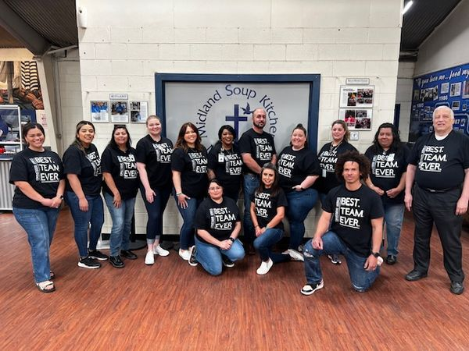
Meet the Team
Administrative Services
Mark Widmann, Director
Nicole Weaverling, Assistant Director
Lauren Reynosa, Human Resources Manager
Lupe Reyes, Talent Acquisition Manager
Karla Romanillo, Benefits Manager
Jamie Higgins, Safety and Risk Manager
37

Slide 38
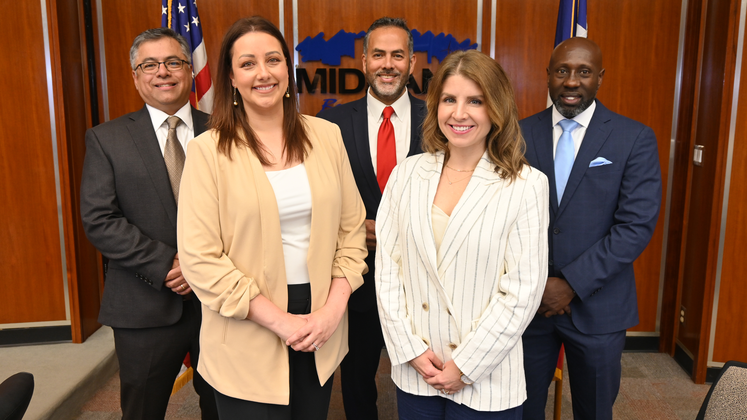
Meet the Team
City Management
Tommy Gonzalez, City Manager
Morris Williams, Jr., Deputy City Manager
Jose Ortiz, Assistant City Manager
Taylor Novak, Chief of Staff
Elizabeth Triggs, Planning and Development Officer
38

Slide 39
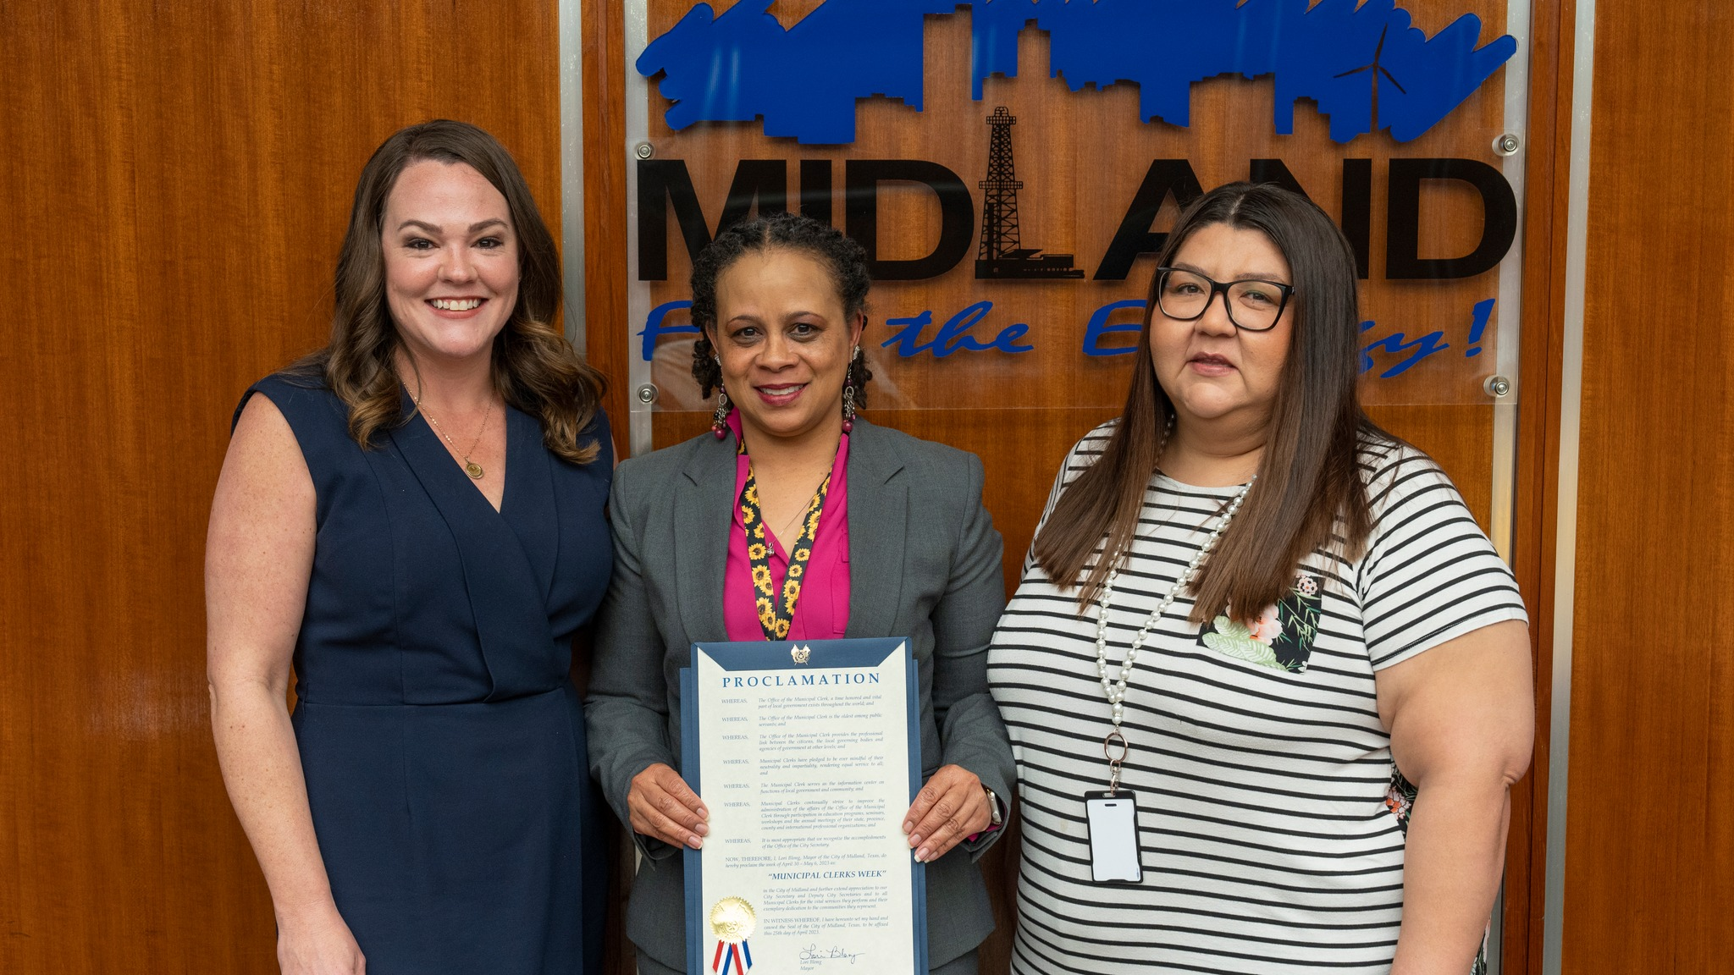
Meet the Team
City Secretary’s Office
Marcia Bentley- German, Chief Governance Officer
39

Slide 40
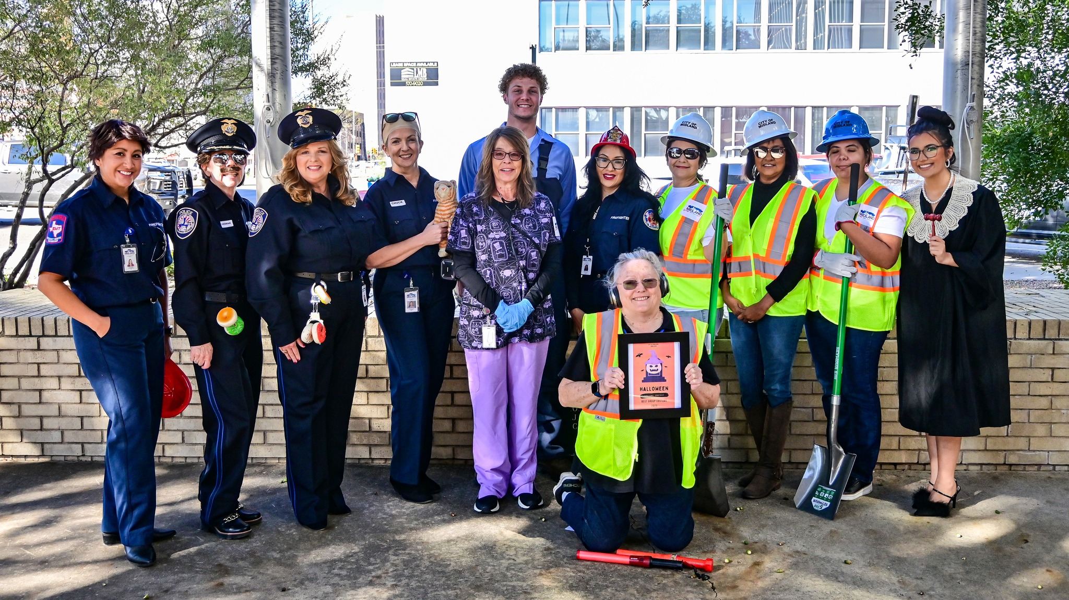
Meet the Team
Finance
Christy Weakland, Director
Vivian Irwin, Assistant Director
Crystal Garcia, Comptroller
Alyssa Coppens, Budget Manager
Mala Ramkissoon, City Treasurer
40

Slide 41
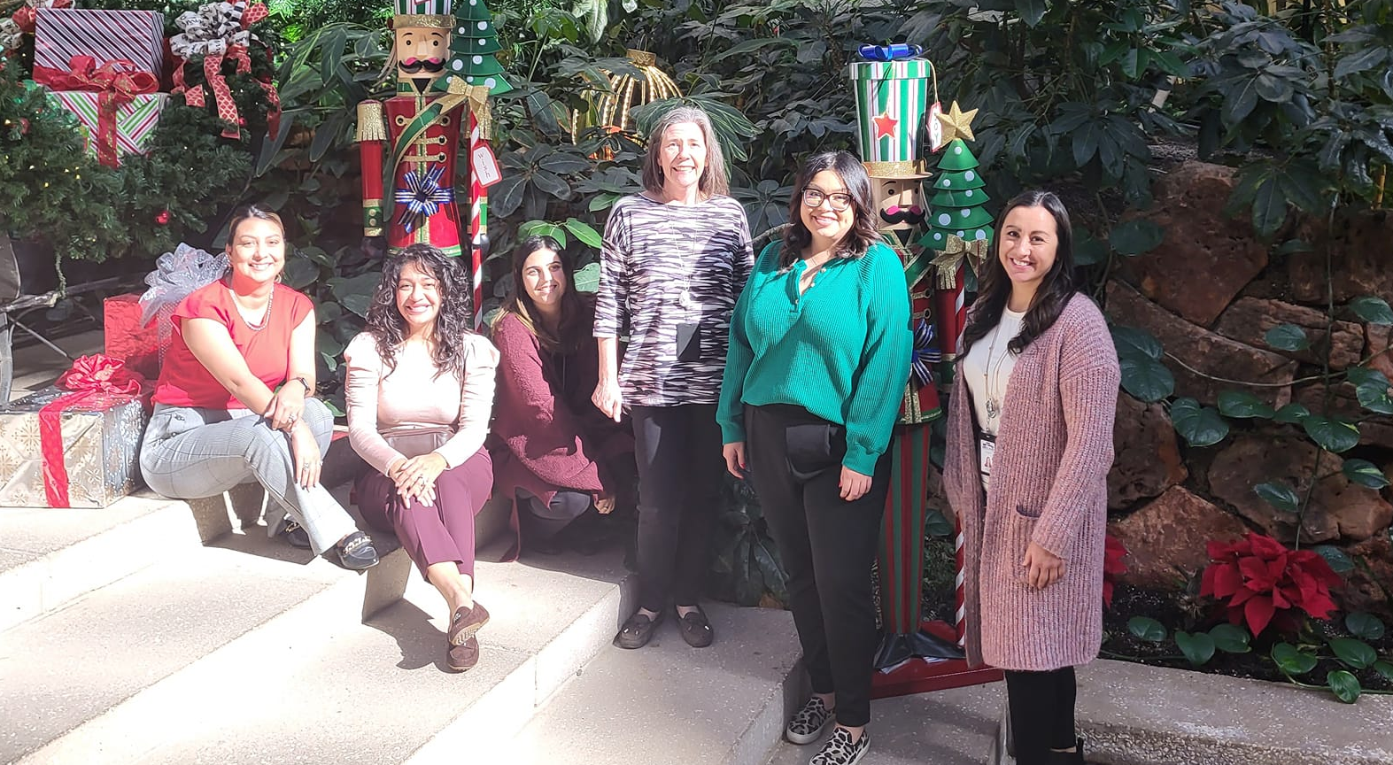
Meet the Team
Purchasing
Regina Stephenson, Director
Erika Munoz, Assistant Director
Mark Garcia, Facilities Services Manager
Eddie Chavez, Vehicle Services Manager
Manual Salinas, Fleet Services Manager
Arturo Delgado, Warehouse Manager
41

