Slide 1
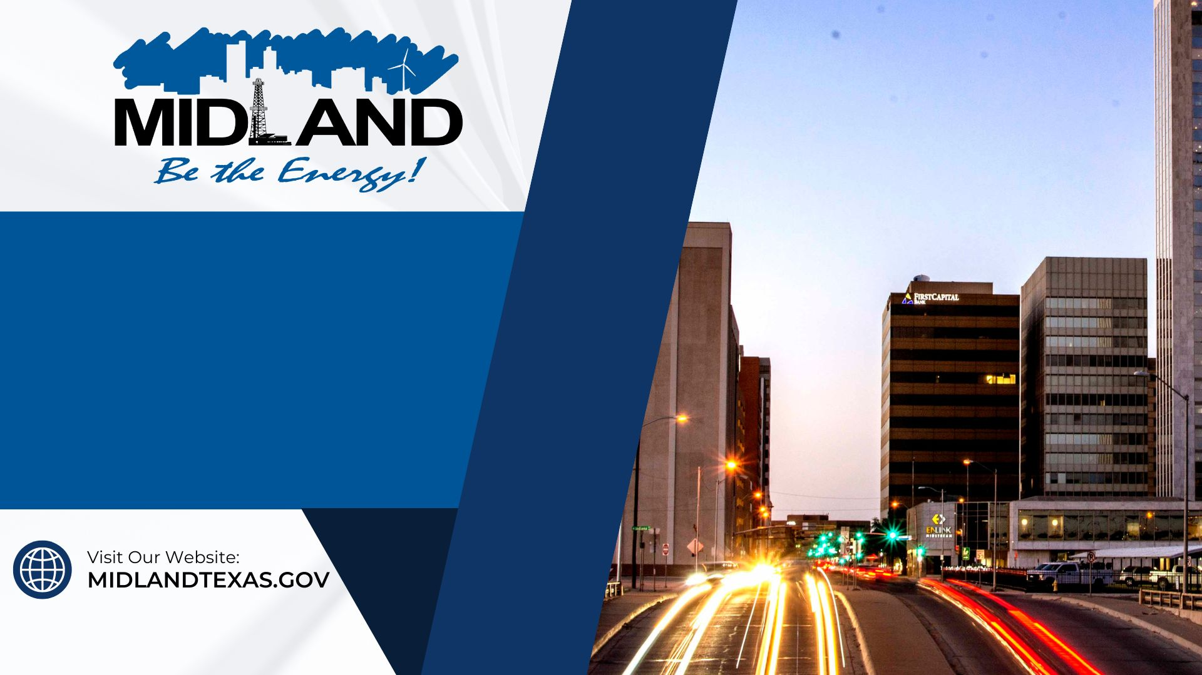
Goal Six
Strengthen & Sustain our Infrastructure
FY 2025 Budget Presentation
July 30, 2024
1

Slide 2
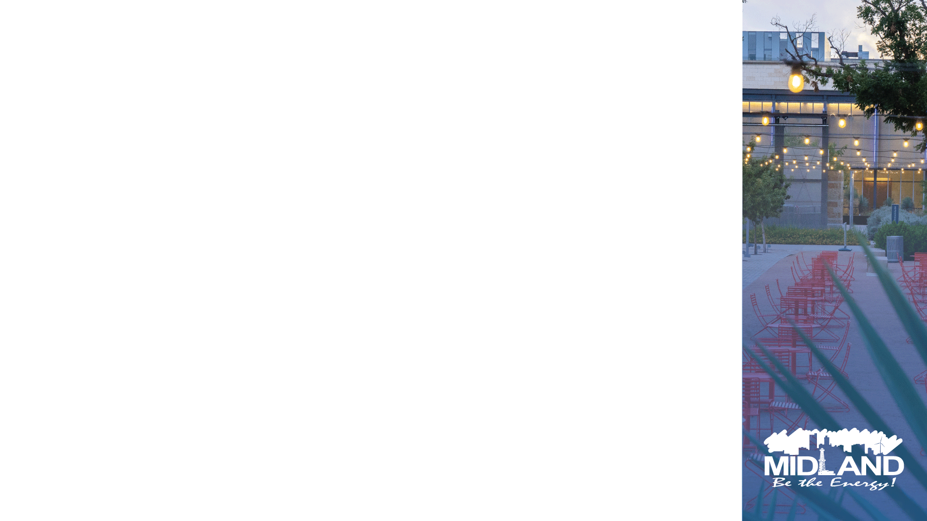
Table of Contents
Vision Block Connections & Strategic Alignment
Priorities Focus
Major Variances
Expenses
FY 2024 Key Accomplishments
FY 2025 Key Challenges
FY 2025 Key Deliverables
2

Slide 3

Vision Block Connections
“The City of Midland will be the Premier and Safest City in West Texas by Providing World Class Municipal Services through Operational Excellence and a Culture of Innovation”
World Class Service (Goals 4, 5, 6
Operational Excellence (Goals 4, 5, 6)
Innovation (Goals 4, 5, 6)
3

Slide 4
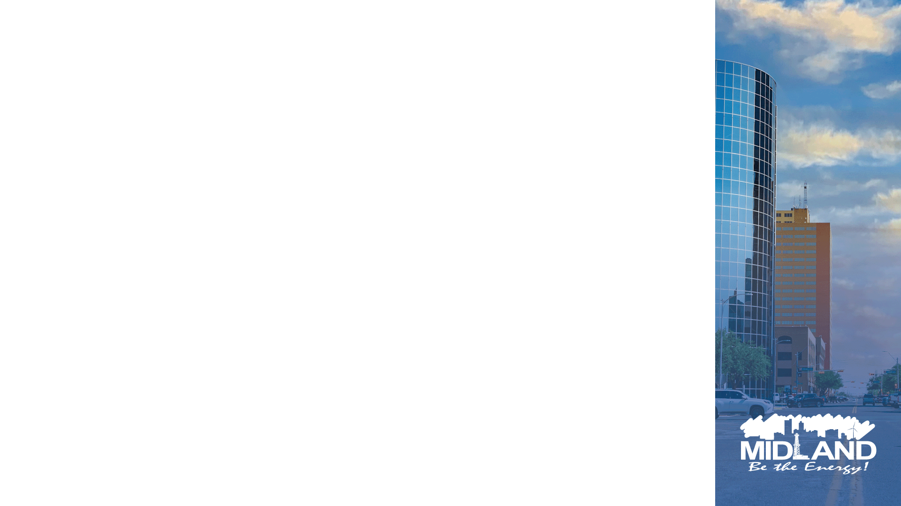
Strategic Alignment
Goal 6: Strengthen and Sustain Our Infrastructure
6.1 Provide Reliable and Sustainable Utilities
Ensure the reliability and sustainability of water and wastewater systems.
6.2 Enhance Infrastructure for Economic Growth
Invest in infrastructure improvements to support economic development and growth.
6.3 Streamline and Consolidate City Facilities
Improve efficiency and cost-effectiveness through streamlined facility operations.
Goal 3: Quality of Life and Place
3.1 Enhance Community Engagement
Promote active community involvement and enhance communication with residents.
3.2 Foster Relationships with Foundations and Outside Businesses
Build partnerships to leverage resources and expertise for community benefit.
Goal 1: Strong Economy with More Quality Jobs
1.1 Increase the Midland Sales Tax Base
Support commercial and residential development to boost economic growth and job creation.
4

Slide 5
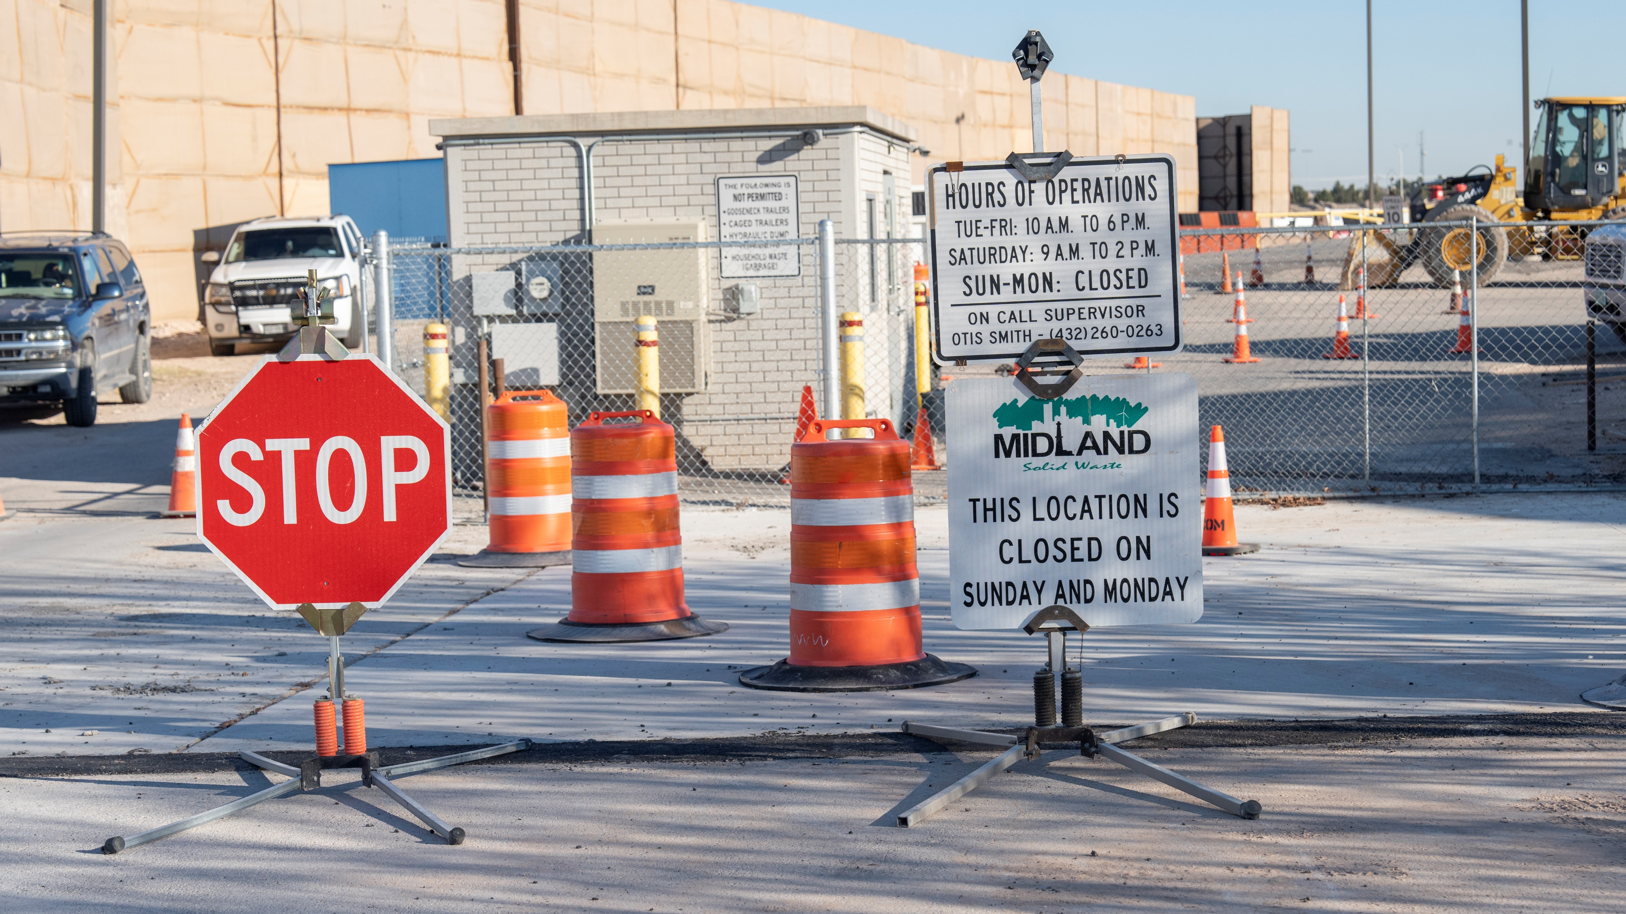
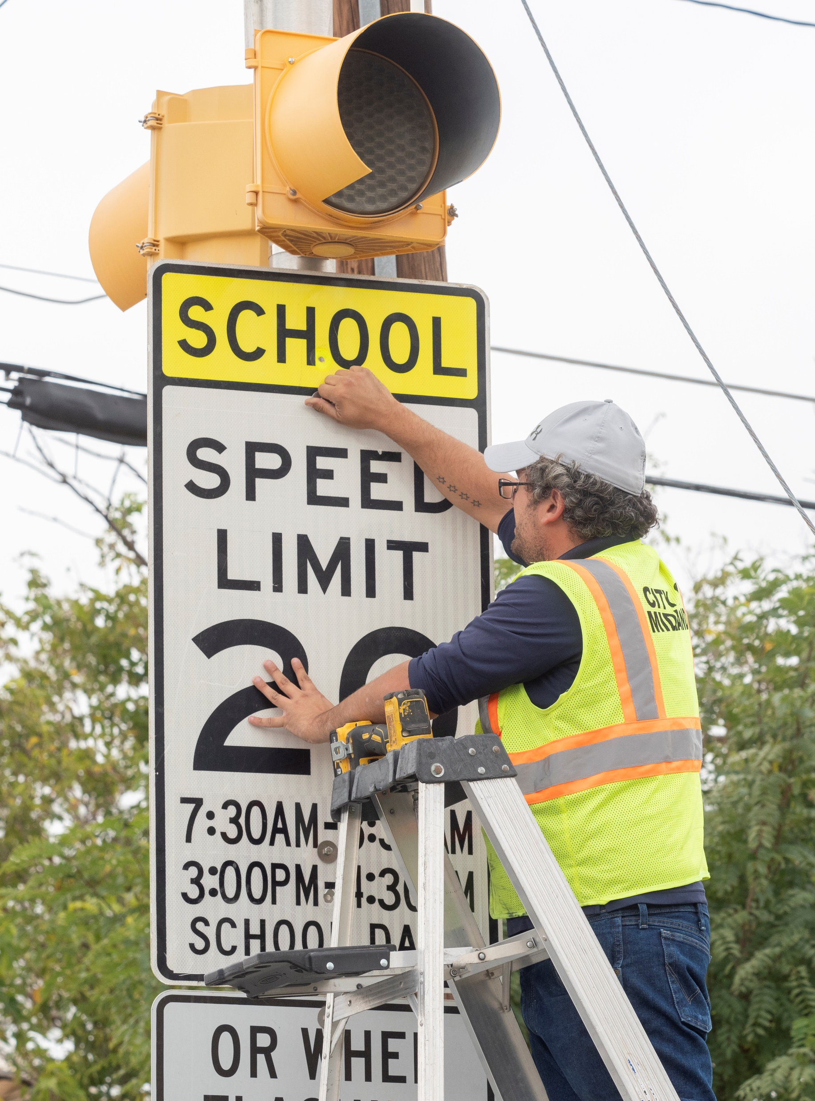
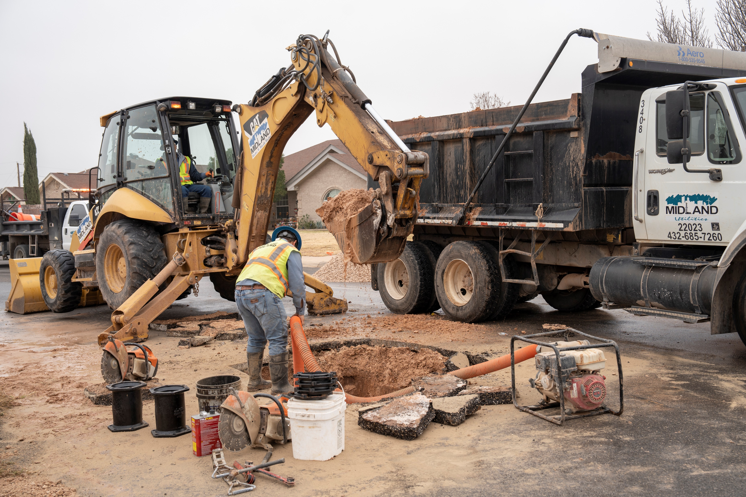

Goal 6 Team Members
Organizational Alignment
Engineering Services
Gabe McClelland, Adrian Acosta, Josh Ferguson, Bobby W., Taha Sakrani
Solid Waste
Jeffery Ahrlett
Utilities
Alma McCammond and Carl Craigo
5

Slide 6
Strengthen and Sustain our Infrastructure
FY 2025 ALL FUNDS BUDGET: $185,919,653
6
Notes:
Distribution of funds among strategic goals
Includes Solid Waste, Utilities, and Engineering

Slide 7
Expenses by Department
7
Notes:
Combination of 2 Departments
Contractual services and internal services have increased

Slide 8
Expenses by Type
8
Notes:
Other uses includes increase in franchise fee
Jal Draw Project is a capital project using drainage fees

Slide 9
Staffing
9

Slide 10
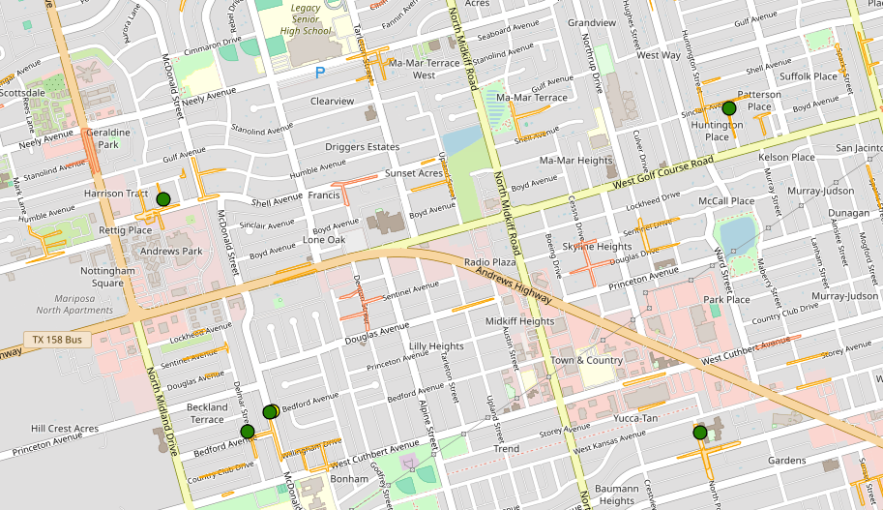
FY2024 Key Accomplishments
Utilities
Executed a satellite leak detection program to look for underground unknown leaks.
Located and repaired 15 substantial underground main leaks.
10

Slide 11
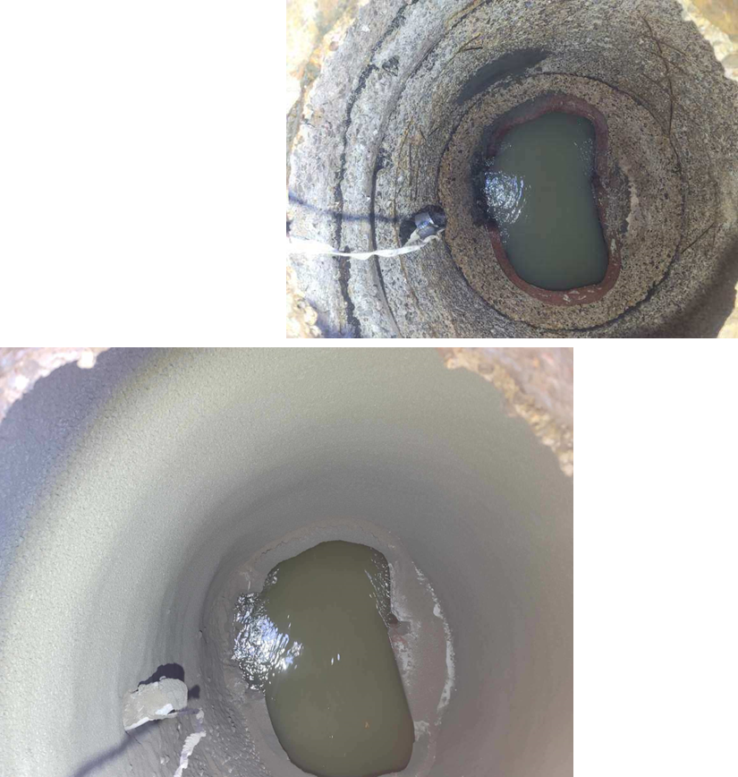
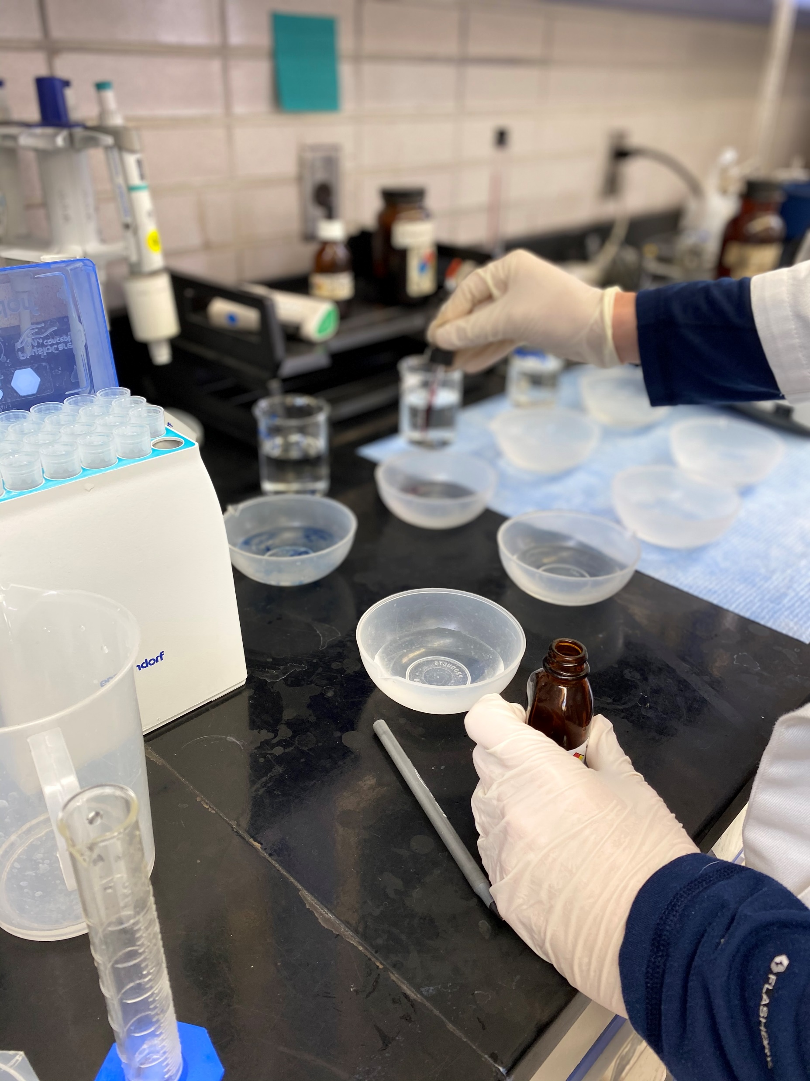
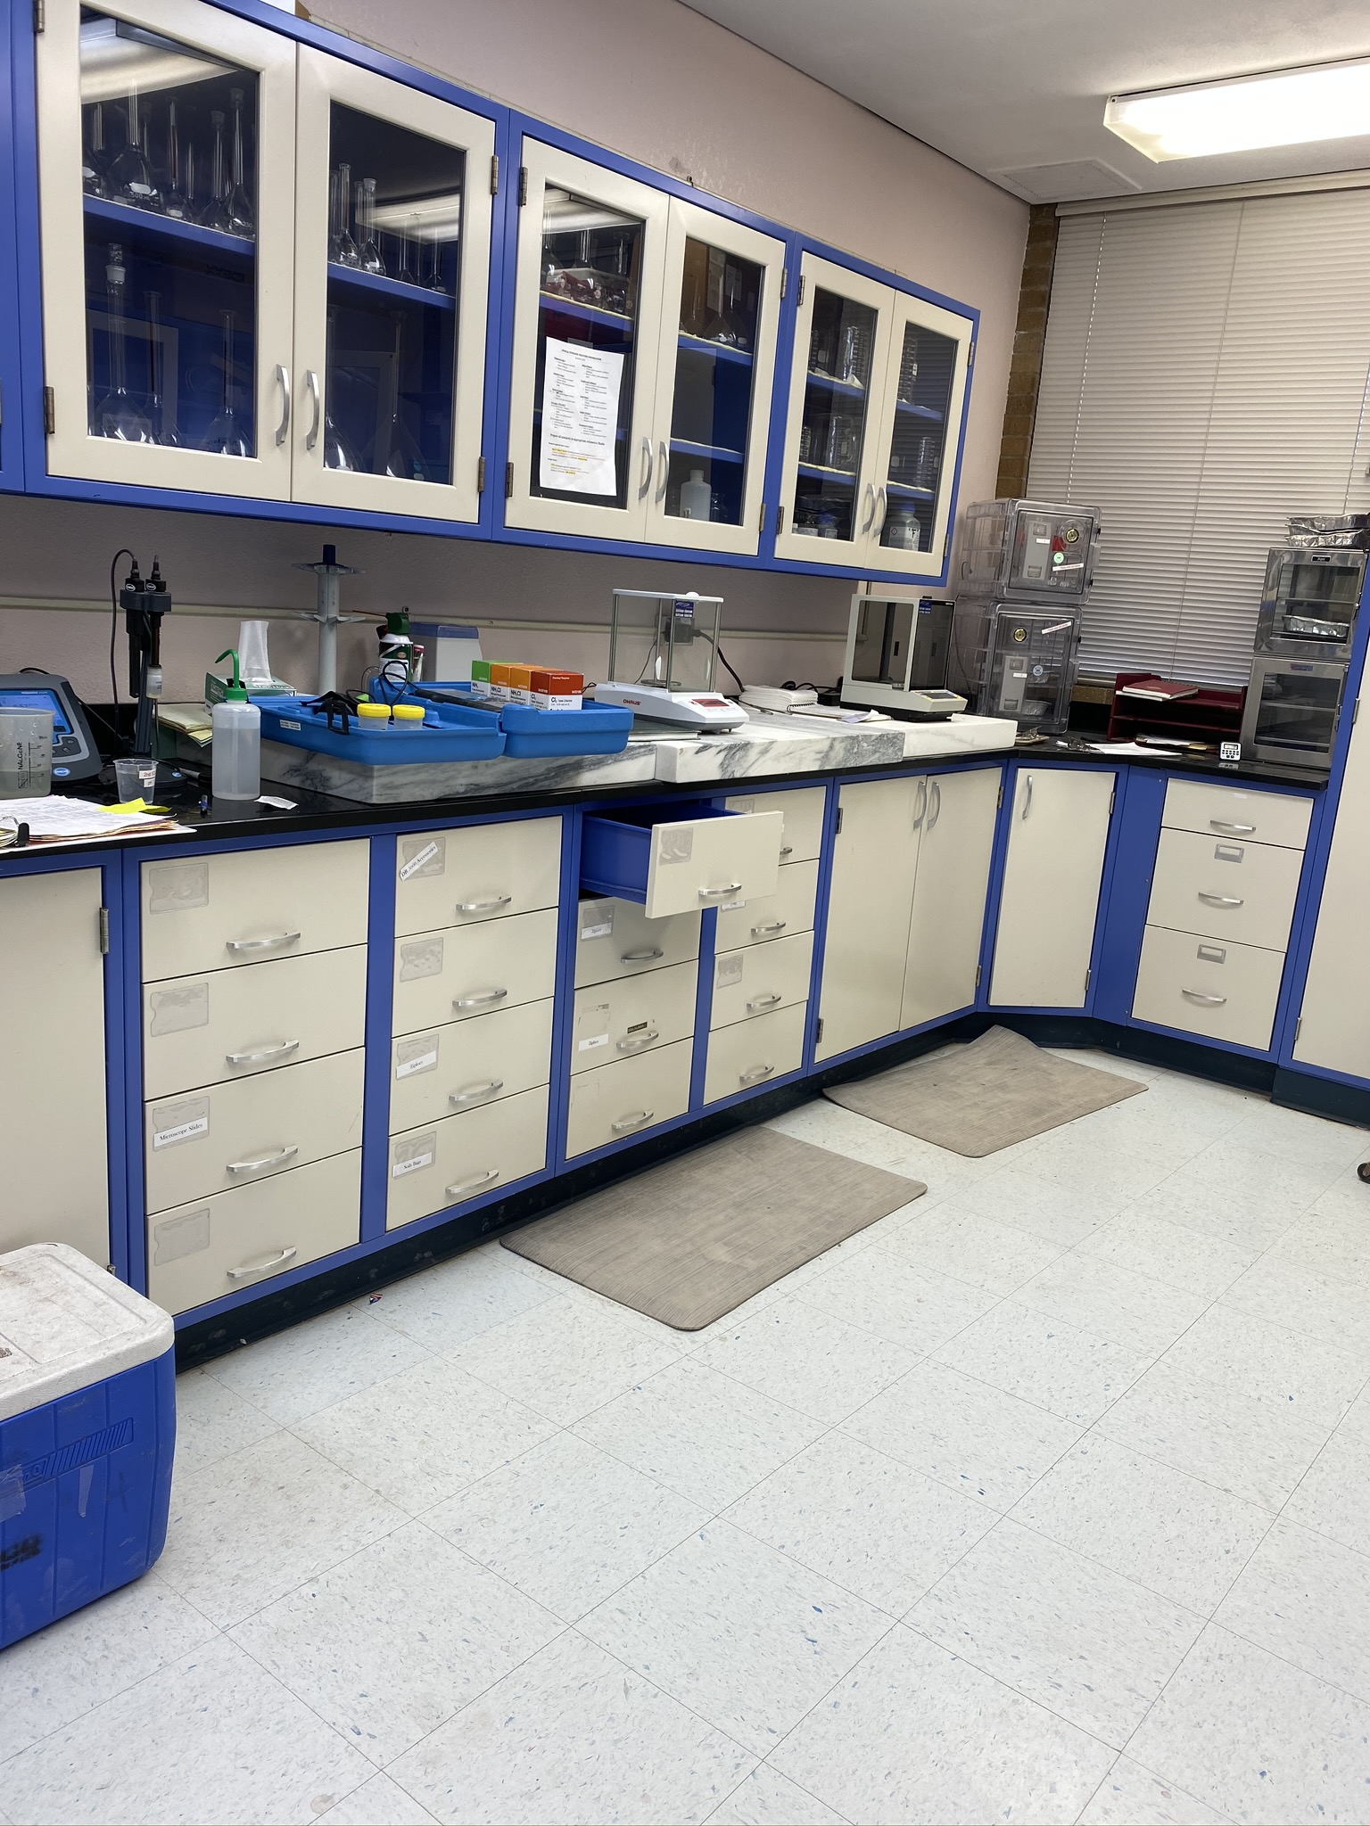
FY2024 Key Accomplishments
Water and Sewer Infrastructure
Approved the MOU for Ft. Stockton Water Source
Installed 28,900 feet of new water mains
Installed 19,870 feet of new sewer mains
Rehabbed 95 and replaced 15 manholes
Expanded Paul Davis Well Field to deliver 10 million gallons/day
Passed TCEQ inspection and audit for environmental control lab, water purification plant, and water reclamation facility
Environmental Compliance
Completed floor replacements at WRF Laboratory Building
Replaced Critical Laboratory Equipment
Replaced 5 sampling stations throughout the city
Completed UCMR5 testing for PFAS
11

Slide 12
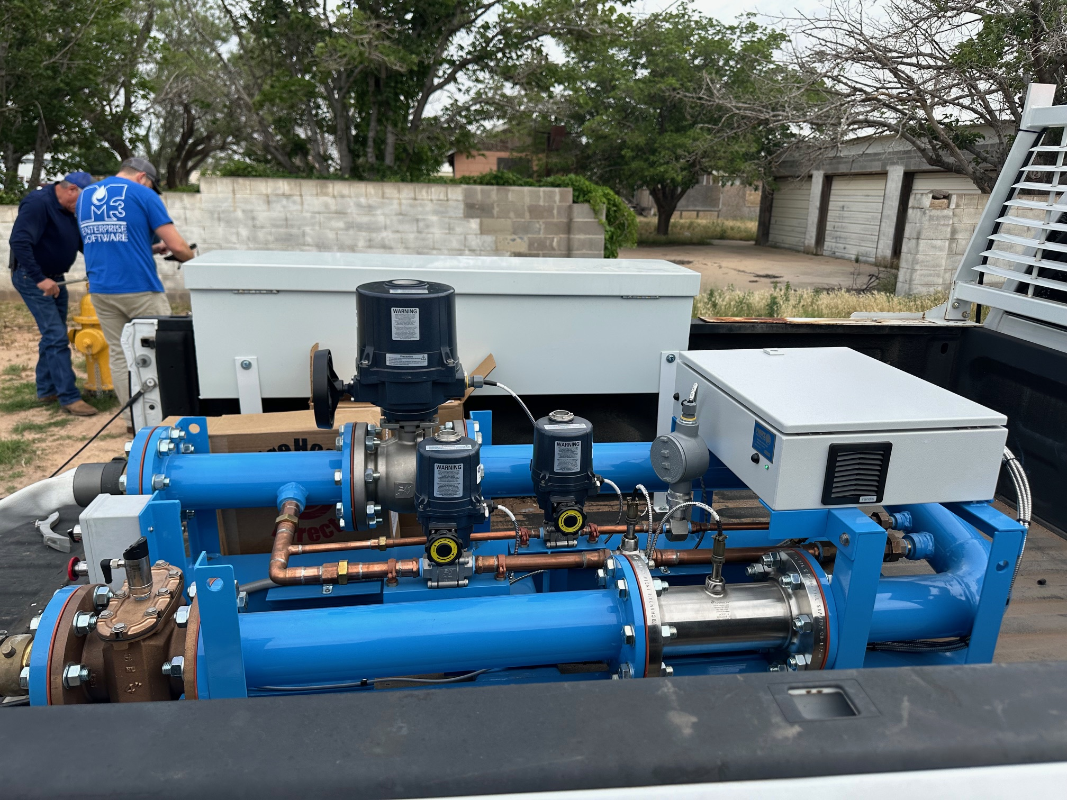
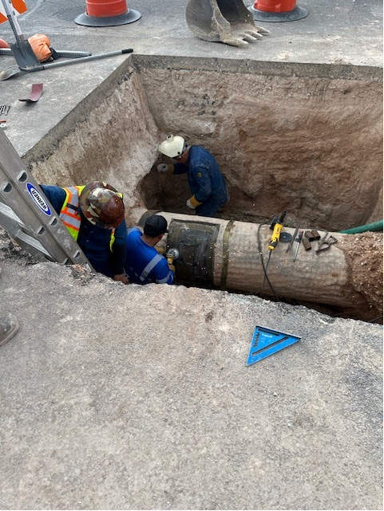
FY2024 Key Accomplishments
Customer Service
Streamlined customer interactions, handling an average of 9114 monthly touchpoints
Provided an average of 24.14 hours of training across departments
Implemented the mCare mobile service order delivery system
Water and Wastewater Maintenance
Installed 4700 feet of water main across Kansas St., Storey Ave., Camp St., and Beal Parkway
Completed 104 water main repairs
Repaired 46 fire hydrants and replaced 19
12

Slide 13
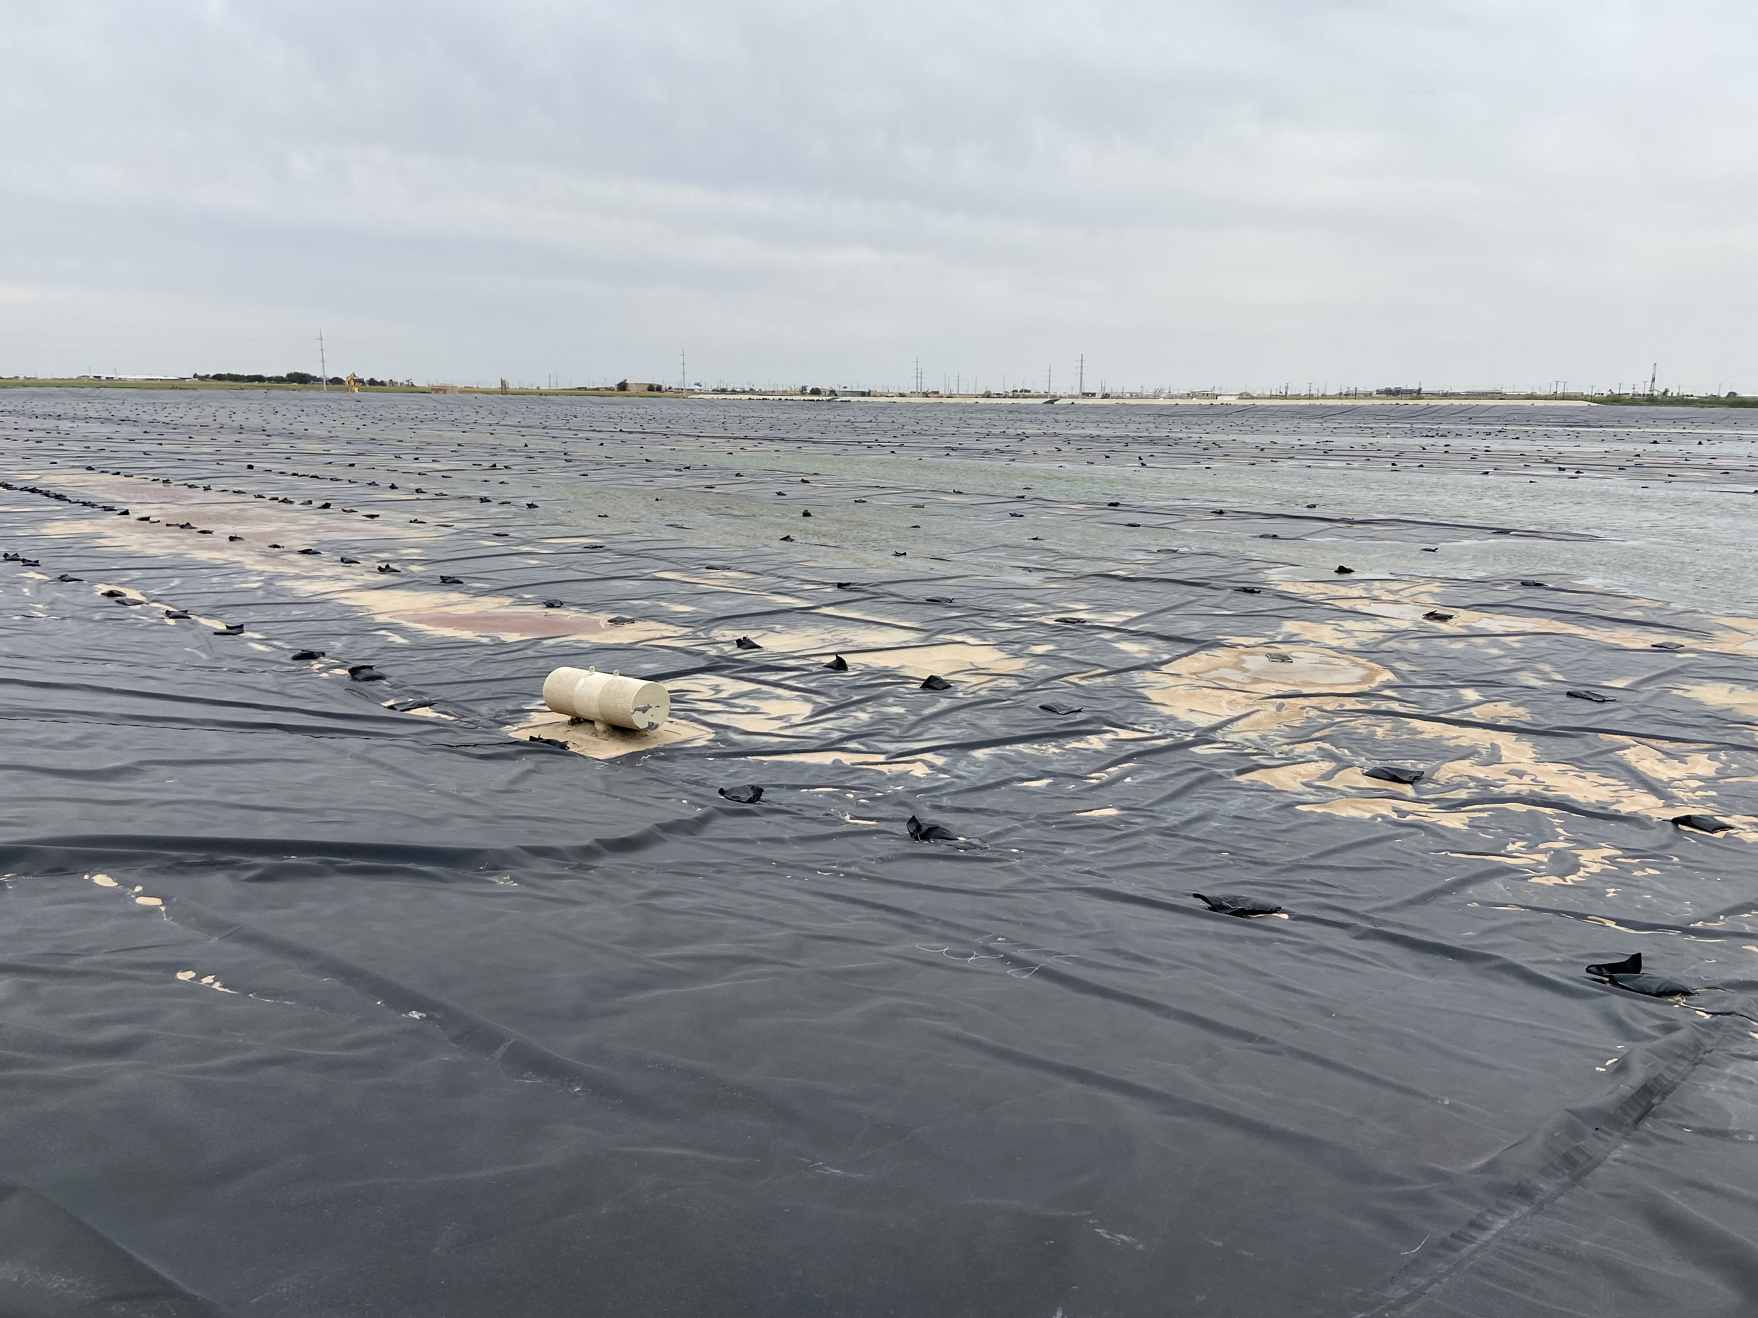
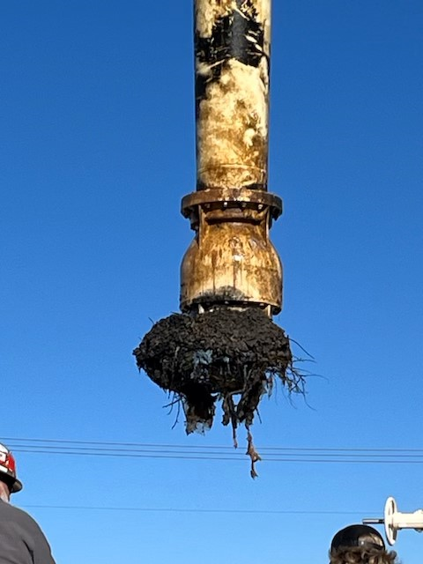
FY2024 Key Accomplishments
Water Reclamation Facility
Draining and cleaning primary clarifiers in-house
New Return Activated Sludge (RAS) pump installed
Major upgrades to the SCADA system via Wonderware
Relining of Plant Farm Ponds
Water Purification Plant
Conducted 2 Dewatering pilots for future solids handling project
Completed annual cleaning and restart of Treatment Train #2 Basins 3&4
Conducted Facility Condition Assessment with Freese & Nichols
Pulled and repaired #2 Raw Pump
Added treatment system for Zebra mussel mitigation from Lake Ivey
Running pilot study for mineral remediation on groundwater systems
13

Slide 14

FY2025 Key Deliverables
Utilities
Install 35,900 feet of new water mains and 53,760 feet of new sewer mains
Rehab 100 manholes and replace 15
Implement advanced groundwater treatment at the T-bar water source
Finalize a new surface water contract with CRMWD
Replace a wastewater lift station serving 70% of the airport area
Start construction on the Northeast Sewer project
Addition of a caustic treatment system for chlorine stabilization
Implement a new solids handling system for sludge
Upgrade treatment systems for manganese and zebra mussel mitigation
14

Slide 15
FY2024 Key Accomplishments
CIP – Paving and Drainage
SH 158 and Sinclair Avenue (In construction)
Wadley Avenue Extension (In construction)
Market Street (In construction)
COMPASS 2024 (In Construction)
Idlewilde Storm Drain and Basin (Complete)
COMPASS 2023 (Complete)
SH 191 Wastewater Extension (Complete)
15

Slide 16
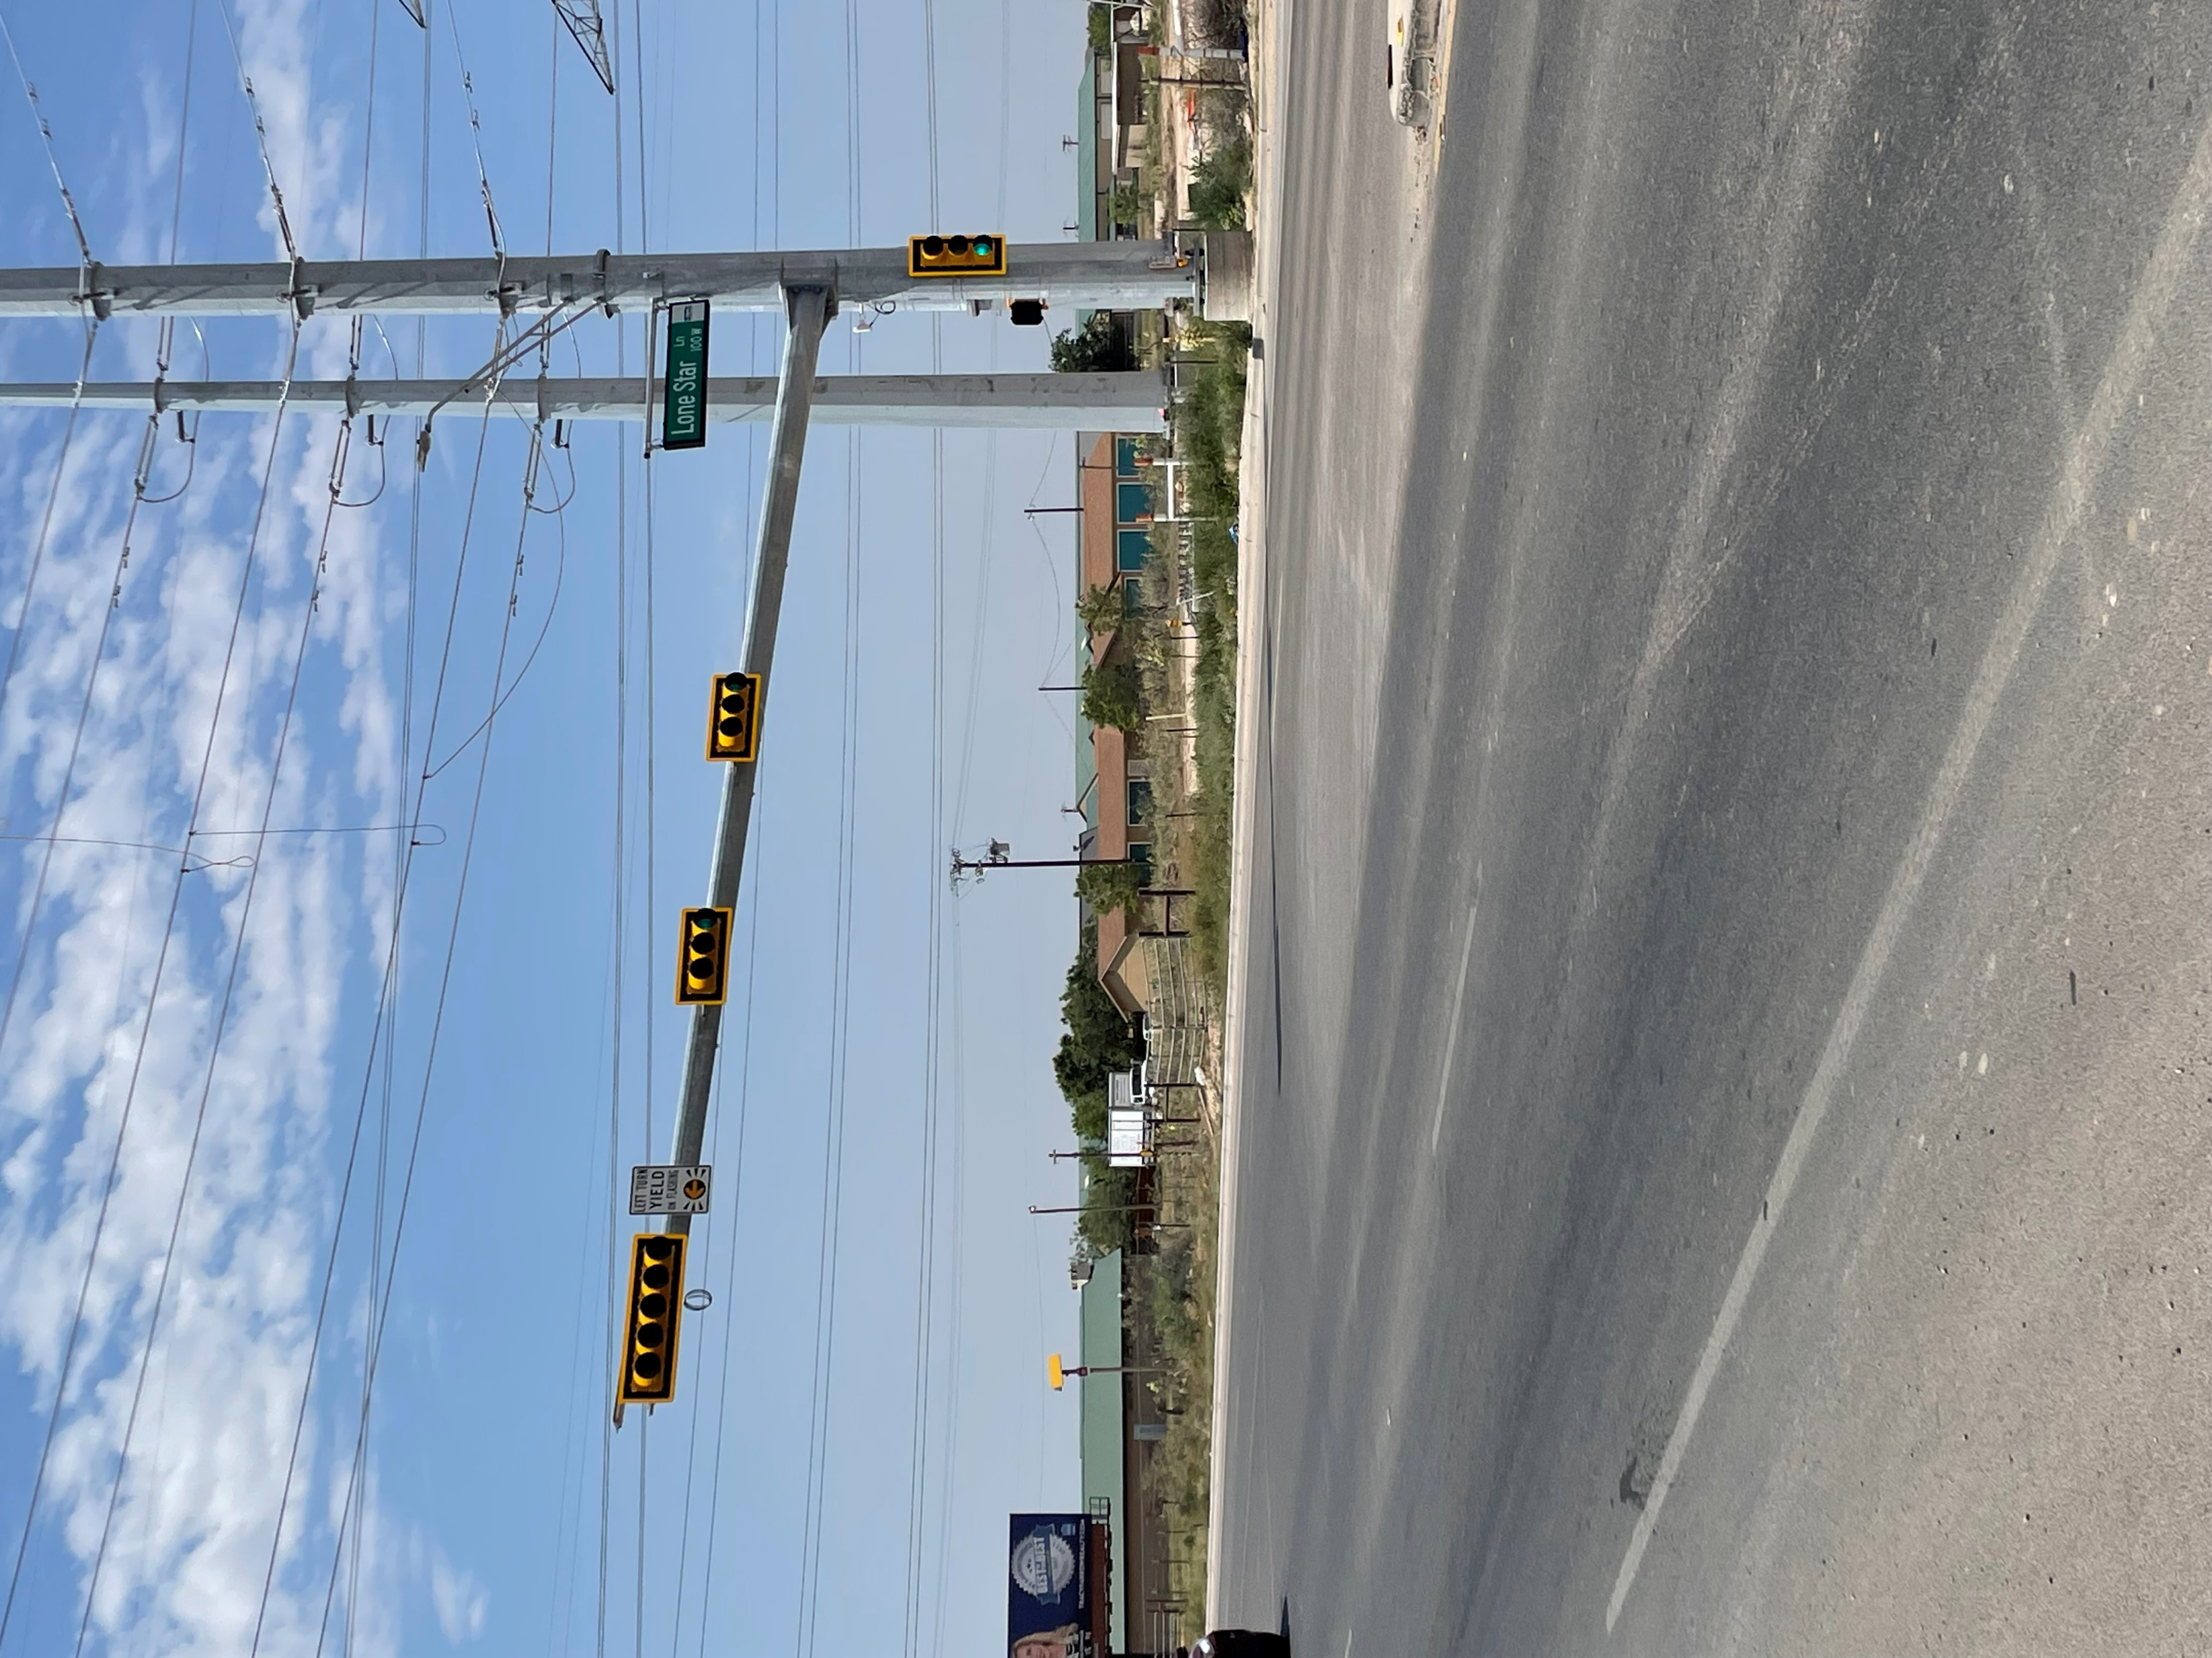
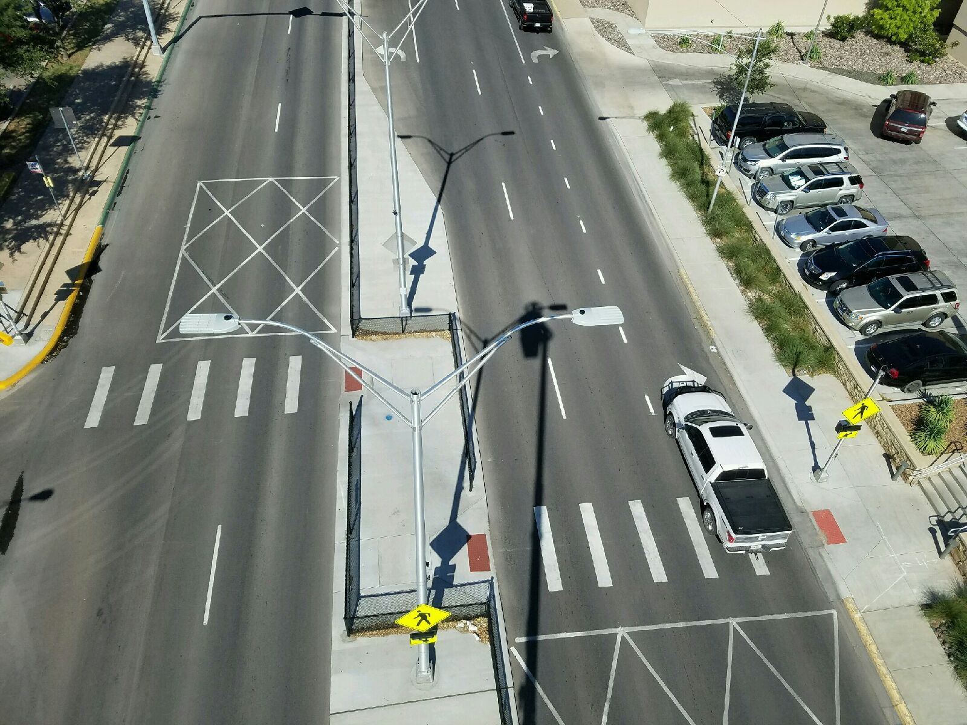
FY 2024 Key Accomplishments
Traffic Operations
SH 349 and Lone Star Lane (complete)
Andrews Hwy. and Woodcrest (In construction)
Avalon and Deauville (Project awarded)
Lamesa and Gist (In construction)
Mockingbird and Magellan (Project awarded)
Design Completed at 4 Locations
16

Slide 17
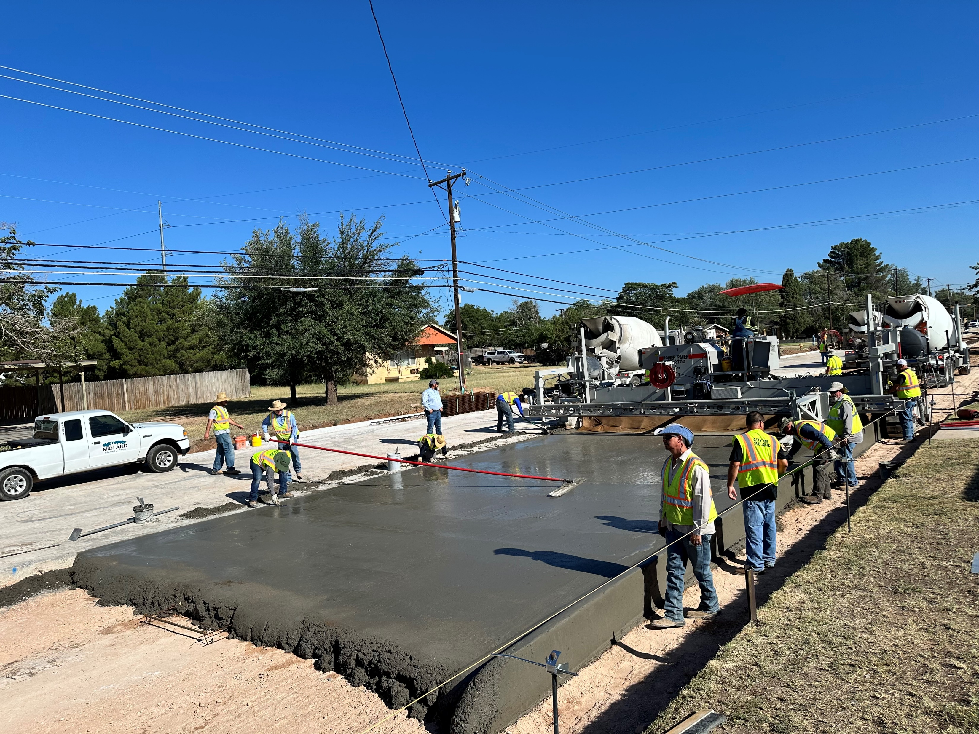
FY2024 Key Accomplishments
Bond Program
Main Street
Main Street Utilities (Completed)
Main Street (Paving Project Awarded)
Garfield Street (Final Phase Awarded)
17

Slide 18
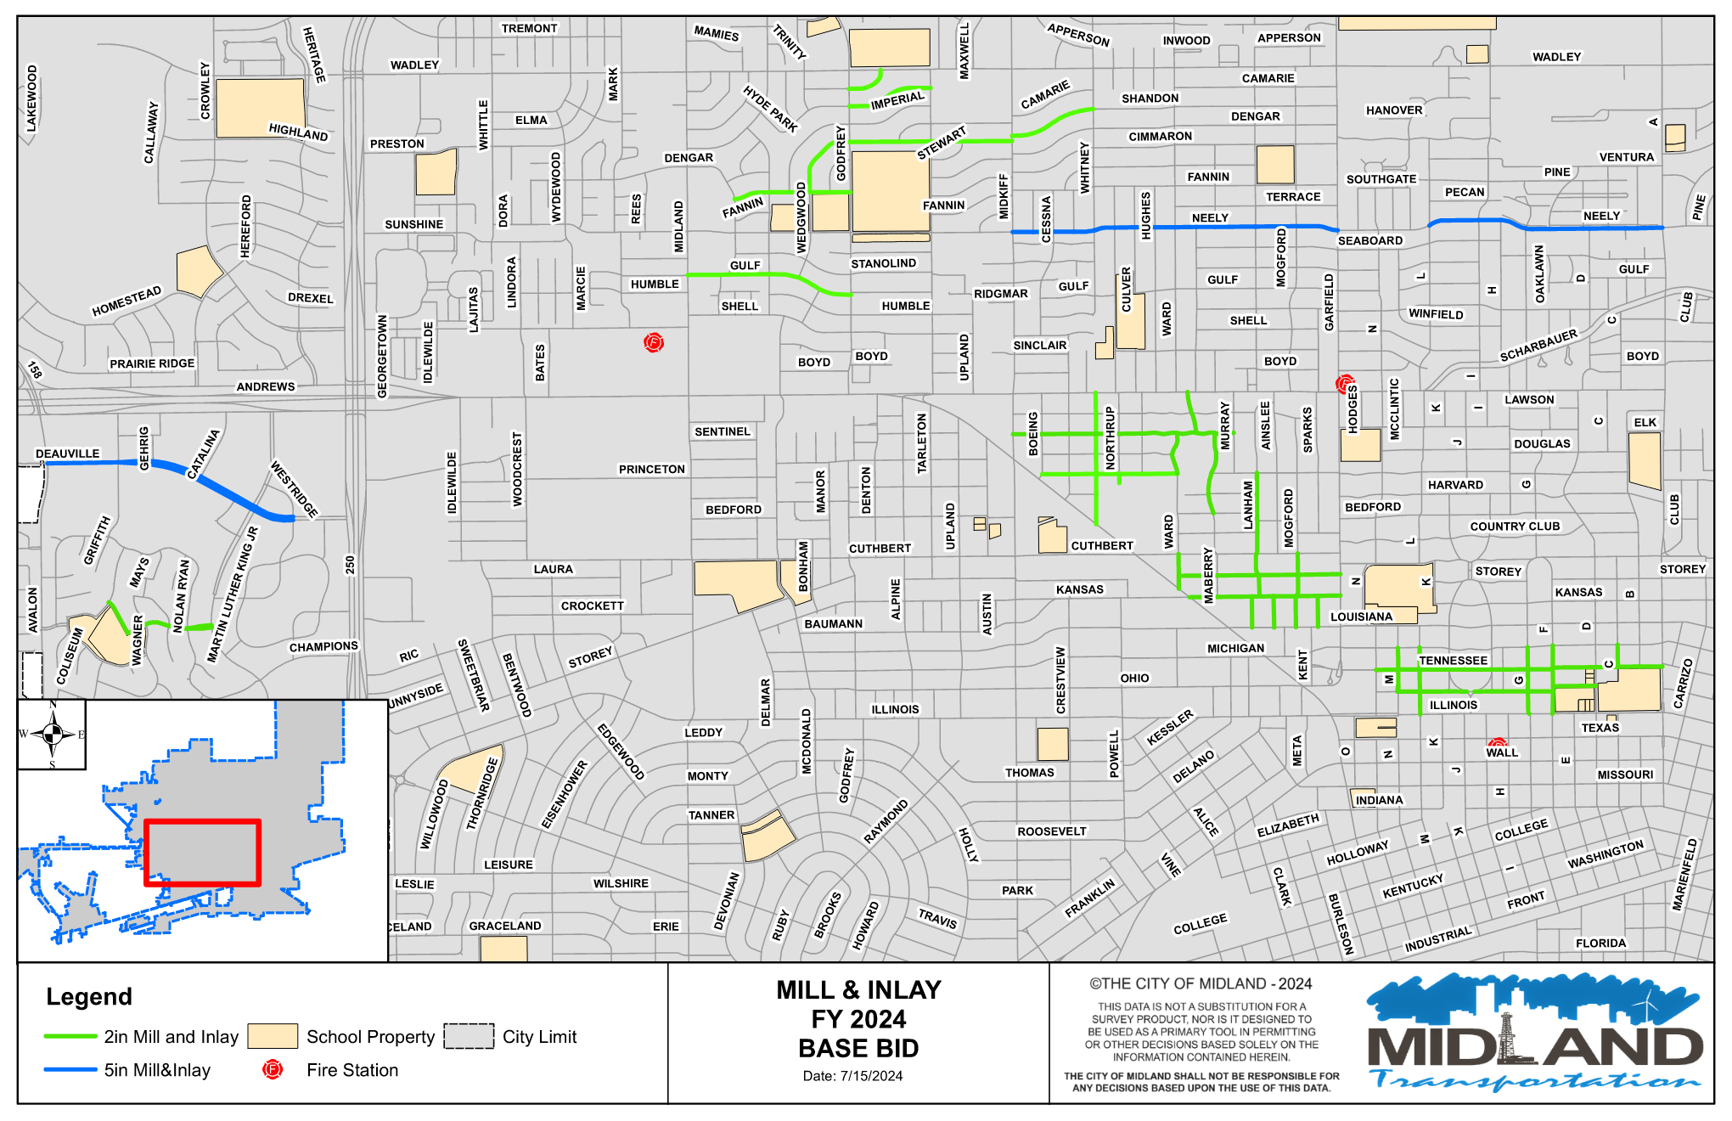
FY2024 Key Accomplishments
FY 2024 Mill and Inlay: 12.4 Miles Paved
18

Slide 19
FY2024 Key Accomplishments: Midland’s Most Traveled Roads
This program has resulted in over 495 work orders to maintain the integrity of our Most Traveled Roads. Accomplishments include:
Work Order Distribution
Litter Abatement | 60 | Enhancements for Pedestrians | 17
Pothole Repair | 58 | Improved Lighting | 67
Landscape Enhancements | 24 | ADA Compliance | 11
Road & Signage Improvements | 16 | Rectifying Buckled Curb & Sidewalks | 56
Vegetation Control | 102 | Street Sweeping | 84
19

Slide 20
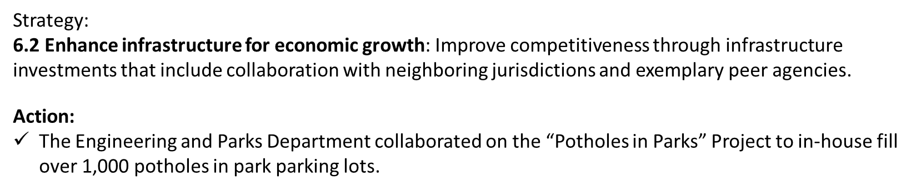
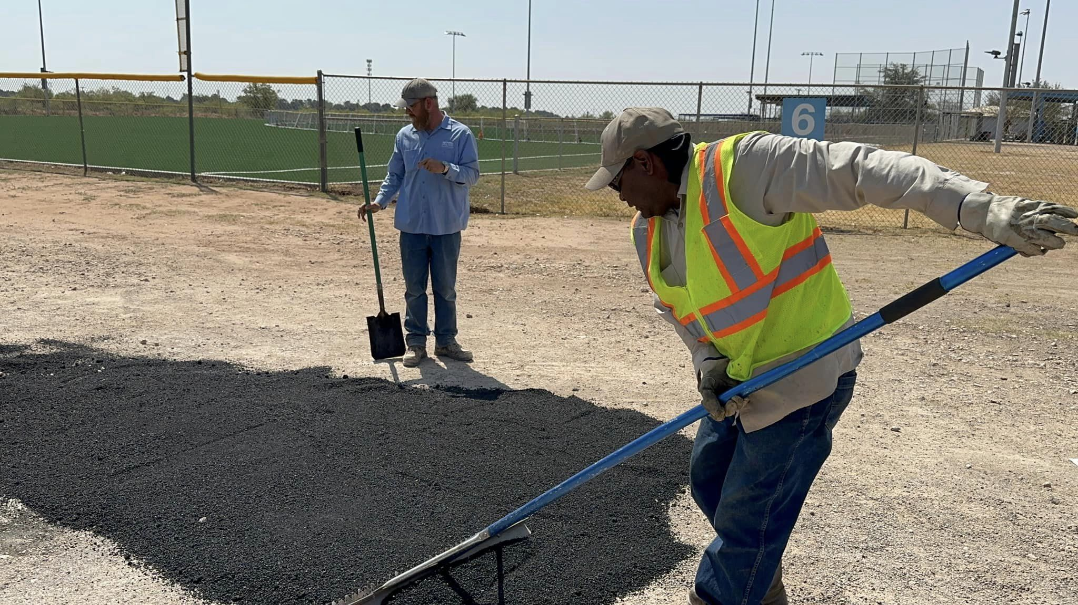
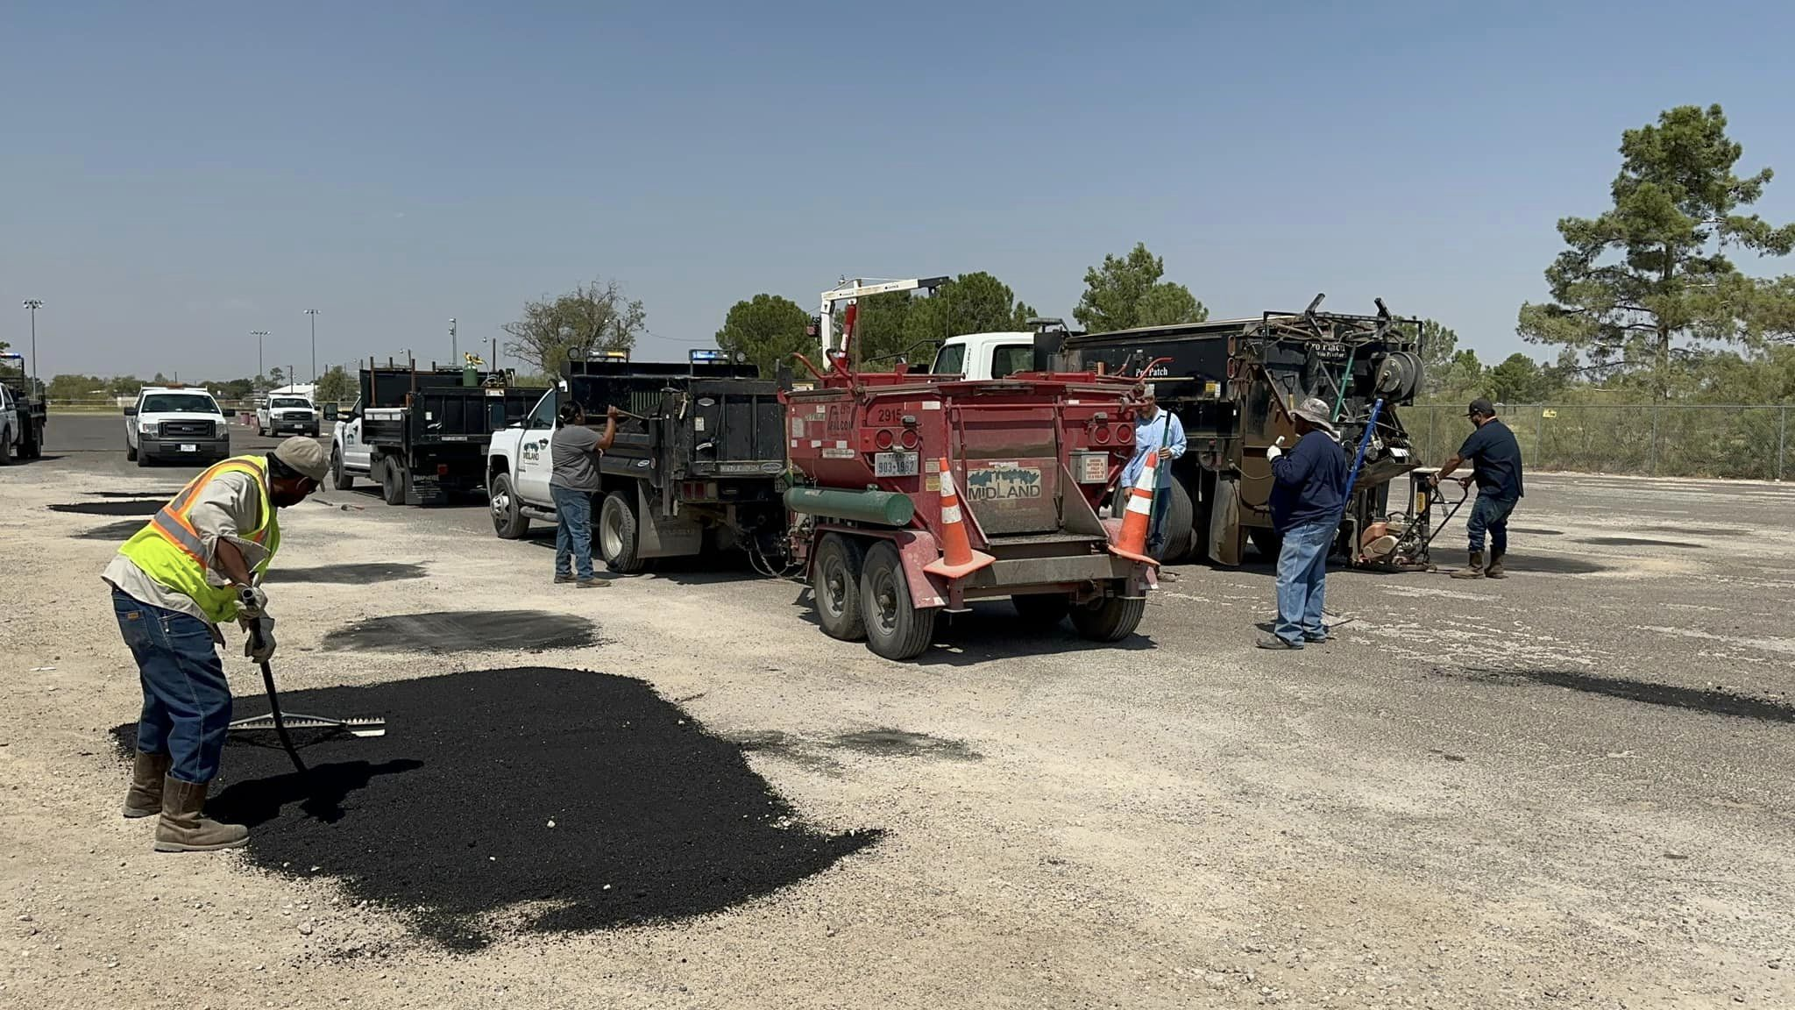
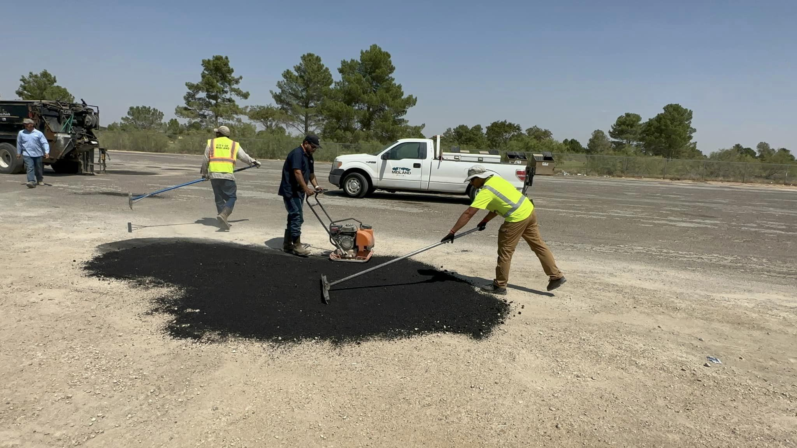
FY 2024 Key Accomplishments: Potholes at Parks
20

Slide 21
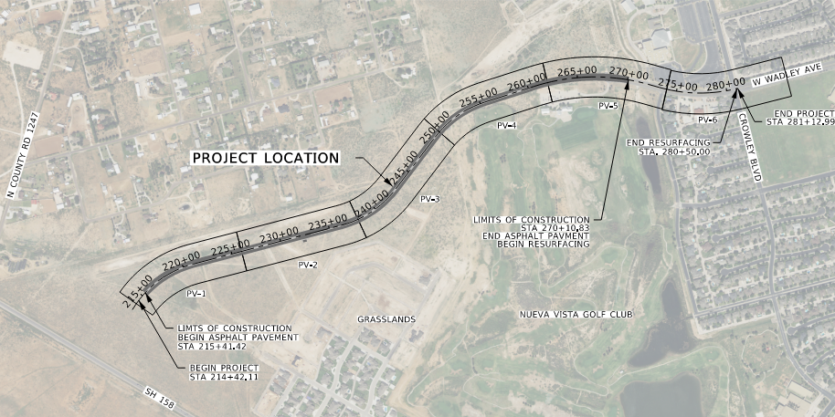
FY2025 CIP Key Deliverables: Keeping Up With Growth
CIP – Paving and Drainage
Wadley Extension/Jal Draw
Fairgrounds Road
COMPASS 2025
Sinclair Backage Road
Mockingbird Lane (Holiday Hill – Midland Drive)
Mockingbird Lane at Whitman
Avalon (Briarwood – Mockingbird)
21

Slide 22
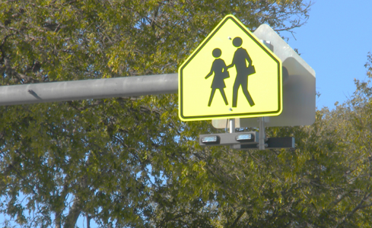
FY2025 Traffic Ops. Key Deliverables: Vision Zero
Traffic Operations
Add Pedestrian Improvements and Bike Lanes
Address Neighborhood Traffic Safety Issues
Complete Signal Light Installations
Complete Design for 6 New Signal Lights
Improve Street Lighting
22

Slide 23
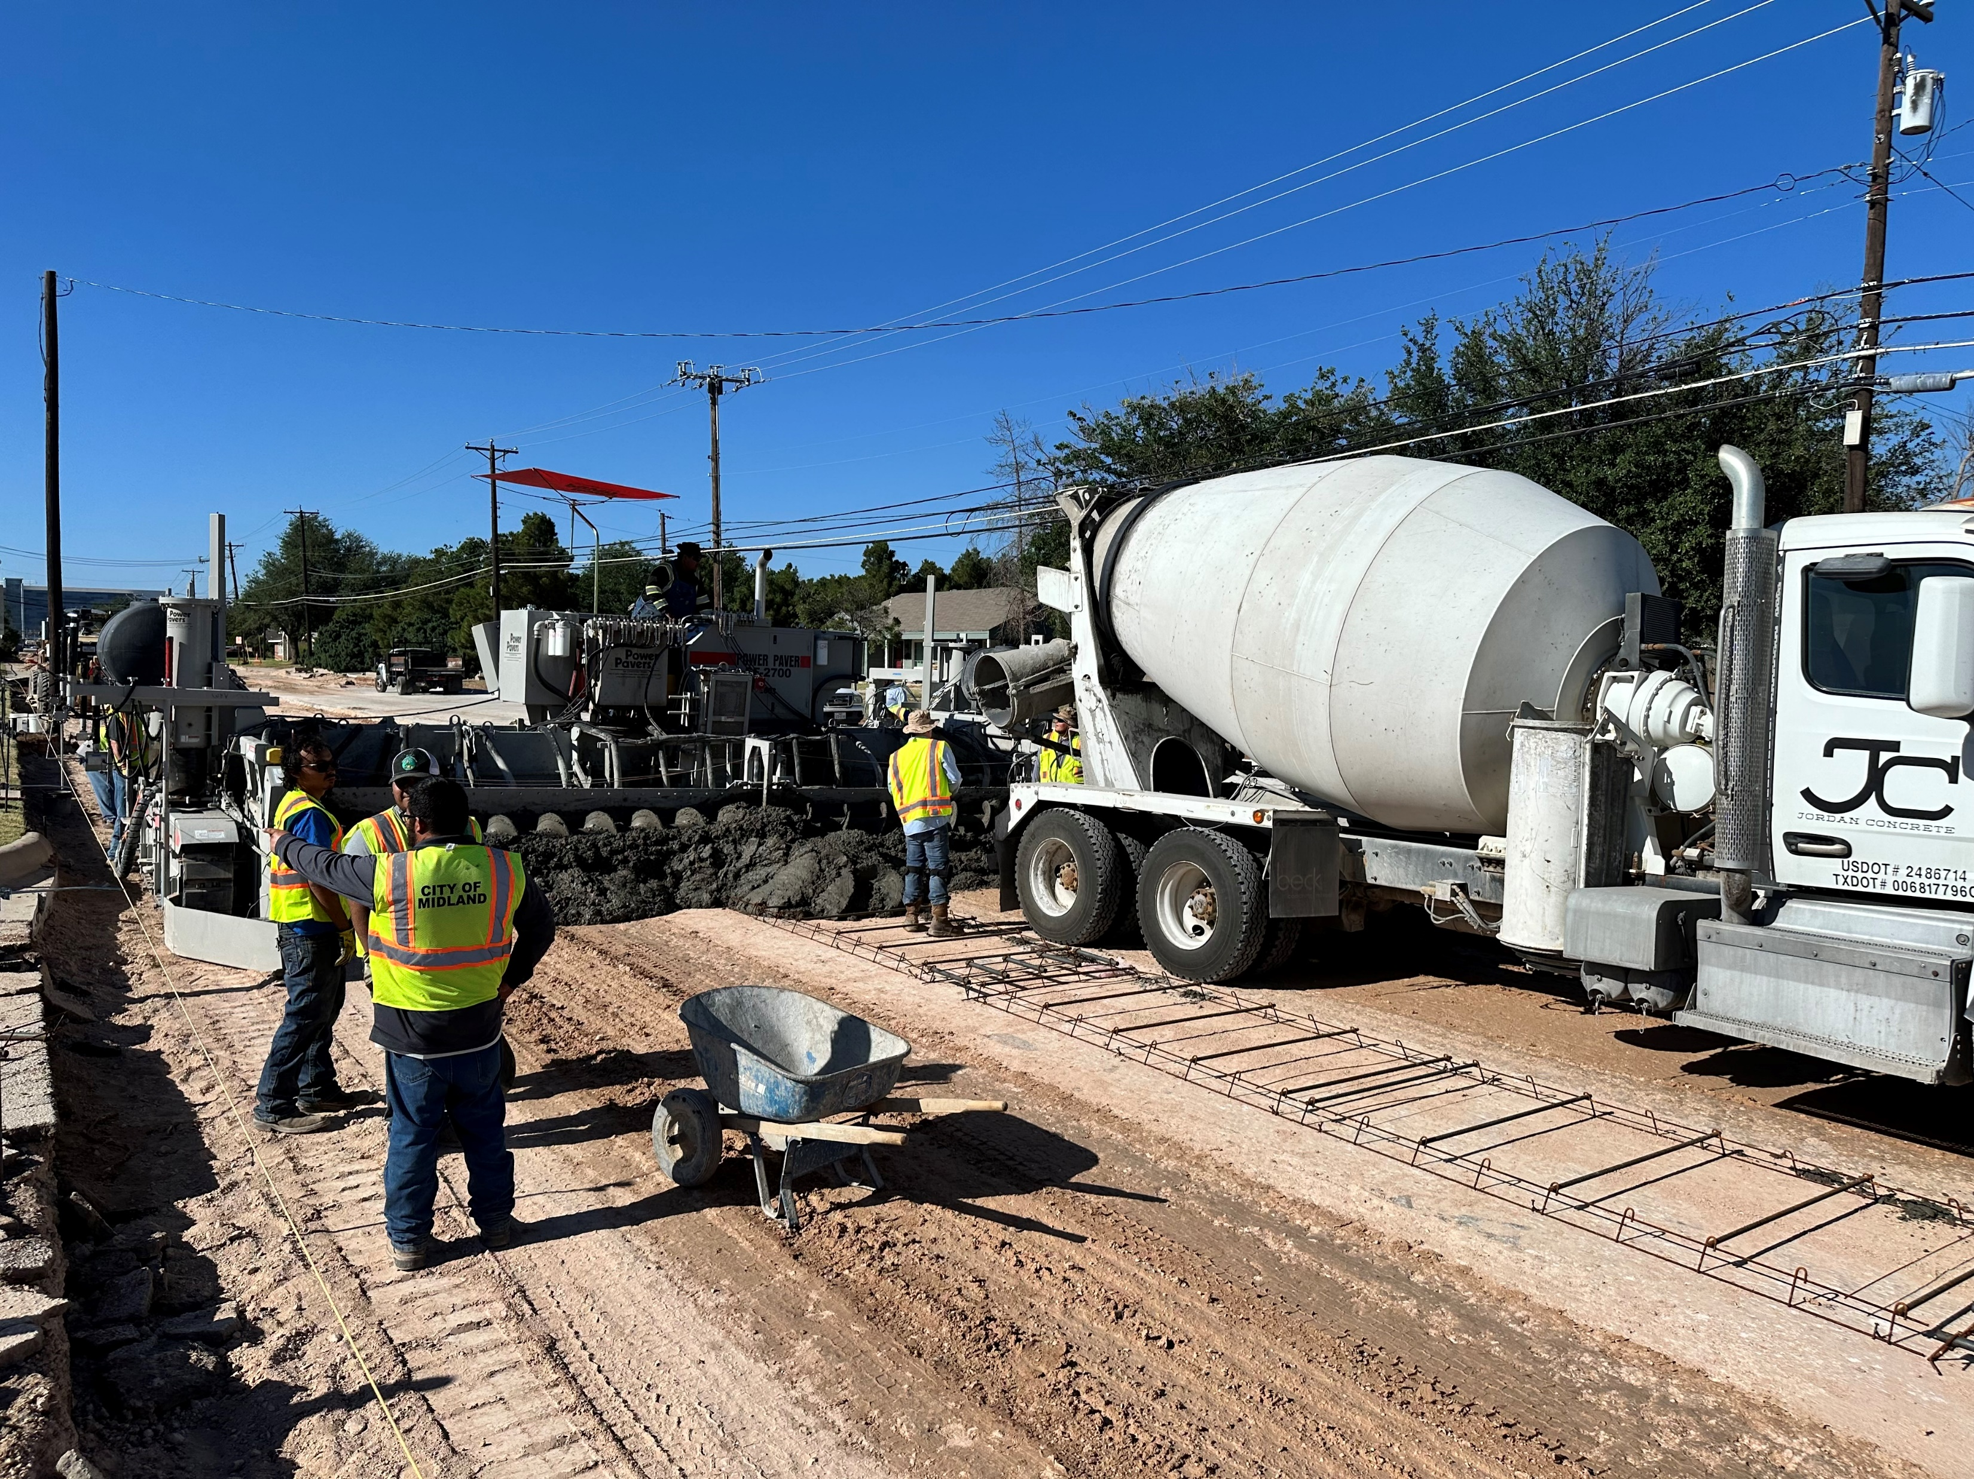
FY2025 Transportation Key Deliverables: Improve Pavement Condition
Maintenance and Operations
Mill and Inlay 8 Miles of Roadway
Grow In-House Asphalt and Concrete Paving Programs
Improve Pothole Response Time
Increase Focus on Midland’s Most-Travelled Roads
23

Slide 24
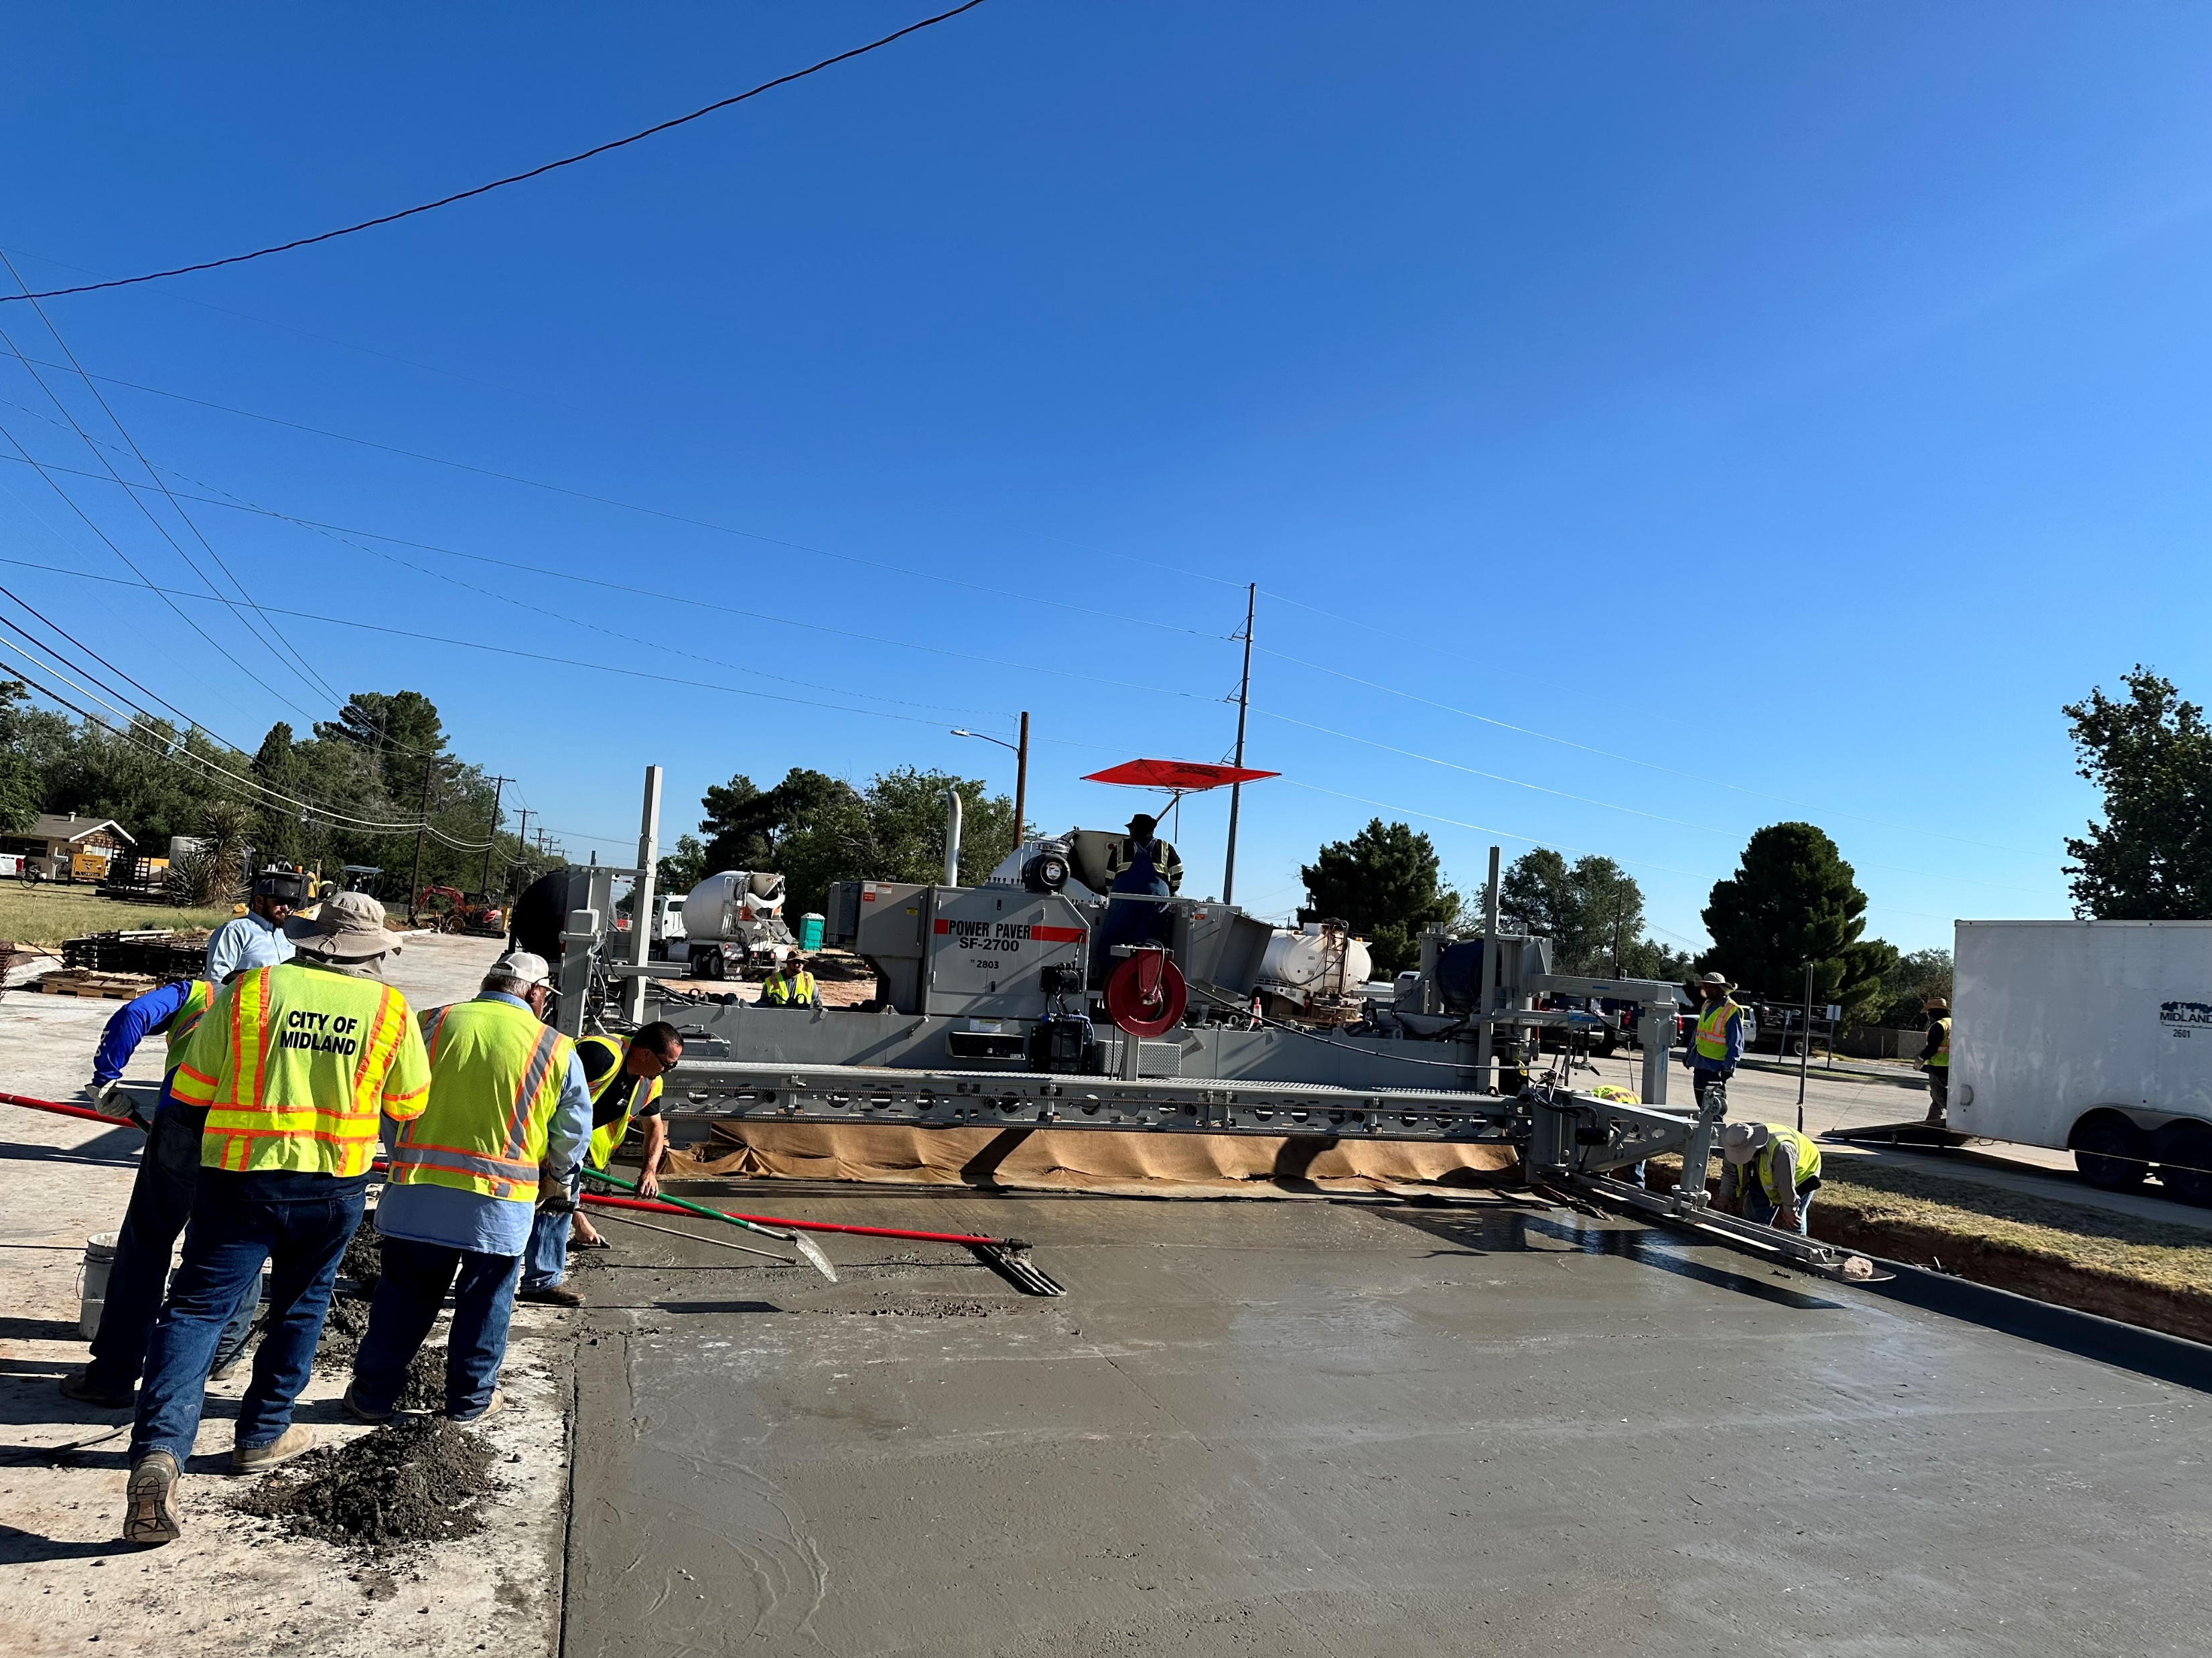
FY2025 Engineering Key Deliverables
Bond Program
Complete Main Street
Complete Garfield Street
24

Slide 25

FY2024 Key Accomplishments
Solid Waste
Cleaned up approximately 280 tons of litter through various programs
Implemented Rubicon Truck Routing System to increase Route Efficiency
Collected approximately 662 tons of large items throughout Midland
Collected 800 tons of Recyclables at the Citizen Collection Station
Changed out over 1,200 dilapidated containers throughout Midland
Cleaned up over 40 major illegal dumpsites
Annually collect approximately 300,000 tons of waste at the Landfill
Averaged around 1,000 tons per day collected at the Landfill
25

Slide 26
FY2025 Key Deliverables
Solid Waste
Building & Completion of First of Two New Citizens’ Convenience Center
Start of Phase One of new Landfill Cell to increase service years and capacity
Purchase new refuse cart truck for increased service
Purchase replacement Excavator Compactor for Landfill
Reconstruct Landfill Entrance Road for enhanced service to customers.
26

Slide 27
MISSION
Deliver exceptional services and promote a high quality of life and place for ALL our citizens.
27

