Slide 1

Goal Four
Transparent & Consistent Communication
FY 2025 Budget Presentation
July, 2024
1

Slide 2

Table of Contents
Vision Block Connections & Strategic Alignment
Priorities Focus
Major Variances
Expenses
FY 2024 Key Accomplishments
FY 2025 Key Challenges
FY 2025 Key Deliverables
2

Slide 3

Vision Block Connections
“The City of Midland will be the Premier and Safest City in West Texas by Providing World Class Municipal Services through Operational Excellence and a Culture of Innovation”
World Class Service (Goals 4, 5, 6)
Operational Excellence (Goals 4, 5, 6)
Innovation (Goals 4, 5, 6)
3

Slide 4

Strategic Alignment
Goal 4: Transparent and Consistent Communication
4.1 Set a Climate of Respect, Collaboration and Team Spirit
4.2 Enhance Communication Efficiency and Effectiveness 4.3 Elevate Internal Communication and Employee Engagement
4.4 Advance the Two-Way Communication of Key Messages
4.5 Strengthen Messaging Opportunities through Various Media Outlets
4

Slide 5
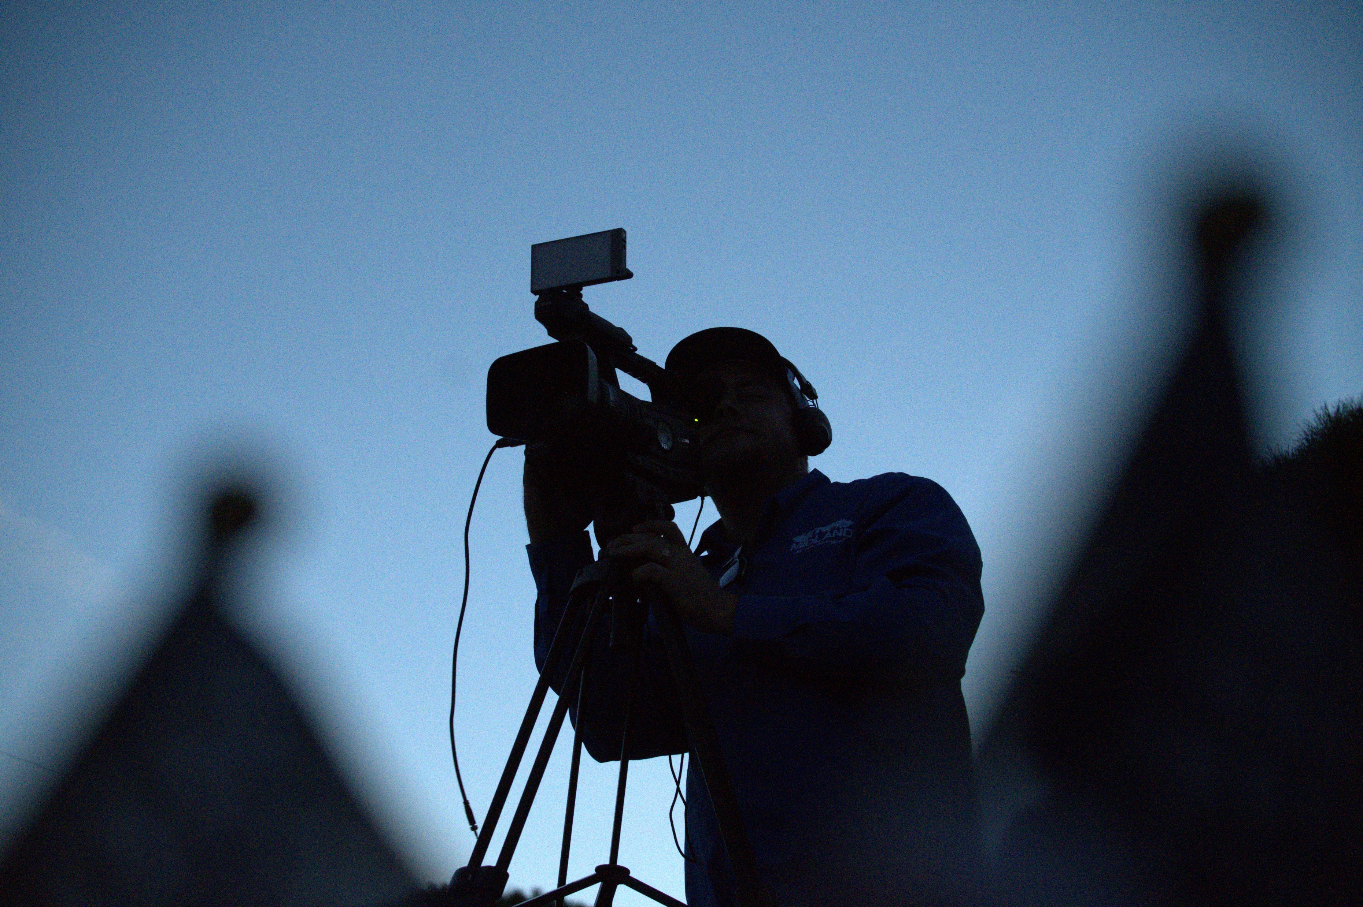
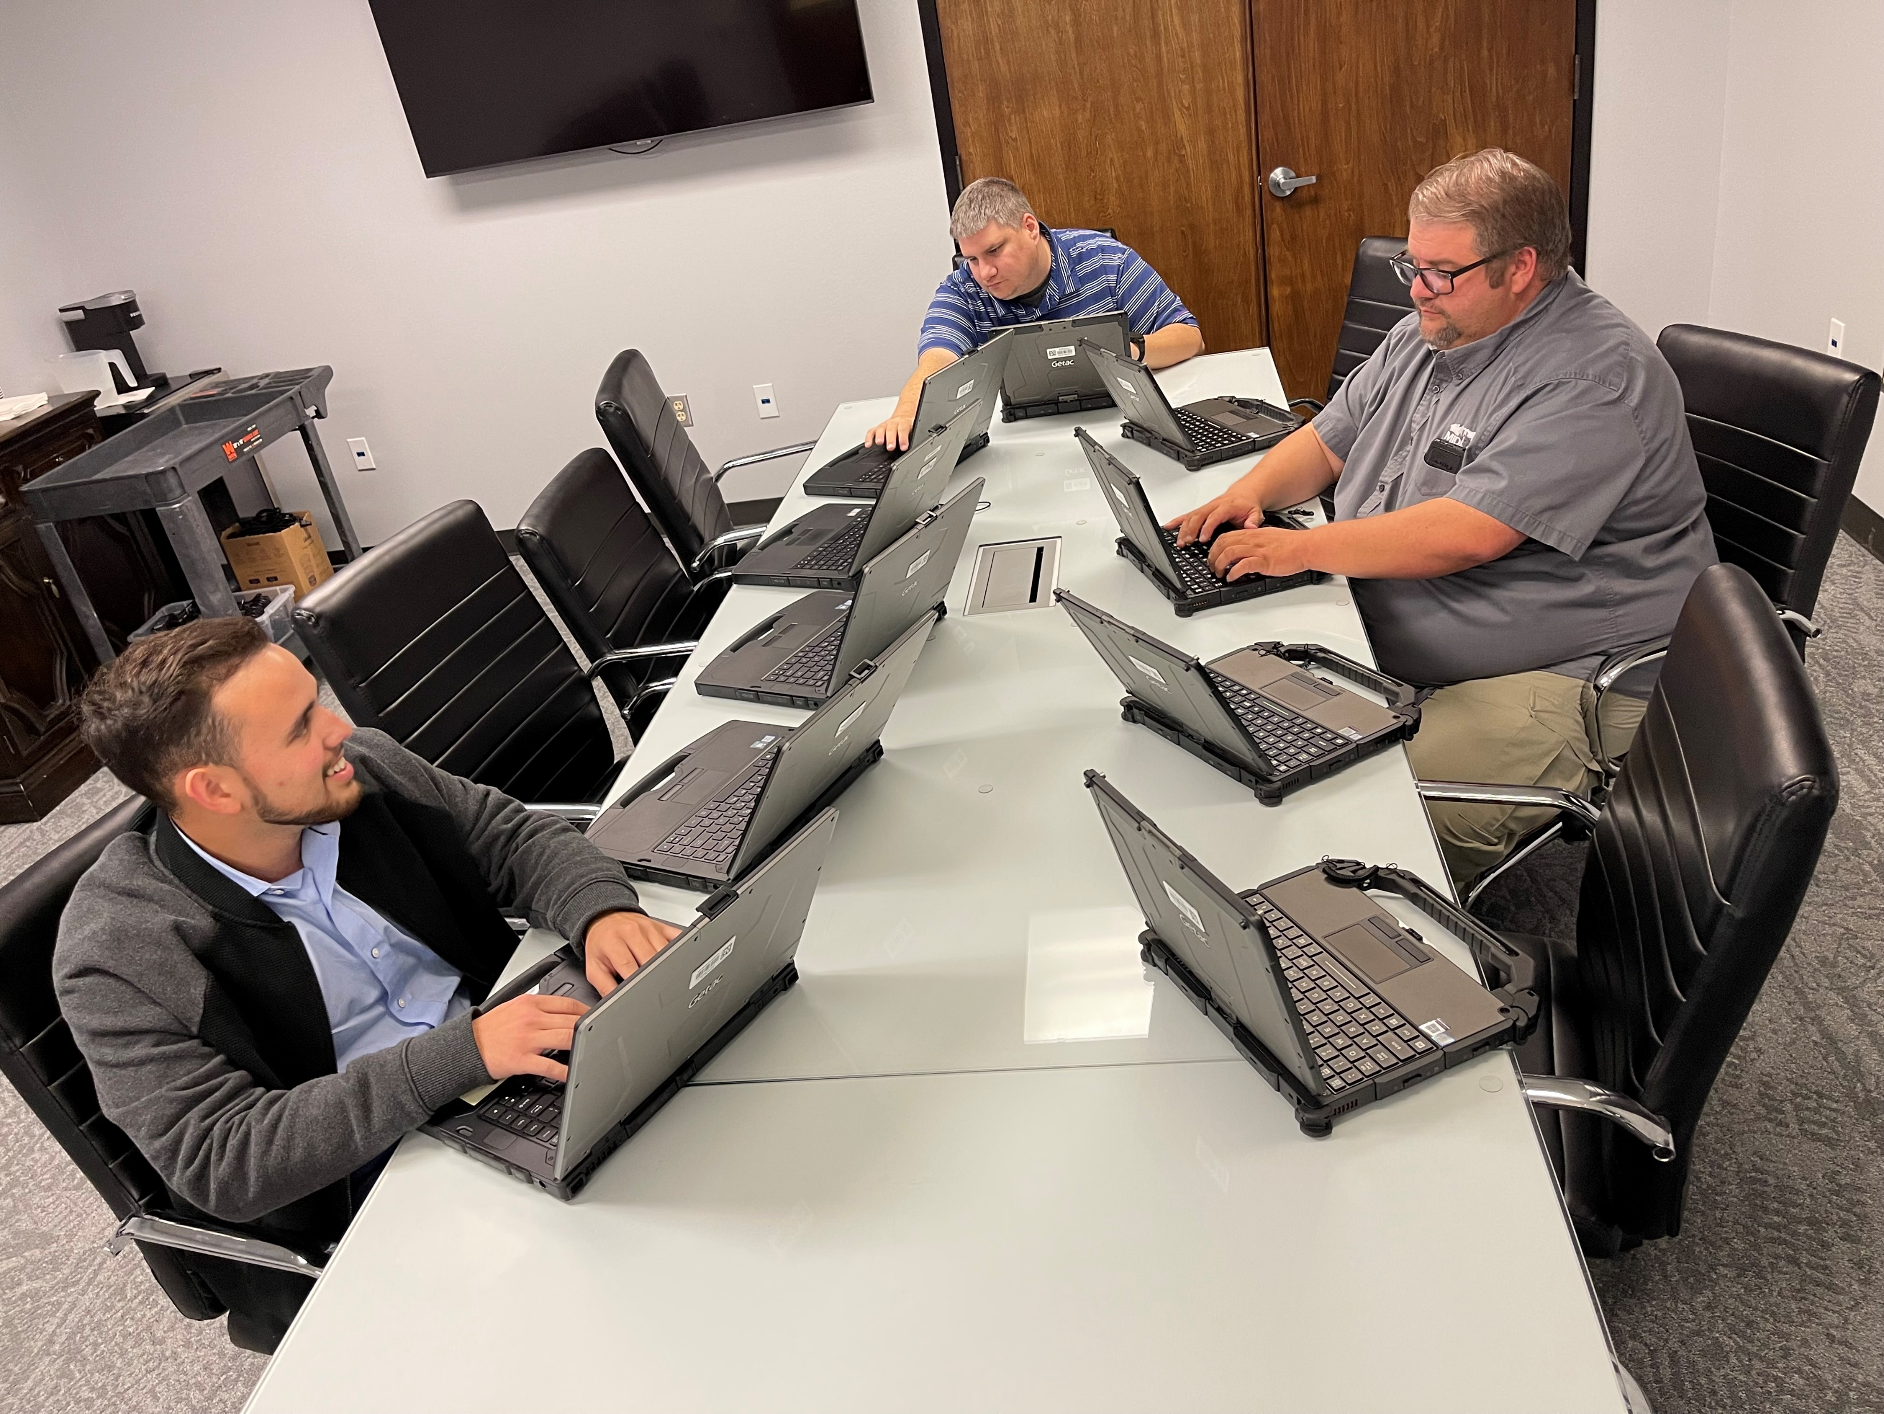

Departments
Organizational Alignment
Information Technology Systems
Strategic Communications
5

Slide 6
Transparent & Consistent Communication
FY 2025 ALL FUNDS BUDGET: $22,045,677
6

Slide 7
Goal Four: Transparent & Consistent Communication
Information Technology Systems
FY 2025 Priorities
Accessible and Easy-to-Use Digital Services for Citizens & Customers (Permits, Health Inspections, Data)
Data Visualization & Transparency
Cybersecurity Automation
Expand Staff Skillset (Coding and Programming)
Measured & Ethical Expansion of Artificial Intelligence (AI)
7

Slide 8
Goal Four: Transparent & Consistent Communication
Strategic Communications
FY 2025 Priorities
City Annual Report with Accompanying Video
High-Quality Cinematic Level Video & Storytelling
Council District Reports for Constituents
Update the design on the City Webpage and other city assets
Focus on Reverse 9-1-1 and Geo-Fenced tailored messaging
Education Pieces: City Government
Create a Stock Library of Fresh City Photo and Video
Focus on stories of Business and “People” of Midland
8

Slide 9
Major Variances
Information Technology Systems
Increase due to Software Licenses and Maintenance Contracts
Recapture of costs for software
Radio System Chargeback
Increased Staffing Needs
9

Slide 10

Major Variances
Strategic Communications Department
Increased Staffing
Needs for replacement of aging and outdated equipment such as cameras, drones, lenses, and editing software.
Training for Staff
10

Slide 11
Expenses by Department
11

Slide 12
Expenses by Type
12

Slide 13
Staffing
Variance Highlights:
ITSD: Addition of a Technical Coordinator, Assistant Tech Support Manager, Information Security Officer, Enterprise Technology Manager, UX Web Content Specialist, UB Systems Administrator (Water Fund), Administrative Assistant
Strategic Communications: Addition of Videographer Position, Addition of Multimedia Specialist/Social Media Coordinator
13

Slide 14
Table of Contents
Vision Block Connections & Strategic Alignment
Priorities Focus
Major Variances
Expenses
FY 2024 Key Accomplishments
FY 2025 Key Challenges
FY 2025 Key Deliverables
14

Slide 15
Key Accomplishments
Information Technology Systems
FY 2024
Interoperable Radio System Implementation (August 2024)
Created User Experience (UX) Team: Website User Interface Updates, Streamlining, and Updates of Information for ease of use
Phone system upgrade to Ring CX with call recording and metric capabilities added for customer service enhancements
City Data Consolidation for Visualization
Metrics, Performance, and Transparency
SeeClickFix & Website Virtual Agent (Ask Jacky) Deployment
15

Slide 16
Key Accomplishments
Information Technology Systems
FY 2024
Service Now Deployment: Work Order and Change Management Inventory for ITSD Staff (Data and Metric Driven)
GIS Updates and Upgrades for citizen information needs
Captured Process Workflows in Permitting, Utility Billing for customer experience improvement & process streamlining
Training through ITSD Implemented for the effective use of new and existing software systems for both staff and customers.
16

Slide 17

Key Accomplishments
Information Technology Systems
FY 2024
Managed the following Software Projects:
General Services: Online Bidding Software, Bonfire
Solid Waste: Truck Routing Optimization Software, Rubicon
Human Resources: Implementation of Digital Employee Performance Evaluations, NeoGov Perform
17

Slide 18
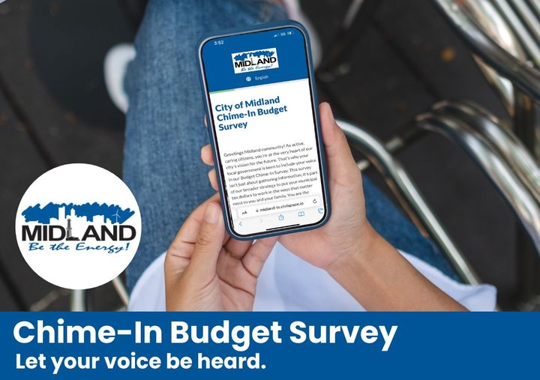

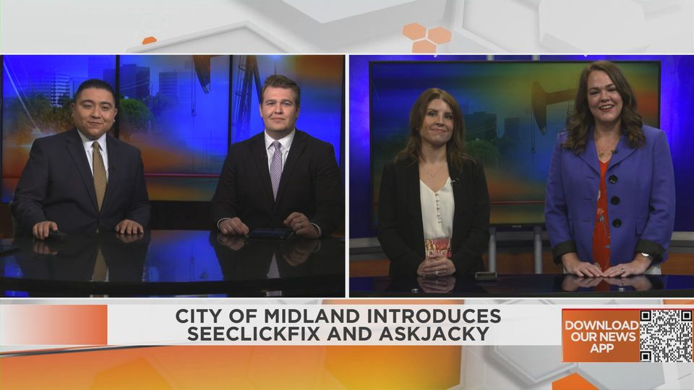
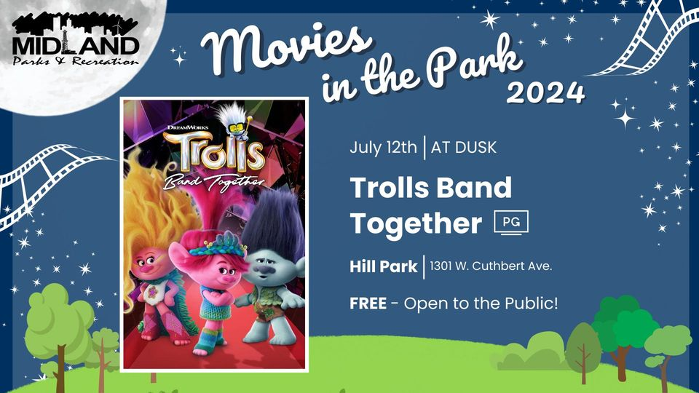
Key Accomplishments
Strategic Communications
FY 2024
Council Update and Midland Minute Videos
Parks and Recreation Videos & Content
Budget Chime-In Survey
Economy Updates (Employment, Airport, Sales Tax)
SeeClickFix & AskJacky Deployment & Advertisement
MDC Partnership Videos & Ads
Celebrate Midland
Employee Spotlights
18

Slide 19
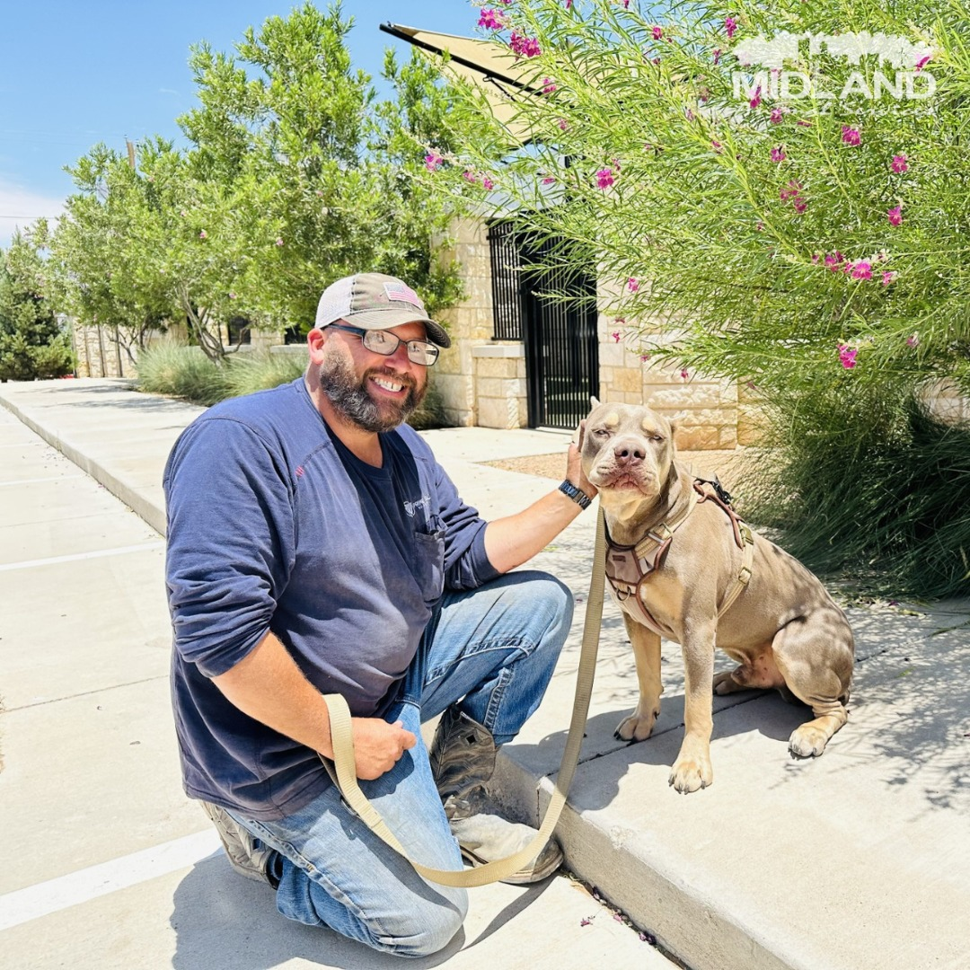

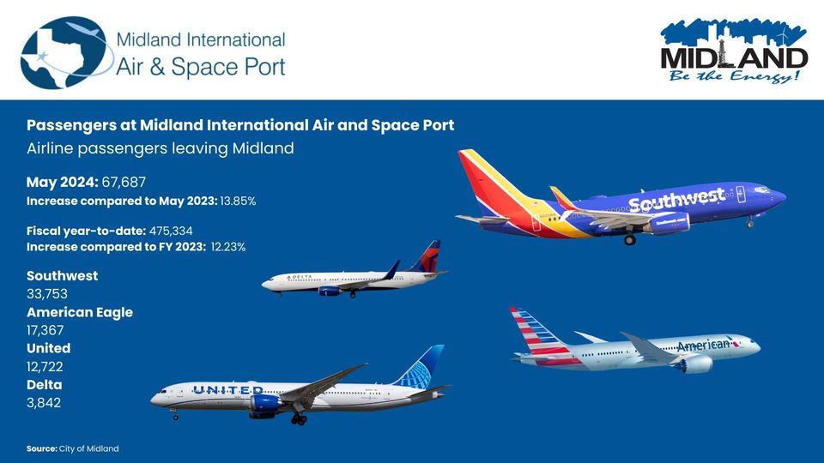
Key Accomplishments
Strategic Communications
FY 2024
Emergency Preparedness & Alerts with Ability to Geofence Locations
Traffic Campaigns
Community Surveys
Community Education Pieces
Responding Timely to Messages and Comments
Op-Ed Pieces
Press Releases and Press Conferences
Fire Pension Information
19

Slide 20
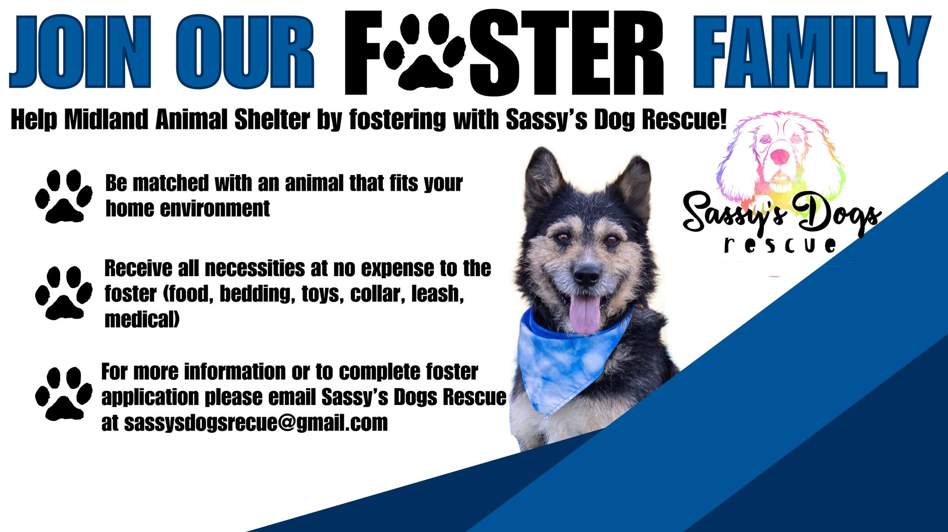

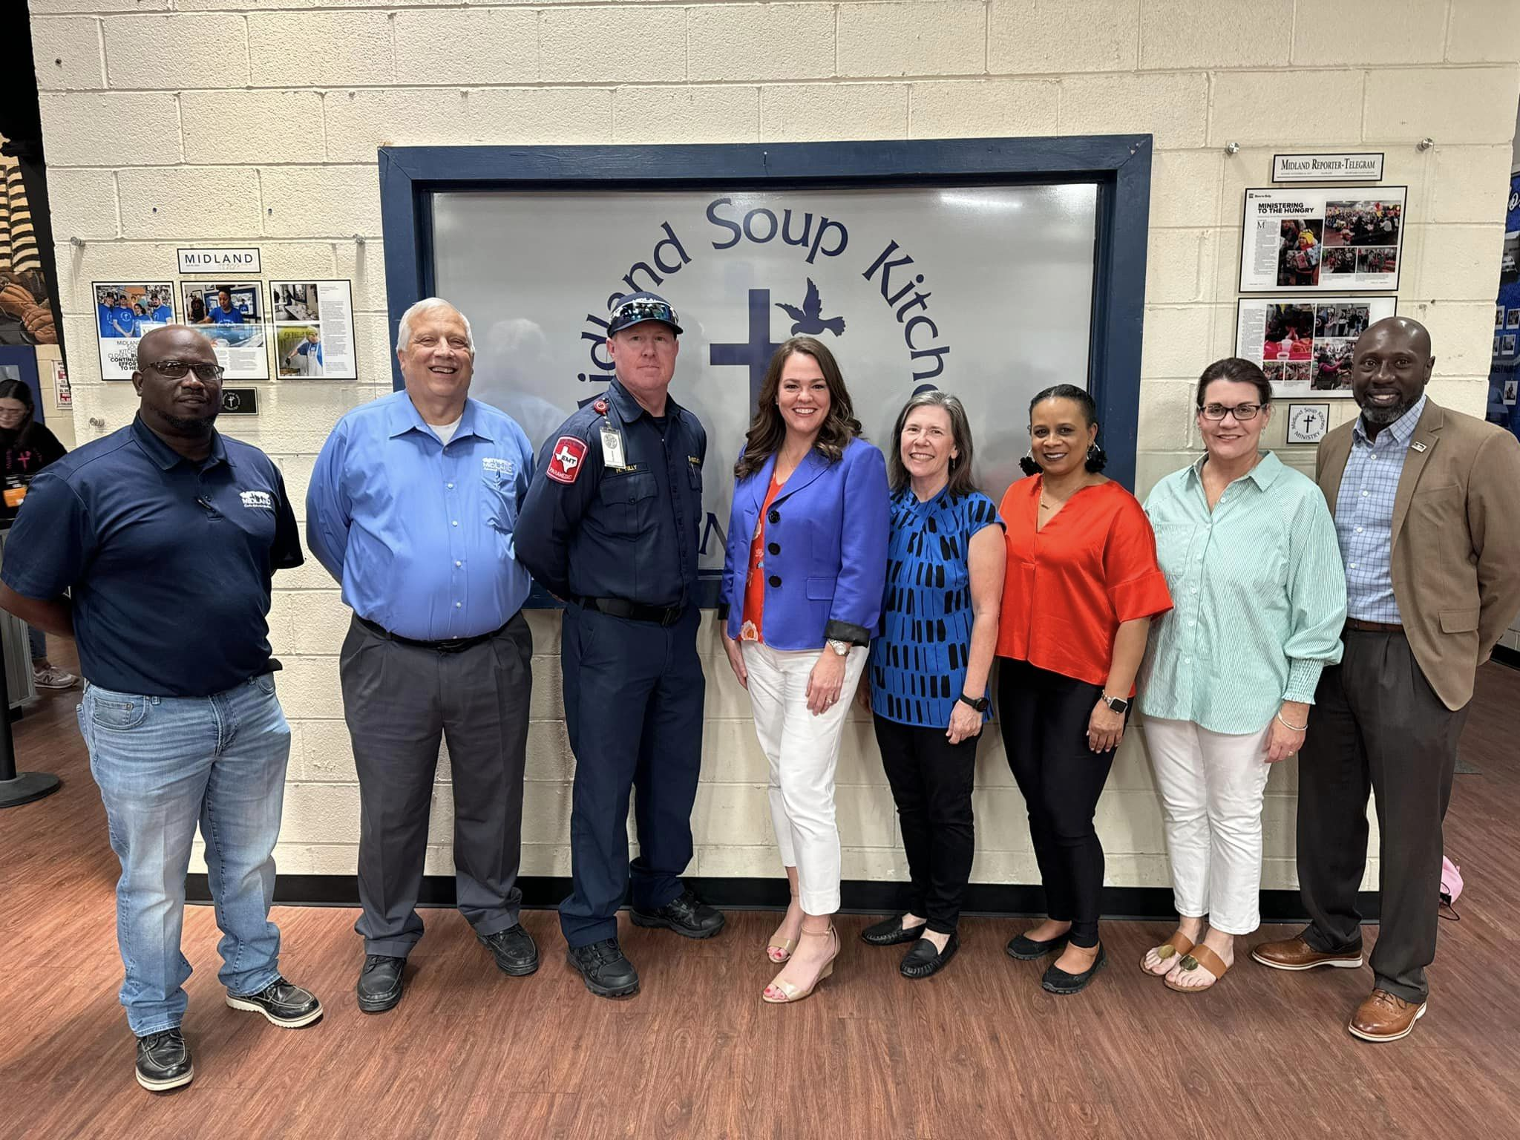
Key Accomplishments
Strategic Communications-Partnerships
FY 2024
Fix West Texas, Sassy’s Dog Rescue, MASA, and Other Animal Rescues
United Way of Midland
Chamber of Commerce
Midland Development Corporation
TXDOT
Midland County
Senior Life
Casa De Amigos
20

Slide 21
FY 2025 Key Deliverables
Strategy: Enhance Communication Efficiency and Effectiveness
Maximize the use of reverse 9-1-1 & citizen notification and alert systems
Expand the use of Virtual Agent via Ring CX software for 24/7 capabilities of phone systems
Target messaging to different areas of the population by geo-fencing districts and sects (Spanish-speaking social media channels and content)
21

Slide 22

FY 2025 Key Deliverables
Strategy: Elevate Internal Communication and Employee Engagement
Complete overhaul and redesign of Employee Intranet to enhance employee resources and database on city information as well as employee resources for Benefits and Wellness
22

Slide 23

FY 2025 Key Deliverables
Strategy: Advance Two-Way Communication of Key Messages
Implement surveys in all customer-facing departments for constant feedback & adjustments
Broaden use of Social Media Direct Messages (Via Facebook, Instagram and Nextdoor) and Comments for engagement
Citizen Requestion and General Question Texting Capabilities through RingCX phone systems
Continuation & Enhancement of Community Town Hall Forums
23

Slide 24
FY 2025 Key Deliverables
Strategy: Strengthen Messaging Opportunities Through Various Media Outlets
Use outside media sources to enhance our internal messaging to Citizens with things such as news articles and interviews, reposts, TV spots, and more
Continue to research new Social Media platforms
Focus on Google Analytics and Google Reviews for City Customer Based Services
24

Slide 25
MISSION
Deliver exceptional services and promote a high quality of life and place for ALL our citizens.
25

Slide 26
Source of Funding
Departments | General Fund | Internal Services | Grand Total
ITSD | 12,380,969 | 9,217,178 | 21,598,147
Strategic Communications | 651,461 |  | 651,461
Grand Total | 13,032,430 | 9,217,178 | 22,249,608
26

Slide 27
Expenses: Non-General Fund
Category | 2023 Actuals | 2024 Budget | 2025 Proposed | Difference | Variance
Contractual Services | 3,029,329 | 5,300,133 | 6,803,243 | 1,503,110 | 28.4%
General Fund Services | 9,739 | 15,342 | 42,678 | 27,336 | 178.2%
Internal Services
Maint. Structures & Equipment | 208,918 | 345,000 | 700,000 | 355,000 | 102.9%
Operational Expenses | 1,444,600 | 830,000 | 1,294,986 | 464,986 | 56.0%
Other Uses | 49,798
Personnel | 184,625 | 211,254 | 376,271 | 165,017 | 78.1%
Transfers | 103,198
Capital | 64,394
Grand Total | 5,094,600 | 6,701,729 | 9,217,178 | 2,515,449 | 37.5%
27

