Slide 1
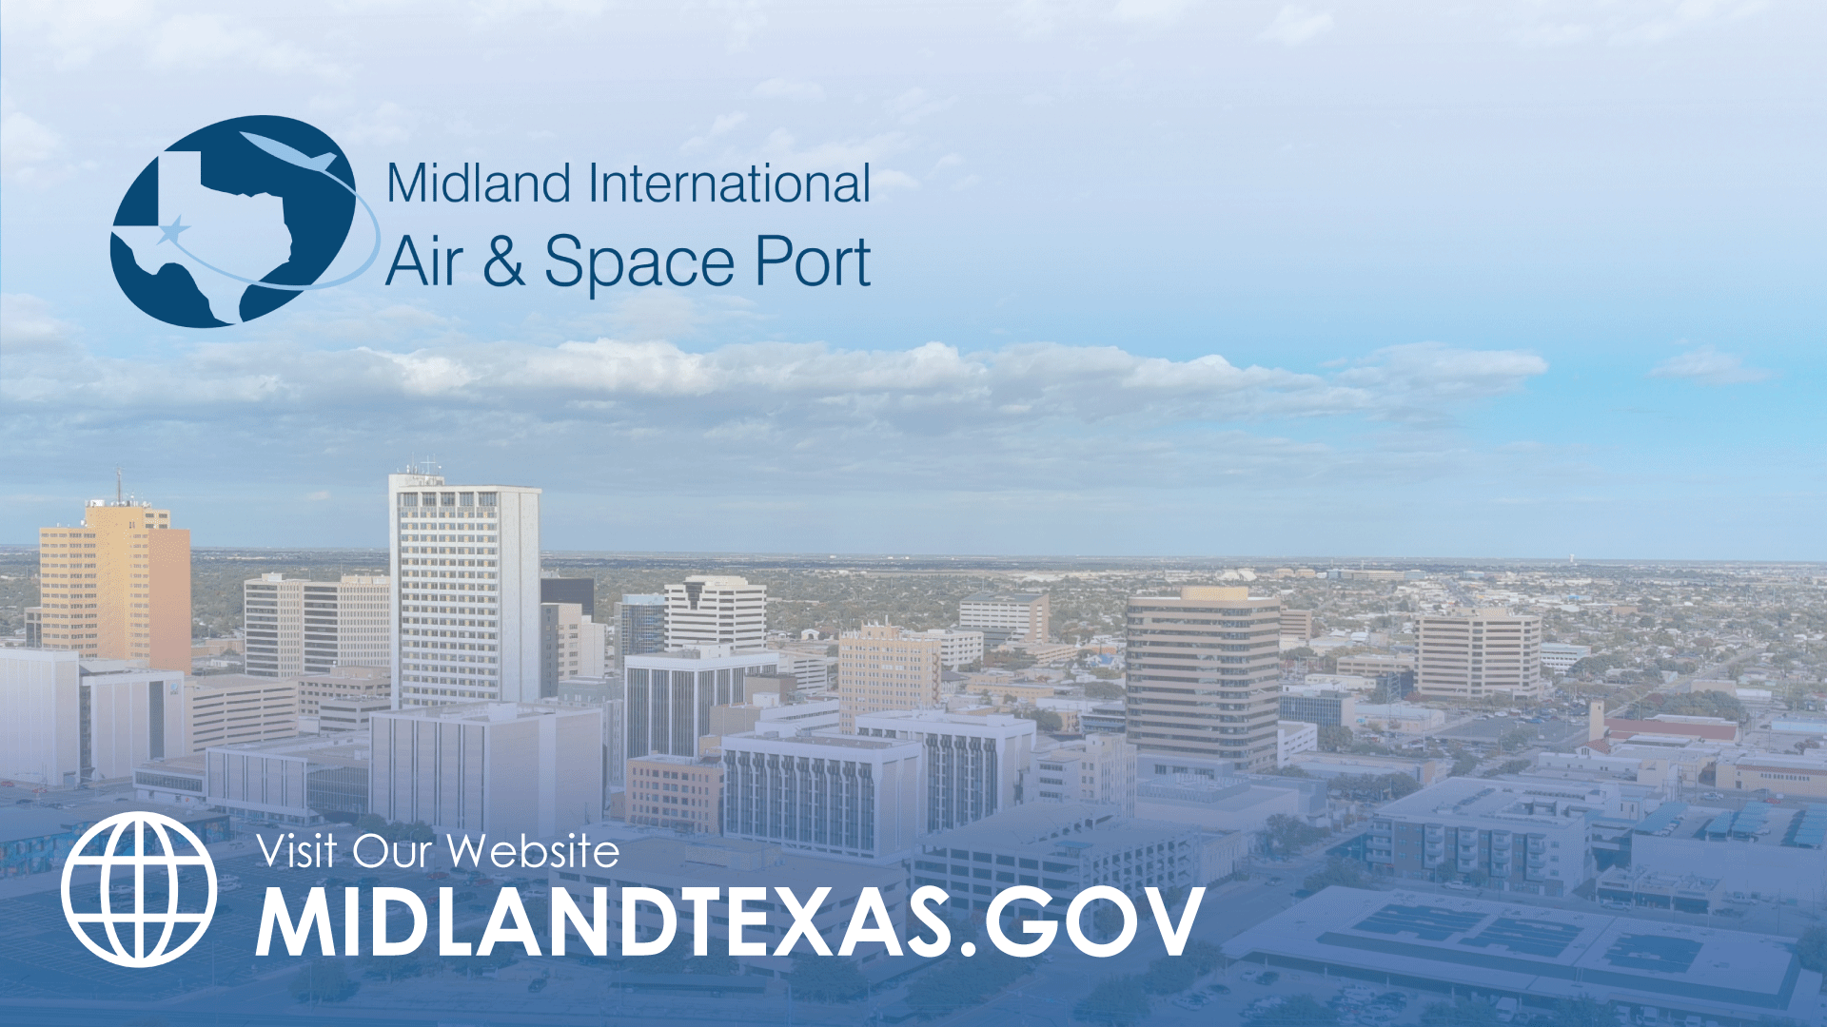
AIRPORT FUNDING PLAN
September 10, 2024

Slide 2

STRATEGIC GOALS
Goal 1: Strong Economy with More Quality Jobs
  1.5 Grow the core business of air transportation: Develop and transform the Midland airport system.
Goal 5: Provide Sound Governance and Fiscal Management
  5.7 Ensure continued financial stability and accountability: Maintain financial transparency.
2

Slide 3

GOALS
Invest in the Future of the Midland Airport System
Provide additional space for TSA Checkpoint.
Provide a long-term infrastructure plan for Midland Airpark hangar development.
Provide a self-serve fuel option at Midland Airpark.
Funding Plan to accomplish these goals.
Continue maximizing our usage of the FAA Grant Programs.
3

Slide 4

TERMINAL MODERNIZATION & PASSENGER SCREENING RELOCATION
4

Slide 5
TERMINAL MODERNIZATION & PASSENGER SCREENING RELOCATION
$38 million total project cost.
The TSA has requested this project.
Currently competing for Grants. Plan to bond the non-grant funded portion of the project.
Passenger wait time can be up to two hours during peak times when only one lane is open.
Will decrease TSA screening time for passengers and allow for a dedicated TSA Pre-Check lane.
5

Slide 6

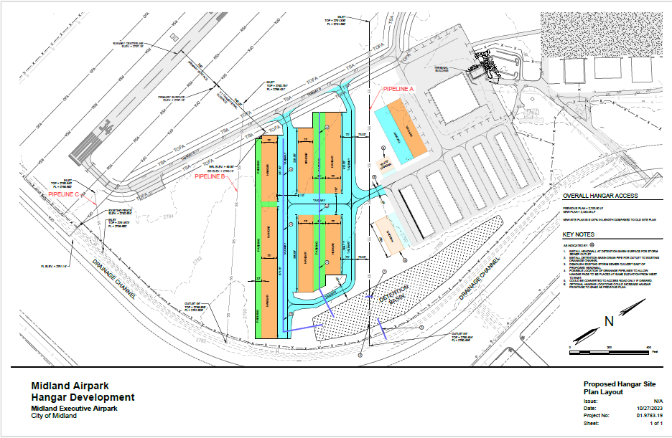
MIDLAND AIRPARK DEVELOPMENT PROJECT
$16 million in Airport Funding.
Increase hangar capacity, which will increase tenant rent revenue stream.
Currently, Airpark has one entrance, this project will add an additional entrance.
6

Slide 7

LEVERAGING STATE & FEDERAL DOLLARS
~70% of the Above Costs are Possibly Grant Funded
7

Slide 8

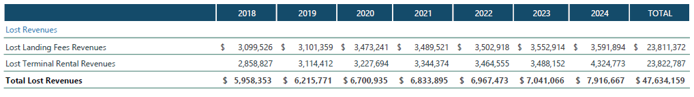
ENTERPRISE FUNDS-AIRPORT
Rates and Charges study shows rates have not remained consistent with industry standards.
The Airport has been subsidized for several years by the General Fund – due to inadequate user fees.
$23 Million in Lost Revenue since 2018 in airline landing fees alone.
$47M
8

Slide 9
AIRPORT COST PER ENPLANEMENT STUDY
Cost Per Enplanement (CPE) – A metric derived by taking the sum of the airlines rates and charges (Such as landing fees and terminal rental), divided by the annual passenger enplanements.
Airport | 2018 | 2019 | 2020 | 2021 | 2022
Midland International Air & Space Port (Midland, Texas) | $2.08 | $2.84 | $3.00 | $3.47 | $2.53
Rick Husband Amarillo International Airport (Amarillo, Texas) | $7.28 | $8.64 | $15.46 | $13.09 | $10.16
Birmingham Airport Authority (Birmingham, Alabama) | $12.22 | $11.03 | $13.76 | $18.69 | $12.72
Lubbock Preston Smith International Airport (Lubbock, Texas) | $8.86 | $8.17 | $12.03 | $10.25 | $8.64
Blue Grass Airport (Lexington, Kentucky) | $10.66 | $10.23 | $11.36 | $13.57 | $11.64
Clinton National Airport (Little Rock, Arkansas) | $10.59 | $10.76 | $19.68 | $12.20 | $11.41
Jackson-Medgar Wiley Evers International Airport (Jackson, Mississippi) | $12.11 | $11.13 | $19.52 | $15.23 | $11.83
9

Slide 10

FUNDING PLAN
Next Steps
A new compensatory model with airlines requires a reasonable step-ladder increase to CPE, which is only achievable with debt funding and limited cash on hand.
Increase in airline contributions, parking revenue, and oil & gas revenue will fund projects.
Airport fund assets include Land (2,600 acres of Executive Airpark land), Oil & Gas revenue, and cash on hand (approximately $37 M).
Smaller projects will be airport cash-funded.
10

Slide 11
FINANCING STRATEGY
New Compensatory Model
Airlines see value in investing in MAF and will contribute what is needed to fund capital projects and debt.
Revenue share model, any remaining operating revenues will be shared with the Airlines at 50%.
New possible CPEs above, after revenue share.
Brings CPE up to industry standards and increases revenue to reinvest in infrastructure.
11

Slide 12
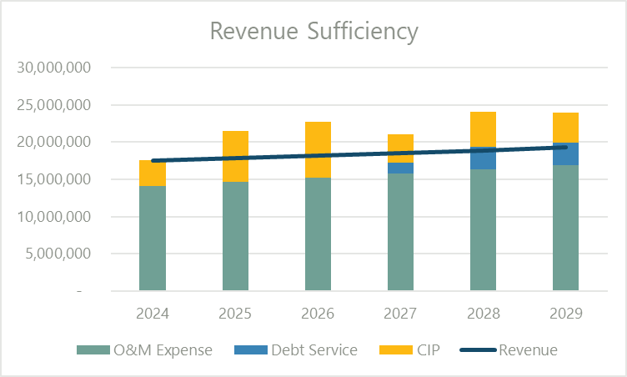
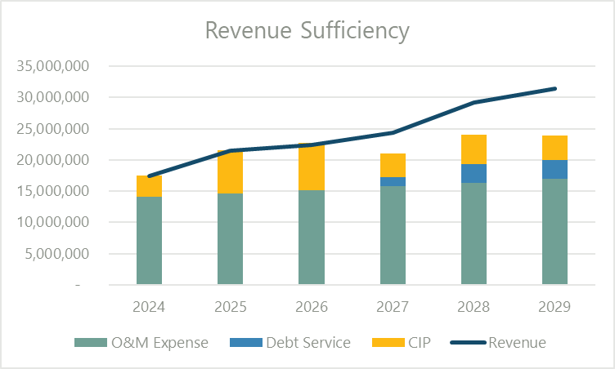
FINANCING STRATEGY
Current Fixed Rate Model
Does not pay operating and capital costs
New Compensatory Model
Covers $31.2 million bond, capital projects, and operating expenses.
12

Slide 13
FUNDING PLAN ACCOMPLISHMENTS
Results
Airport is 100% self-sufficient, no subsidy from the General Fund.
Airport has reimbursed the General Fund for subsidies received for the last six years.
User fees/airline fees will fund projects, with no increase to property taxes.
A better passenger experience for Airport patrons.
New infrastructure for Midland Airpark.
Continued development of the Spaceport.
13

Slide 14

MISSION
Deliver exceptional services and promote a high quality of life and place for ALL our citizens.

