Slide 1

BUDGET 2024-2025
September 10, 2024
TITLE HERE
TITLE HERE

Slide 2

ALIGNMENT WITH STRATEGIC PLAN
Goal 5: Provide Sound Governance & Fiscal Management
5.7 Ensure Continued Financial Stability and Accountability: Maintain Financial Transparency.
2

Slide 3

HEARING DATES
September 10 – Public Hearing of Budget and Tax Rate – First Reading
September 17 – Public Hearing of Budget and Tax Rate – Adoption
3

Slide 4

2025 PROPOSED TAX RATES
Tax Rate | Adopted 2023-24 | Proposed 2024-25
Proposed Tax Rate (Adopted for 2023-24) | .350662 | .348662
Voter-Approval Tax Rate | .353162 | .353200
Voter-Approval Tax Rate w/ Increment | .380408 | .361054*
No-New-Revenue Rate | .328693 | .344044**
Interest & Sinking (Debt Service) | .060852 | .058342
4

Slide 5
PROPERTY TAX VALUATION
 | FY 2024 Adopted | FY 2025 Proposed | Difference
Property tax Rate (Cents per $100) | 0.350662 | 0.348662 | -0.002000
Per $100,000 of Home Value | $350.66 | $348.66 | -$2.00
On a $300,000 Home Valuation | $1,051.99 | $1,045.99 | -$6.00
5

Slide 6
PROPERTY TAX VALUATION: FY2023-FY2025
 | FY2023 Adopted | FY 2024 Adopted | FY 2025 Proposed | Two Year Difference
Property tax Rate (Cents per $100) | 0.355039 | 0.350662 | 0.348662 | -0.006377
Per $100,000 of Home Value | $355.04 | $350.66 | $348.66 | -$6.38
On a $300,000 Home Valuation | $1,065.12 | $1,051.99 | $1,045.99 | -$19.13
6

Slide 7
PROPERTY TAX RATES: FY2023-FY2025
Reduction of 64 Tax Basis Points
7

Slide 8
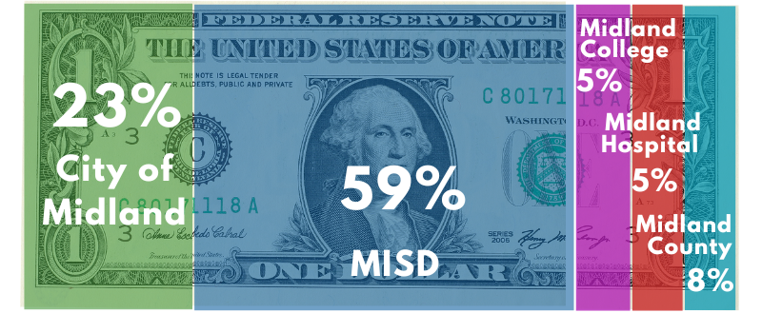
FY2024 PROPERTY TAX BY ENTITY
8

Slide 9
FY2024 TAX RATES-PEER CITIES
Municipal Tax Bill on a $300,000 Valuation Property
9

Slide 10
FY2024 TAX BILLS-PEER CITIES
10

Slide 11
HISTORICAL TAX LEVY
fy2005 to fy2025
(Represented In Cents PER $100 VALUATION)
11

Slide 12
STRATEGIC PLAN FUNDING-ALL CITY FUNDS
Strategic Goal | FY2024 Budget | FY2025 Proposed | Difference | Variance
Goal 1: Strong Economy & More Quality Jobs | $26,608,999 | $29,494,333 | $2,885,334 | 10.8%
Goal 2: Set Standard for a Safe & Secure City | 95,442,408 | 99,662,154 | 4,219,746 | 4.4%
Goal 3: Quality of Life & Place | 31,007,907 | 40,754,831 | 9,746,924 | 31.4%
Goal 4: Transparent & Consistent Communication | 18,869,485 | 22,045,677 | 3,176,192 | 16.8%
Goal 5: Sound Governance & Fiscal Management | 73,491,307 | 76,435,673 | 2,944,366 | 4.0%
Goal 6: Strengthen and Sustain Infrastructure | 178,572,497 | 185,919,653 | 7,347,156 | 4.1%
Grand Total | $423,992,603 | $454,312,320 | $30,319,717 | 7.1%
12

Slide 13
STRATEGIC PLAN FUNDING-GENERAL FUND
Strategic Goal | FY2024 Budget | FY2025 Proposed | Difference | Variance
Goal 1: Strong Economy & More Quality Jobs | $5,417,409 | $6,822,793 | $1,405,384 | 25.9%
Goal 2: Set Standard for a Safe & Secure City | 94,326,508 | 98,659,730 | 4,333,222 | 4.6%
Goal 3: Quality of Life & Place | 10,877,780 | 11,308,778 | 430,998 | 4.0%
Goal 4: Transparent & Consistent Communication | 12,167,756 | 12,828,499 | 660,743 | 5.4%
Goal 5: Sound Governance & Fiscal Management | 21,126,562 | 21,660,256 | 533,694 | 2.5%
Goal 6: Strengthen and Sustain Infrastructure | 23,575,730 | 25,059,646 | 1,483,916 | 6.3%
Grand Total | $167,491,745 | $176,339,702 | $8,847,957 | 5.3%
13

Slide 14
GENERAL FUND INCREASE BREAKDOWN
$11.0M Increase
$5.2M – Cost of Living Adjustment (COLA) and Pay
Progression for City Staff
$2.5M – Personnel positions and Re-classes
$2.0M – Software & Liability Coverage Increases
$500K – Increase to Power & Utilities
$500K – City Increase to Midland Firemen's Relief and
Retirement Fund Contribution; 22.2% to 24.2%
$350K – 3% increase on Health Insurance Premiums
+5.3%
FY 2024
$167M
FY 2025
$176M
14

Slide 15

MISSION
Deliver exceptional services and promote a high quality of life and place for ALL our citizens.

