Slide 1
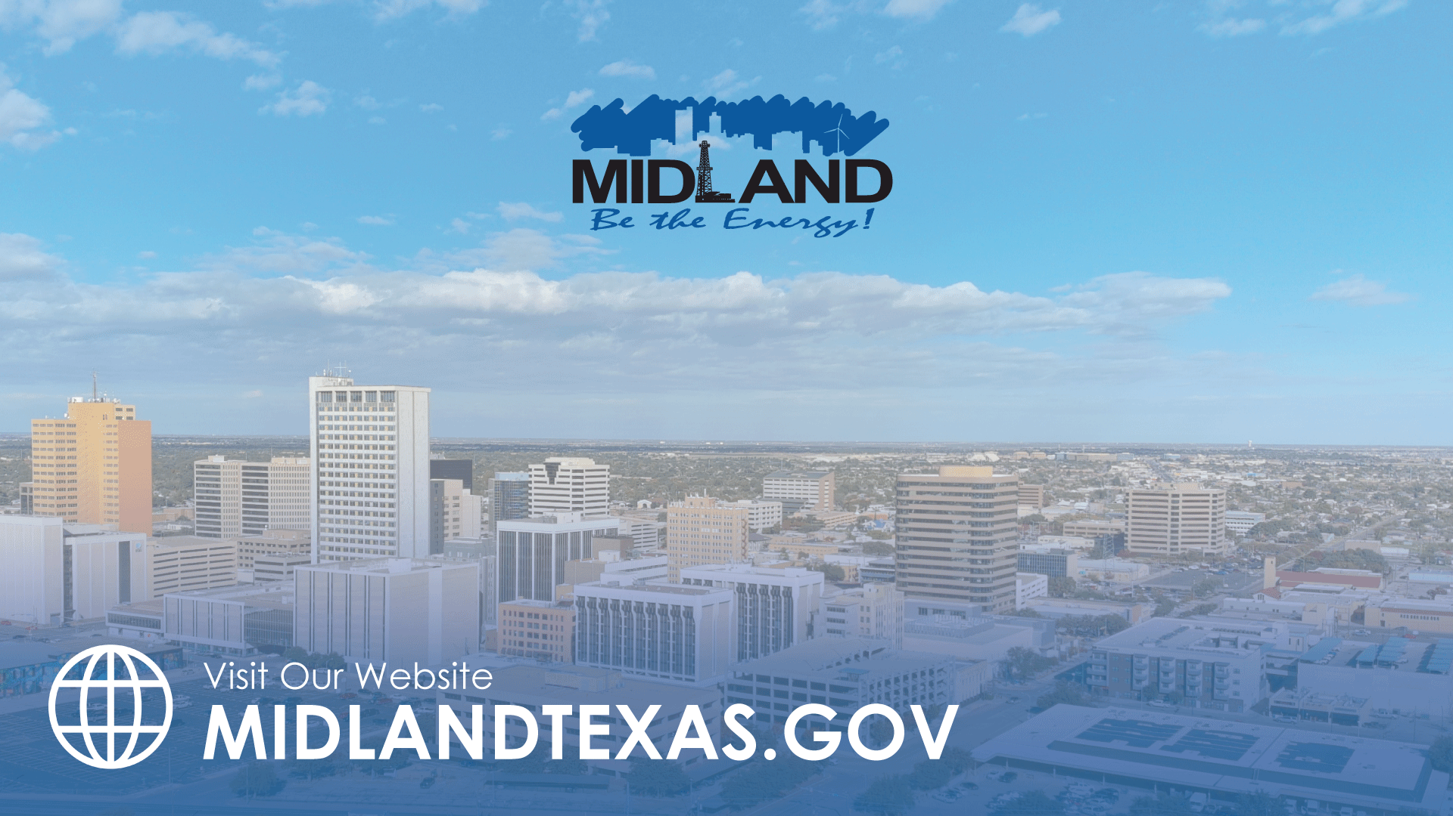
CITY/COUNTY
PARTNERSHIPS
TITLE HERE
TITLE HERE

Slide 2

STRATEGIC GOAL CONNECTIONS
Goal 3: Quality of Life & Place
Goal 5: Provide Sound Governance and Fiscal Management
Goal 6: Strengthen and Sustain Our Infrastructure
2

Slide 3



Interlocal Partnership
Enhance Resource Sharing
Improve Infrastructure Through Joint Efforts
Promote Synergistic Development
Fast-track Project Timelines
Shared Goals (Vision Zero)
Keeping Up With Growth
3

Slide 4
Accomplishments
16 Roadway Improvement Projects
$6 Million in Reimbursements
4

Slide 5

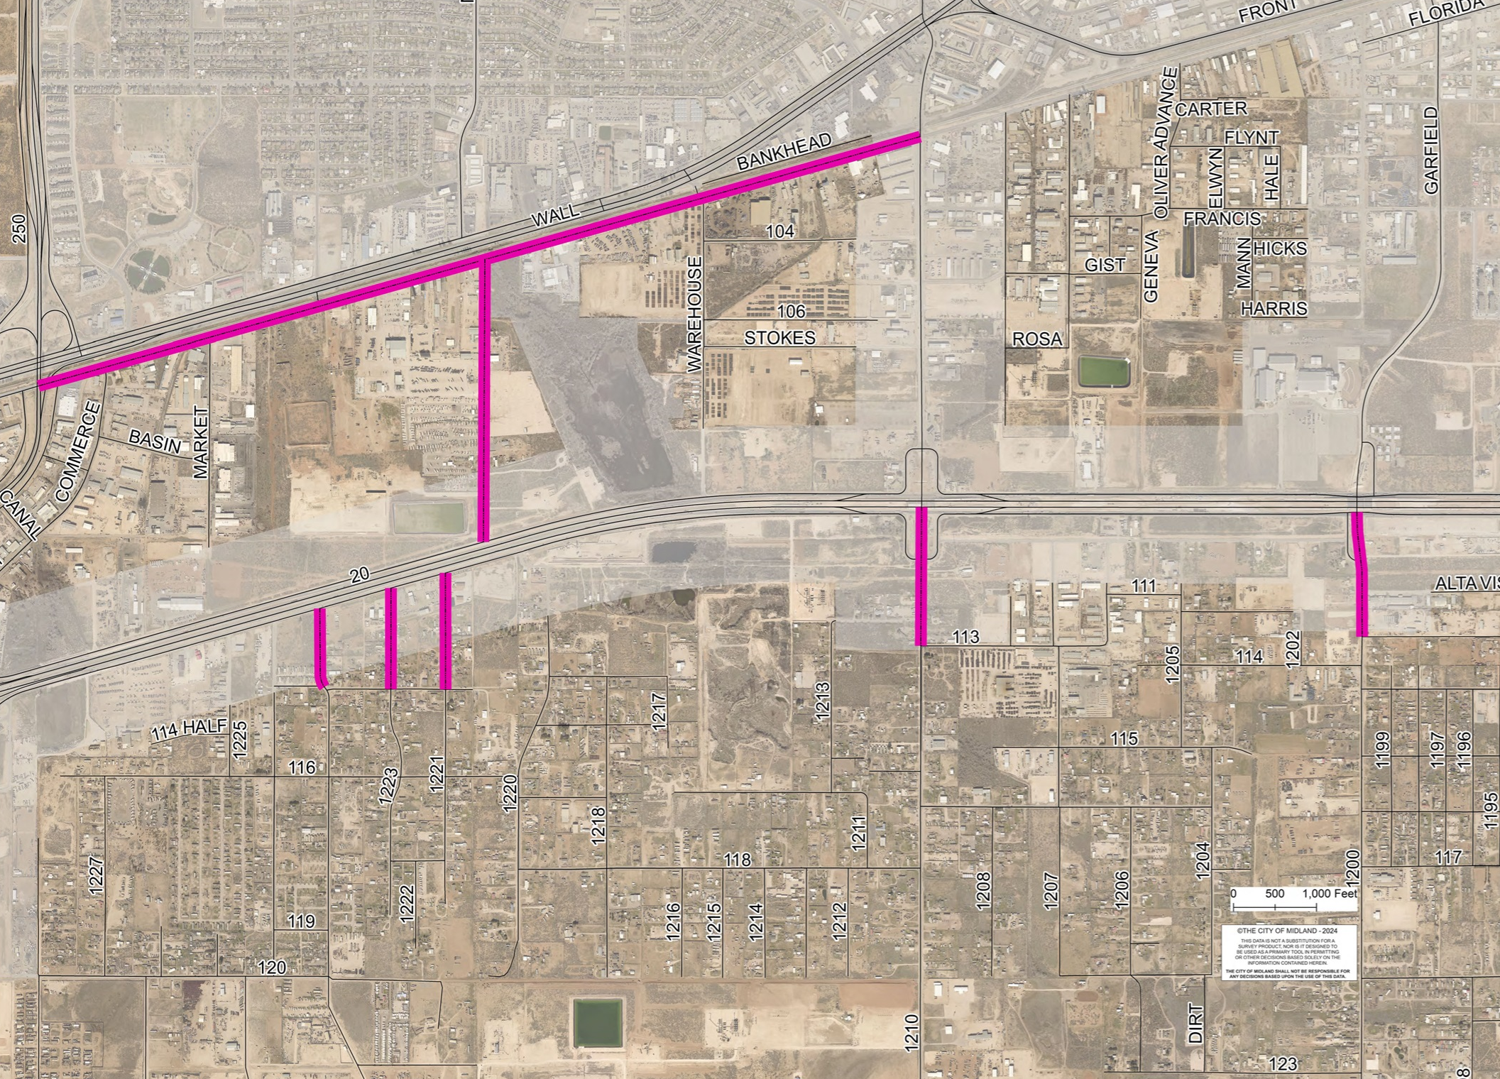
PAST PROJECTS
5

Slide 6
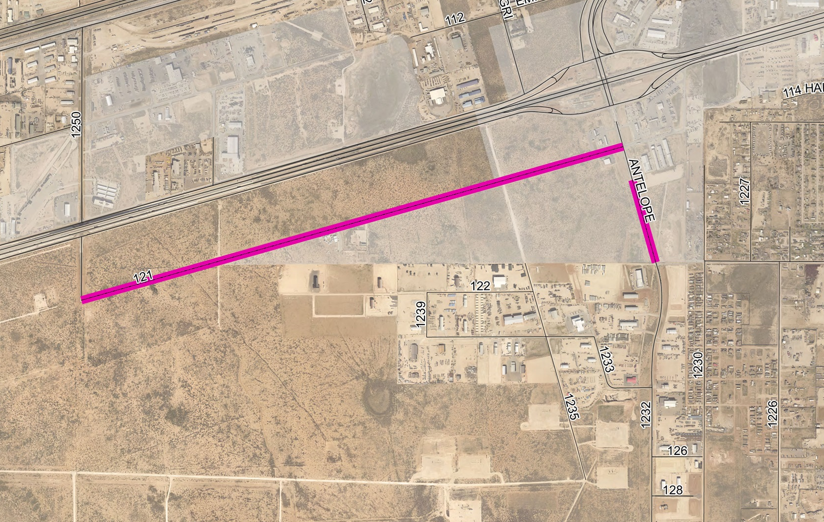
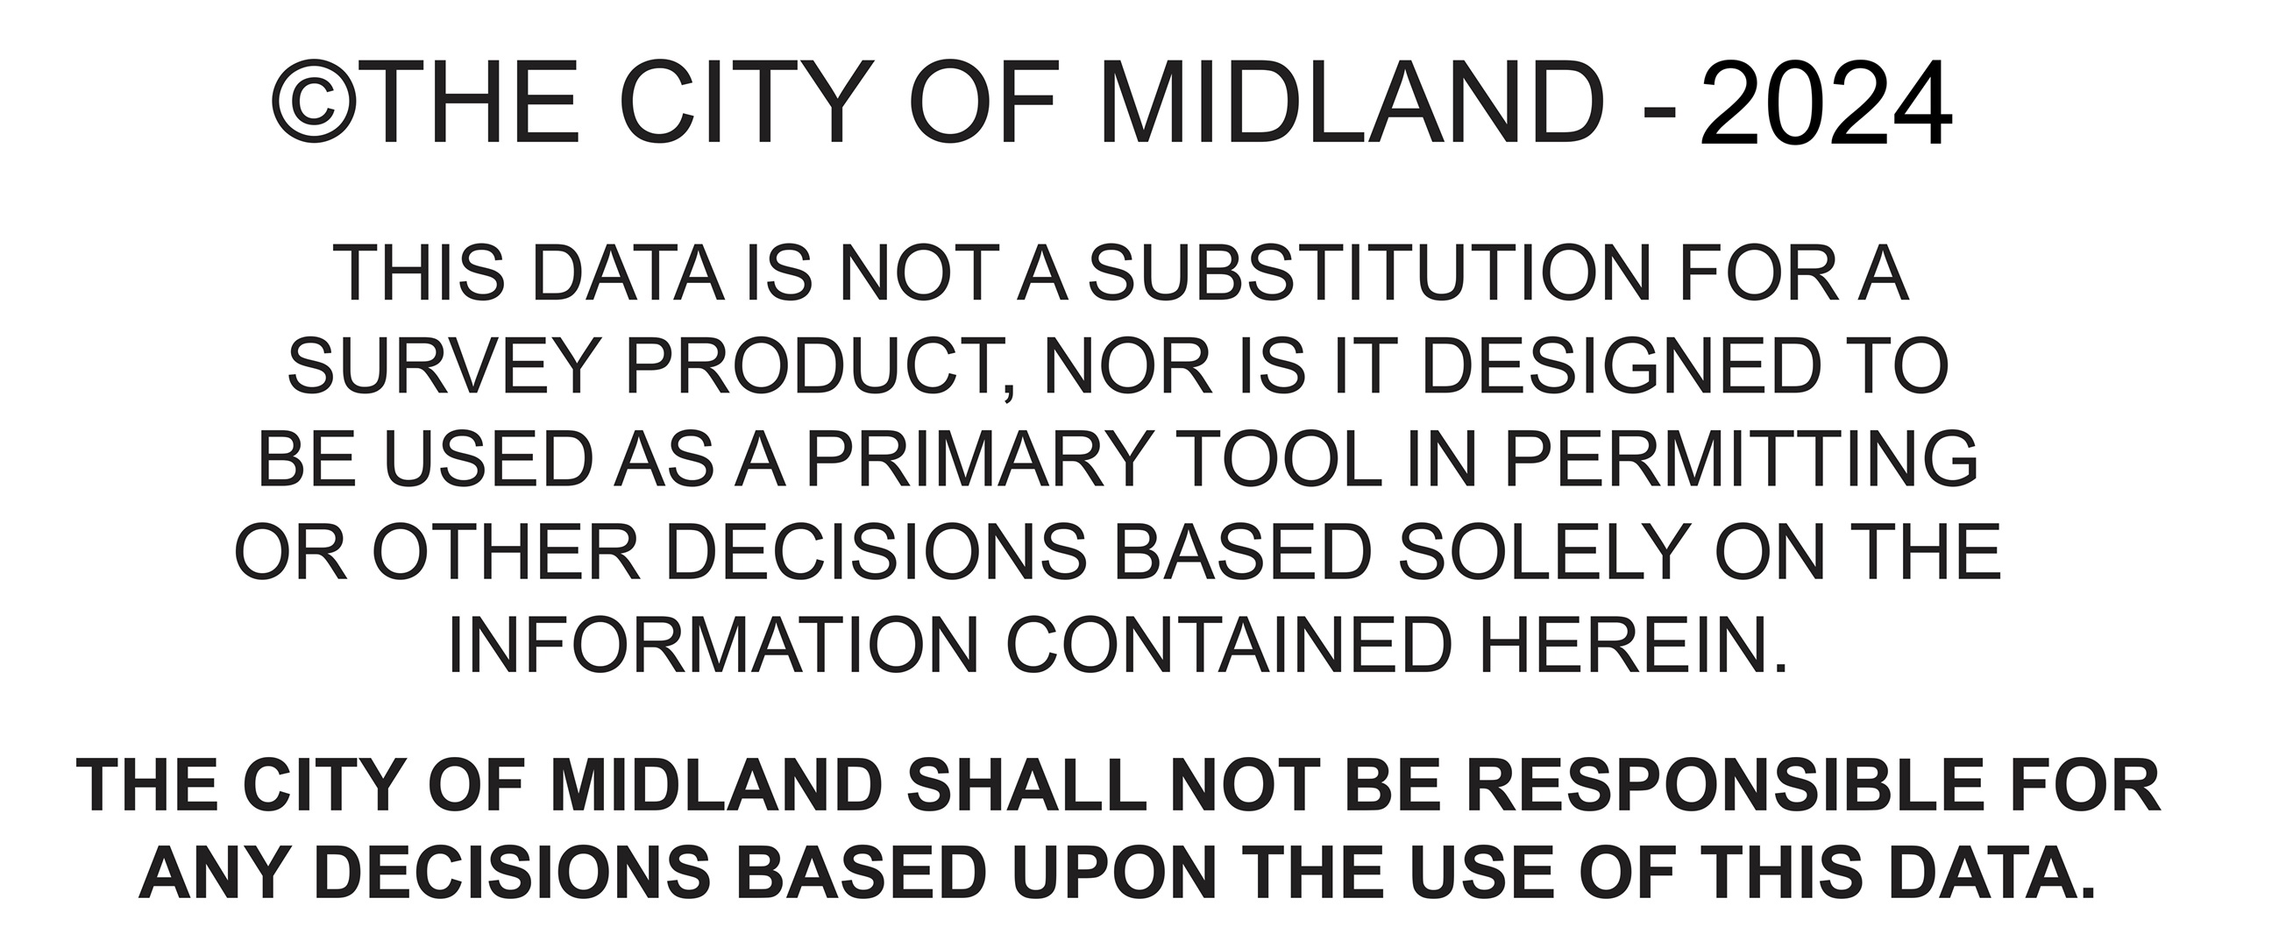
PAST PROJECTS (CONT.)
6

Slide 7

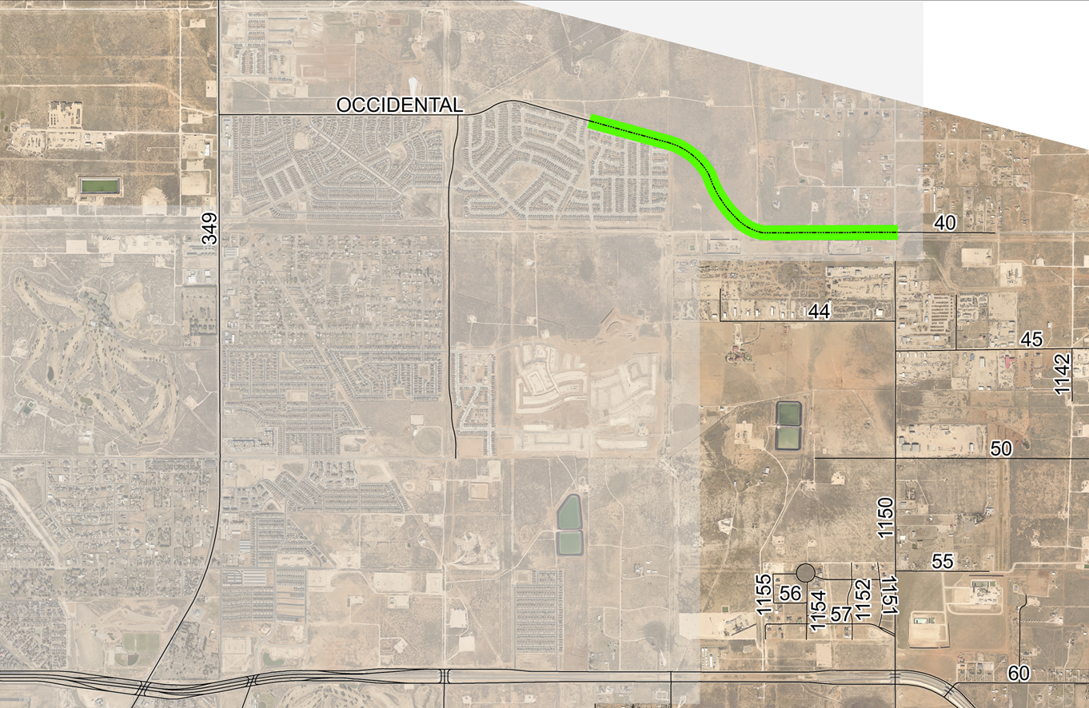
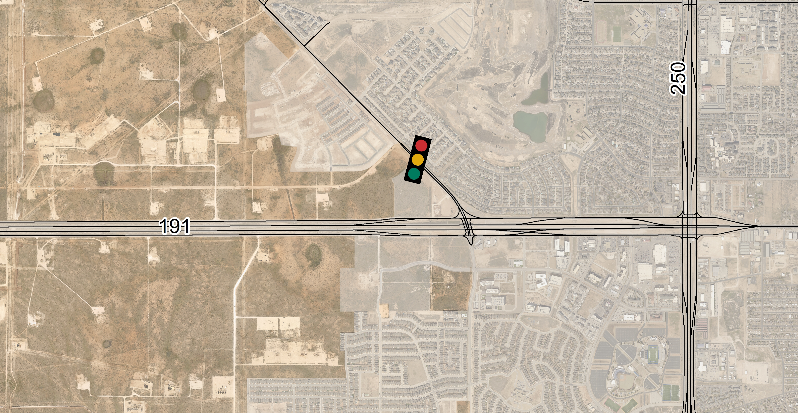
CURRENT PROJECTS
7

Slide 8

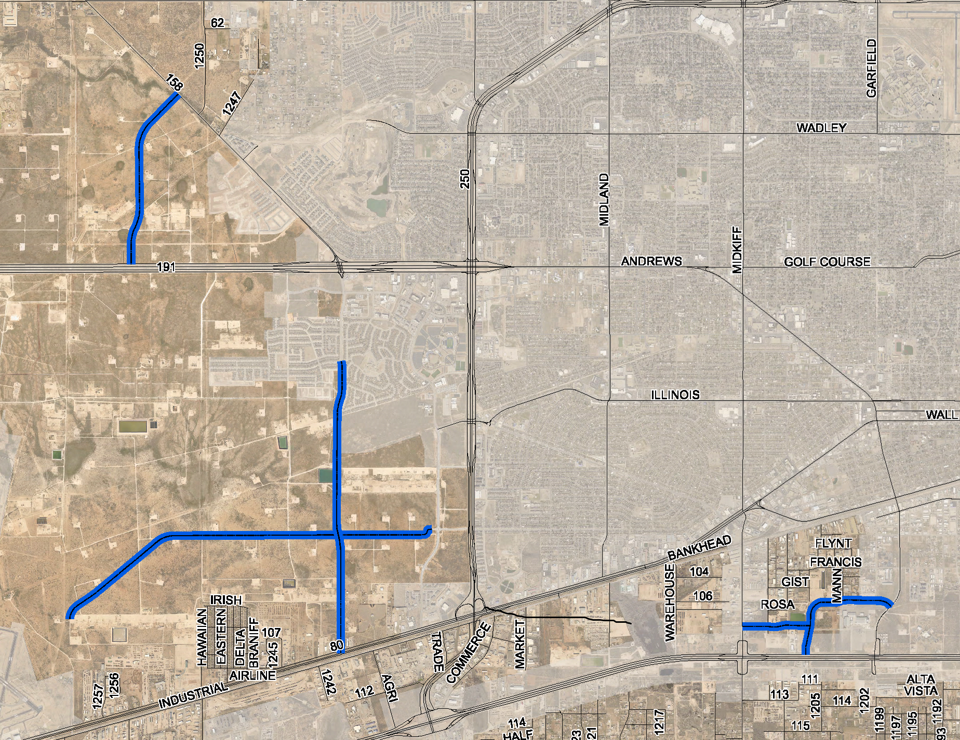
FUTURE PROJECTS
8

Slide 9
ALL PROJECTS
9

Slide 10
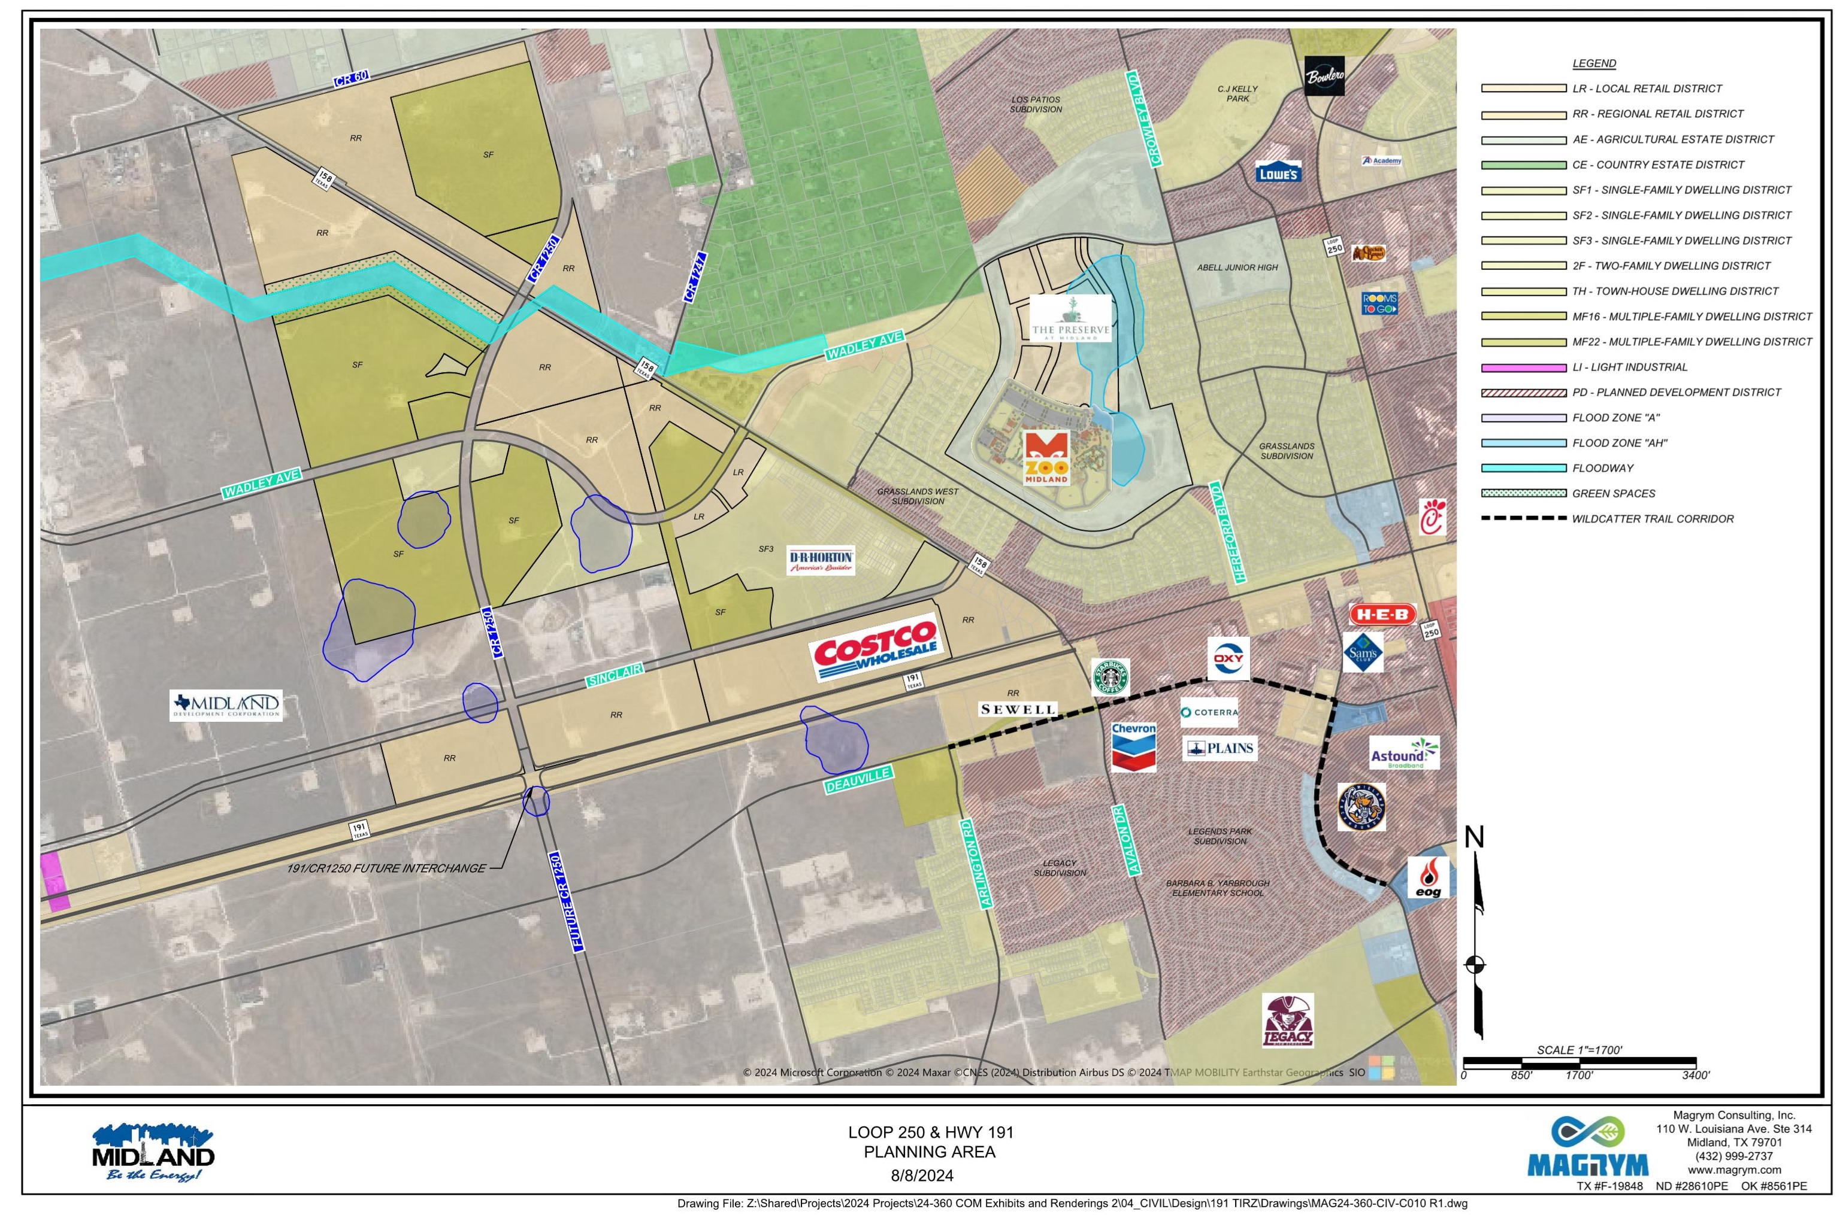
Partnerships
10

Slide 11
OTHER PROJECTS
Utilities Extension – The City extended utilities to serve Midland Co. facilities.
Signal Swap – Midland Co. is funding a traffic signal at Sinclair & SH 158; the City will maintain the signal at Co. Rd 120 & Antelope Trail.
Horseshoe Trails – A trail system is being developed around Horseshoe Arena to improve accessibility and recreation.
Midland Co. Courthouse – The City plans pedestrian improvements around the courthouse.
11

Slide 12

MISSION
Deliver exceptional services and promote a high quality of life and place for ALL our citizens.

Slide 13

Regional Partnerships
Along with interlocal partnerships, such as those with the county, MDC, and developers, regional partnerships with entities like TxDOT and the MPO are vital to achieving our transportation and safety goals. These collaborations help us secure state and federal funding, fast-track project timelines, and align with broader regional initiatives, ensuring more comprehensive and successful outcomes.
13

