Slide 1

INFLATION AND THE ‘MIDLAND FACTOR’
NOVEMBER 12, 2024
TITLE HERE
TITLE HERE

Slide 2

ALIGNMENT WITH STRATEGIC PLAN
Goal 5: Provide Sound Governance & Fiscal Management
5.7 Ensure Continued Financial Stability and Accountability: Maintain Financial Transparency.
2

Slide 3

IMPACTS OF INFLATION
Regional Inflation
Revenue (Sales Tax)
Midland and Municipal Government
Sanitation
Water
Parks
The ‘Midland Factor’
Cash vs Bond
3

Slide 4

REGIONAL INFLATION
4

Slide 5
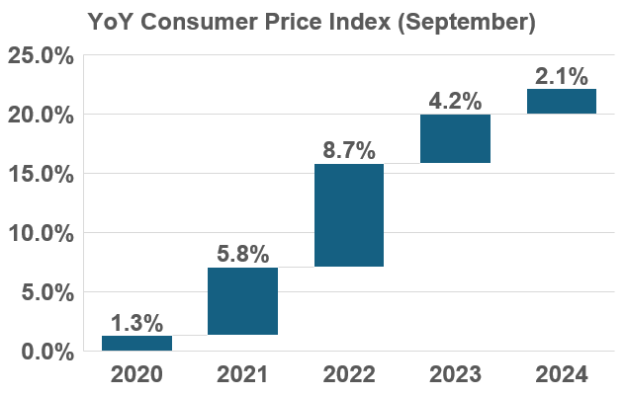
REGIONAL INFLATION
5

Slide 6
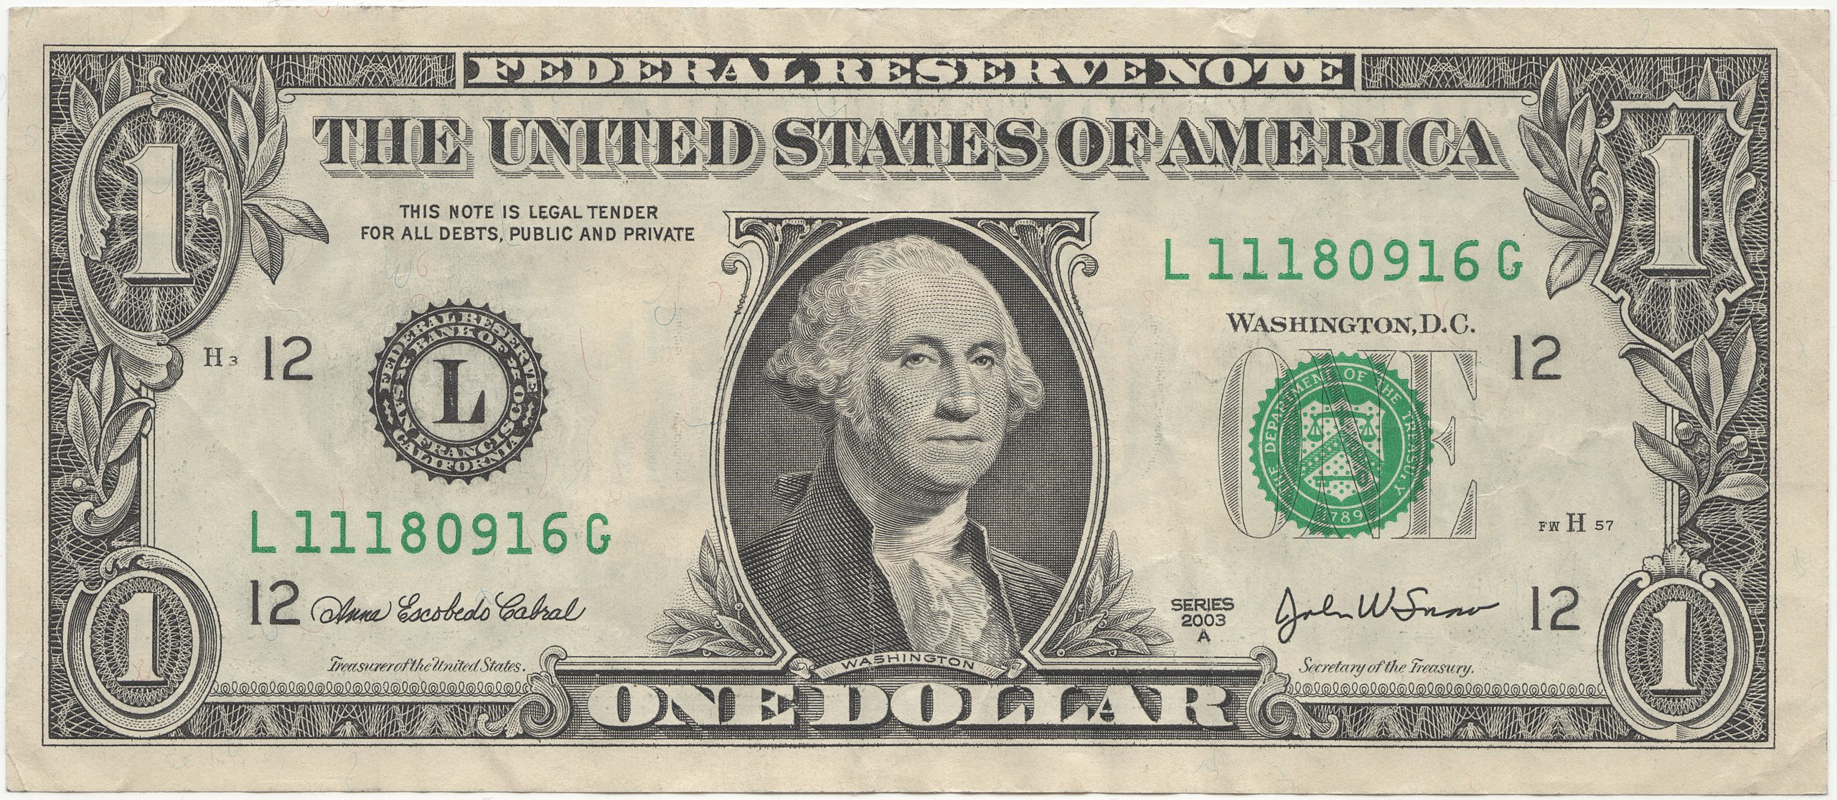

2020 DOLLAR
2024 DOLLAR
2028 DOLLAR…?
6

Slide 7

SALES TAX– OIL & OTHER
7

Slide 8
SALES TAX– OIL & OTHER
8

Slide 9

SANITATION
Landfill Entrance Road Project
First EOPC estimate in 2022: $2,615,097
2024 Bid: $3,664,036
$1.05M increase in only 2 years
9

Slide 10
SANITATION
Automated Garbage Trucks
$317,222 in 2021
$431,685 in 2024
$114,463 increase in only 3 years, or 36%
10

Slide 11
SANITATION
Landfill Compactor
2020 – $1,100,000
2024 – $1,600,000
$500,000 increase in 4 years, 45.5%
11

Slide 12

SANITATION
Dumpsters (Per Container)
2020 – $469
2023 – $645
$176 increase in 3 years, 37.5%
12

Slide 13
WATER & SEWER
Midland Northeast Wastewater Line Project
Bid increased by $17 Million from project estimate 3 years ago, a 57% Increase
13

Slide 14

WATER & SEWER
Chemical Costs FY2020 to FY2024
Notes:
LAS – Liquid Ammonium Sulfate
Polymer – flocculant, a substance that reacts with solids suspended in the water to form clumps, known as flocs. This is very useful in the wastewater treatment process, and so polymers are often used by themselves, achieving flocculation so that solids can be easily removed.

Slide 15
WATER & SEWER
UEP Pipes FY2020 to FY2023
Increased as much as $83 per unit in 3 years, 155% Increase of some PVC
15

Slide 16
PARKS
Doug Russell Bath House Reconstruction
Bid increased by $1.6 Million from the prior year bid for FY24
16

Slide 17
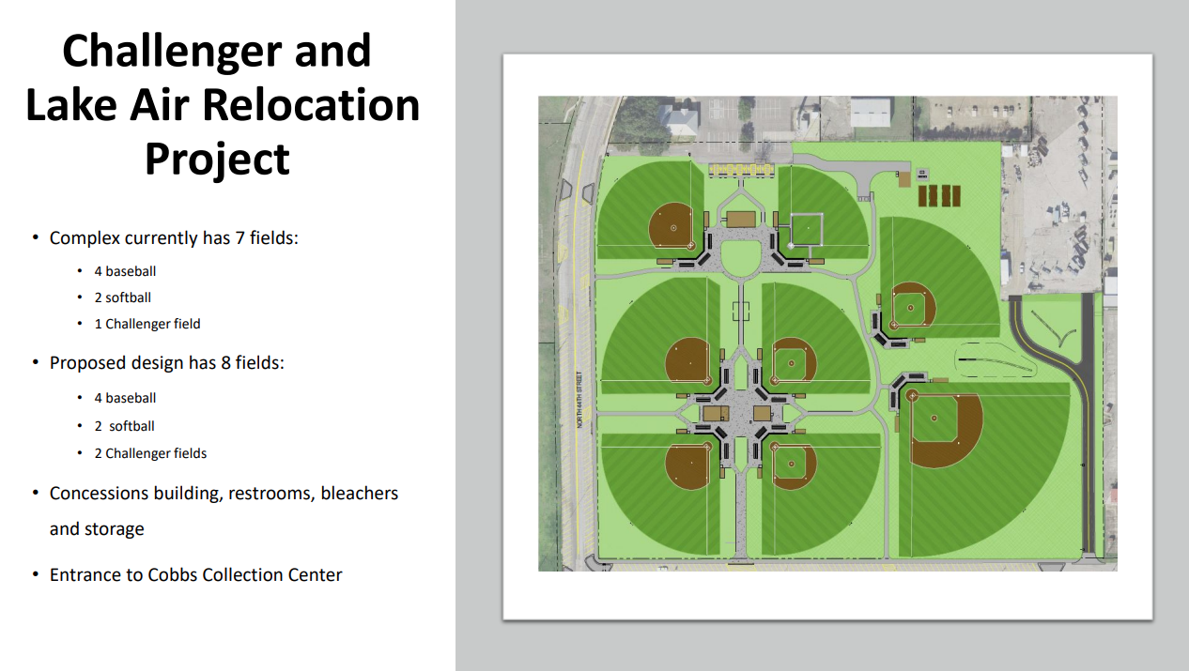
City of Waco opens Challenger and Lake Air Little League Ballpark
$9M for 8 fields with new lighting, May 2022
17

Slide 18
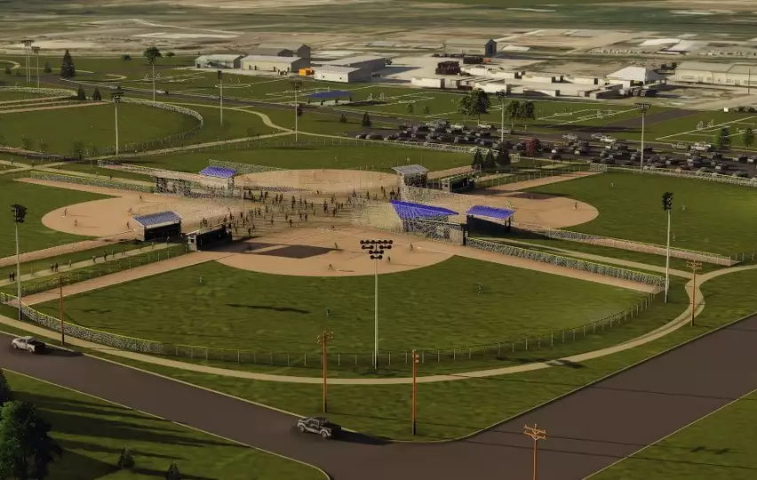
REYES MASHBURN NELMS PARK RENOVATION
Baseball Fields & Lighting
The Midland City Council approved renovations to baseball fields & facilities in Midland
$16.2M for 6 fields and lighting November 2023
Project Includes:
6 Turf Baseball fields
LED Field Lighting
Concession/Restroom Building
207 Parking Spaces
18

Slide 19
WACO
MIDLAND
$9 Million (2022)
8 New fields
New Lighting
Concession and Restrooms
$16.2 Million (2023)
6 New fields
New Lighting
Concession and Restrooms
Parking
19

Slide 20
CASH vs BOND
Reduces Debt burden/risk and helps credit rating
No Interest or Premium costs
If funds are already in reserves, it allows for quicker project implementation
Allows more of annual budget allocated toward operating expense rather than debt payment
Sets a rigid timeline for projects based on steady build up of cash reserves
Preserves Cash Reserves for urgent and unforeseen needs
Interest rates could be cost savings compared to inflation
Projects can be funded based on need rather than
Predictable expense spread out over the term of the loan
Addressing both backlogged and future needs in the same funding source in a shorter span of time
20

Slide 21
EXAMPLE $28M PROJECT
Cash
Start setting aside funds in FY2025 and save for 3 years
Assume 57% project increase (same as NE Wastewater project)
The project would cost $44M at the end of those 3 years
Project would begin in FY2028
City funds would be encumbered and cash reserves would need to be built up before any additional projects
CO Bond
Receive Bond funds in FY2025 and begin project in the same year
20-year bond, $16M in interest over the term of the loan
Total payment would add up to $44M, paid out over 20 years
Project would be complete FY2028
Bond would have an annual payment of $2.1M, done FY2046, City can save for cash projects or determine additional bond needs
21

Slide 22
TIME VS COST
Finding additional costs in either inflation or interest
Cash method would require being able to set aside $15M per year
Inflation
Interest
Base Project Cost
Base Project Cost
CASH
BOND
22

Slide 23
TIME VS COST
As dollars decrease in value, the amount set aside diminishes
Inflation
Interest
Base Project Cost
Base Project Cost
CASH
BOND
23

Slide 24

MISSION
Deliver exceptional services and promote a high quality of life and place for ALL our citizens.

