Slide 1

November 12, 2024
ITEM 3a
CODE ENFORCEMENT UPDATE AND RECOMMENDATIONS
TITLE HERE
TITLE HERE

Slide 2

PRESENTATION PURPOSE
An update on code enforcement activities and initiatives, including key accomplishments
Recommendations to improve code enforcement efficiency + effectiveness in support of Midland’s vision to be the premier and safest city in West Texas
2

Slide 3
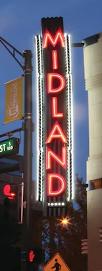

STRATEGIC PLAN LINKS
Goal 2. Set the Standard for a Safe + Secure City
2.1 Be the safest city in West Texas: Enhance public safety programs
2.3 Implement effective code enforcement strategies: Address nuisances to improve overall health and safety
2.4 Revitalize neighborhoods: Utilize best practices to support the redevelopment of neighborhoods
3

Slide 4

STRATEGIC PLAN LINKS
Goal 3. Quality of Life + Place
3.3 Create an attractive + inclusive environment: Develop and enhance live, work, and play opportunities for our citizens
3.4 Establish beautification programs: Implement initiatives to make the community clean and bright
4

Slide 5
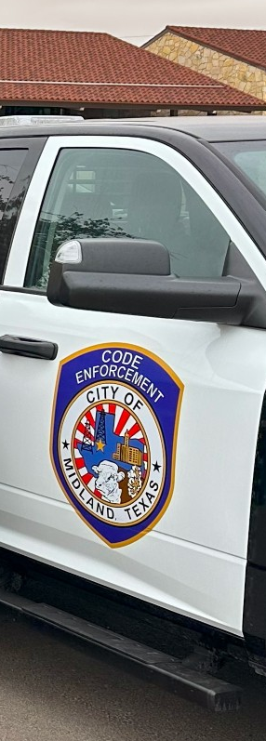
MISSION & PURPOSE
The purpose of Code Enforcement is to be proactive and responsive to the needs of the citizens of Midland while obtaining compliance with the City’s codes and ordinances.
Ordinances are intended to improve the quality of life by ensuring a cleaner, safer, and more attractive community.
Compliance with ordinances reduces vandalism, deters crime + maintains property values.
5
Notes:
While many agencies respond to enforcement issues on a complaint-only basis, this method is not necessarily the most effective use of City resources.
Code Enforcement programs which are specialized and proactive are more likely to develop the expertise and efficiency to respond to the issues and objectives meeting the City’s goals to educate the community, so they understand code compliance is an integral part of our community.
It is our intention to move the conversation away from proactive versus reactive and toward an understanding of gaining voluntary compliance for code abatement, using the tools afforded to our team.
Voluntary compliance with the City’s municipal code is met through preventing the deterioration of neighborhoods and buildings, rehabilitating existing housing and buildings, educating individuals on preventative maintenance, protecting the public from unsafe and substandard buildings, and preventing future blight/decline of property values.

Slide 6

KEY RESPONSIBILITIES
Respond to citizen reports and proactively patrol for health, safety, and aesthetic compliance
Investigate and address land use & zoning, building code, property maintenance, and nuisance violations
Work with property owners to achieve compliance
6
Notes:
Benefit of proactively patrolling – helps deter violations before they are too difficult to abate
Strategic proactive patrolling to first prioritize citizen complaint and then patrolling surrounding area for other nuisance and health, safety and welfare concerns

Slide 7
TEAM & OTHER DUTIES
Team: 11 Code Officers (6 licensed), 2 Admin Assistants, 4 Maintenance Specialists
Maintenance team handles weed/debris abatement, junk removal, graffiti cleanup, securing vacant buildings
Code Enforcement also assists in large item pick-up, homeless encampment clean-up + cross-functional operations
7

Slide 8
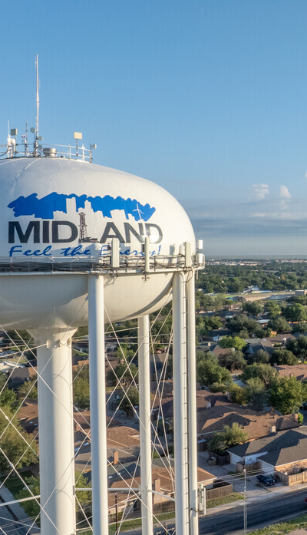

PRIORITIES + METRICS
In May, shifted focus to increase:
Proactivity + Responsiveness (volume, SCF closure rate, average response time to new violations)
Efficiency (closure rate, average time to close, percent closed within 30 days)
Effectiveness (voluntary compliance rate, repeat violation rate, abatement cost recovery rate)
8

Slide 9
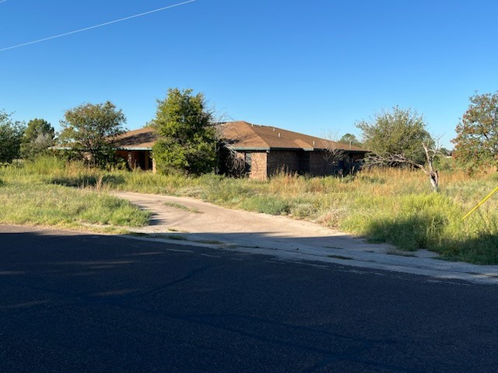
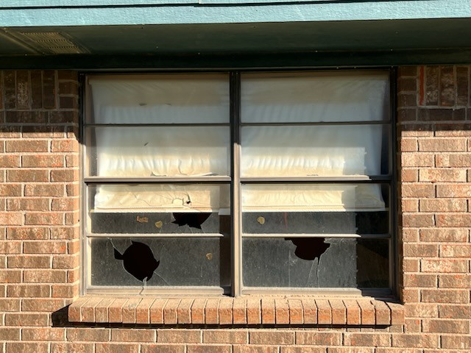
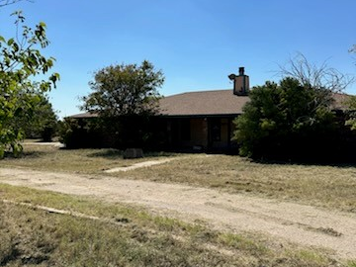
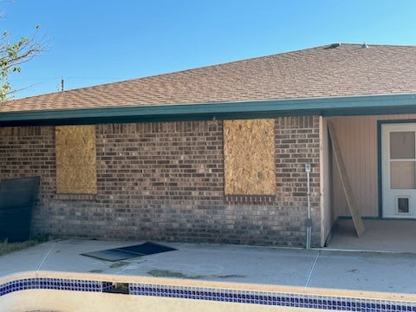
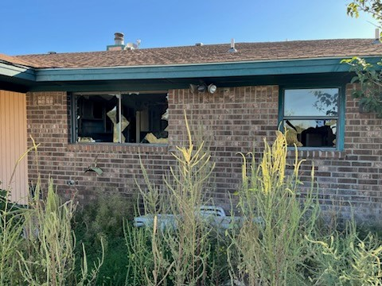
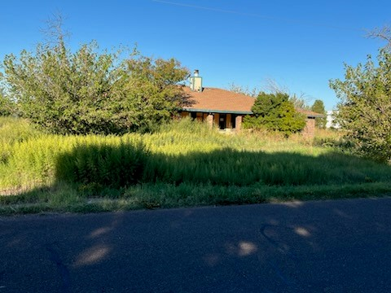
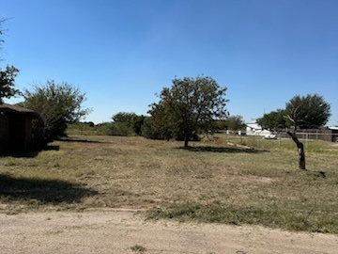
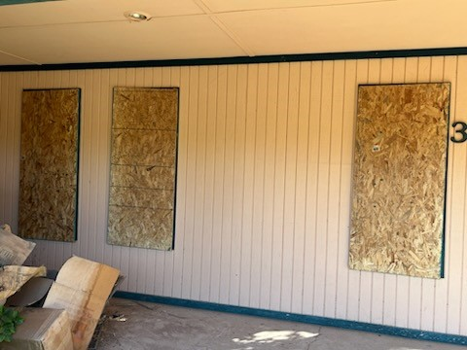
SUCCESS STORIES: ABATEMENTS
Before
After
9
Notes:
Multiple police calls to the house over the last ten years
Took one week and all 4 maintenance folks to complete – result is that mowing contracts are completely backed up

Slide 10
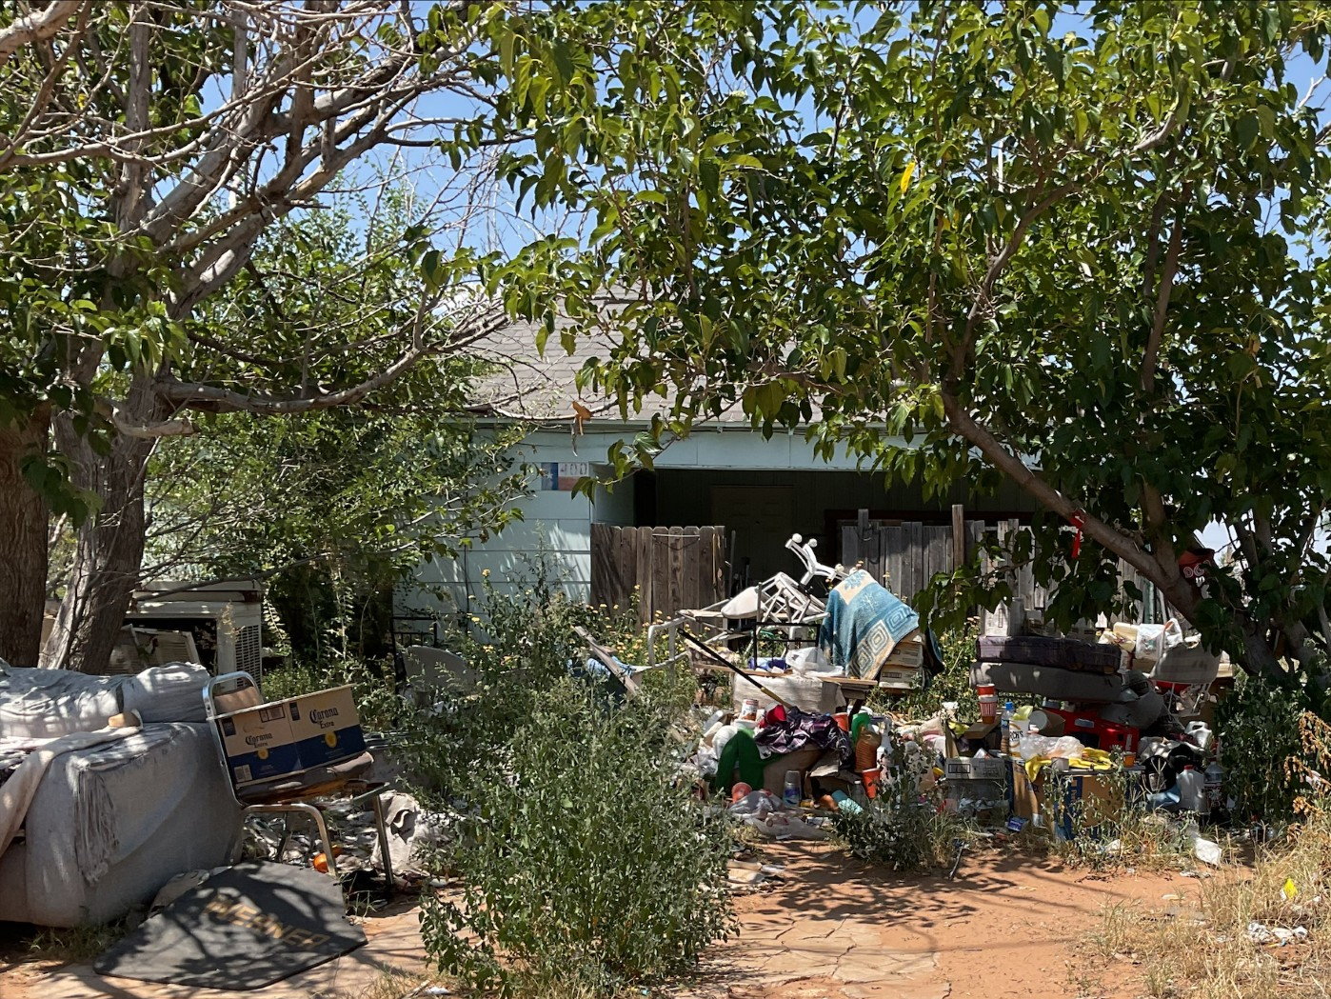
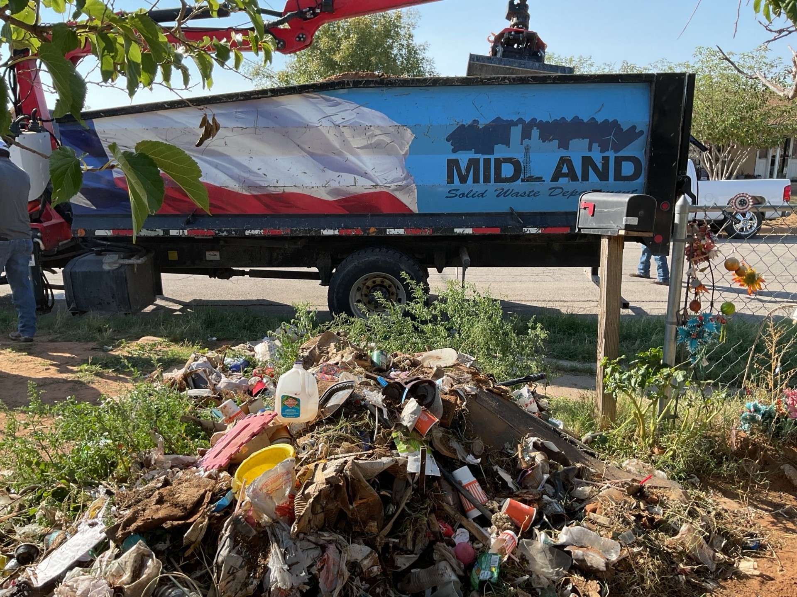
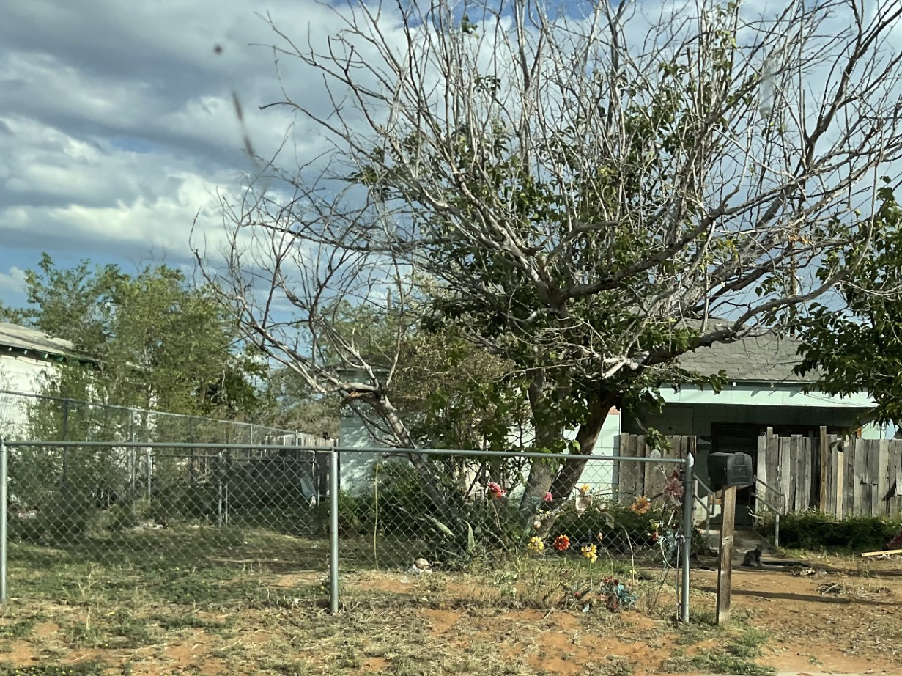
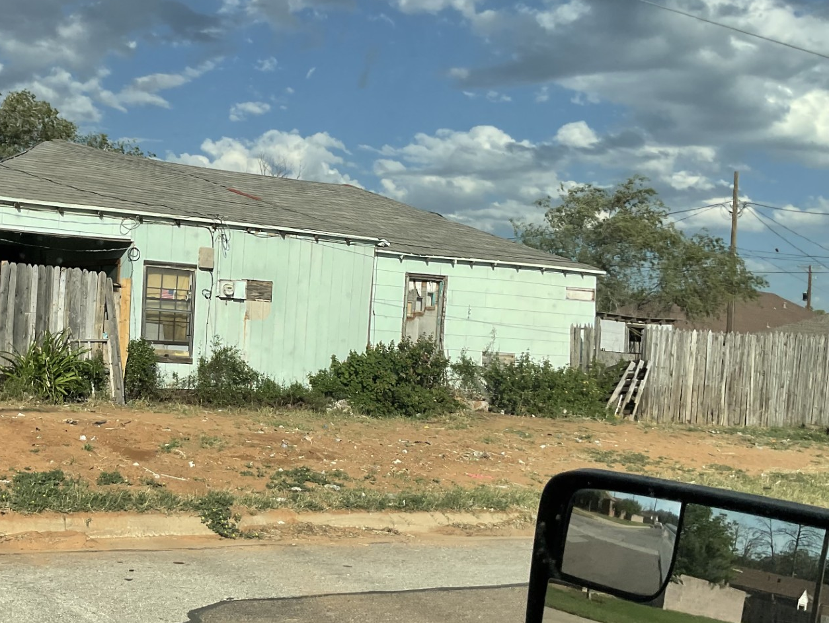
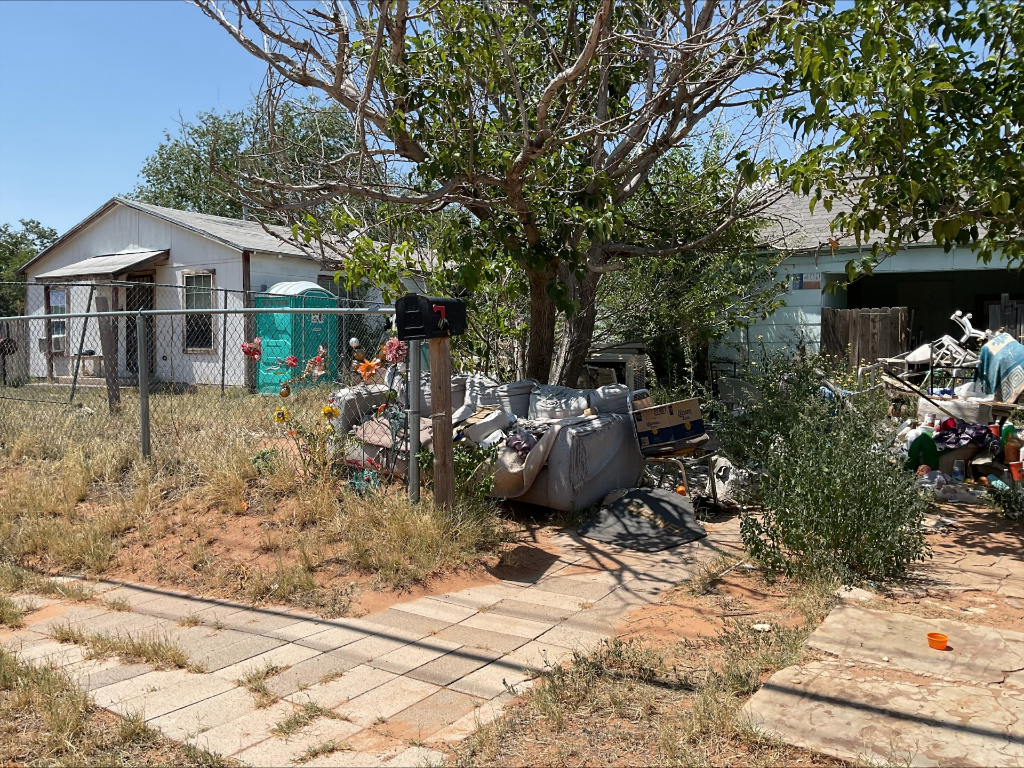
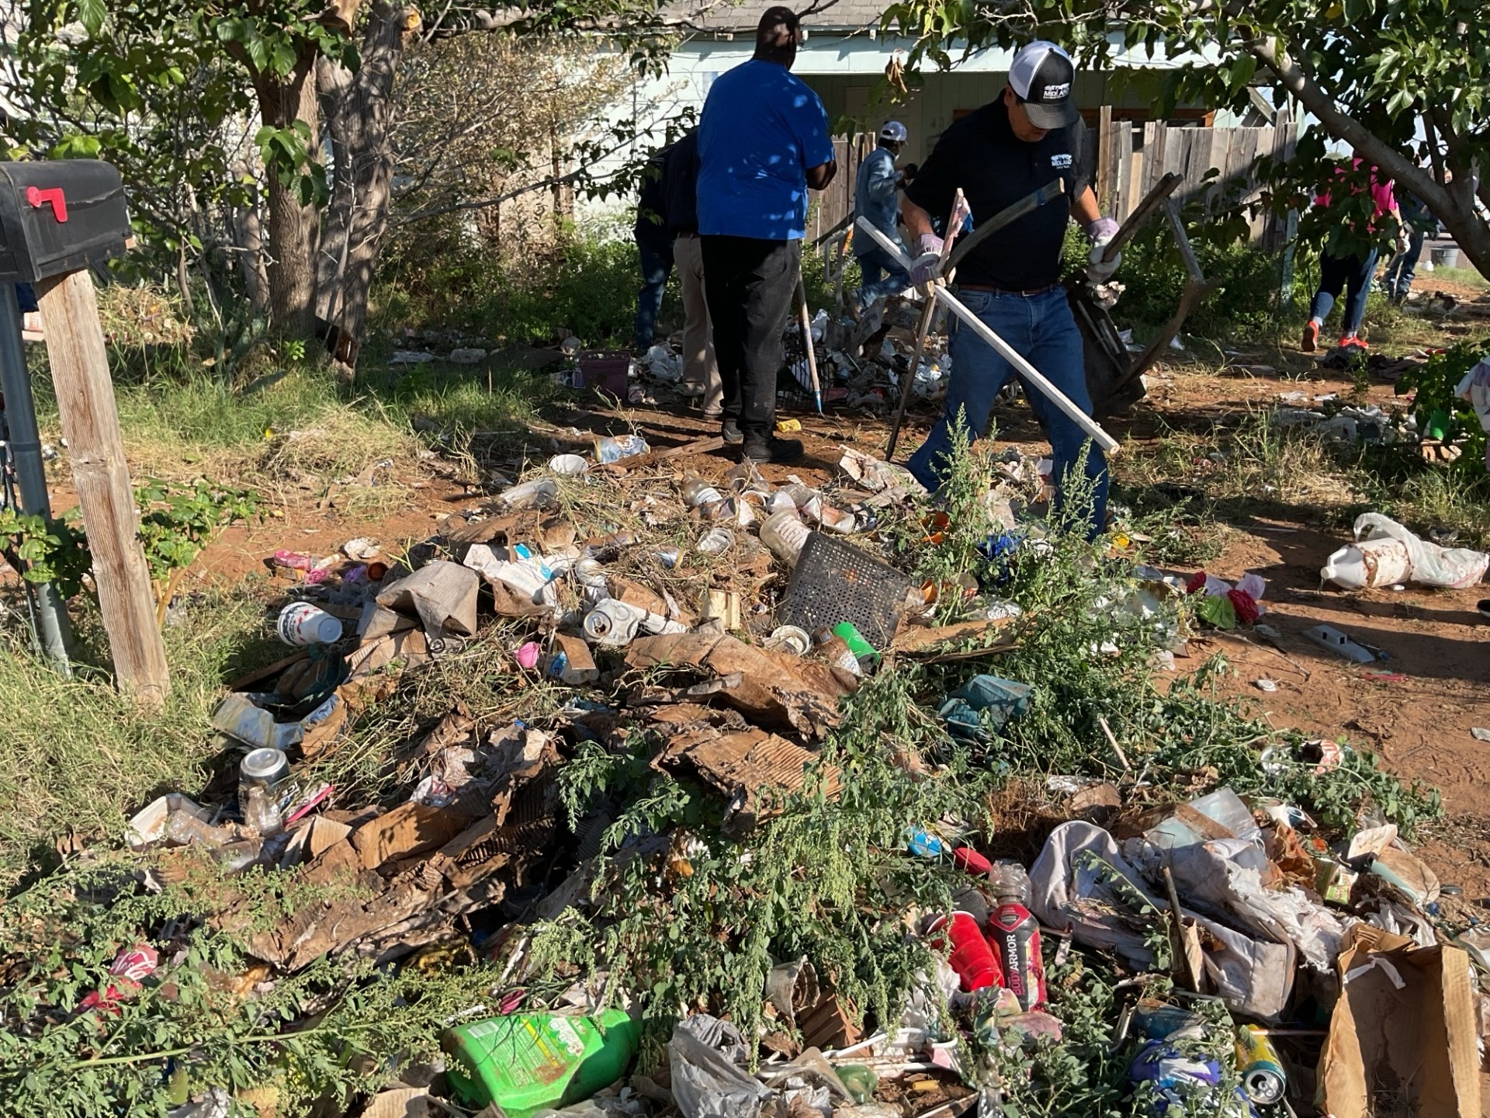
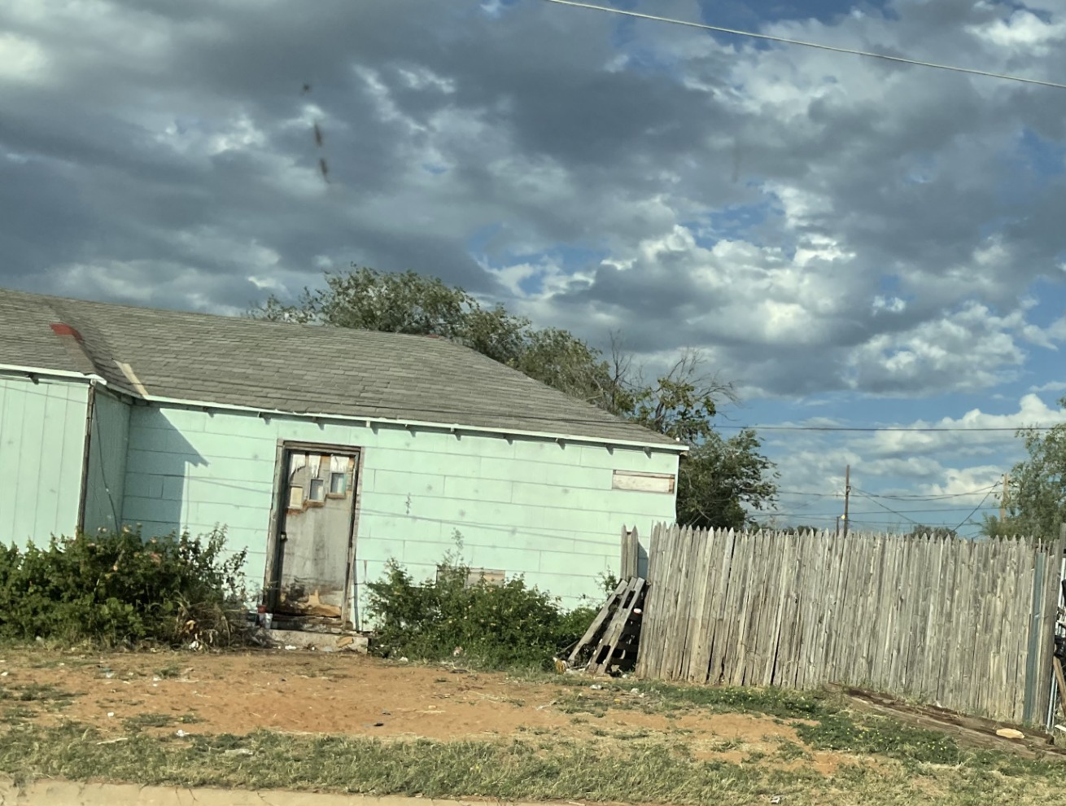
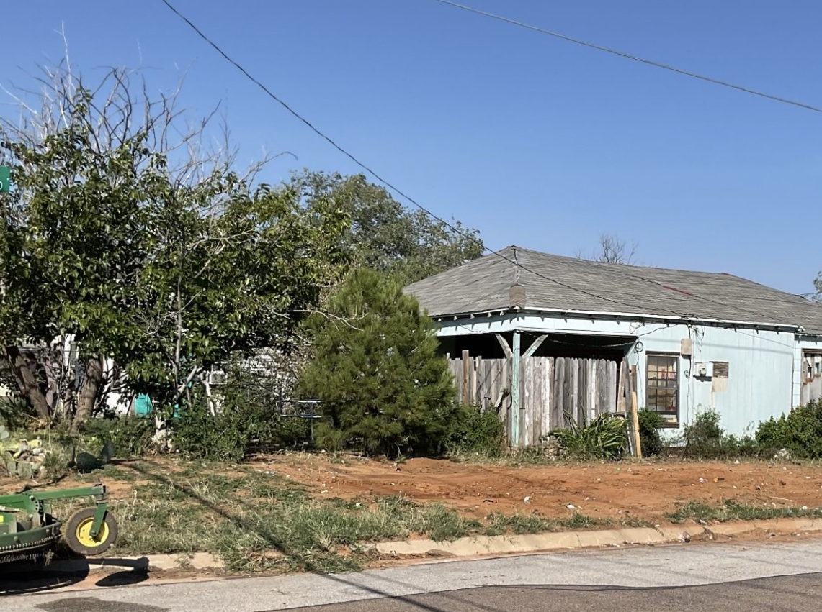
SUCCESS STORIES: ABATEMENTS
Before
After
10
Notes:
400 Hart has been one of our problem properties. We currently have three open debris cases against the property. What makes this property unique is that we were never able to get identifying information of the tenant of the property. Code has been out multiple times in order to get voluntary compliance from Ms. Flores but she has always denied City help or co-operating with the City in cleaning the debris. CT033351 – Accumulation of Debris – Closed – Paid Full Fine of $566.00
CT034483 – Accumulation of Debris – Closed – Paid Full Fine of $581.00
CT034062 – Accumulation of Debris – Summons Hearing
CT034771 – Accumulation of Debris – Summons Hearing
CT035389 – Accumulation of Debris – Summons Hearing
Example of how abatement is a more effective form of enforcement relative to court proceedings

Slide 11
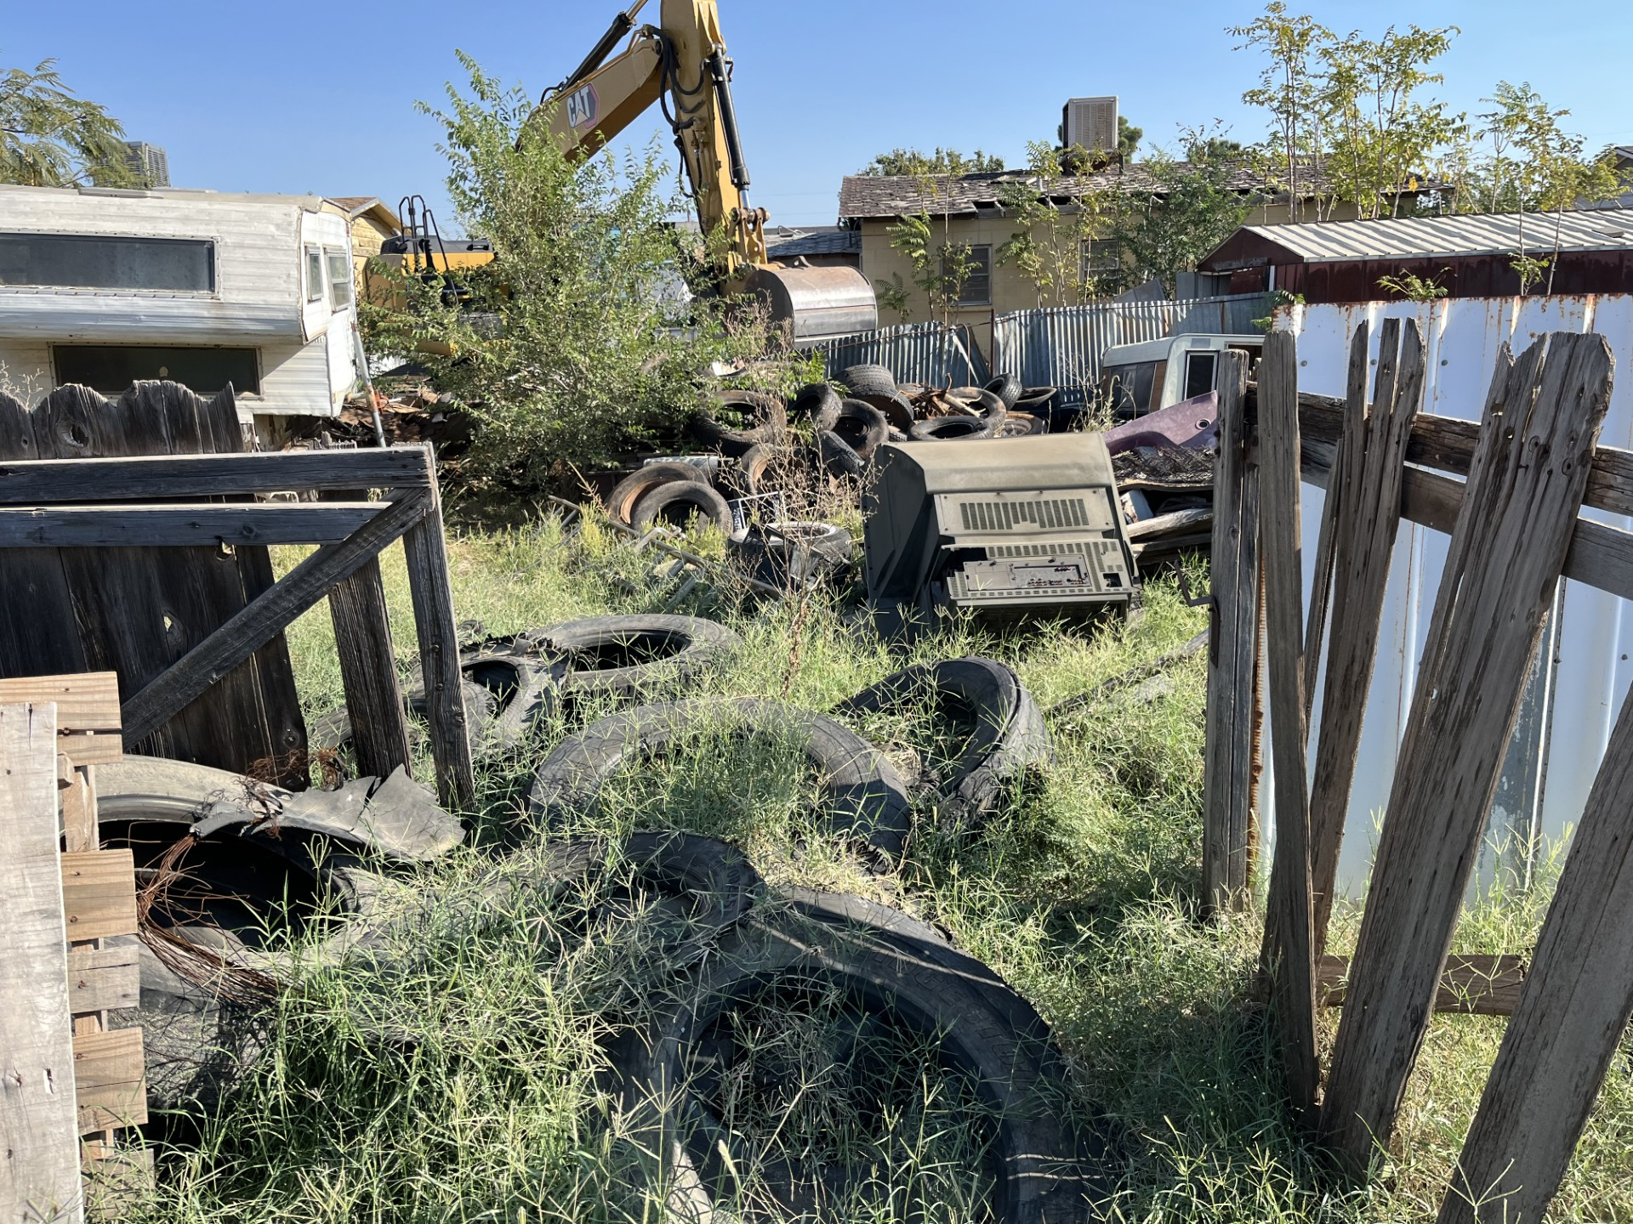
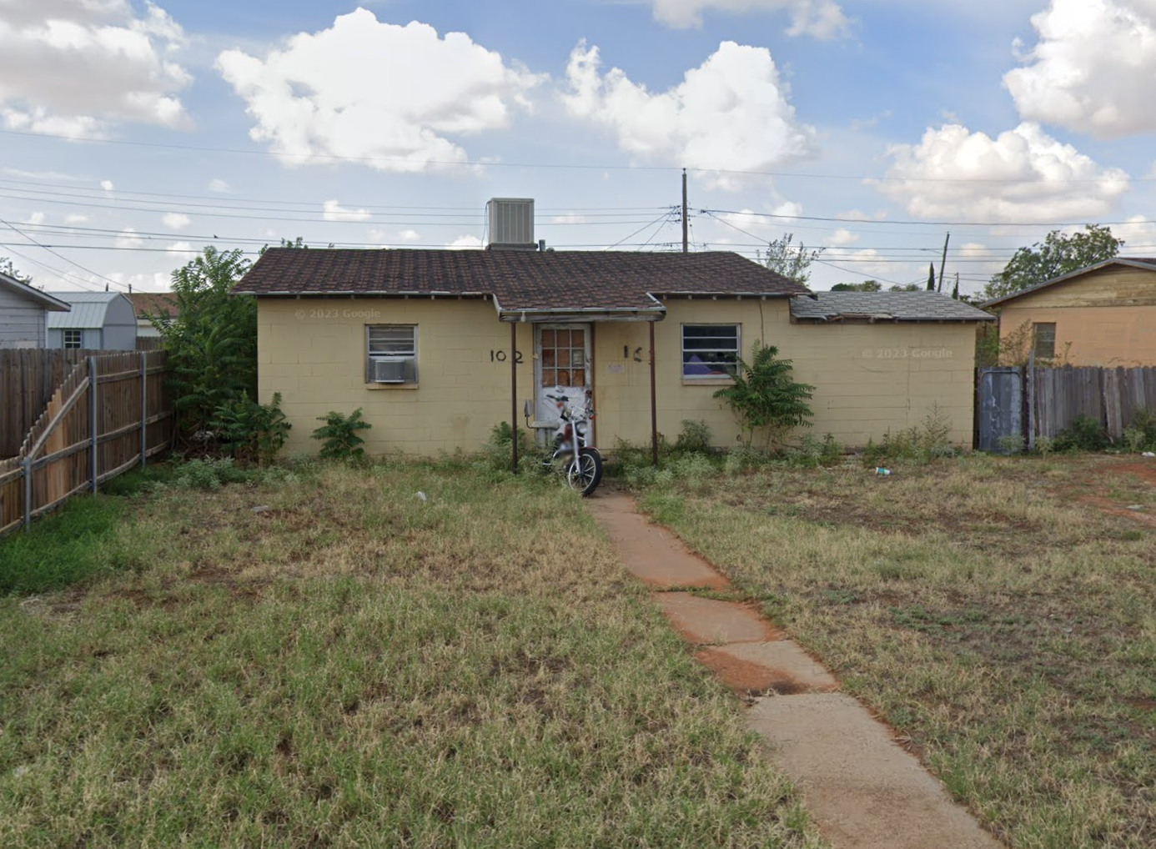
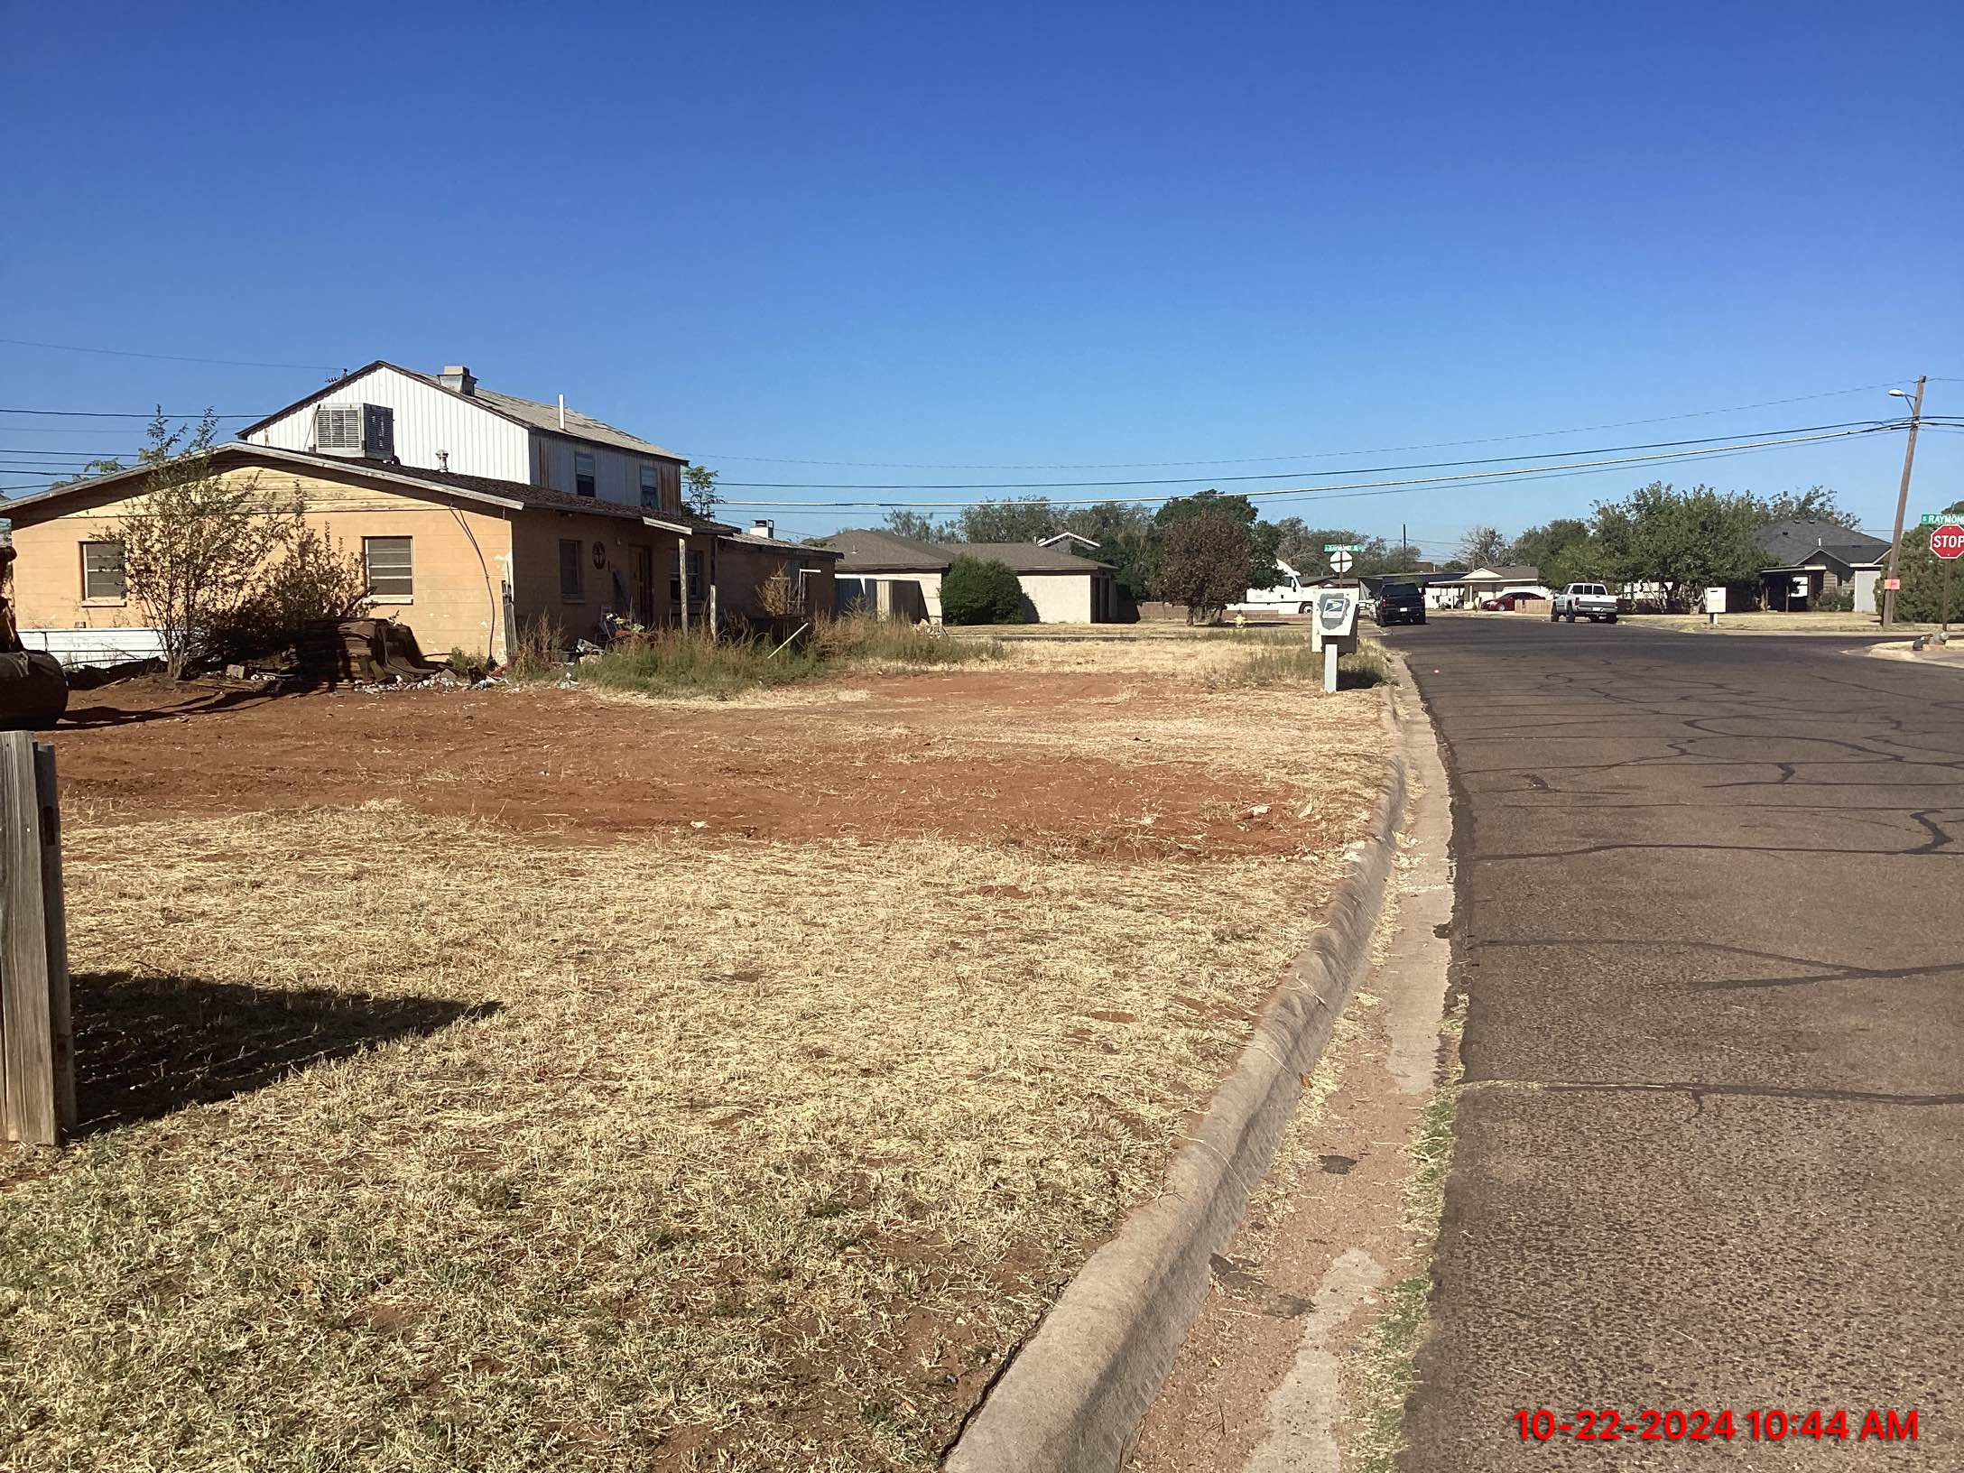
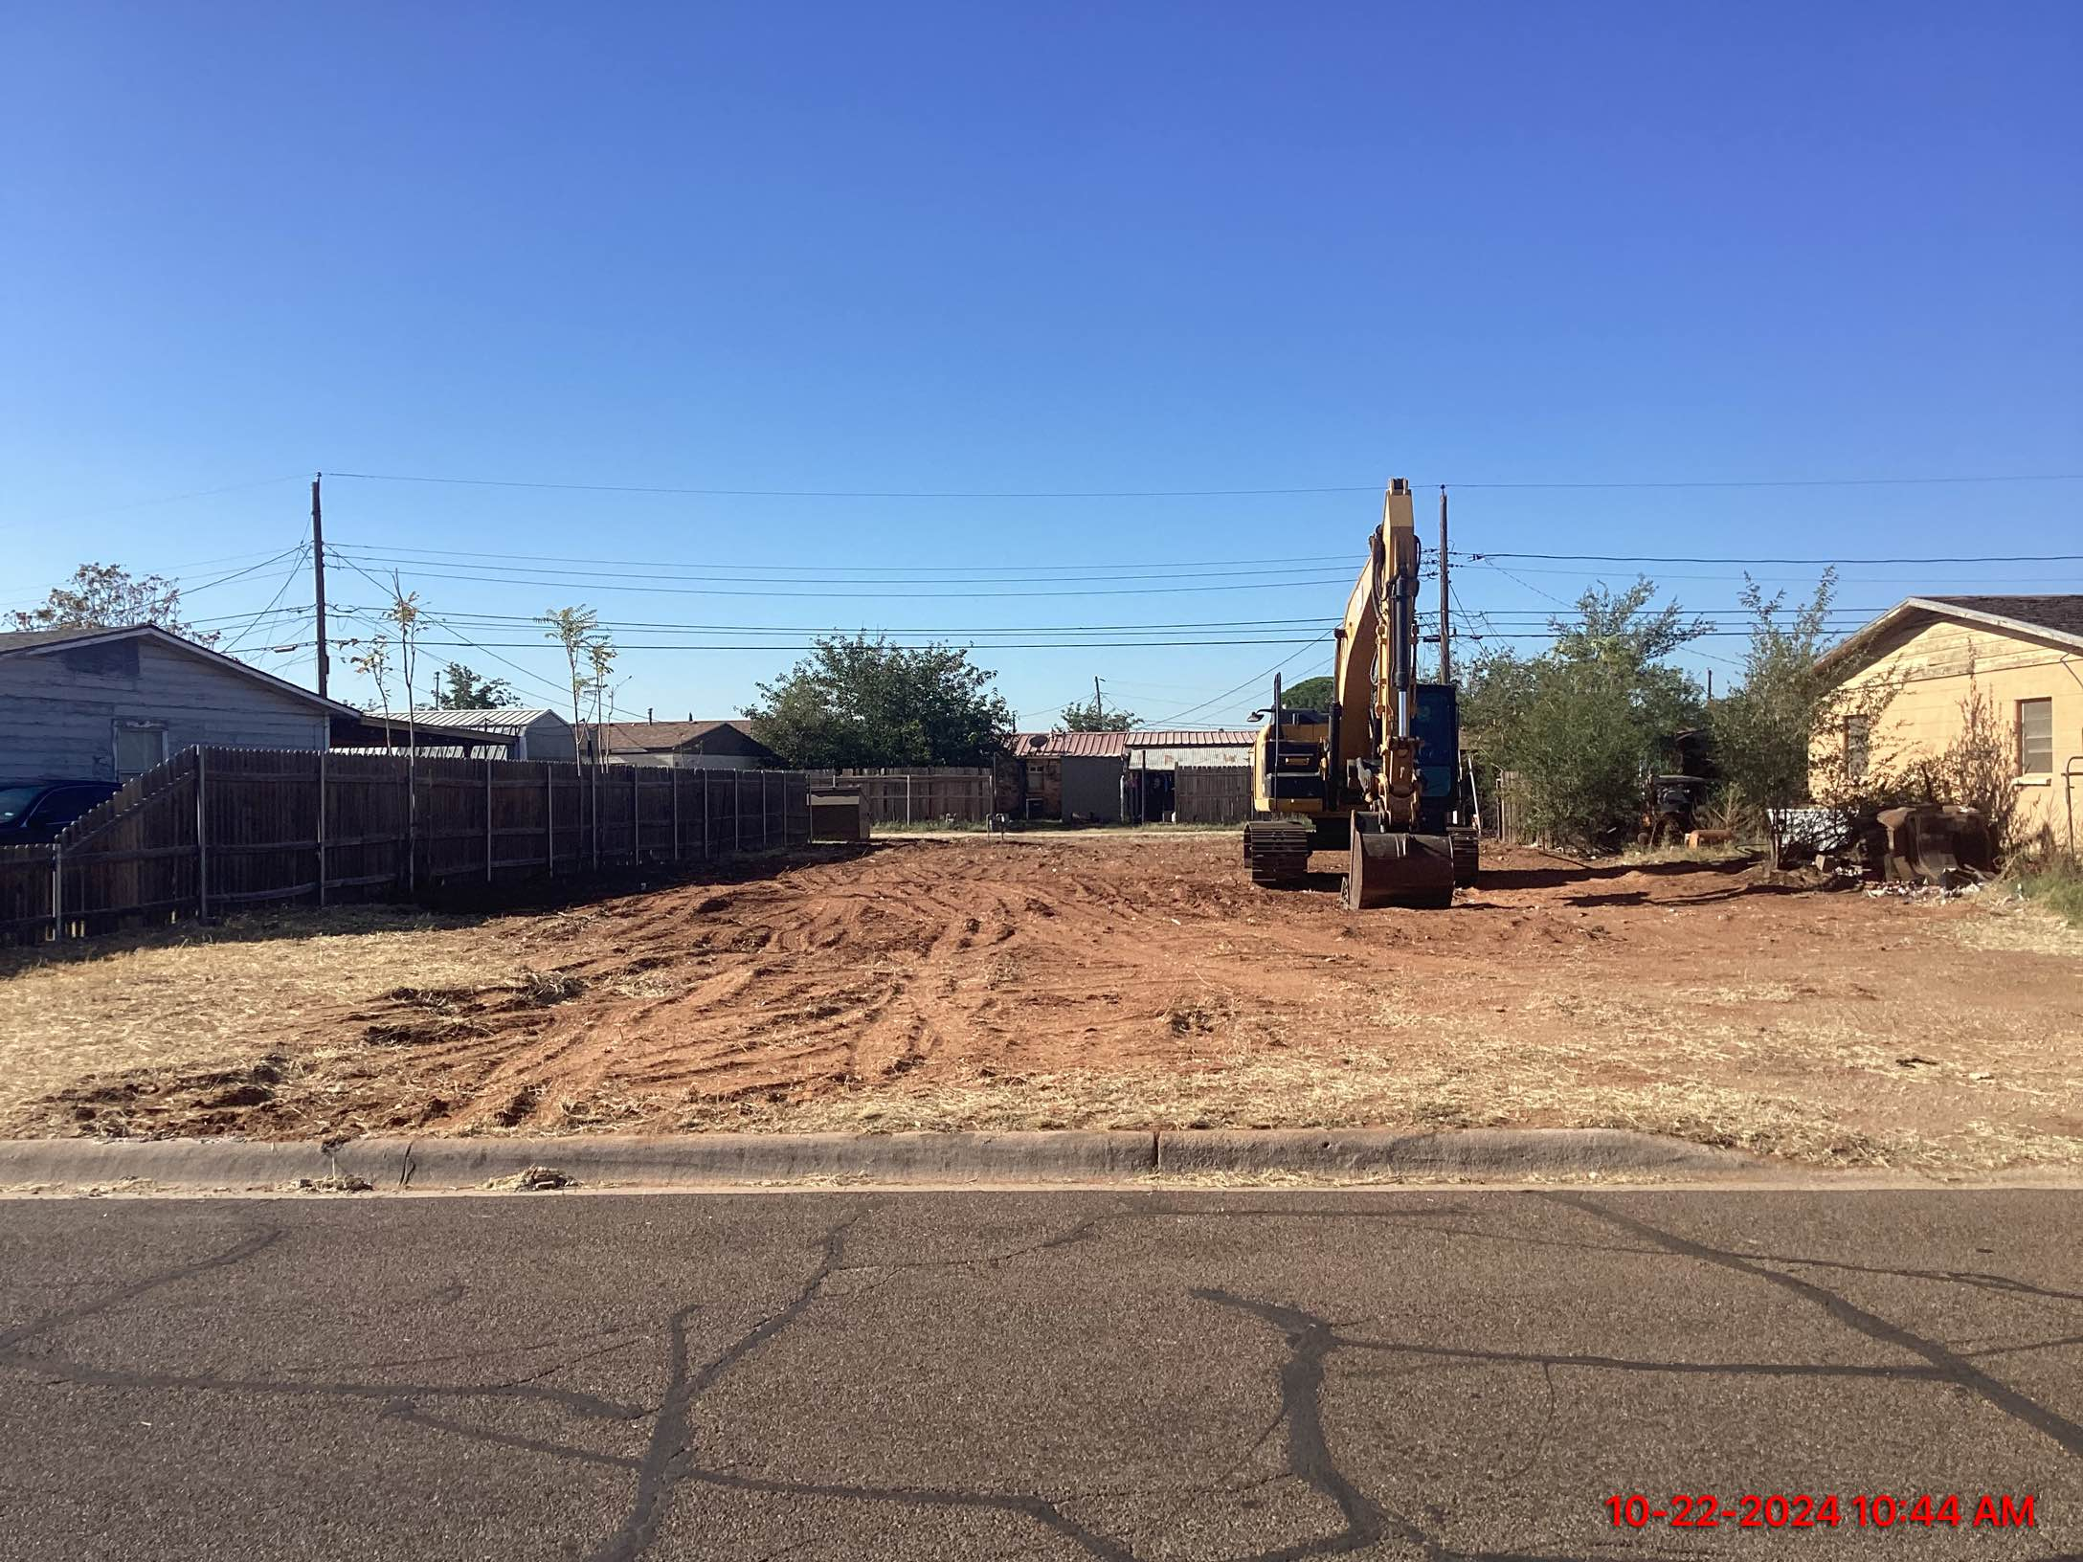
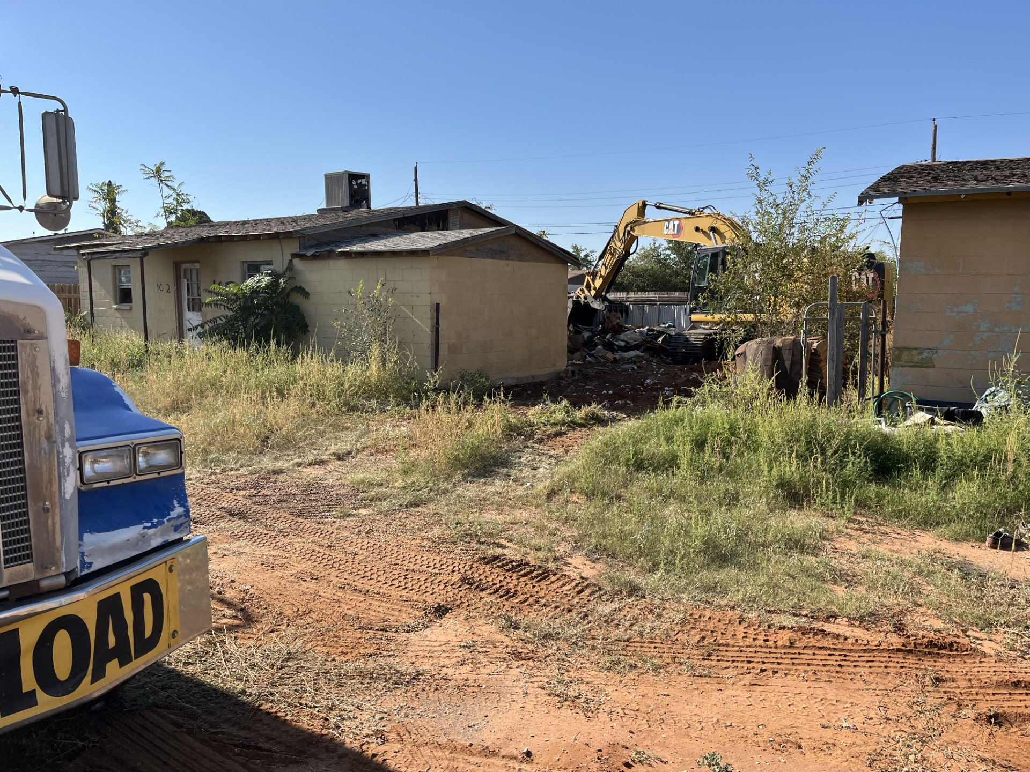
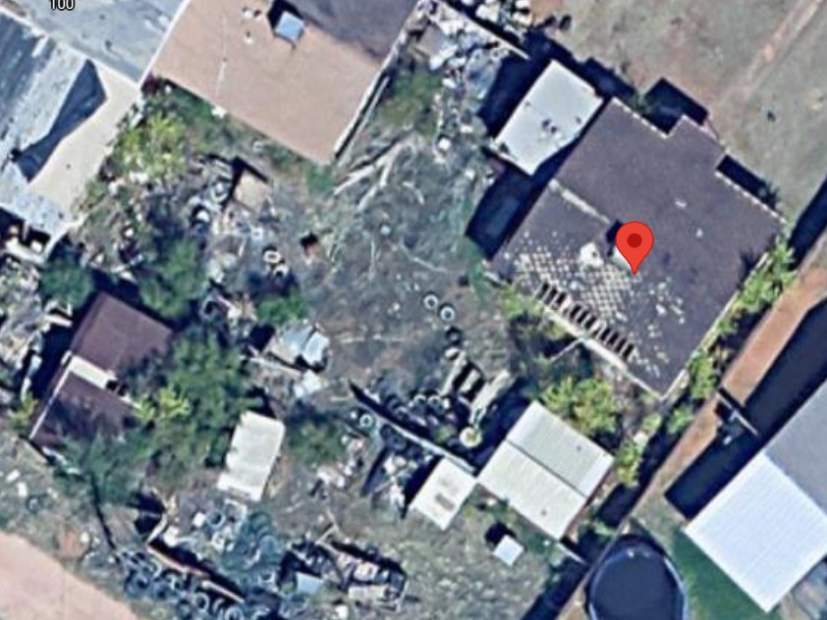
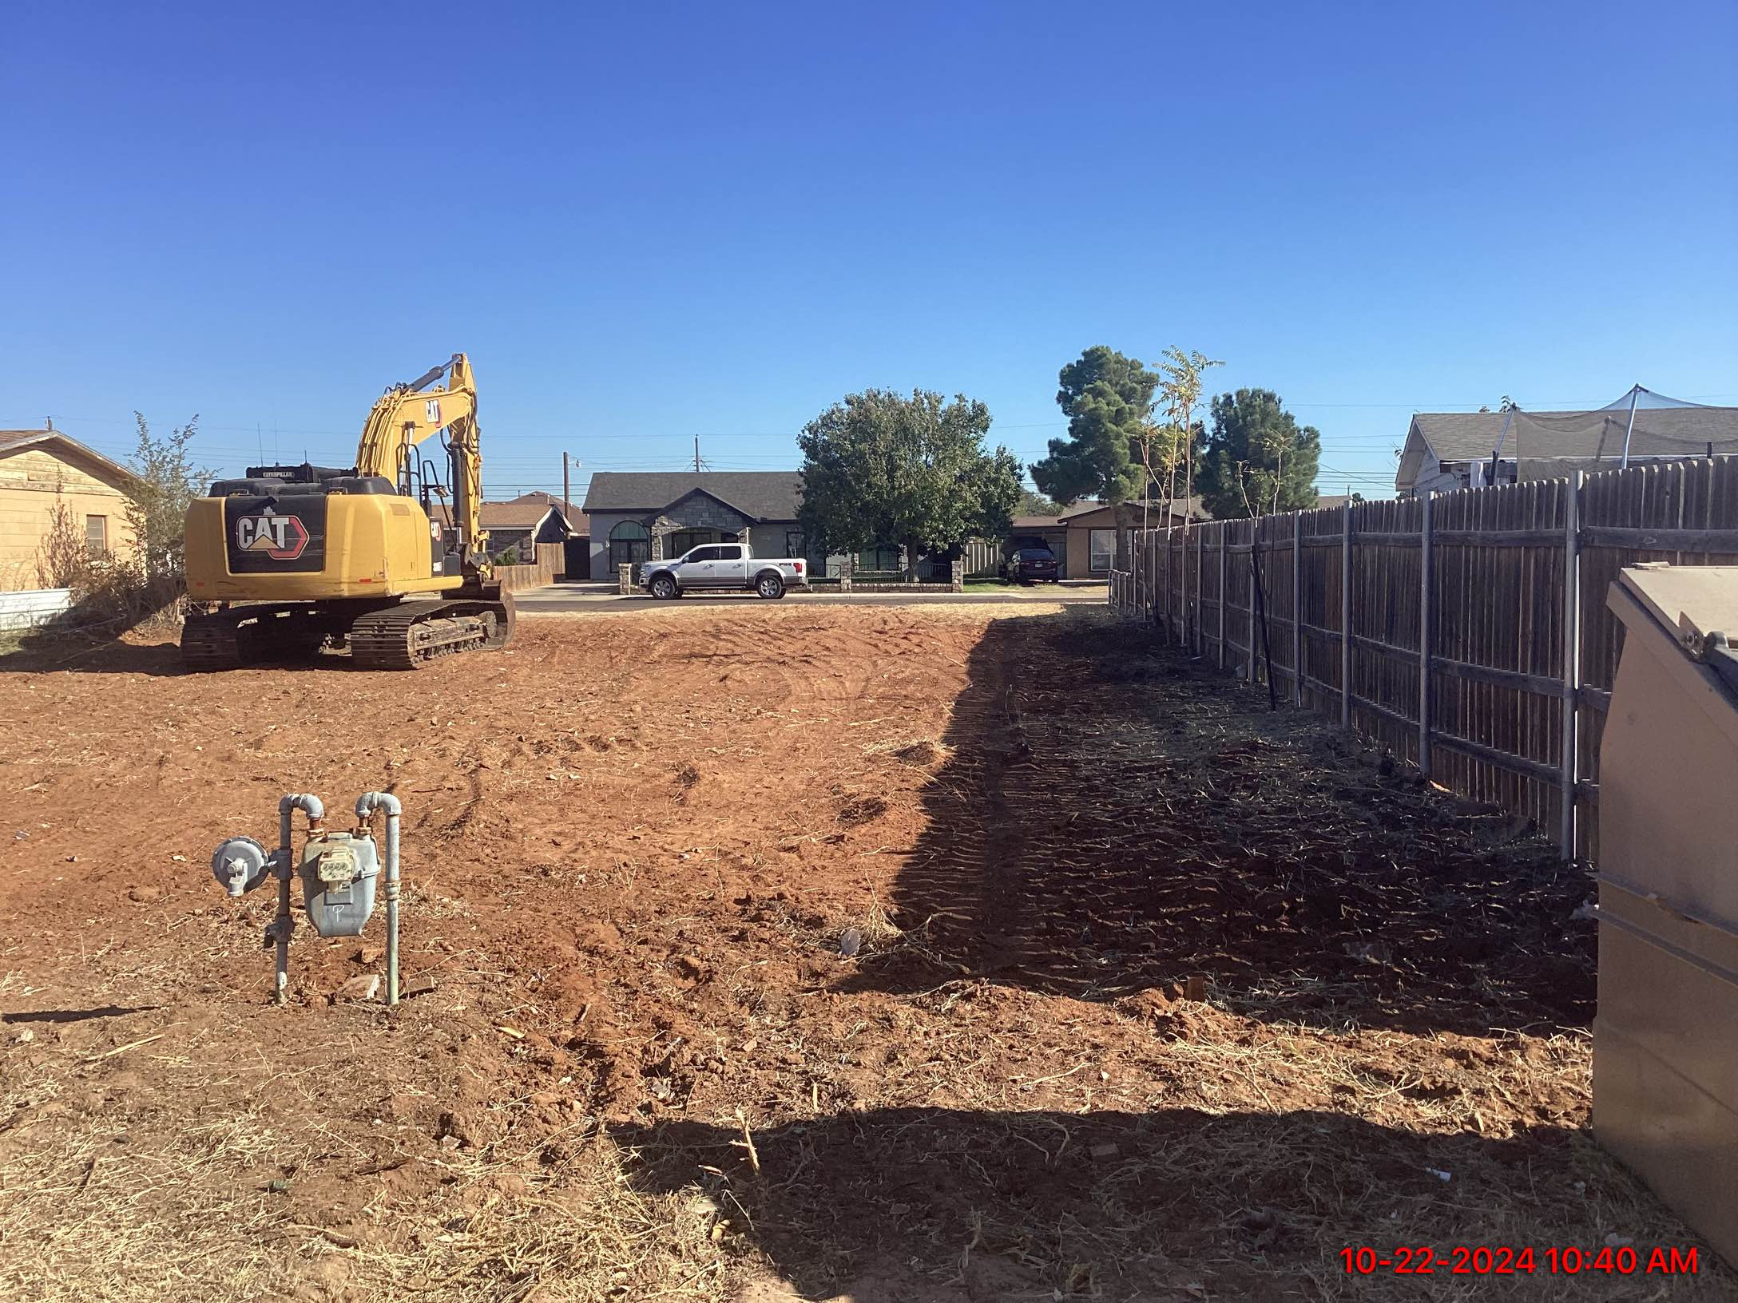
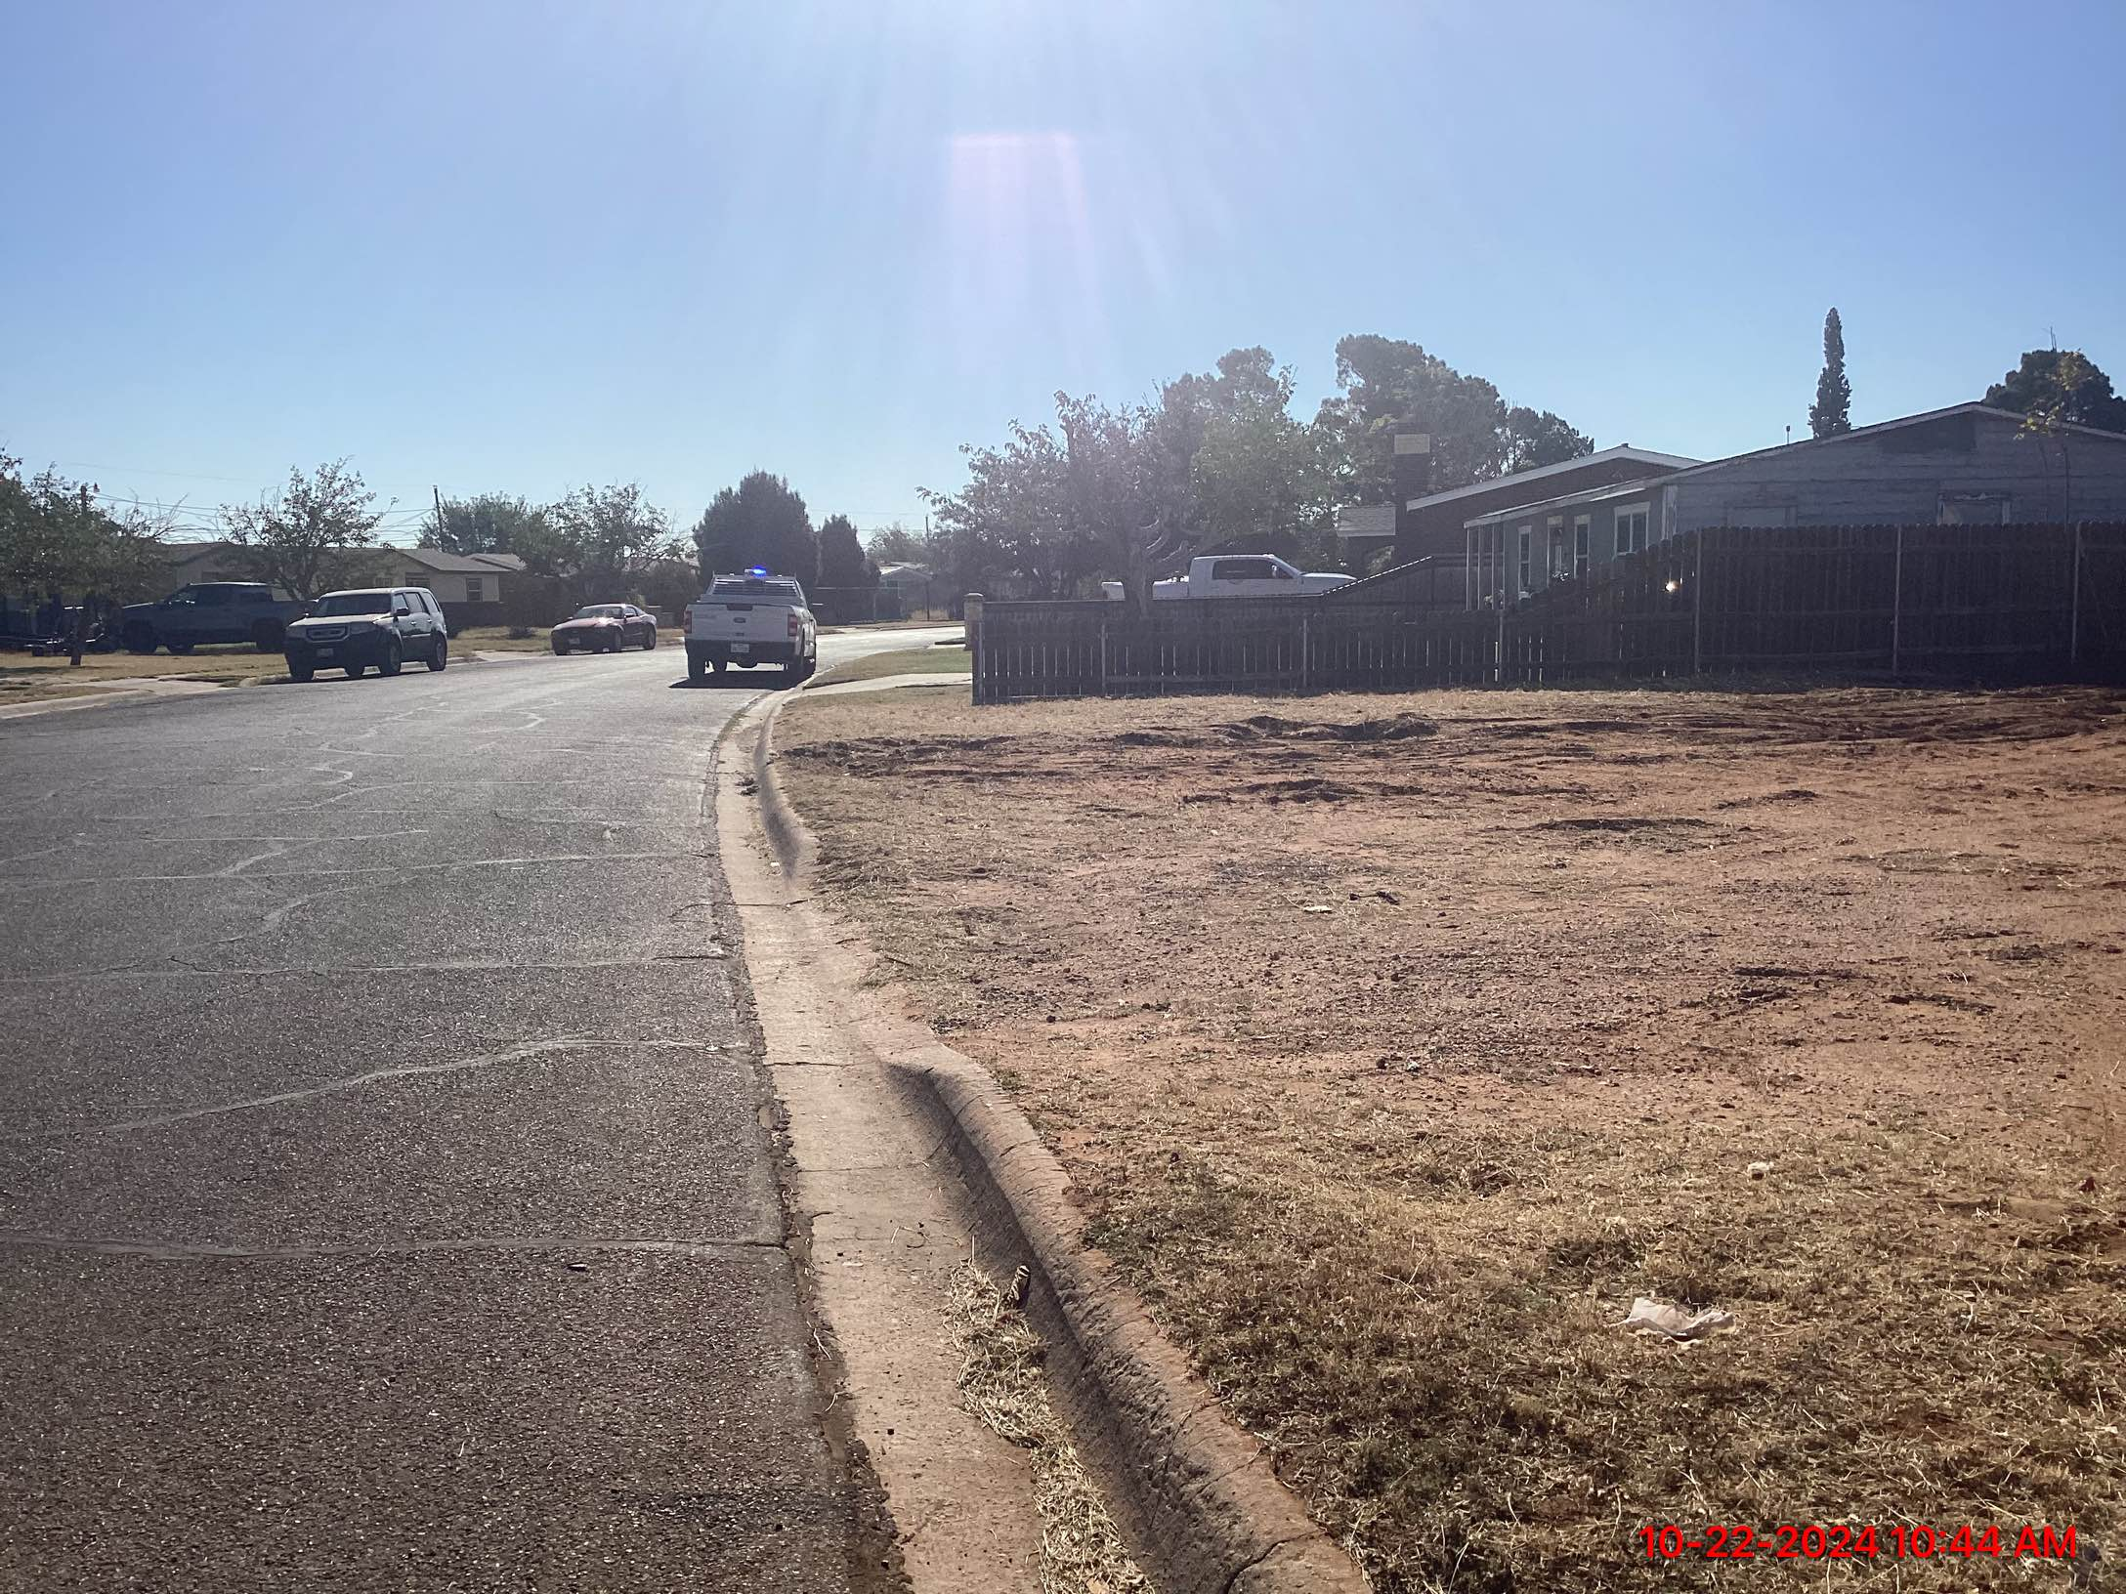
SUCCESS STORIES: DEMOLITIONS
Before
After
11
Notes:
Canyon - $38k

Slide 12
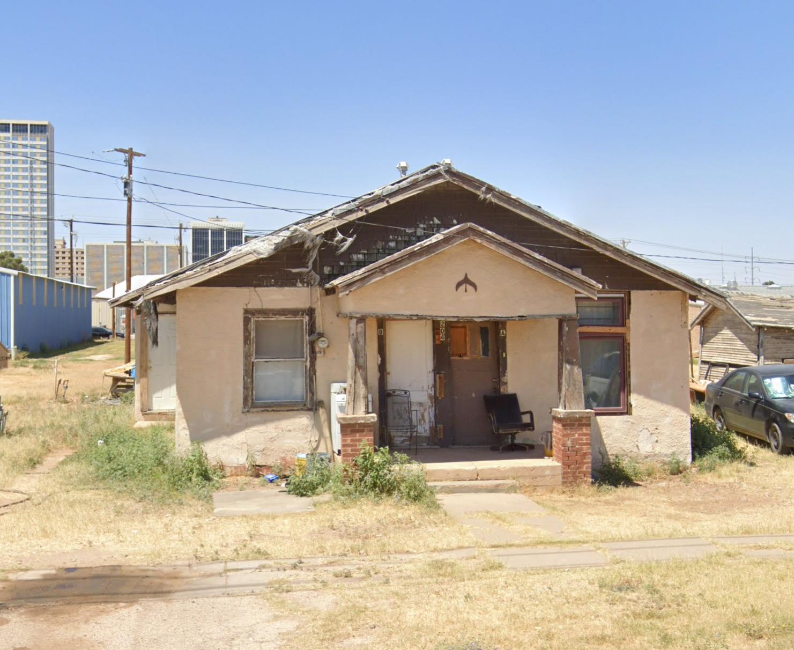
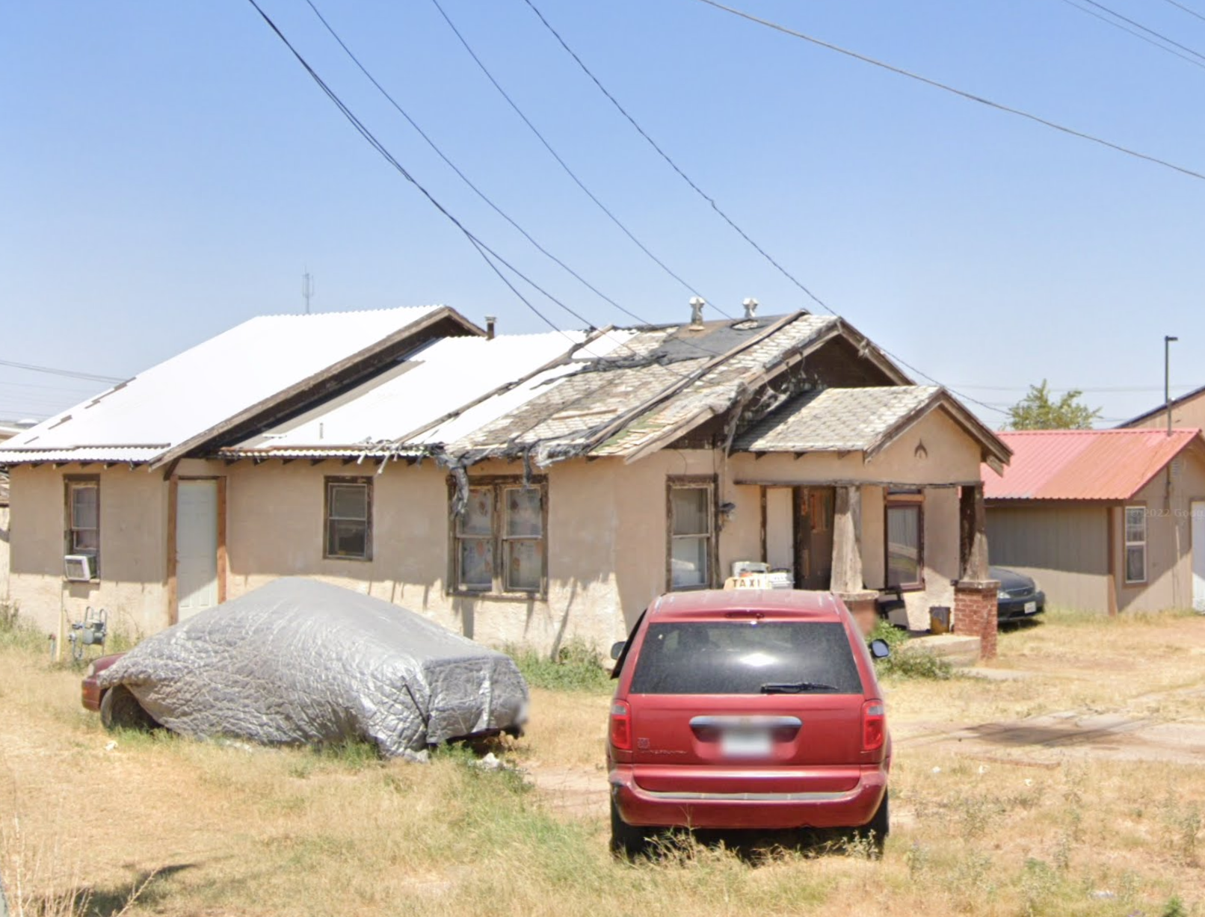
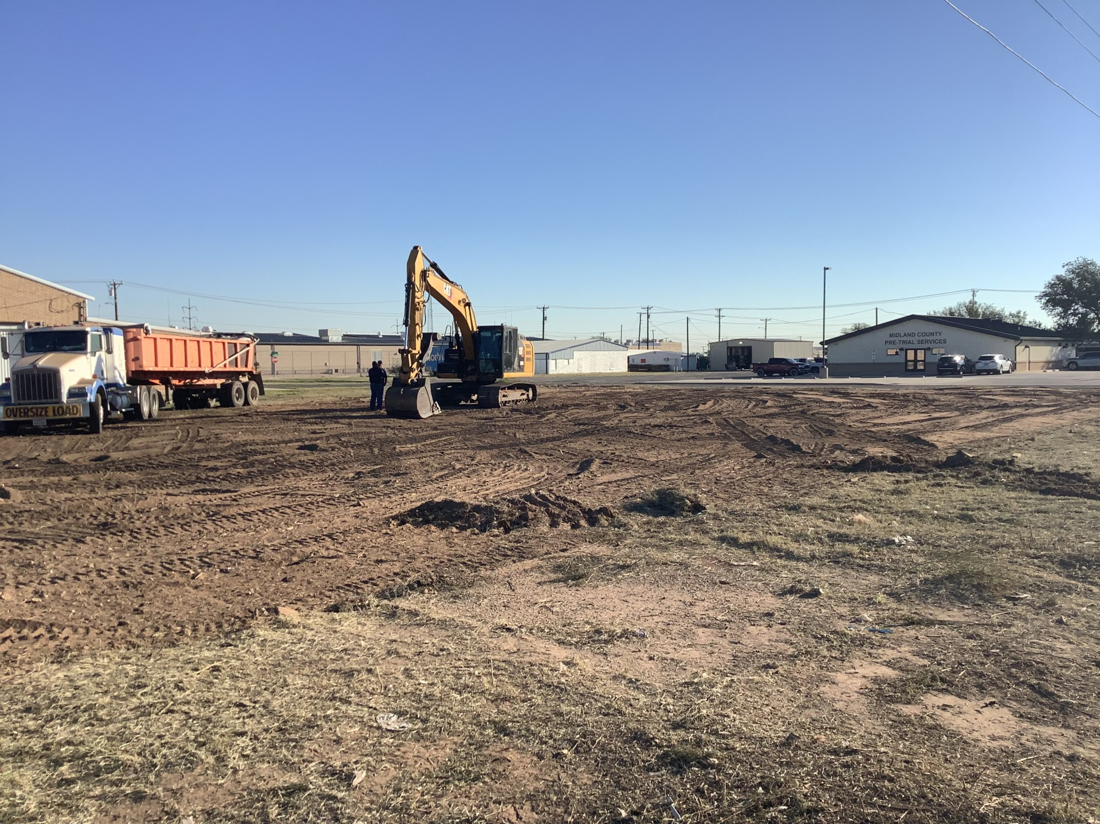
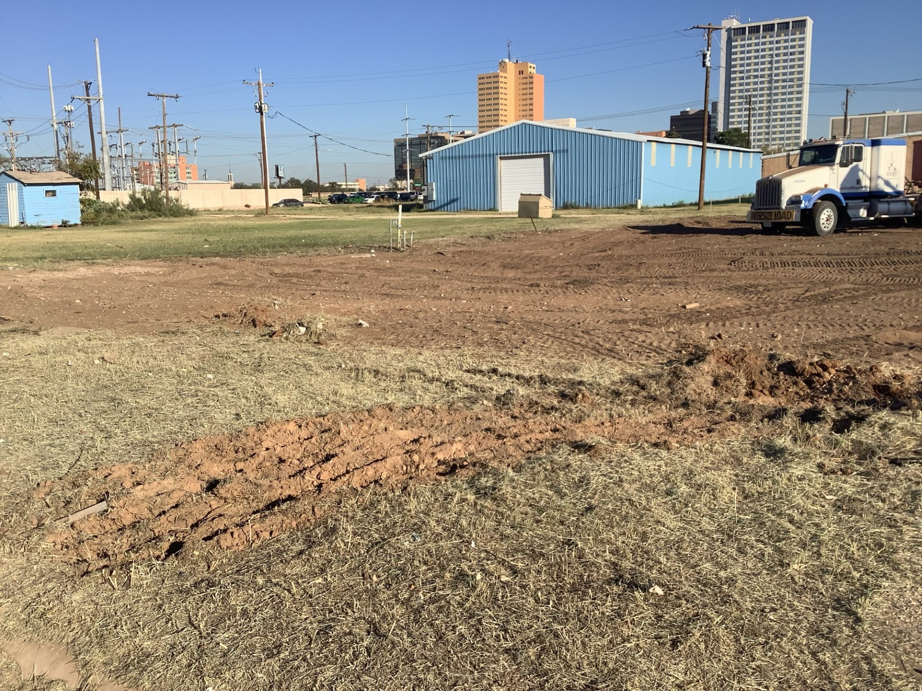
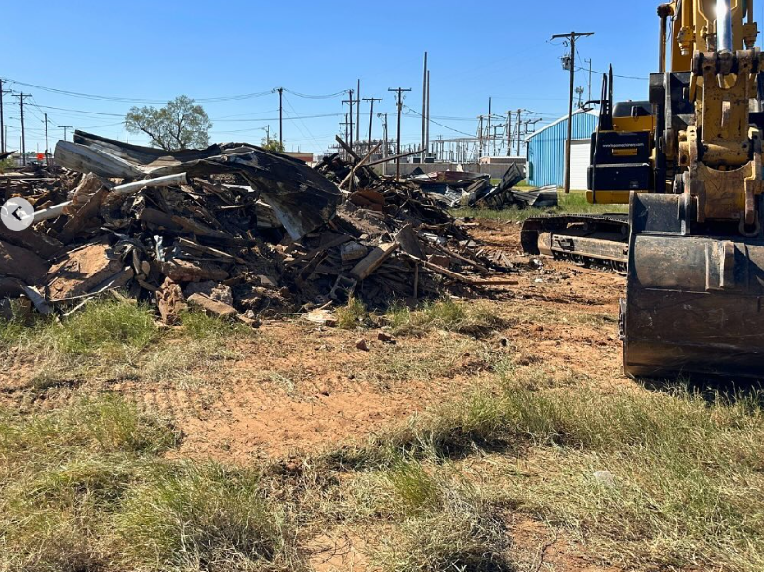
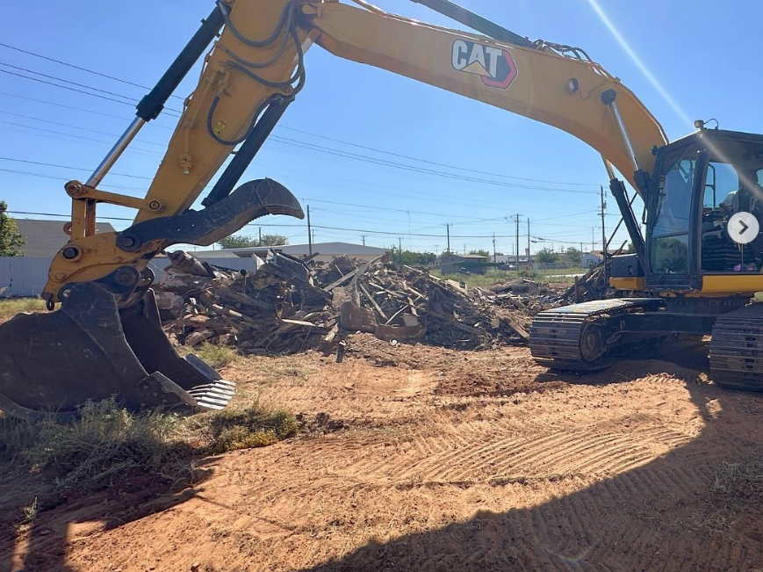
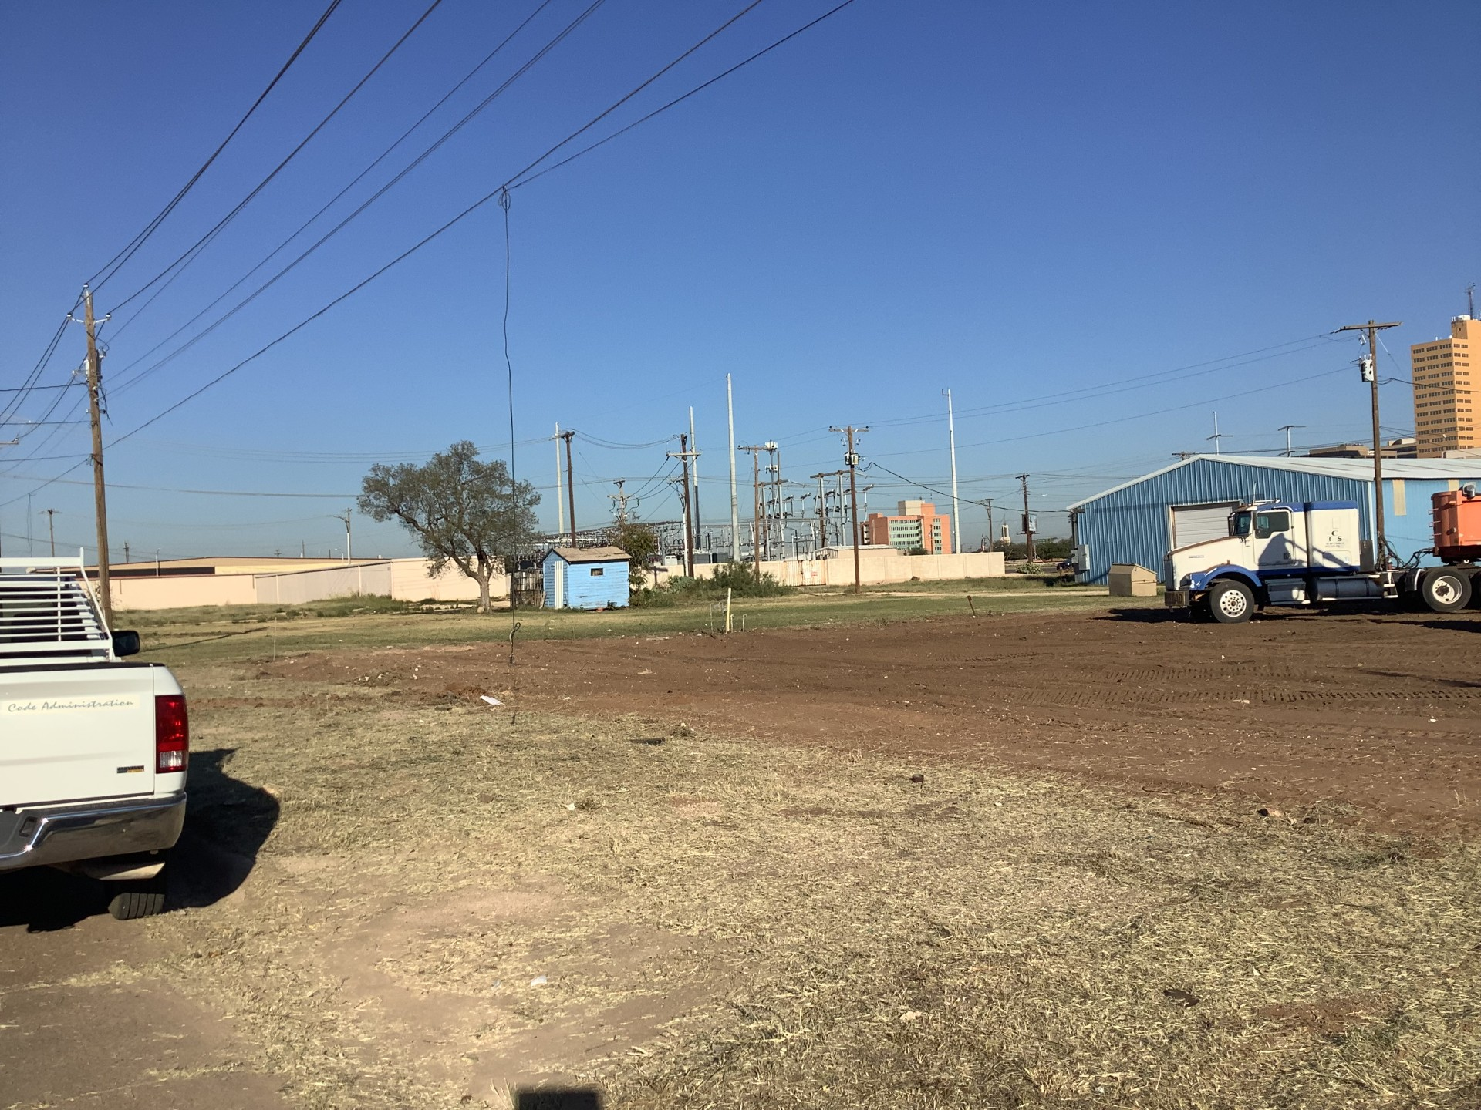
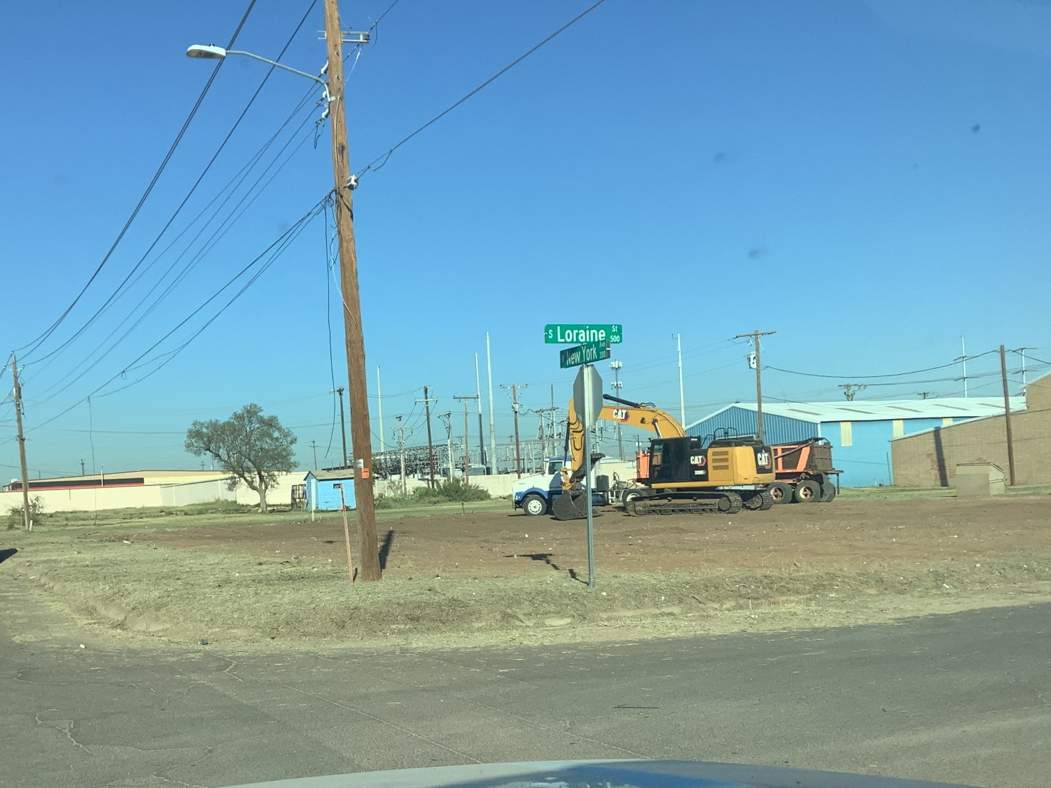
SUCCESS STORIES: DEMOLITIONS
Before
After
12
Notes:
Loraine - $36k

Slide 13
INCREASED CASE VOLUME
On average, monthly caseload has nearly quadrupled since April
Added 3 new officers
Emphasis on proactive patrolling
Focused on efficiency to keep officers in the field longer
Better
13

Slide 14
CASE TYPE SNAPSHOT (OCT 2024)
Over two-thirds of cases involve weeds, followed by debris & litter, parking, and junked vehicles
More difficult-to-abate violations, like land use and unpermitted building, make up 6% of cases
14

Slide 15
IMPROVED CLOSURE RATE
Better
Despite higher case volumes, closure rates improved to 90% (up from 87%)
City-led abatements raised debris closure rates; weed cases remain an area for improvement
15

Slide 16
IMPROVED CLOSURE EFFICIENCY
Better
Closure efficiency improved across case types
Since May, 86% of closed cases closed within 30 days
Opportunity for improvement: Weeds
Abatable
16

Slide 17
KEY PERFORMANCE INDICATORS
 | Indicator | Annual Goal | FY23 | FY24 YTD
Proactive + Responsive | Case Volume (# of cases initiated) | 12,960 | 7,518 | 1,227
 | See Click Fix Closure Rate (% of SCF cases closed) | 95% | 80.4%*** | **
Efficient | Closure Rate (% of initiated cases closed) | 95% | 88.5% | **
 | Average Time to Close (average days to close a case) | 18 | 19.9 | **
 | % Closed within 30 days (% of closed cases closed within 30 days) | 90% | 84.9% | **
VAD Program | Buildings Demolished | 5 | 2 | 0
 | Buildings Boarded & Secured | 5 | 1 | 2****
*Unavailable for FY23 as this is a new measure established August 2024; **Lagged variable measured one month after month close; ***Began tracking in August; ****Includes one City-led and one voluntary board and secure
17

Slide 18
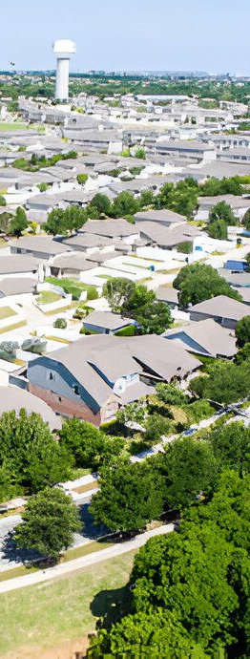
SUMMARY OF KEY RESULTS
Case volume has nearly quadrupled average monthly case volumes since May compared to the previous 7 months.
Despite significantly increased volumes, case closure rates and timelines continue to improve.
New abatement and demolition procedures applied to challenging cases address long-standing issues and offer lessons for future implementation.
18

Slide 19
STRATEGIES IMPLEMENTED
Increased Proactivity: Added staff, proactive patrolling in response to citizen complaints, and efficient practices have increased case volumes by keeping officers in the field longer.
Increased Efficiency: Streamlined procedures for weeds and tall grass (e.g., annual 10-day notice, City-led abatement) have boosted efficiency and been replicated for similar violations.
Increased Effectiveness: New abatement processes for challenging cases have improved outcomes and will inform future efforts; established lien process to improve cost recovery.
19
Notes:
Benefit of proactively patrolling – helps deter violations before they are too difficult to abate
Strategic proactive patrolling to first prioritize citizen complaint and then patrolling surrounding area for other nuisance and health, safety and welfare concerns

Slide 20
FUTURE STRATEGIES
Increased Proactivity + Responsiveness
Community Outreach and Education: Expand preventive measures and tailor outreach to improve voluntary compliance based on case type and neighborhood.
Strategic Case Prioritization: Align enforcement efforts with city goals, focusing on responsiveness to citizen-initiated cases and high-impact areas (e.g., vacant, abandoned, deteriorating buildings and properties along key corridors).
20

Slide 21
FUTURE STRATEGIES
Increased Efficiency
Resource and Staff Realignment: Shift maintenance team to address routine cases, freeing code officers for complex cases
Efficiency Enhancements: Use third-party contractors and competitive bidding for common cases to speed up response time.
Code Updates: Consider adopting the property maintenance code for clear standards, boosting efficiency in addressing deteriorated buildings and properties along key commercial corridors.
21

Slide 22
FUTURE STRATEGIES
Increased Effectiveness
Deterrence for Repeat Violations: Explore higher abatement costs and other enforcement options for repeat offenses to promote better compliance.
Cost Recovery and Effectiveness: Focus on increasing cost recovery rates, reducing repeat offenses, and boosting voluntary compliance – start by implementing a way to measure effectiveness.
22

Slide 23

MISSION
Deliver exceptional services and promote a high quality of life and place for ALL our citizens.

