Slide 1
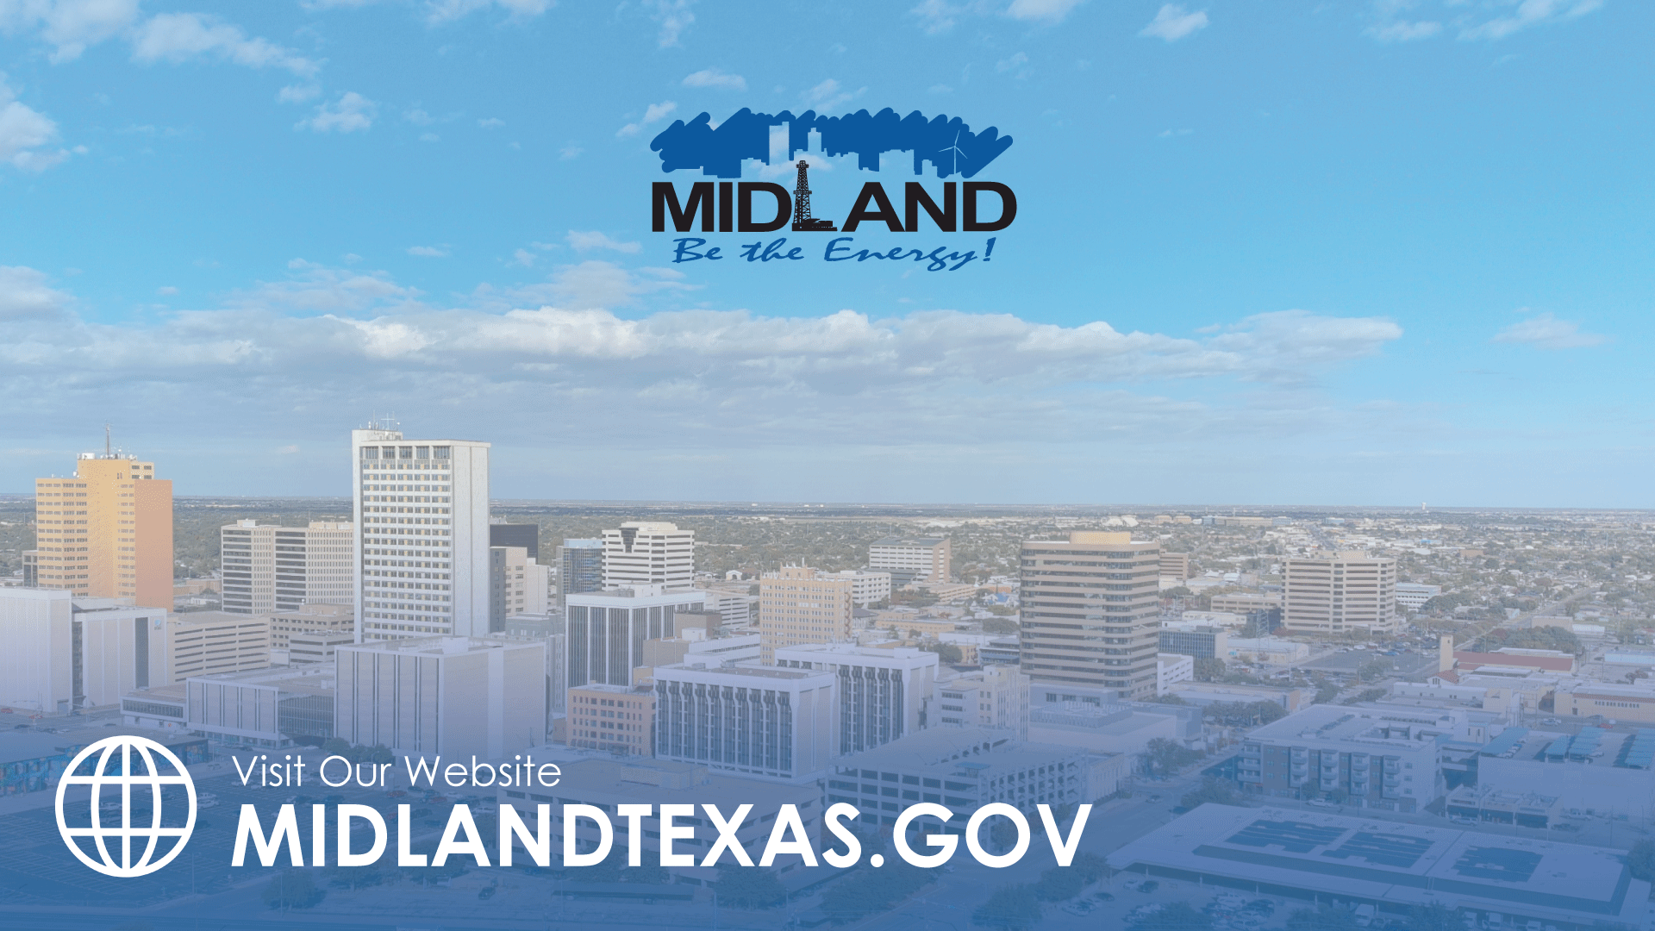
November 12, 2024
ITEM 30
CREATING TAX INCREMENT REINVESTMENT ZONE NO. 3 ALONG THE 191 CORRIDOR
TITLE HERE
TITLE HERE

Slide 2

PURPOSE
Consider an ordinance creating Tax Increment Reinvestment Zone #3 to enable strategic infrastructure investments that support growth along the Highway 191 corridor and:
Establishing its boundary, term, and board of directors; and
Attaching a Preliminary Project & Financing Plan
2

Slide 3
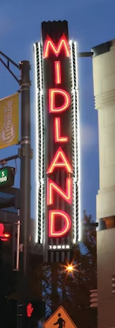

STRATEGIC PLAN LINKS
Goal 1. Strong Economy with More Quality Jobs
1.1 Increase the Midland sales tax base
1.2 Enhance visitor revenue opportunities
1.3 Continue Downtown + West Midland Development
1.4 Nurture development districts
1.6 Diversify Midland’s economy
1.9 Establish our community as a premier destination for retail and entertainment
3
Notes:
1.1 Increase the Midland sales tax base: Develop strategies to expand the tax base by attracting businesses and supporting local commerce
1.2 Enhance visitor revenue opportunities: Boost tourism through infrastructure improvements
1.3 Continue Downtown and West Midland Development: Promote revitalization efforts
1.4 Nurture development districts: Establish action plans to enhance development districts
1.6 Diversify Midland’s Economy: Support initiatives that diversify the local economy and enhance resilience
1.9 Establish our community as a premier destination for retail and entertainment: Offer unique experiences that draw visitors, driving economic growth and community vibrancy

Slide 4
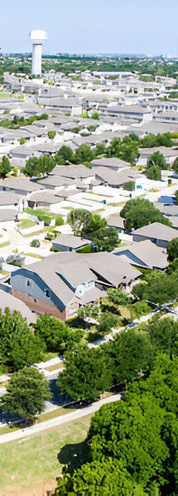
STRATEGIC PLAN LINKS
Goal 3. Quality of Life and Place
3.3 Create an attractive + inclusive living environment: Develop live, work, and play opportunities
Goal 6. Strengthen and Sustain our Infrastructure
6.2 Enhance infrastructure for economic growth
6.5 Implement a funding stream for infrastructure
6.6 Strategize for and monitor City growth: Develop proactive responses to growth rather than reactive
4
Notes:
Goal 3. Quality of Life and Place
3.3 Create an attractive and inclusive living environment: Develop and enhance live, work, and play opportunities
Goal 6. Strengthen and Sustain our Infrastructure
6.2 Enhance infrastructure for economic growth: Improve competitiveness through infrastructure investments that includes collaboration with neighboring jurisdictions
6.5 Implement a funding stream for infrastructure: Establish reliable funding for continual improvements
6.6 Strategize for and monitor City growth: Develop proactive responses to growth rather than reactive

Slide 5
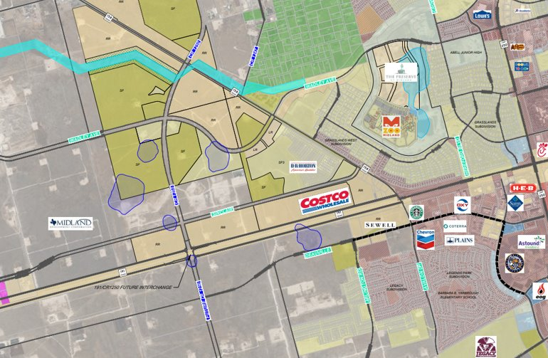

WEST MIDLAND
A KEY DEVELOPMENT DISTRICT
Sports Complex Corridor + Youth Sports
Midland Zoo + The Preserve
SH 191 Corridor Connections
Deauville Employment Center
Existing + New Retail Development including Costco
New Legacy High School
New Street Infrastructure
New Residential Development
5

Slide 6
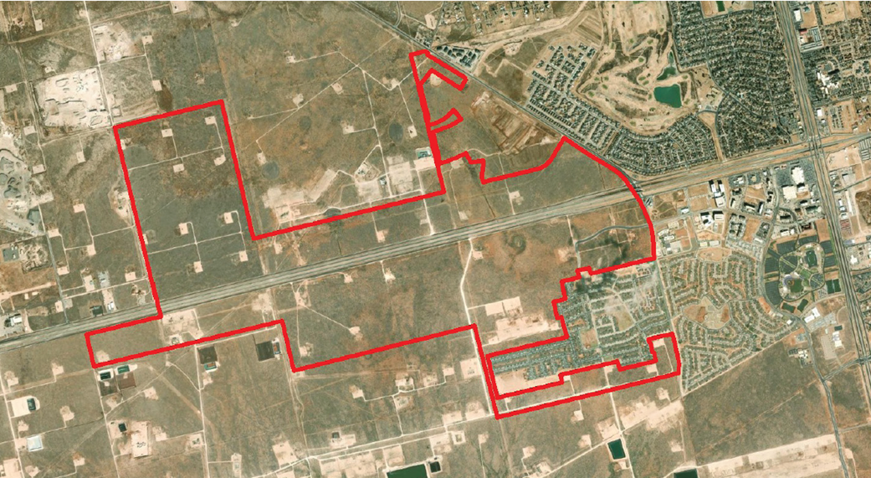
Purpose of tirz #3
Enable strategic infrastructure investments that support economic growth along the Highway 191 corridor
Leverage tax increment financing to proactively manage and support growth in this key development district
Enhance access to essential amenities and services
Provide long-term economic benefits that strengthen Midland’s economy
Improve overall quality of life for residents
Includes approximately 1,799 acres along SH 191 corridor, including 600 acres of MDC-owned property
6
Notes:
Canyon - $38k

Slide 7
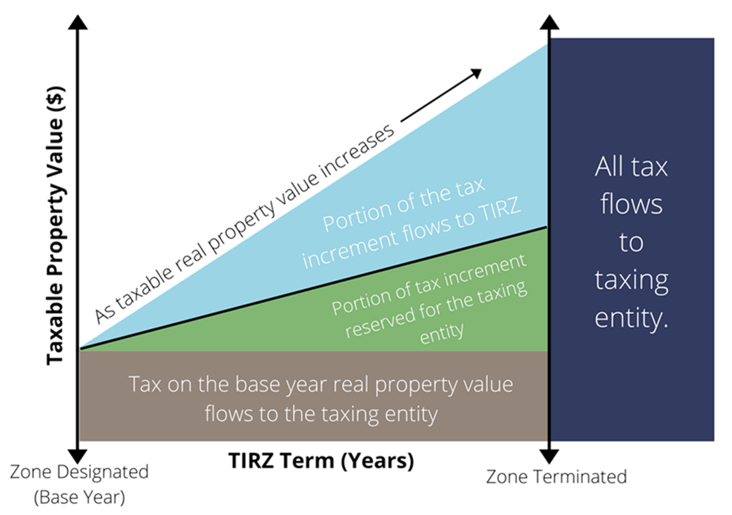
CREATION PROCESS
Chapter 311 outlines procedures for creating or amending a TIRZ. Two main documents:
Creation ordinance; and
TIRZ Project + Financing Plan
Creation ordinance establishes four key elements:
Boundary;
Term;
TIRZ Board; and
Preliminary Project + Financing Plan
The Final Project + Financing Plan is approved by the TIRZ Board and then the City Council by separate ordinance, including participation rate.
TIRZ directs a portion of tax generated from new development within TIRZ
7
Notes:
Canyon - $38k

Slide 8
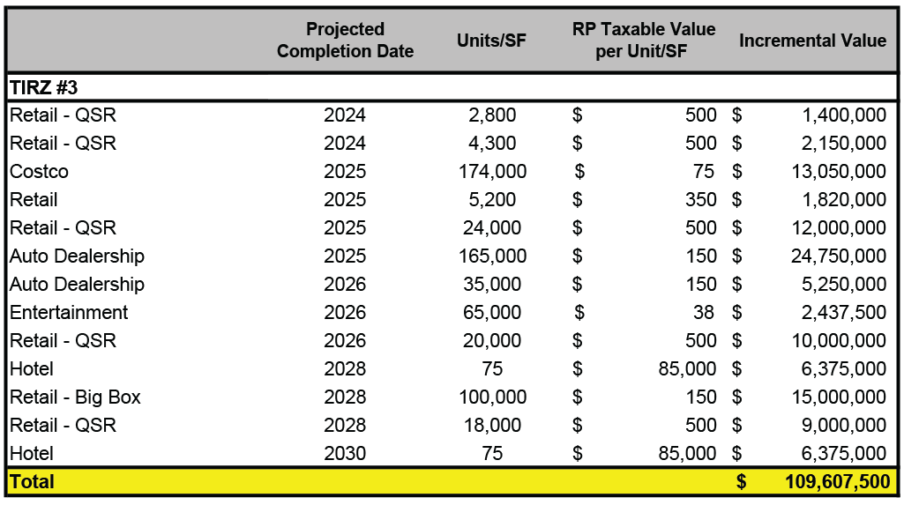
DEVELOPMENT PROJECTIONS
Overview of potential development scope and timing within the TIRZ
Based on market and development trends, and guidance from the City
Reflects anticipated growth over the life of the TIRZ (30 years)
8
Notes:
Canyon - $38k

Slide 9
Projected tax revenue
Proposing 50% of the City’s real property increment within the Zone, above a 2024 base
30-year term - December 31, 2054 (with final year’s tax to be collected by September 1, 2055)
Total Taxes Generated includes Real Property, Sales, and 7% City Hotel Occupancy Tax
9

Slide 10
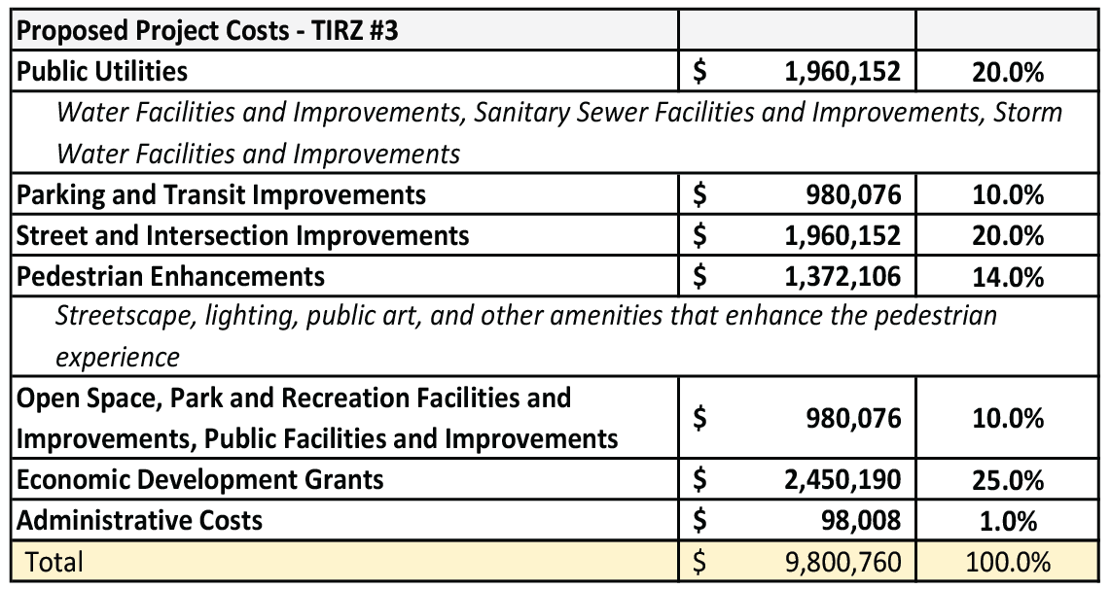
Eligible projects
Categories include all projects eligible under Chapter 311
Costs are estimates and may be revised
Savings from one line item may be applied to a cost increase in another
Individual TIRZ project cost allocations will be evaluated on a case-by-case basis and brought to the TIRZ Board + City Council for consideration
10
Notes:
Canyon - $38k

Slide 11
PROPOSED NEXT STEPS
Adopt creation ordinance, including:
Boundary
Term (30-year term through Dec. 31, 2054)
TIRZ Board (composed of City Council; offers opportunity to add members if other taxing units choose to participate)
Preliminary Project + Financing Plan
11

Slide 12
PROPOSED NEXT STEPS
Nov. 12th
Dec. 17th
1st Quarter 2025
1st Reading + Public Hearing for Creation Ordinance
2nd Reading for Creation Ordinance
Adopt Final Project + Financing Plan and participation rate
12

Slide 13

MISSION
Deliver exceptional services and promote a high quality of life and place for ALL our citizens.

