Slide 1

November 12, 2024
ITEM 31
CREATING TAX INCREMENT REINVESTMENT ZONE NO. 4 ALONG LOOP 250 WEST + INCLUDING THE SPORTS COMPLEX
TITLE HERE
TITLE HERE

Slide 2

PURPOSE
Consider an ordinance creating Tax Increment Reinvestment Zone #4 to support the Scharbauer Sports Complex and ancillary development, enhancing Midland’s quality of life + regional competitiveness as a youth sports destination, and:
Establishing its boundary, term, and board of directors; and
Attaching a Preliminary Project & Financing Plan
2

Slide 3
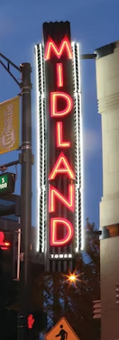

STRATEGIC PLAN LINKS
Goal 1. Strong Economy with More Quality Jobs
1.1 Increase the Midland sales tax & HOT base
1.2 Enhance visitor revenue opportunities
1.3 Continue Downtown + West Midland Development
1.4 Nurture development districts
1.6 Diversify Midland’s economy
1.7 Expand opportunities for general + small business
1.9 Establish our community as a premier destination for retail and entertainment
3
Notes:
1.1 Increase the Midland sales tax base: Develop strategies to expand the tax base by attracting businesses and supporting local commerce
1.2 Enhance visitor revenue opportunities: Boost tourism through infrastructure improvements
1.3 Continue Downtown and West Midland Development: Promote revitalization efforts
1.4 Nurture development districts: Establish action plans to enhance development districts
1.6 Diversify Midland’s Economy: Support initiatives that diversify the local economy and enhance resilience
1.9 Establish our community as a premier destination for retail and entertainment: Offer unique experiences that draw visitors, driving economic growth and community vibrancy

Slide 4
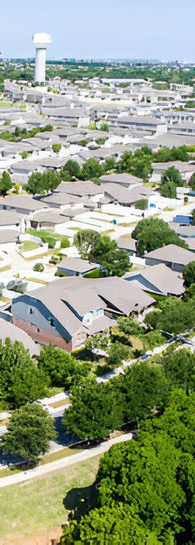
STRATEGIC PLAN LINKS
Goal 3. Quality of Life and Place
3.2 Foster relationships: Collaborate to create world-class facilities + amenities
3.3 Create an attractive + inclusive living environment: Develop live, work, and play opportunities
3.6 Build the best parks system in our region
Goal 6. Strengthen and Sustain our Infrastructure
6.2 Enhance infrastructure for economic growth
6.5 Implement a funding stream for infrastructure
4
Notes:
Goal 3. Quality of Life and Place
3.3 Create an attractive and inclusive living environment: Develop and enhance live, work, and play opportunities
Goal 6. Strengthen and Sustain our Infrastructure
6.2 Enhance infrastructure for economic growth: Improve competitiveness through infrastructure investments that includes collaboration with neighboring jurisdictions
6.5 Implement a funding stream for infrastructure: Establish reliable funding for continual improvements
6.6 Strategize for and monitor City growth: Develop proactive responses to growth rather than reactive

Slide 5
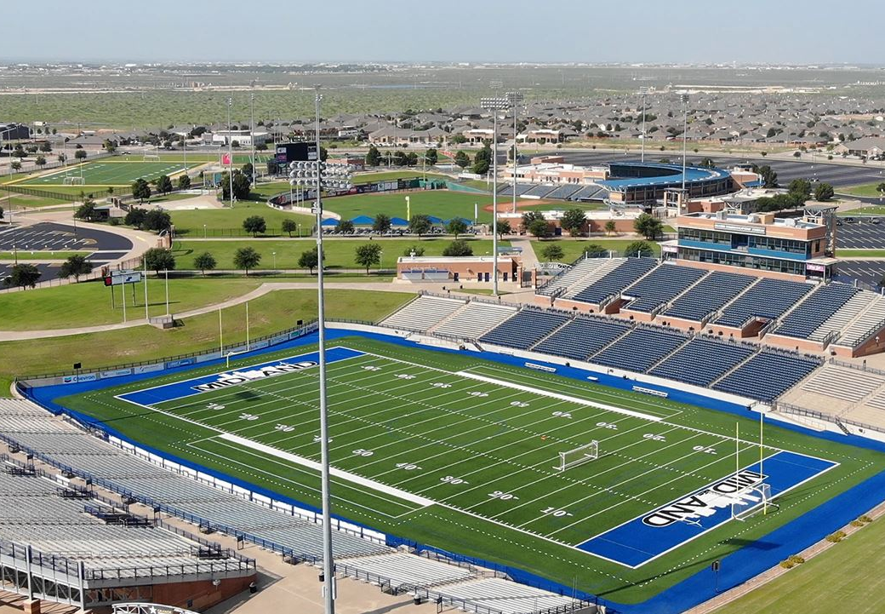

SPORTS COMPLEX
AN ECONOMIC OPPORTUNITY
Developing youth sports as an economic driver + business recruitment tool
Ancillary hotel, entertainment, and restaurant development
Building on existing investments: Midland Athletic Syndicate, Rockhounds, Wildcatter Trail, Beal Park
Midland Zoo + The Preserve
SH 191 corridor connections
5
Notes:
12 HOTELS IN THE AREA AND ROOM FOR MORE – TOGETHER GENERATED $3M IN HOT REVENUE IN 2023 ALONE

Slide 6
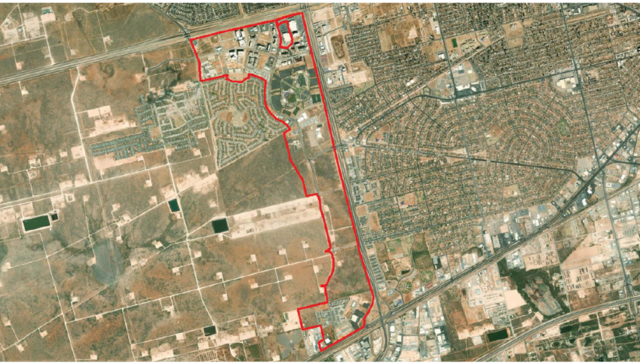
Purpose of tirz #4
Establishing TIRZ No. 4 enhances quality of life by providing critical funding for the Scharbauer Sports Complex and supporting development
Provides dedicated funding stream to support capital projects and ongoing maintenance of the facility
Boosts Midland’s appeal and competitiveness in youth sports
Strengthens Midland’s role as a regional sports destination
Includes approximately 1,066 acres along the Loop 250 West corridor, including the City-owned Sports Complex
6
Notes:
Canyon - $38k

Slide 7
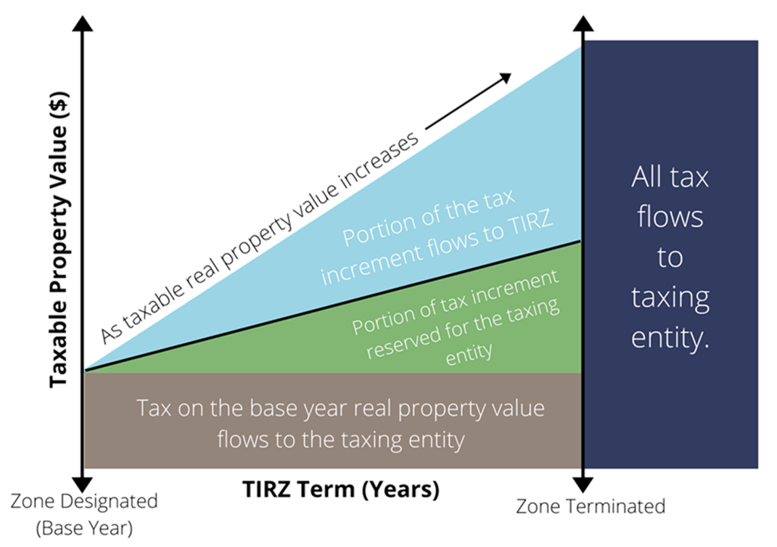
CREATION PROCESS
Chapter 311 outlines procedures for creating or amending a TIRZ. Two main documents:
Creation ordinance; and
TIRZ Project + Financing Plan
Creation ordinance establishes four key elements:
Boundary;
Term;
TIRZ Board; and
Preliminary Project + Financing Plan
The Final Project + Financing Plan is approved by the TIRZ Board and then the City Council by separate ordinance, including participation rate.
TIRZ directs a portion of tax generated from new development within TIRZ
7
Notes:
Canyon - $38k

Slide 8
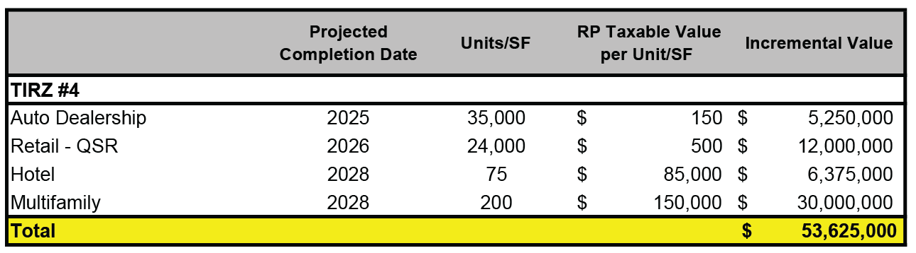
DEVELOPMENT PROJECTIONS
Overview of potential development scope and timing within the TIRZ
Based on market and development trends, and guidance from the City
Reflects anticipated growth over the life of the TIRZ (30 years)
8
Notes:
Canyon - $38k

Slide 9
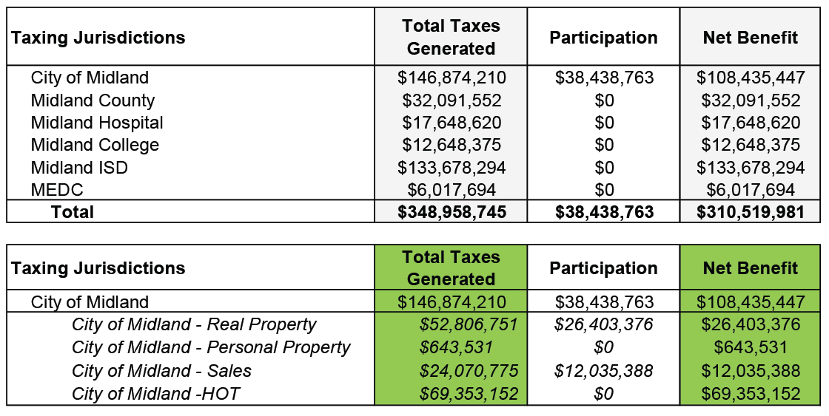
Projected tax revenue
Proposing 50% of the City’s real property & sales tax increment within the Zone, above a 2024 base
30-year term - December 31, 2054 (with final year’s tax to be collected by September 1, 2055)
Total Taxes Generated includes Real Property, Sales, and 7% City Hotel Occupancy Tax
9

Slide 10
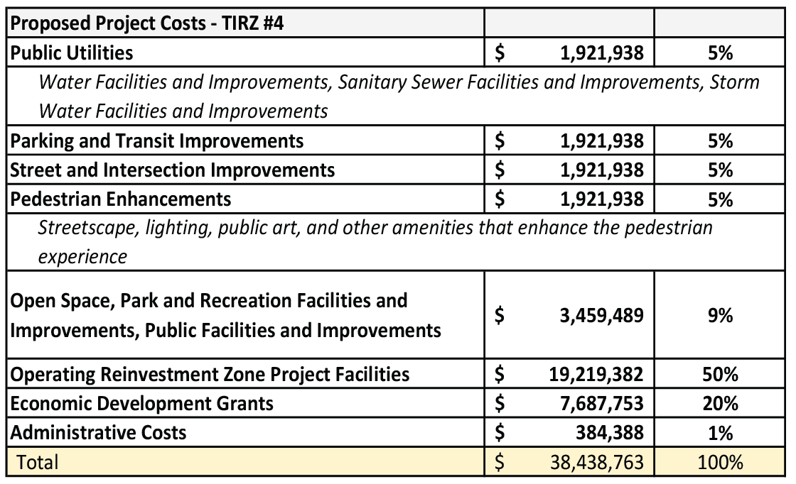
Eligible projects
Categories include all projects eligible under Chapter 311
Costs are estimates and may be revised
Savings from one line item may be applied to a cost increase in another
Individual TIRZ project cost allocations will be evaluated on a case-by-case basis and brought to the TIRZ Board + City Council for consideration
10
Notes:
Canyon - $38k

Slide 11
PROPOSED NEXT STEPS
Adopt creation ordinance, including:
Boundary
Term (30-year term through Dec. 31, 2054)
TIRZ Board (composed of City Council; offers opportunity to add members if other taxing units choose to participate)
Preliminary Project + Financing Plan
11

Slide 12
PROPOSED NEXT STEPS
Nov. 12th
Dec. 17th
1st Quarter 2025
1st Reading + Public Hearing for Creation Ordinance
2nd Reading for Creation Ordinance
Adopt Final Project + Financing Plan and participation rate
12

Slide 13

MISSION
Deliver exceptional services and promote a high quality of life and place for ALL our citizens.

Slide 14
SPORTS COMPLEX NEEDS
 | 2019 | 2020 | 2021 | 2022 | 2023
Revenue | $2,006,554 | $1,500,347 | $1,202,315 | $1,291,649 | $2,280,495
Expenses | $5,544,050 | $6,538,702 | $4,921,372 | $12,660,017 | $5,289,263
Total | ($3,537,495) | ($5,038,356) | ($3,719,057) | ($11,368,368) | (3,008,768)
The Sports Complex 4B sales tax fund balance has historically offset costs but is diminishing since eliminated in 2017
14
Notes:
Operations are about $2M annually ($1.94M in 2023)

