Slide 1

INFRASTRUCTURE NEEDS- REFUNDING AND CO’S
November 12, 2024
TITLE HERE
TITLE HERE

Slide 2

ALIGNMENT WITH STRATEGIC PLAN
Goal 3: Quality of Life and Place
3.3 Create an attractive and inclusive living environment: Develop and enhance live, work, and play opportunities for our citizens
3.5 Nurture and promote a healthy community: Increase healthy community living and education opportunities for citizens of all ages
3.6 Build the best parks system in our region: Offer diverse, accessible, and enjoyable green spaces, tournament-ready ball fields, safe playgrounds, and unique recreational opportunities that enhance the quality of life / quality of place for our community
2

Slide 3

ALIGNMENT WITH STRATEGIC PLAN
Goal 5: Provide Sound Governance & Fiscal Management
5.7 Ensure Continued Financial Stability and Accountability: Maintain Financial Transparency.
6. Strengthen and Sustain our Infrastructure
6.5 Implement a Funding Stream for Infrastructure: Establish reliable funding for continual improvements.
6.6 Strategize for and Monitor City Growth: Develop proactive responses to growth rather than reactive.
3

Slide 4

TOTAL ISSUANCE - $56.8M
$28.8M Road Infrastructure
$28M Beal Park Improvements
4

Slide 5

INFRASTRUCTURE NEEDS - $28.8M
PROJECTS | EST. COST
Sinclair Backage Road (SH 158 to CR 1250) | $9.0M
Mockingbird Lane (Holiday Hill – Midland Drive) | $7.5M
Mockingbird Land at Whitman (by Summit Center) | $3.0M
Avalon (Briarwood – Mockingbird LN) | $4.5M
Wadley/Jal Draw Multiuse Trail | $2.0M
Public Infrastructure | $2.8M
5

Slide 6

BEAL PARK IMPROVEMENTS - $28M
PHASES | 2025 | 2026 | 2027 | TOTAL
Phase I | $19,000,000 |  |  | $19,000,000
Phase II |  | $12,000,000 |  | $12,000,000
Phase III |  |  | $7,000,000 | $7,000,000
Public Private Partnership | ($2,500,000) | ($5,000,000) | ($2,500,000) | ($10,000,000)
TOTALS | $16,500,000 | $7,000,000 | $4,500,000 | $28,000,000
6

Slide 7
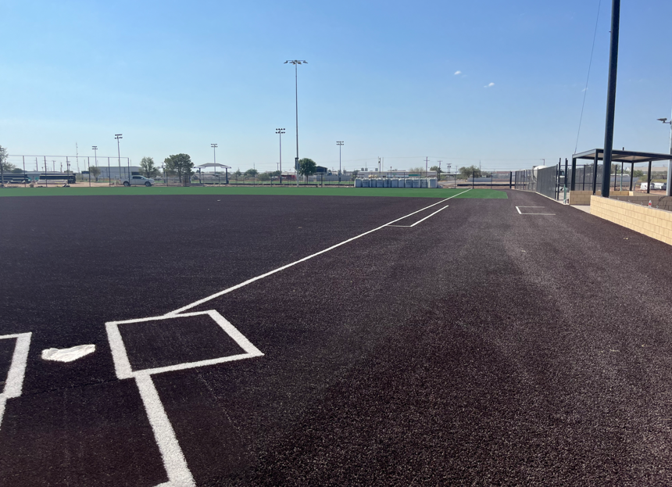
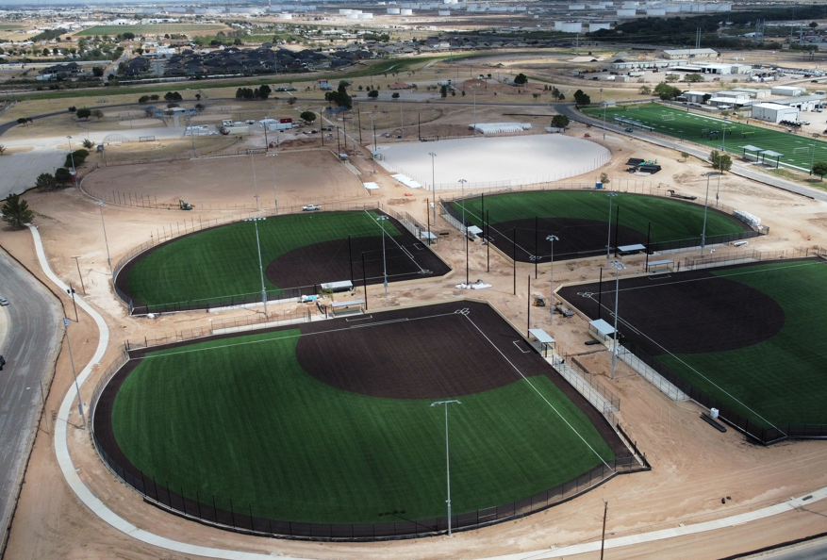
REYES MASHBURN NELMS PROGRESS
7

Slide 8

REFUNDING OPPORTUNITY
Series 2016 Certificates of Obligation present an opportunity for refunding
Savings of $1.5-$1.7M
Can be combined with other bond offerings
8

Slide 9
TAX SUPPORTED DEBT PER CAPITA

Slide 10
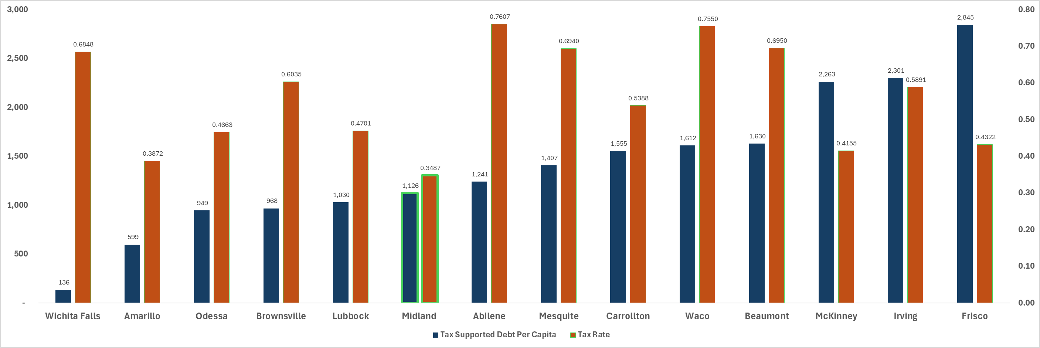
DEBT PER CAPITA vs PROPERTY TAX RATES

Slide 11

MISSION
Deliver exceptional services and promote a high quality of life and place for ALL our citizens.

Slide 12

TOTAL DEBT PER CAPITA

