Slide 1

ITEM 6: PROJECT ACCOUNT FOR GRANT MATCHING PURPOSES
TITLE HERE
TITLE HERE

Slide 2

STRATEGIC GOAL CONNECTIONS
Goal 5: Provide Sound Governance and Fiscal Management
5.7 Ensure continued financial stability and accountability: Maintain financial transparency.
2

Slide 3

GRANTS PROGRAM OVERVIEW
The grants program identifies and pursues competitive grant opportunities including local, state and federal grant funding for the City of Midland.
History:
Established in late December of 2022 under Finance
In October of 2023, the Grant Writer was moved to the Engineering Department
In November of 2023, the Grant Program became a part of the Intergovernmental Relations Office, remaining on the 5th floor due to heavy emphasis on infrastructure grants
One Grant Writer and One Intergovernmental Relations Officer
Since its inception, the success of the Grant Program can be measured by a 3,401.92% ROI to the City
3
Notes:
To promote fiscal stewardship and quality of life in Midland, the grants program within the Intergovernmental Relations division works to identify and apply competitively for local, state, and federal grant funding opportunities.

Slide 4
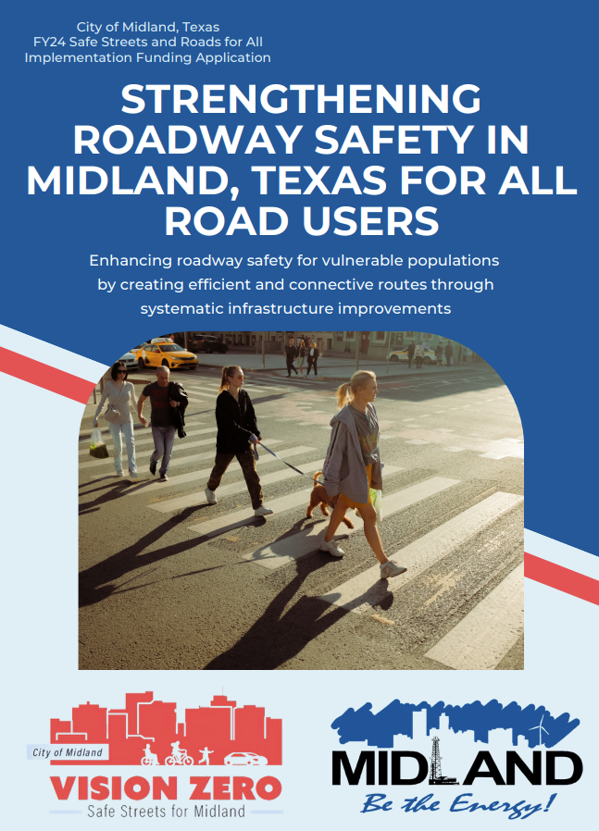
COMPETITIVE GRANT FUNDING
Competitive Grant Funding refers to local, state or federal dollars that are awarded through a process where multiple organizations or entities submit applications to compete for available funds.
The Process:
Applicants must submit a detailed proposal for the grant based on selection
criteria created by the granting agency
Once submitted, the granting entity reviews the applications and determines the
applications that best fit the goal of the funding opportunity and community need
After a period of time, usually 3-4 months, the granting agency will announce
awarded applications
4
Notes:
To promote fiscal stewardship and quality of life in Midland, the grants program within the Intergovernmental Relations division works to identify and apply competitively for local, state, and federal grant funding opportunities.

Slide 5
COMPETITIVE GRANT FUNDING
The Grant Program maintains a list of active funding opportunities and works with all City Departments to identify best suited funding opportunities to priority projects and programs aligned with the strategic plan.
The Process:
City Department identifies funding need (planning, design, infrastructure, programmatic, etc.) in alignment with the strategic plan
Grants Team matches identified need to funding opportunities as they become available
Grants Team works with department on scope, estimated cost, potential match requirements and all required documentation needed by granting agency
Grants team prepares detailed grant application (normally 15-20 pages) for identified project
**Identifying the match requirements is critical to submitting a viable grant application as most funding agencies REQUIRE proof and source of match in the application
5
Notes:
Typically 20% but depends on the program. So if total project is $10million, we awarded 8 million and match is 2 million
Accept applications submissions

Slide 6

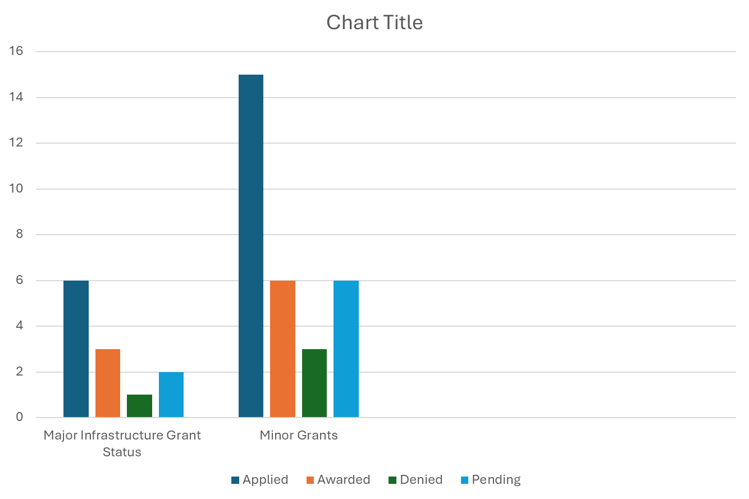
COMPETITIVE APPLICATIONS
Major:
Applied: 6
Awarded: 3
Denied: 1
Pending: 2
Minor:
Applied: 15
Awarded: 6
Denied: 3
Pending: 6
6
Notes:
TA is matched through parks bond, but it would be helpful to have a established funding source

Slide 7

AWARDED GRANTS
Funding for major infrastructure improvements has been the focus for the grants program with efforts resulting in over $15+ Million in awarded grant funding since the inception of the grant program
Granting Program | Project | Awarded Funding
FHWA Safe Streets and Roads for All (Federal) | Lamesa Road Corridor Improvements and Citywide Signal Retiming | $8,664,368
TxDOT Transportation Alternatives (State) | Wildcatter Trail Phase 1 | $3,697,495
TxDOT Category 10 Funds (State) | Wildcatter Trail Phase 2 | $2,970,000
 | Total: | $15,331,863
7

Slide 8

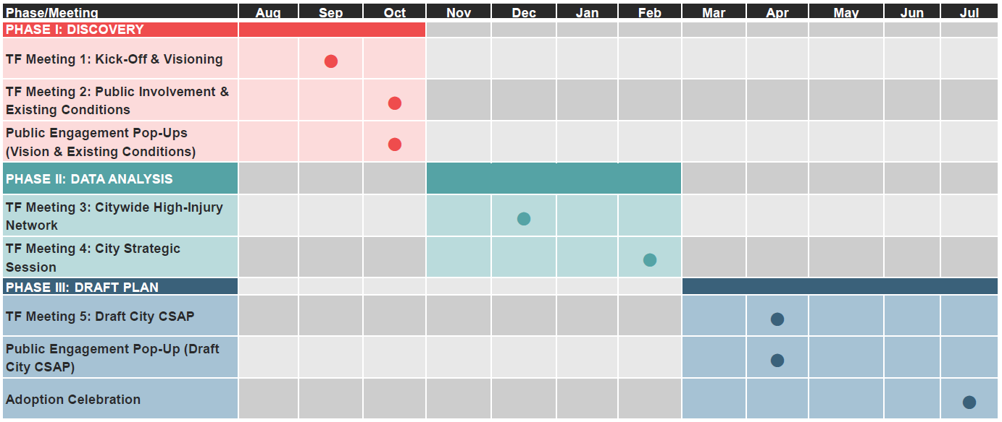
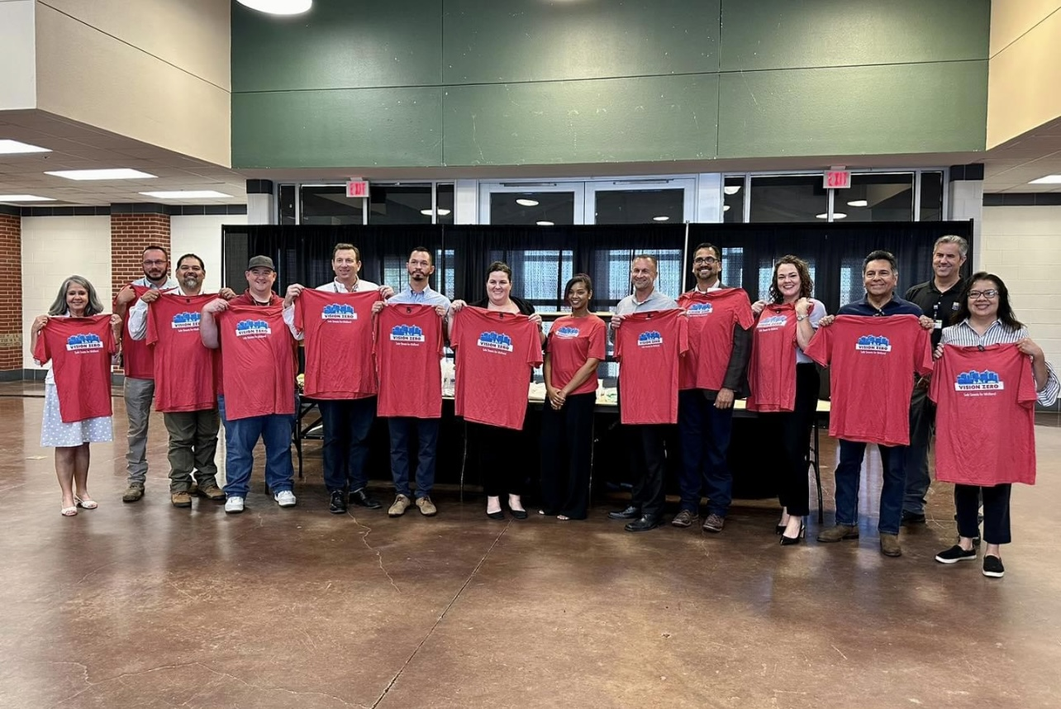
SAFETY ACTION PLAN & VISION ZERO
2023
2024
Timeline of CSAP adoption was moved up due to the SS4A program being released 3 months earlier than anticipated. Fast tracking the completion and adoption of the CSAP allowed the City to apply for FY24 funding resulting in the award of $8.6 million! We can now apply more competitively for future funding opportunities - ensuring no money is left on the table.
8

Slide 9
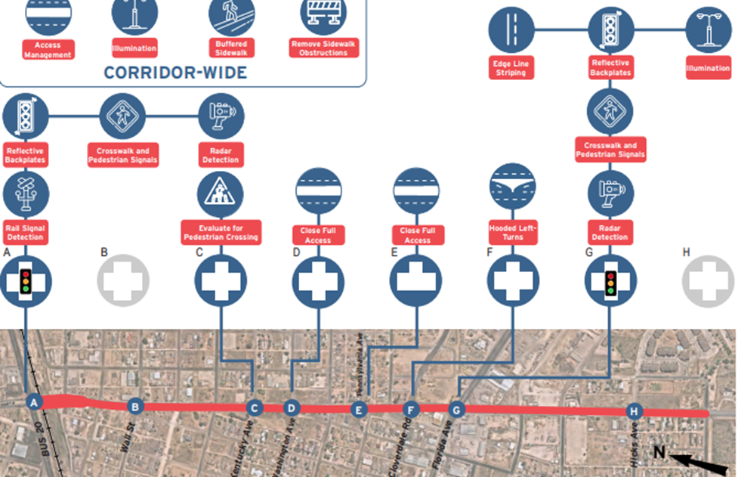
SAFE STREETS & ROADS FOR ALL: LAMESA RD.
Utilizing recommendations from Midland’s Vision Zero- Comprehensive Safety Action Plan, the City was awarded funding from FHWA Safe Streets and Roads for All (SS4A) program, to complete systematic infrastructure improvements along Lamesa Road and citywide signal retiming to increase roadway safety.
Awarded Funding | Required Match | Total Project Cost
$8,664,368 | $2,166,092 (20%) | $10,830,460
9

Slide 10

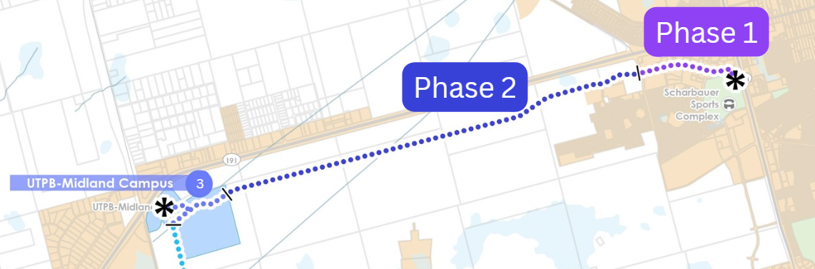
WILDCATTER TRAIL PHASE I & 2
Transportation Alternatives Grant Phase 1- Champions, Tradewinds & Deauville | TxDOT Category 10 Funds Phase 2- Arlington to UTPB CEED Building
Phase one includes pedestrian shade structures (trailhead), bike and pedestrian trail, and enhanced pedestrian crossing equipment. Currently finalizing RFQ documents to begin PS&E phase of the project. Expected to be let for construction early 2026. | Phase two continues the trail west to connect phase one, to University of Texas Permian Basin’s CEED building at the corner of HWY 191 and 1788.
Awarded Funding | Required Match | Total Project Cost
$3,697,495 | $924,974 (20%) | $4,622,469
Awarded Funding | Required Match | Total Project Cost
$2,970,000 | $0 | $2,970,000
10

Slide 11
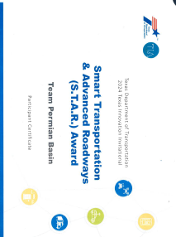
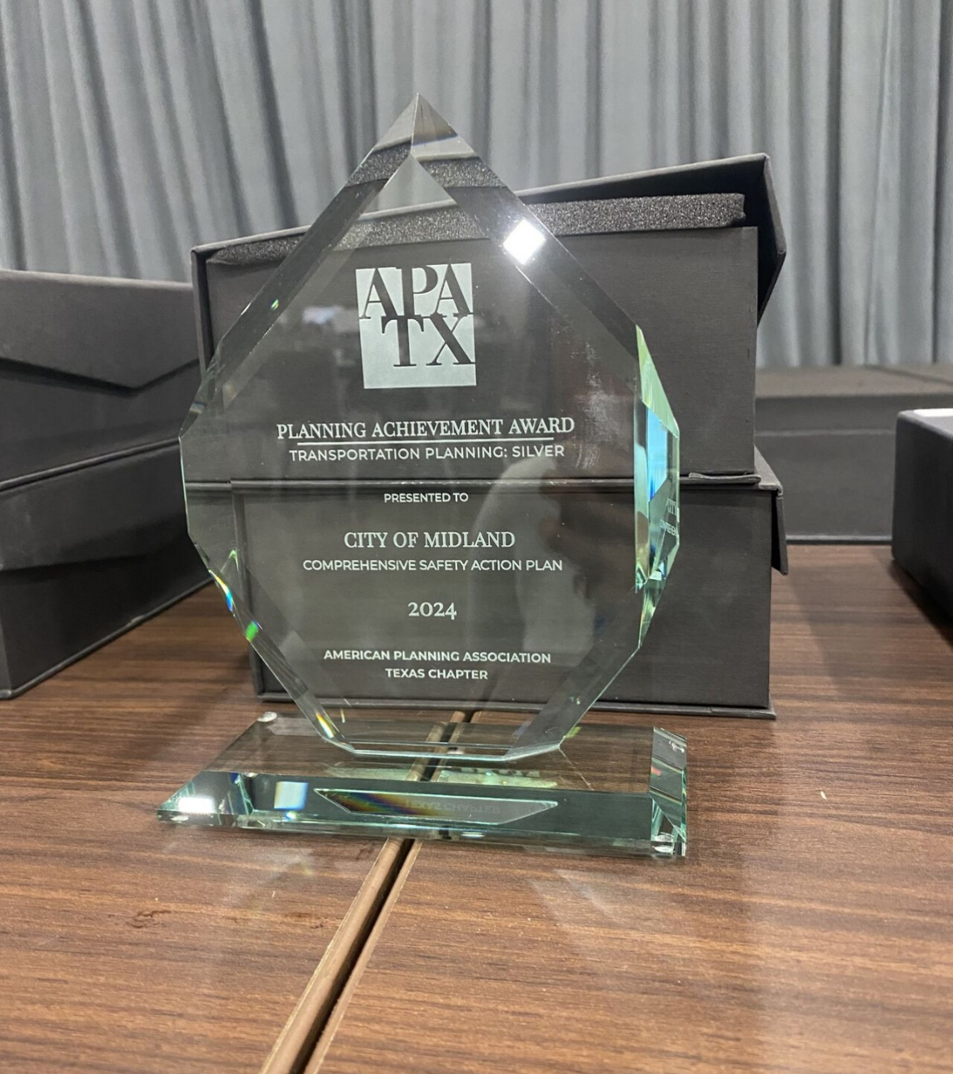
OTHER GRANT PROGRAM HIGHLIGHTS
The grant program has also assisted in securing funding for the Police Department, Fire Department, Development Services and Parks and Recreation Department totaling almost $2 million.
Other Key Accomplishments:
Awarded the S.T.A.R. (Smart Transportation & Advanced Roadways) Award
from TXDOT at the 2024 Innovation Invitational for work done with
Team Permian Basin on a grant application for the Permian Corridor
Assessment and Mitigation Program Pilot
The City of Midland Vision Zero Safety Action Plan received a
Silver Award for transportation planning at the American
Planning Association- Texas Chapter Conference
11

Slide 12
CURRENT MATCHING NEEDS FOR AWARDED GRANTS
Both Transportation Alternatives (WCT Phase 1) and Safe Streets and Roads for All (Lamesa Corridor & Signal Retiming) have a 20% local match requirement.
12
Notes:
TA is matched through parks bond, but it would be helpful to have a established funding source

Slide 13
KEEPING THE MOMENTUM ALIVE
The Grants Program has submitted federal and state level applications for infrastructure and drainage improvements currently in review by granting agencies.
Applied | Upcoming
ATIIP (Federal)- Multimodal trail extending current trail system around Reyes-Mashburn park, north to connect with the new high school, and south to BI-20. | Transportation infrastructure opportunities RAISE (USDOT) PROTECT (FHWA) FY26 Transportation Alternatives (TxDOT)
FIF (State) - Channel improvements along BI-20 outlined in the 1994 Drainage Plan to take homes out of direct floodways and reduce overall flooding in southeast Midland. | Parks Texas Parks & Wildlife Outdoor Grants Local Foundations
13
Notes:
Applied amount:
ATIIP: 240K match is 60k (active transportation infrastructure improvement program) USDOT
FIF: 12 mil (at this time no match based on area of project)

Slide 14
RECCOMENDED ACTION
As the grant program continues to seek grants, a source for matching funds is necessary to continue to pursue grants competitively through the approval of the following motion:
The creation of a project account that will be used for grant matching purposes, allocating $400,000.00 to start
Directing that reimbursements from outside entities for purposes related to public improvement shall be deposited.
14

Slide 15

MISSION
Deliver exceptional services and promote a high quality of life and place for ALL our citizens.

