Slide 1

November 12, 2024
ITEM 12
ASTOUND BROADBAND STADIUM CONCESSION AMENDMENT
TITLE HERE
TITLE HERE

Slide 2
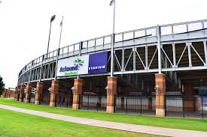

STRATEGIC GOAL CONNECTIONS
Goal 5: Provide Sound Governance and
Fiscal Management
5.2 Enhance Citizen Experience
5.5 Promote a Well-Balanced Customer Service Philosophy: Consistently deliver excellent service to citizens.
2

Slide 3

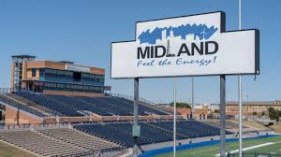
COMMUNITY IMPACT
Provide consistent services expected at a stadium venue at a reasonable price.
Improve customer experience with an updated point of sale system.
Improve quality of products sold with RO system.
3
Notes:
Increase admissions – potential for increasing annual revenue
Improve working conditions + security –
Enhanced security for cashiers
Actual breakroom with AC
Storage for belongings
Staff restroom

Slide 4
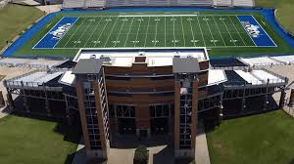
AMENDMENT
Contract #17002610 has been in effect since September 13, 2017. DBH Midland, LLC and COM staff seek to amend the existing contract in order continue providing excellent service to Midland patrons at Astound Broadband Stadium.
Increases in Product and Personnel costs are the basis for the request to adjust the percentages paid to the COM.
4
Notes:
Increase admissions – potential for increasing annual revenue
Improve working conditions + security –
Enhanced security for cashiers
Actual breakroom with AC
Storage for belongings
Staff restroom

Slide 5
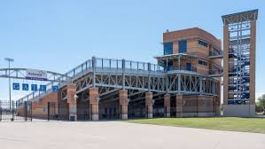
AMENDMENT
Section 3.4.1 – RFP Cost Summary Percentage Fees would change as noted:
2017 2024 Amend Gross Receipts
15% 6% up to $249,999.99
20% 8% $250,000-$349,999.99
25% 13% $350,000-$449,999.99
30% 14% $450,000-$549,999.99
35% 15% $549,999.99 and up
5
Notes:
Increase admissions – potential for increasing annual revenue
Improve working conditions + security –
Enhanced security for cashiers
Actual breakroom with AC
Storage for belongings
Staff restroom

Slide 6
FISCAL IMPACT
2017 Contract |  |  |  |  |  |  | 2024 Contract Amendment
Concession Sales Tiers |  |  |  | % | COM Revenue |  | Concession Sales Tiers |  |  |  | % | COM Revenue
$0.00 | to | $249,999.00 | $249,999.00 | 15% | $37,499.85 |  | $0.00 | to | $249,999.99 | $249,999.99 | 6% | $15,000.00
$250,000 | to | $349,999.00 | $349,999.00 | 20% | $20,000.00 |  | $250,000.00 | to | $349,999.99 | $349,999.99 | 8% | $8,000.00
$350,000 | to | $449,999.00 | $449,999.00 | 25% | $3,427.14 |  | $350,000.00 | to | $449,999.99 | $449,999.99 | 13% | $1,781.98
$450,000 | to | $549,999.00 | $549,999.00 | 30% | - |  | $450,000.00 | to | $549,999.99 | $549,999.99 | 14% | -
$550,000 | to | +$550,000.00 | +$550,000.00 | 35% | - |  | $550,000.00 | to | +$550,000.00 | +$550,000.00 | 15% | -
2023 Concession Sales |  |  |  |  | 2023 Revenue |  | 2023 Concession Sales |  |  |  |  | New Revenue
 |  | $363,707.56 |  |  | $60,926.99 |  |  |  |  | $363,707.56 |  | $24,781.98
Total Revenue Reduction $36,145.01
6
Notes:
Increase admissions – potential for increasing annual revenue
Improve working conditions + security –
Enhanced security for cashiers
Actual breakroom with AC
Storage for belongings
Staff restroom

Slide 7
AMENDMENT
A new section would be added to the Contract outlining DBH Midland, LLC and COM additional obligations:
Company’s Additional Obligations
Provide XENIAL POS machine terminals at all point-of-sale locations.
Provide new equipment needed to improve concession services.
Provide for the presence of at least one (1) manager and one (1) assistant manager at each event, and ensure that reasonably sufficient full-time and part-time staff is scheduled to work at each event.
7
Notes:
Increase admissions – potential for increasing annual revenue
Improve working conditions + security –
Enhanced security for cashiers
Actual breakroom with AC
Storage for belongings
Staff restroom

Slide 8
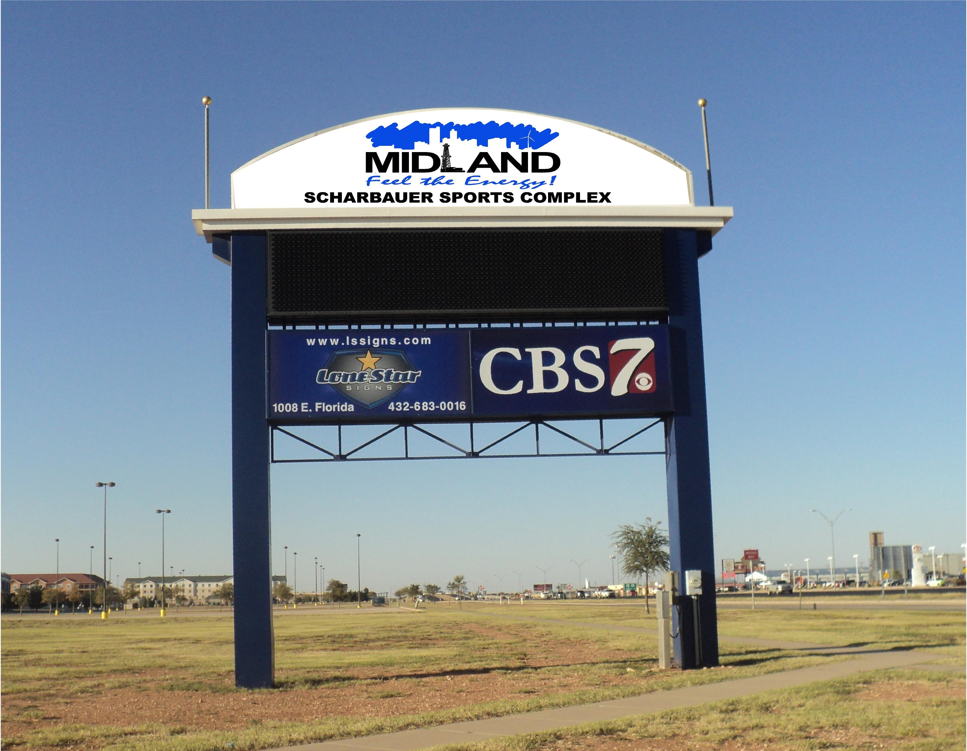
AMENDMENT
City’s Additional Obligations
Provide hardwired internet connectivity in the West Concession Stand and the North Concession Stand.
Provide Wi-Fi connectivity in all concession stands (i.e., North, East, South, and West) and within the concourse of the Stadium (for the benefit of the portables).
Provide for the installation of a reverse-osmosis water system in the West Concession Stand.
8
Notes:
Increase admissions – potential for increasing annual revenue
Improve working conditions + security –
Enhanced security for cashiers
Actual breakroom with AC
Storage for belongings
Staff restroom

Slide 9
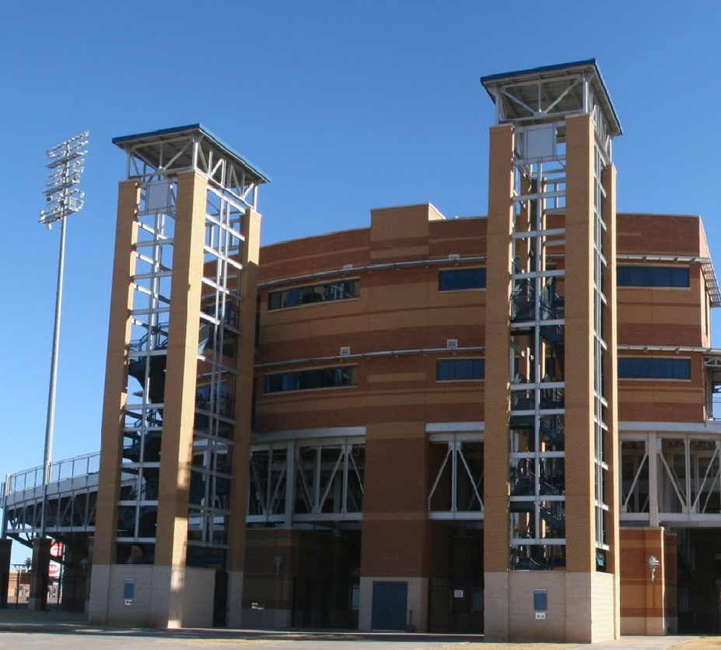
ACTION NEEDED
Resolution authorizing the execution of an amendment to that certain City of Midland Contract #17002610 relating to concession management services for events held at Astound Broadband Stadium.
9

Slide 10

MISSION
Deliver exceptional services and promote a high quality of life and place for ALL our citizens.

