Slide 1
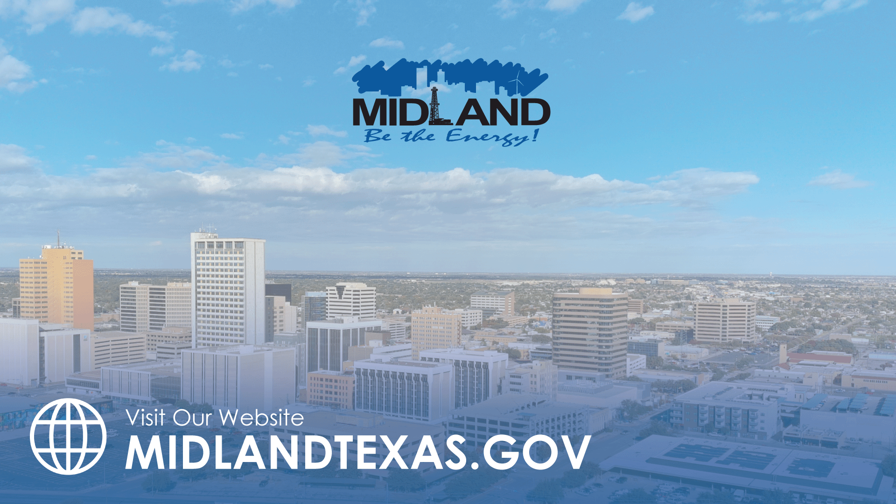
INVESTING IN MIDLAND: INFRASTRUCTURE AND PUBLIC SAFETY
TITLE HERE
TITLE HERE
Notes:
Finance team will update throughout the year, but wanted to highlight today how City is invested in infrastructure and public safety, the basic services a City provides to the citizens.

Slide 2

STRATEGIC GOAL CONNECTIONS
Goal 2: Set the Standard for a Safe and Secure City
2.6 Grow and Retain Public Safety Resources: Expand law enforcement presence as well as fire reduction and prevention programs while reducing attrition.
Goal 5: Provide Sound Governance & Fiscal Management
5.1 Recruit and Retain a Skilled and Diverse Workforce: Invest in talent and diversity; grow local pipeline of skilled employees.
5.7 Ensure Continued Financial Stability and Accountability: Maintain financial transparency.
Goal 6: Strengthen and Sustain Our Infrastructure
6.5 Implement Funding Stream for Infrastructure: Establish reliable funding for continual improvements.
6.6 Strategize for and Monitor City Growth: Develop proactive responses to growth rather than reactive.
2
Notes:
Prioritizing our Priorities
We are tying results back to the Strategic Plan goals 2, 5, and 6.
Strategic plan set goals for a safe and secure city and to strengthen and sustain our infrastructure

Slide 3


BUDGET PROCESS
Individual Budget Briefing with Council
5-YEAR Forecast of Funds
5-YEAR Capital Improvement Plans
3
Notes:
Goal 5-Maintain financial transparency we have improved our processes.
The strategic plan that you Council develops guides us to develop our CIP and operational needs.
Annually, we develop a prosposed budget, and individually brief the council. You provide input and we incorporate your input.
Five year forecasts were provided, showing real data from the most recent years and using regression analysis to provide a forecast of expenses and revenue
Looking at growth, departments prepare a capital improvement plan and needs.
The council developed a strategic plan that assisted to guide the city departments in development of goals and the actions needed to meet the vision.
Each council member was provided with a budget briefing session and input was incorporated into budget- in alignment with Strategic Plan.
Five year forecasts were provided, showing real data from the most recent years and using regression analysis to provide a forecast of expenses and revenue.
Not a scare tactic- the revenue can shift but this shows what it would look like unaltered.
Five year capital improvement plans were provided by each of our basic services and enterprise funds, with a list of needs.

Slide 4
STRATEGIC PLAN FUNDING:
ALL CITY FUNDS
Goal 2 and Goal 6, emphasizing Safety and Infrastructure, are 63% of the City’s Budget,
totaling $285.6 Million in FY2025
4
Notes:
PIE chart of all city funds based on the strategic plan goal.
63% of budget is Infrastructure and Public Safety. The budget reflects what we are focused on, the BASIC services the City provides to citizens

Slide 5
STRATEGIC PLAN FUNDING:
ALL CITY FUNDS
When looking at the overlap in Goals, Safety and Infrastructure, are 74.1% of the City’s Budget,
totaling $336.4 Million in FY2025
5
Notes:
PIE chart of all city funds based on the strategic plan goal.
74.1% of budget is Infrastructure and Public Safety. The budget reflects what we are focused on, the BASIC services the City provides to citizens

Slide 6
STRATEGIC PLAN FUNDING:
ALL CITY FUNDS
When looking at the overlap in Goals, Safety and Infrastructure, are 74.1% of the City’s Budget,
totaling $336.4 Million in FY2025
6
Notes:
PIE chart of all city funds based on the strategic plan goal.
74.1% of budget is Infrastructure and Public Safety. The budget reflects what we are focused on, the BASIC services the City provides to citizens

Slide 7
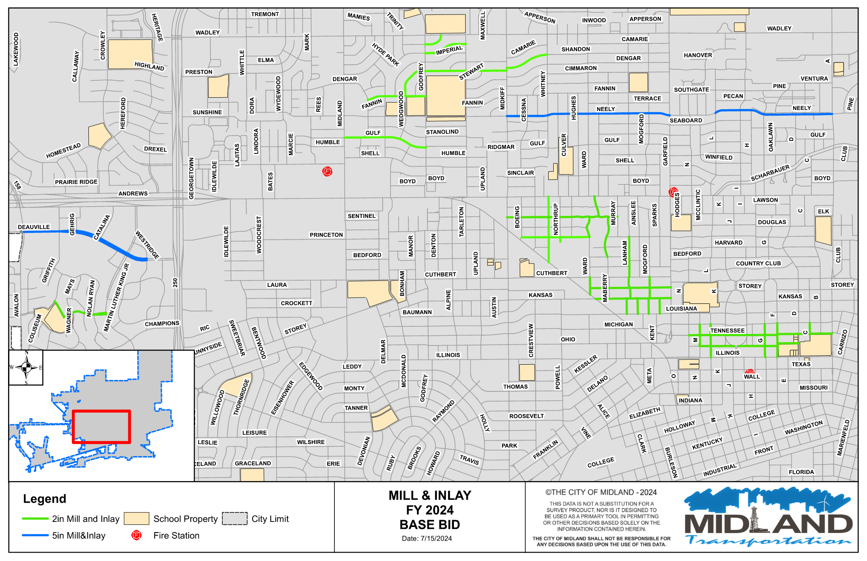
STRENGTHEN & SUSTAIN INFRASTRUCTURE
FY 2024 Mill and Inlay: 12.4 Miles Paved $8.6 Million
7
Notes:
General Fund responsible for road maintenance, budgeted Mill and Inlay annually

Slide 8

STRENGTHEN & SUSTAIN INFRASTRUCTURE 2025 ROADS INVESTMENT
PROJECTS | EST. COST
Sinclair Backage Road (SH 158 to CR 1250) | $9.0M
Mockingbird Lane (Holiday Hill – Midland Drive) | $7.5M
Mockingbird Land at Whitman (by Summit Center) | $3.0M
Avalon (Briarwood – Mockingbird LN) | $4.5M
Wadley/Jal Draw Multiuse Trail | $2.0M
Public Infrastructure | $2.8M
Total | $28.8M
8
Notes:
These are the new infrastructure projects planned for the year to keep up with growth
Connecting Midland- Development of the City- development in 191 and north Midland

Slide 9
STRENGTHEN & SUSTAIN INFRASTRUCTURE WATER
PROJECTS | INVESTMENT
Maintenance replacing aging and failing Mains, Valves, Manholes, etc. | (Annual) $6.5 M
NE Sewer Watermain Project | $46.8 M
Airport Wastewater Lift Station Construction | $3.0 M
Wadley (I to Garfield) Utility Construction | $3.0 M
Golf Course Rd. at Scharbauer Utility Const | $3.0 M
Sludge Tank at WRF | $10.0 M
Phase 1 Paul Davis Advanced Treatment | $30.0 M
Total | $102.3 M
9
Notes:
Water-
Has Maintenance annually, and the new infrastructure projects for the year to keep up with growth.
Potential additional funds in FY28 for further growth. FY28 $40 Million Funding
Design, permitting, and construction of Sludge tank at WRF $10 Million
Phase I Paul Davis Advanced Treatment $30 Million
$40 Million
Many time Budgeting for Unfunded Mandates from TCEQ

Slide 10
STRENGTHEN & SUSTAIN INFRASTRUCTURE SANITATION
PROJECT | INVESTMENT
North Citizen Collection Station – N. 349 | $4.1 M
West Citizen Collection Station – W. Hwy 80 | $4.4 M
Landfill Entrance Road Reconstruction | $4.4 M
Landfill Cell Design & Construction | $11.0 M
Total | $23.9 M
10
Notes:
Total Capital Needs Solid Waste 40,000,00
18 Million 2024 Certificates of Obligation will fund Needs = $40 Million
Includes state mandates
2024 CO ISSUANCE OF $18 Million
Landfill Gas Flare System:
Federal emission guidelines require existing landfills to calculate the annual non-methane organic compounds (NMOC) emission rate. The NMOC emission rate is required until emissions surpass 34 Mg/Yr. Once the emission rate surpasses 34 Mg/Yr. The landfill must construct a gas control system to manage the landfill gas. The City of Midland Landfill is expected to exceed 34 Mg/yr. in 2025. Unfunded Mandate
Estimated Engineering and Gas Flare System Construction Costs: $5,500,000

Slide 11

STRENGTHEN & SUSTAIN INFRASTRUCTURE AIRPORT
11
~70% of the Above Costs are Possibly Grant Funded

Slide 12

STRENGTHEN & SUSTAIN INFRASTRUCTURE HOGAN GOLF COURSE
$24.5 M Investment in Current and Future Projects
Greater detail after the Master Plan
12
Notes:
11 million CO Bond from 2024- Highlighted Projects
Hogan Golf course isn’t new infrastructure, but more about maintaining our current infrastructure. Capital improvements needed here and budget 11 mill currently.

Slide 13

PARK IMPROVEMENTS
PROJECT | INVESTMENT
Reyes Mashburn Nelms | $16.7 Million
Beal Park Improvements | $28.0 Million
Beal Park Public Private Partnerships | $16.8 Million
TOTALS | $61.5 Million
13
Notes:
Adds to our Infrastructure – renovating existing infrastructure.
Beal Foundation: $10M
Scharbauer Foundation: $5M (spray park)
Exxon Mobile: $1.75M (playground & naming rights)
Warren Equipment: $50k (pending approval)
TOTAL Raised: $16.8M
Excellent public-private partnership thanks to Council fund raising help!

Slide 14
SAFE & SECURE CITY:
FIRE RETIREMENT FUND
Approximately $50M+ to fund Firefighter Retirement
Ensure future stability of fund with Actuarily Determined Contribution (ADC)
14
Notes:
The City investing in public safety officers, finding a cash solution to fund benefits and retirement for Fire Fighter Retirement Review Board, and ensure future of the fund with ADC.
We have already mentioned the cash resolution of the Fire Fighter Retirement Fund. Both the Firefighters and the City have worked together and taken steps toward this solution: firefighters made plan changes and the City increased contributions by 2%, changes made January 1, 2024.

Slide 15
INFRASTRUCTURE & PUBLIC SAFEY: TOTAL INVESTMENT
ROADS: $34.5 million*
PARKS: $61.5 million
WATER: $102.3 million
SANITATION: $23.9 million
AIRPORT: $158.0 million
GOLF: $24.5 million
FIRE: $50.0 million
TOTAL: $454.7 Million
*does not include 2018 Road Bond of $100 million
15
Notes:
$454.7 million is the investment to upgrade and provide new infrastructure in Midland. Our budget reflects where our priorities lie. …

Slide 16

MISSION
Deliver exceptional services and promote a high quality of life and place for ALL our citizens.

Slide 17
DETAIL OF GOAL OVERLAP
Goal | Expense Type | Notes | Amount
Goal 1 - Economy | Capital | Debt payment on Convention Center | 1,794,800
Goal 1 - Economy | Maint. Structures & Equip | Maintenance for Airport | 674,877
Goal 3 - Quality of Life | Capital | Parks Capital Vehicles | 40,500
Goal 3 - Quality of Life | Capital | Sports Complex Capital Building & Structures | 140,000
Goal 3 - Quality of Life | Capital | Golf Course Interest & Sinking Transfer | 541,532
Goal 3 - Quality of Life | Capital | Parks Oil & Gas Transfer out to Parks Maint Fund | 2,000,000
Goal 3 - Quality of Life | Capital | Parks Oil & Gas Capital Improv Other Than Bldg | 18,500,000
Goal 3 - Quality of Life | Maint. Structures & Equip | Parks Maintenance (General Fund) | 2,069,302
Goal 4 - Transparency | Dispatch (Emergency Comm) | Under ITSD | 3,695,927
Goal 5 - Governance | Capital | Garage Vehicle/Equipment Purchases | 15,836,551
Goal 5 - Governance | Maint. Structures & Equip | Facilities Maintenance | 399,200
Goal 5 - Governance | Maint. Structures & Equip | Garage Maintenance | 5,104,106
 |  | Total | 50,796,794
17

Slide 18
STRENGTHEN & SUSTAIN INFRASTRUCTURE 2018 ROAD BOND
Roads Constructed
Bond Amount
Time Frame
Final Projects
$100 Million
2017 – Vote
2018 – first $25M
2023 – final $25M
24 out of 26 roads completed
Main Street &
Garfield
18
Notes:
INFRASTRUCTURE: The $100M road bond, which was passed in a 2017 public vote, is finally in its last stages. 24 out of 26 roads have been completed, leaving Main St and Garfield.

Slide 19
STRENGTHEN & SUSTAIN INFRASTRUCTURE WATER
$4M Annually Over the Next 5 Years to replace aging and failing Water Mains and Valves throughout City
$2M Wastewater Manholes & Draws Rehab
$500k Line Maintenance from Operating Budget
19
Notes:
Budgeting for Unfunded Mandates from TCEQ
FY28 $40 Million Funding
Design, permitting, and construction of Sludge tank at WRF $10 Million
Phase I Paul Davis Advanced Treatment $30 Million
$40 Million

Slide 20
STRENGTHEN & SUSTAIN INFRASTRUCTURE ROADS AND DRAINAGE
Completed
Idlewilde Storm Drain and Basin $2.0 million
COMPASS 2023 $3.5 million
SH 191 Wastewater Extension $3.9 million
In Progress
$5.7M for Road Maintenance and Resurfacing
12 Corridors and Vision Zero Focus
Wildcatter Trail to begin construction
Garfield and Main Street nearing completion
Upcoming
$28.8M in Road and Public Infrastructure Projects
20

Slide 21

GENERAL FUND
Streets Maintenance - $7 M of $35 M in needs
Parks Maintenance - $8.7M of $11.6 M
Decreased General Fund Revenue Consequences:
Deteriorating Infrastructure, Roads, Utilities
Maintaining Parks, Community Centers, Attractions to the City
Less flexibility to address emergencies or downturns
Necessitates Prioritization of Needs
21
Notes:
General Fund- Roads and Parks- don’t want to use fund balance or sustain other funds.

Slide 22

ENTERPRISE FUNDS
WATER AND SEWER
HOGAN GOLF COURSE*
SANITATION
AIRPORT
22
Notes:
Revenue analysis completed for all Enterprise Funds in order to ensure self-support- update fees
Many of our rates under industry standards, call for an increase.
New standards put in place for annual increases and contracts with airlines for competitive reasons
Rate increases to pay for capital needs!

Slide 23

STRENGTHEN & SUSTAIN
INFRASTRUCTURE
$30 Million in Proactive Infrastructure Planning + Partnerships:
$13M contribution from MDC for key roadway projects
$3.3M City investment in design for MPO projects leading to $33.2M in future letting
$8.6M SS4A grant enabled by Vision Zero
$6.7M grants for Wildcatter Trail
City-County collaboration on TIRZ 3 & 4
Partnerships for Future Growth: Outer-Loop PEL
Study, I-14, and I-27
23
Notes:
Because we understand the midland factor and costs of inflation, leaders have been Proactive in Infrastructure planning and partnerships:
To stay ahead of growth, Midland committed an additional $30 million to infrastructure projects, adding to the $400 million already allocated for streets, water, sewer, solid waste, the airport, and recreation facilities. The city’s five-year Cap
Over $15M in Grants for Vision Zero and Wildcatter Trail thanks to our Grant team
Continue to utilize these strategies- proactively creating public private partnerships and creative funding these needs.

Slide 24

FY2025 KEY DELIVERABLES
Utilities
Install 35,900 feet of new water mains and 53,760 feet of new sewer mains
Rehab 100 manholes and replace 15
Implement advanced groundwater treatment at the T-bar water source
Finalize a new surface water contract with CRMWD
Replace a wastewater lift station serving 70% of the airport area
Start construction on the Northeast Sewer project
Addition of a caustic treatment system for chlorine stabilization
Implement a new solids handling system for sludge
Upgrade treatment systems for manganese and zebra mussel mitigation
24

Slide 25
SOLID WASTE IDENTIFIED NEEDS
Capital Estimates for Solid Waste CO's
"Exhibit A"
1. North Citizen Collection Station $4 ,100,000
2. West Citizen Collection Station $4,404,346
3. Landfill Entrance Road Reconstruction $4,396,843
4. Landfill Gas Flare System 5 ,500,000
5. Cell Construction Costs 11,000,000
6. ITSD Tower Relocation 2 ,000,000
7. Oil Well Relocation 1 ,000,000
8. Other Capital Costs 8 ,000,000
Total Capital Needs Solid Waste 40,000,000
2024 CO ISSUANCE OF $18 Million
25

Slide 26
SUSTAINABILITY: FUTURE WATER INVESTMENTS
Capital Project Bond Funding:
FY25 refunding and funding of capital projects
FY28 funding of advanced treatment and Sludge handling
Rate Adjustments:
FY25 Catchup increase
FY26-29 Annual increases
26
Notes:
2.5% Increase to rate annually

Slide 27
SAFE & SECURE CITY:
 | Personnel Budget | FY2022 | FY2023 | FY2024 | FY2025
All Employees | City Portion Retirement Contribution** | TMRS 14.51% FRRF 22.2% | TMRS 14.80% FRRF 22.2% | TMRS 15.66% FRRF 22.2% | TMRS 15.88% FRRF 24.2%
 |  | TMRS $(-190 K) | TMRS $190 K | TMRS $630 K | TMRS $170K/FRRF $500k
 | Health Insurance Premium Increase (City Portion) | 9.3% | 5.0% | 5.5% | 3.0%
 |  | ~ $1.1 M | ~ $680 K | ~ $820 K | ~ $460 K
2023 → 2024
5% increase across the board to base pay
Cost: $1.2 M
13 positions added:
- 1 training engineer
- 6 EMS crew
- 6 firefighters to cut down on OT
Cost: $1.0 M
27
Notes:
Focus on Public Safety- In FY2024
5% increase to base pay: $1.2 M
13 Positions added: $1.0M
FIRE – received a 5% step increase; 13 positions were added to address growth and improved response times. Firefighter pay has also been reviewed against other Cities and a comprehensive pay adjustment is being considered by management.
PROVIDING FOR GROWTH AND IMPROVED RESPONSE TIMES

Slide 28
STRATEGIC PLAN FUNDING-ALL CITY FUNDS
Strategic Goal | FY2024 Budget | FY2025 Budget | Difference | Variance
Goal 1: Strong Economy & More Quality Jobs | $26,608,999 | $29,494,333 | $2,885,334 | 10.8%
Goal 2: Set Standard for a Safe & Secure City | 95,442,408 | 99,662,154 | 4,219,746 | 4.4%
Goal 3: Quality of Life & Place | 31,007,907 | 40,754,831 | 9,746,924 | 31.4%
Goal 4: Transparent & Consistent Communication | 18,869,485 | 22,045,677 | 3,176,192 | 16.8%
Goal 5: Sound Governance & Fiscal Management | 73,491,307 | 76,435,673 | 2,944,366 | 4.0%
Goal 6: Strengthen and Sustain Infrastructure | 178,572,497 | 185,919,653 | 7,347,156 | 4.1%
Grand Total | $423,992,603 | $454,312,320 | $30,319,717 | 7.1%
28
Notes:
$20 MILLION DEFERRED NEEDS IN BUDGET 24-25
Making your priorities a priority
This shows the Council approved budgets for 2023 and 2024 as broken down by Strategic Goal categories. The highest increase year over year was in Public Safety at 15.3% with Economic development second at 13% increase. Looking at the funding of the priorities as a percentage of total of the General Fund, Public safety is 57 and 58% respectively, with infrastructure second at 18% of the whole for each year.
Recruiting an excellent workforce has been addressed by making Human Resources a higher priority, and repurposing vacancies to add strategic positions imperative to carry out the Strategic Plan

Slide 29
CAPITAL IMPROVEMENT PLANS FY25
ROADS AND PUBLIC INFRASTRUCTURE
$5.7M for Road Maintenance and Resurfacing
12 Corridors and Vision Zero Focus
Wildcatter Trail to begin construction
Completion of Garfield and Main Street projects
$28.8M Certificate of Obligation for Road and Public Infrastructure Projects
29

Slide 30

SAFE & SECURE CITY
SAFE PASSAGE INITIATIVE
Operation Intersection
2,267 traffic stops
1,388 citations.
54 arrests.
1 vehicle pursuit.
Operation Cruise Control - ongoing
723 traffic stops
333 citations
20+ arrests
Decreased Collisions
Decreased in non-traffic related crimes in focused area
Notes:
From July 2024 to December 2024
Investment of Personnel- Snow used current resources and personnel to restructure how to target these dangerous intersections
Safe Passage Initiative – began July 2024. Decline in number of crashes since implementation.
showing that High Visibility traffic enforcement aids in the suppression of other crimes.

Slide 31

RESULTS THROUGH EXCELLENCE
Safer Streets, Safer Neighborhoods
Action: The Police Department prioritized proactive law enforcement by implementing targeted safety initiatives, like the Safe Passage Initiative to reduce traffic collisions and address speeding
Result: These efforts contribute to the lowest levels of crimes like robbery, assault, burglary, and larceny since 2021, a 10.5% overall decrease in crime since 2023, and the fewest traffic collisions in four years
31
Notes:
Why it Matters: Proactive policing makes neighborhoods safer, reduces traffic accidents, and helps residents feel more secure in their daily lives.
2. Crime Reduction: A 10.5% Drop in Part 1 Crimes
By adjusting enforcement strategies, such as increasing traffic enforcement, the city achieved a significant reduction in Part 1 Violent crimes. This change demonstrated how process shifts can directly enhance public safety and quality of life.

Slide 32
STRENGTHEN & SUSTAIN INFRASTRUCTURE
RESULTS THROUGH COLLABORATION
Homeless Encampment Cleanups (Code Enforcement, Solid Waste, PD, Community Development)
Major Board & Secure and/or Abatement Projects (Code Enforcement, Solid Waste, PD + Fire)
SCF (IT + Strategic Communications with Customer-Facing Depts)
Potholes in Parks Parking Lots (Parks + Engineering)
Wadley-Barron Algae Clean-Up (Water Utility + Parks)
Collaboration in Economic Development: Costco, Omni (MDC + Legal + City Manager's Office)
32
Notes:
HIGH-PERFORMING TEAM:
Key Results Achieved in 2024
Header: Accomplishments That Elevated Team Performance
Enhanced Communication: Introduced an internal communication platform to streamline updates and feedback loops.
Talent Development: Hosted 15 workshops for leadership and technical skills, with 90% employee participation.
Innovative Practices: Piloted AI-driven tools to automate routine administrative tasks, saving 1,200 staff hours annually.
Employee Engagement: Achieved an 85% participation rate in annual surveys, with feedback leading to actionable improvements.

Slide 33
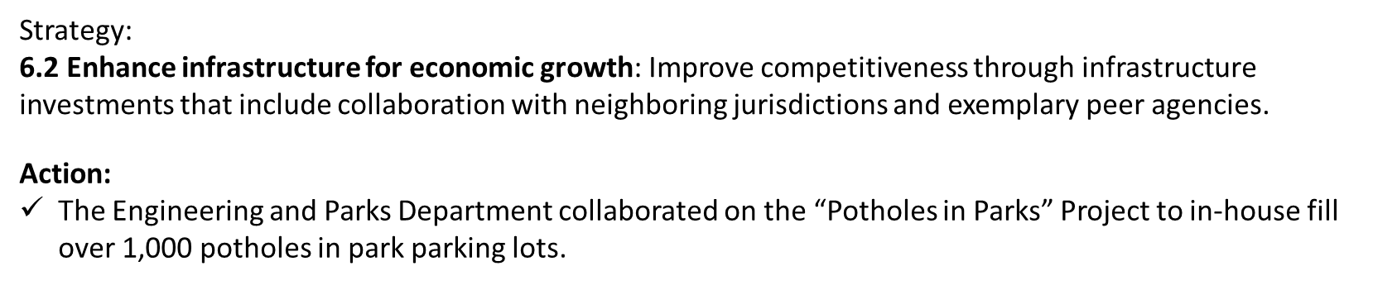
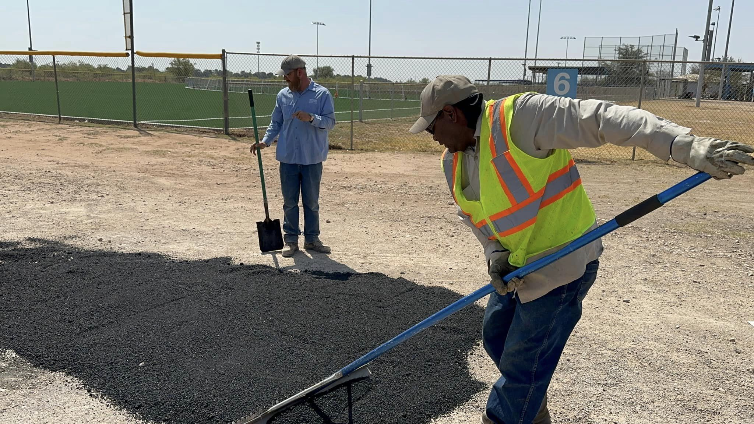
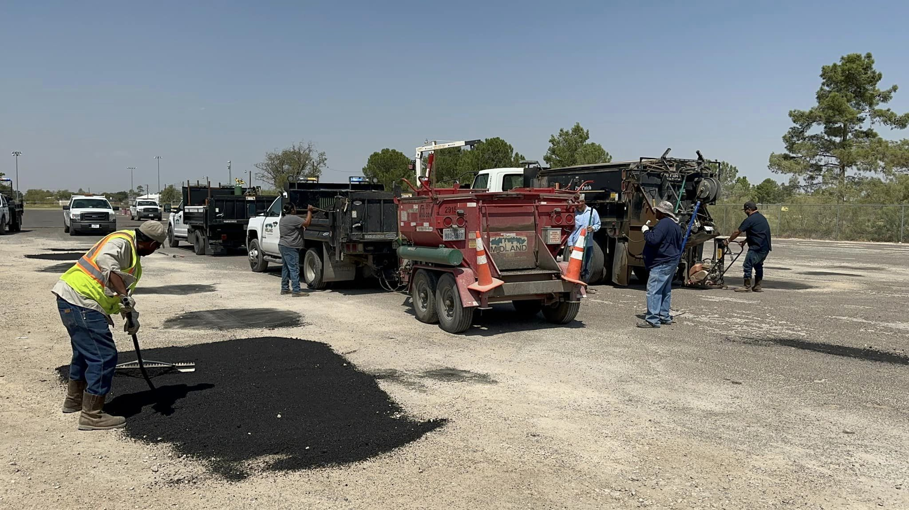
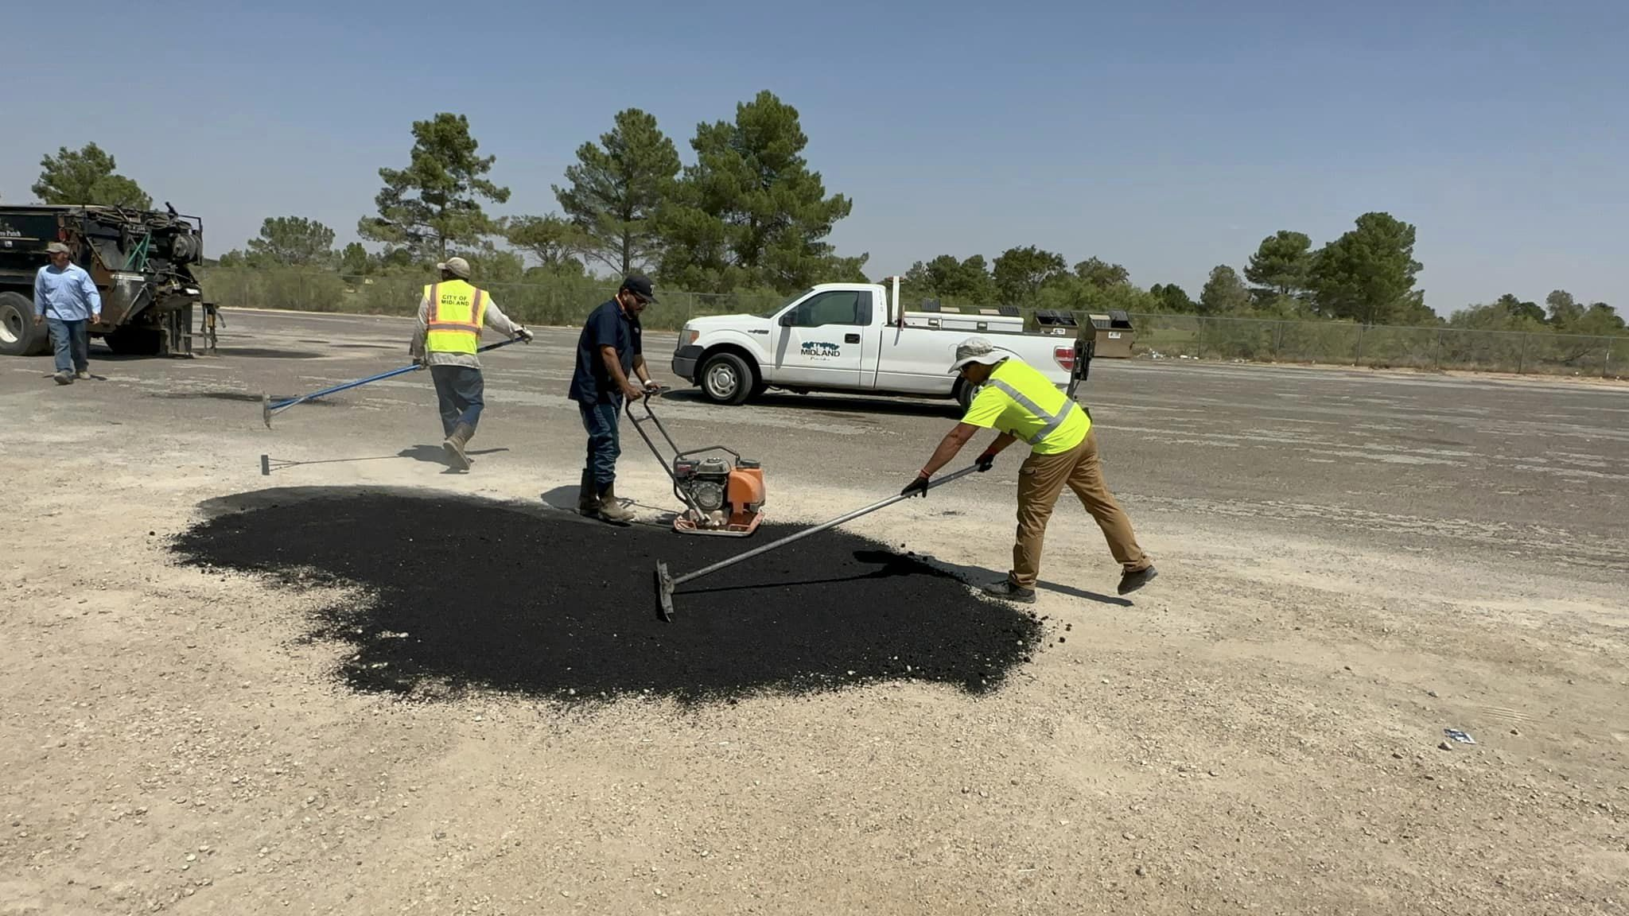
STRENGTHEN & SUSTAIN INFRASTRUCTURE
POTHOLES AT PARKS
33
Notes:
Pothole Repairs: Doubling Productivity
Leveraging technology like SeeClickFix https://www.midlandtexas.gov/1295/Download-SeeClickFix-to-your-Smartphone, Midland identified and repaired nearly 26,000 potholes in a single year—double the previous year’s total of 13,000. This streamlined process enabled faster response times and visible improvements for citizens.

Slide 34
STRENGTHEN & SUSTAIN INFRASTRUCTURE MIDLAND’S MOST TRAVELED ROADS
This program has resulted in over 495 work orders to maintain the integrity of our Most Traveled Roads. Accomplishments include:
Work Order Distribution
Litter Abatement | 60 | Enhancements for Pedestrians | 17
Pothole Repair | 58 | Improved Lighting | 67
Landscape Enhancements | 24 | ADA Compliance | 11
Road & Signage Improvements | 16 | Rectifying Buckled Curb & Sidewalks | 56
Vegetation Control | 102 | Street Sweeping | 84
34
Notes:
Engineering, Solid Waste- Parks, Code Enforcement , Streets
Key Goals Include:
Improving infrastructure and
Creating a safer, visually appealing cityscape.
The 12-Corridor Program represents a cross-functional effort aimed at addressing an all-inclusive list of issues encountered across our 12 most-traveled roadways, spanning over 50 miles
12 CORRIDORS PROGRAM: UPDATE
RESULTS THROUGH COLLABORATION

Slide 35
PUBLIC SAFETY
Police Staffing & Compensation
Restructure Pay Scale in 2024
Total Steps Reduced from 9 to 7
Reach Salary Cap at Year 10 instead of 18
Improved Process:12 Corridors and Vision Zero
Fire Fighter Retirement Fund
Fire Retirement Solution - Cash
Ensuring Future Fire Benefits with ADC
35

Slide 36
SAFE & SECURE CITY:
NON-SWORN PERSONNEL
Personnel Changes | FY2023 | FY2024 | FY2025
COLA | 5.0% | 5.0% | 2.0% Managers/Directors 2.5% Non-Managerial
Merit Pay (*as eligible) | 3.0% | 3.0% | 5.0%
Salary Tables (% increase) | 5.0% | 5.0% | N/A
Other Personnel changes | Bottom three levels removed and all staff moved up one level |  | Salary increase for Maintenance, Equip. Operators, and other Infrastructure focused staff
36
Notes:
Point out the Infrastructure positions

Slide 37
SAFE & SECURE CITY:
POLICE
Personnel Changes | FY2023 | FY2024 | FY2025
Sworn Police Salary Tables (% increase) | 5.0% | 5.0% | 2.5%
Step Raise/Merit Pay (*as eligible) | Next Step (5%) | Next Step (5%) | Next Step (5%)
Other Police Changes |  | Salary Table Restructure. Decreased Max Step on Police and Warrant Officers
2023 → 2024
2023 → 2024
2023 → 2024
5% increase across the board to base pay
Cost: $1.1 M
Pay steps decreased from 9 steps to 7 steps
Cost: $1.4 M
The years to reach max pay (step 7) decreased from 18 years to 10 years
37
Notes:
Focus on Public Safety- In FY2024
5% increase to base pay $1.1M
Pay steps consolidated from 9 to 7: $1.4M
The maximum pay can now be reached in 10 years instead of 18
POLICE – Recruitment and Retention is also a priority for our SWORN employees. Police received a 5% step increase and an overall re-structure of the steps to reach maximum pay 8 years earlier.

Slide 38
SAFE & SECURE CITY:
FIRE
Personnel Changes | FY2023 | FY2024 | FY2025
Sworn Fire Salary Tables (% increase) | 5.0% | 5.0% | 2.5%
Step Raise/ Merit Pay (*as eligible) | Next Step (5%) | Next Step (5%) | Next Step (5%)
Other Fire Changes | Combined Firefighters and Fire Engineers, with increased Max Pay and Step 7 to 9 | 13 Positions added
2023 → 2024
5% increase across the board to base pay
Cost: $1.2 M
13 positions added:
- 1 training engineer
- 6 EMS crew
- 6 firefighters to cut down on OT
Cost: $1.0 M
38
Notes:
Focus on Public Safety- In FY2024
5% increase to base pay: $1.2 M
13 Positions added: $1.0M to address growth and improved response times.
FIRE – received a 5% step increase; 13 positions were added to address growth and improved response times. Firefighter pay has also been reviewed against other Cities and a comprehensive pay adjustment is being considered by management.

Slide 39

SAFE & SECURE CITY
SOUND FISCAL PRACTICES
Potential Fire Retirement Fund Solution:
Cash Infusion being used in lieu of Pension Obligation Bond
Saving over $60M in Bond Interest
Huge factor in maintaining Bond Rating
Future Stability of the Fund
Actuarily Determined Contribution (ADC) participation by both Fund and City (2:1)
Regular Investment and Financial presentations by the Fund to Council
39
Notes:
Will fund the pension bond upon approval vote from the Fire Fighter Retirement Review Board
We have worked together with the Firefighters toward a solution to the Fire Retirement Fund that saves the City over $60M in interest, as well as provide for stability of the fund moving forward.

Slide 40
STRENGTHEN & SUSTAIN INFRASTRUCTURE
WATER CAPITAL AND REFUNDING
FY24 $25 million for Project construction and Refunding
Refund NE Sewer Main: $16 Million
Airport Wastewater Lift Station Construction: $3 Million
Wadley (I to Garfield) Utility Construction: $3 Million
Golf Course at Scharbauer Utility Construction: $3 Million
$25 Million
FY28 $40 Million Funding
Design, permitting, and construction of Sludge tank at WRF $10 Million
Phase I Paul Davis Advanced Treatment $30 Million
$40 Million
40
Notes:
Were issued a CO in 2024 for the first four projects.
Projects needed following completion- potential further issuance

Slide 41

PROPOSED 4-LEVEL PARKING GARAGE
Current parking lots have 2,828 parking spots available and are above 80% full most weekends and completely full most holidays, with free (LOST REVENUE) overflow parking necessary.
Airport funding for a 4-level garage adds 1,006 additional spaces.
El Paso added a parking garage 8 years ago and created an extra 700 spaces.
Projected immediate revenue increase of $5 million a year, growing every year after.
41

Slide 42

STRENGTHEN & SUSTAIN
INFRASTRUCTURE
SOLID WASTE
Cleaned up approximately 280 tons of litter through various programs
Implemented Rubicon Truck Routing System to increase Route Efficiency
Collected approximately 662 tons of large items throughout Midland
Collected 800 tons of Recyclables at the Citizen Collection Station
Changed out over 1,200 dilapidated containers throughout Midland
Cleaned up over 40 major illegal dumpsites
Annually collect approximately 300,000 tons of waste at the Landfill
Averaged around 1,000 tons per day collected at the Landfill
42
Notes:
Includes responsibility of unfunded mandates

Slide 43
SOUND GOVERNENCE AND FISCAL MANAGEMENT
Healthy Fund Balances
Ensuring ALL Funds are Self-Supporting
Revenue and Fee Restructuring of Enterprise Funds
Utilized Vacancies to create Execute Strategic Plan
TIRZ and Strategic Use of 380 Agreements
Collection Practices Implemented
Audits Underway of Franchise Fees, Hotels, Sales Tax
43
Notes:
TIRZ and 380 – Downtown, 191 – Costco area, Sports Complex
Vacancies were funded to implement strategic plan- strategic positions
Summary: We will continue to ensure all funds are self-supporting with healthy reserves. We have completed studies and revenue analysis, restructured many enterprise fee schedules. Utilize funds budgeted for positions but not used for execution of strategic plan. Revenue saving/sourcing strategies implemented:
Done with first 20 hotels and should collect revenue-

