Slide 1
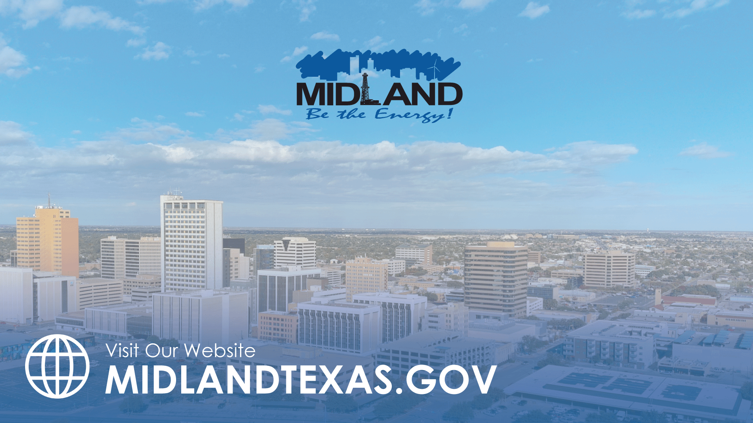
TRANSPORTATION LANDSCAPE IN MIDLAND
TITLE HERE
TITLE HERE

Slide 2

Strategic Goal Connections
Goal 3: Quality of Life & Place
Goal 5: Provide Sound Governance and Fiscal Management
Goal 6: Strengthen and Sustain Our Infrastructure
2

Slide 3
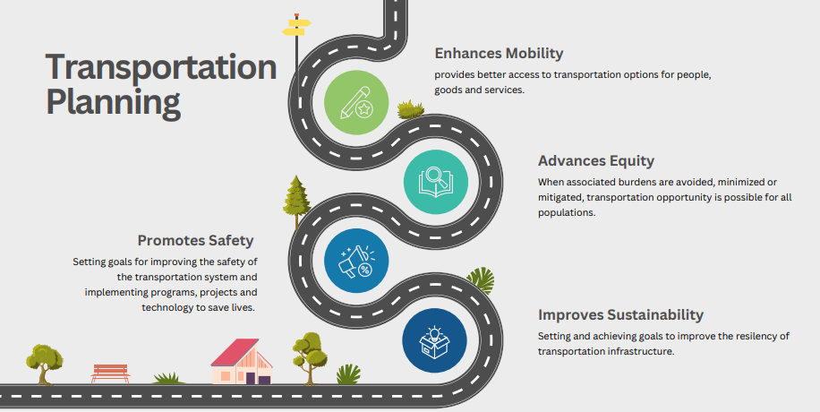
Transportation Planning
Transportation systems when properly and adequately planned, funded and maintained can produce social, economic and safety benefits.
Transportation Planning requires advocacy from government agencies, private sector organizations and stakeholders
3

Slide 4
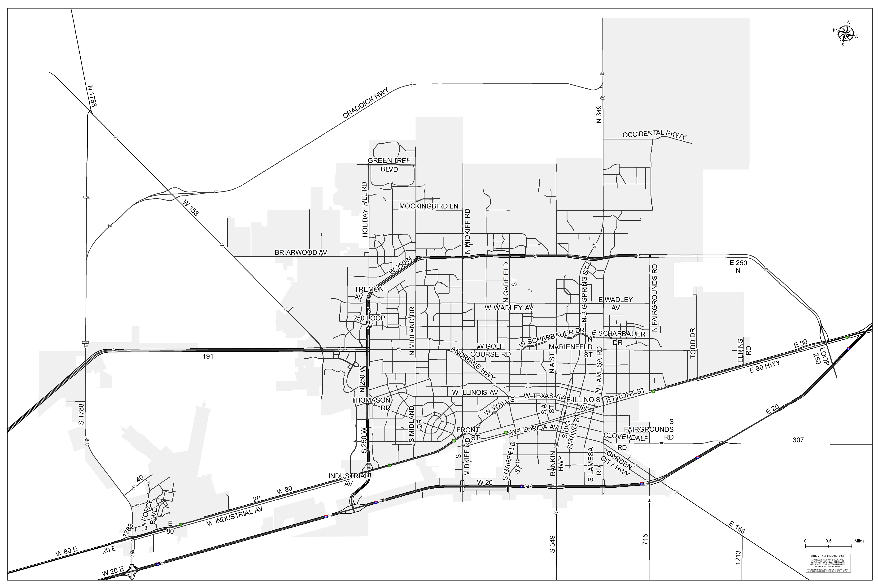
Midland
4

Slide 5

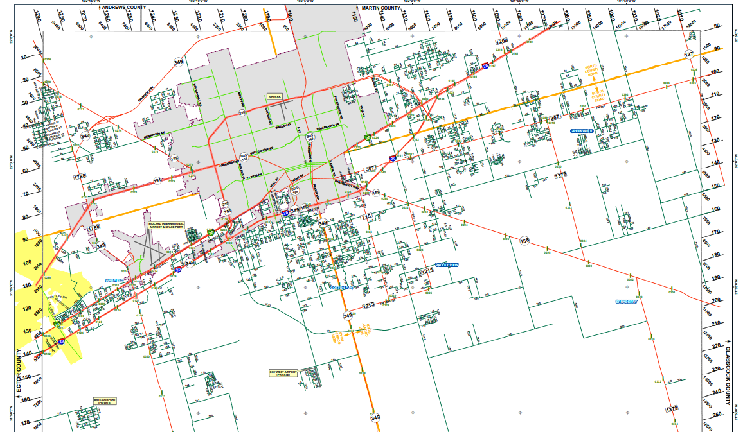
Transportation Resiliency
The key to building a resilient transportation system in Midland includes various needs:
Reducing truck traffic congestion due to heavy freight traffic
Providing safer and more reliable routes
Roadway connectivity and access to key state and national markets
Safe passage that separates commuter and commercial traffic
5

Slide 6

KEY PLAYERS IN MIDLAND TRANSPORTATION
Texas Department of Transportation (State right-of-way)
Permian Basin Metropolitan Planning Organization (PBMPO)
City of Midland (City right-of-way)
Midland County
Midland Development Corporation (MDC)
6

Slide 7
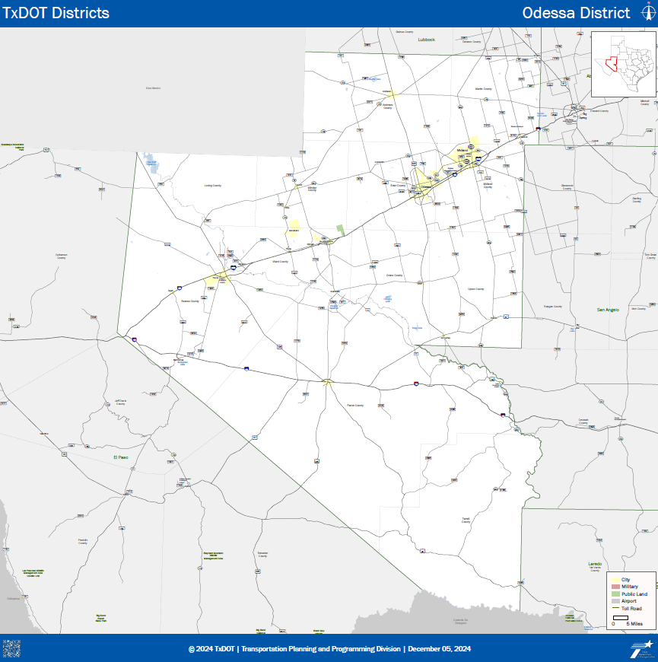
TEXAS DEPARTMENT OF TRANSPORTATION (TxDOT)
ODESSA DISTRICT
7

Slide 8
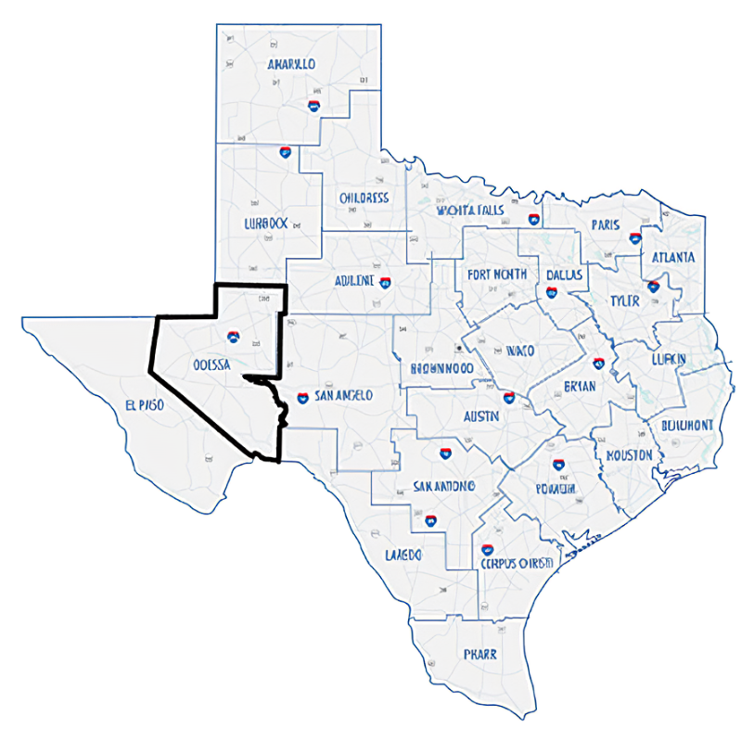
TxDOT Odessa District
The Odessa District plans, designs, builds, operates and maintains the state transportation system in the following counties: Andrews, Crane, Ector, Loving, Martin, Midland, Pecos, Reeves, Terrell, Upton, Ward, and Winkler.
18,348 square miles
8,228 lane miles
For 2024 and 2025, the district has been allocated an average of $4.1 billion in UTP funding. This funding will be used to enhance safety, upgrade energy sector corridors, improve interchanges, and develop Super 2 lanes on smaller, high-volume roads. The district has let $1.8 billion in projects and is planning to initiate another $377million in construction projects in fiscal year 2025.
8

Slide 9
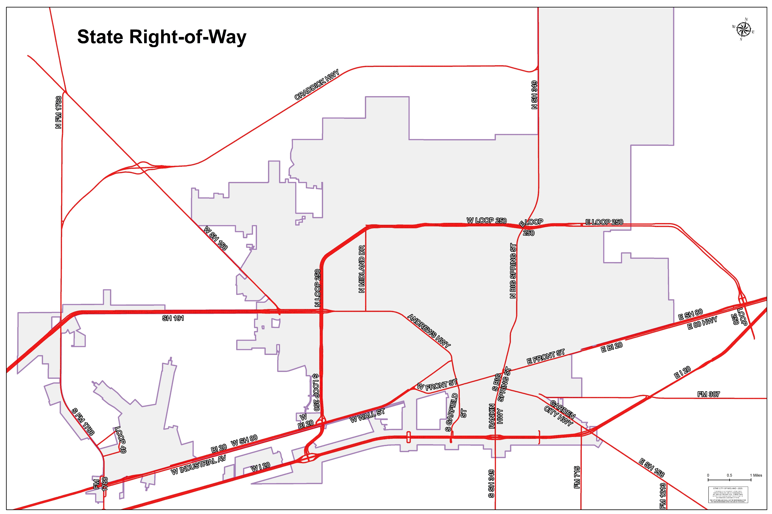
TxDOT ROW In City limits (On System)
9

Slide 10
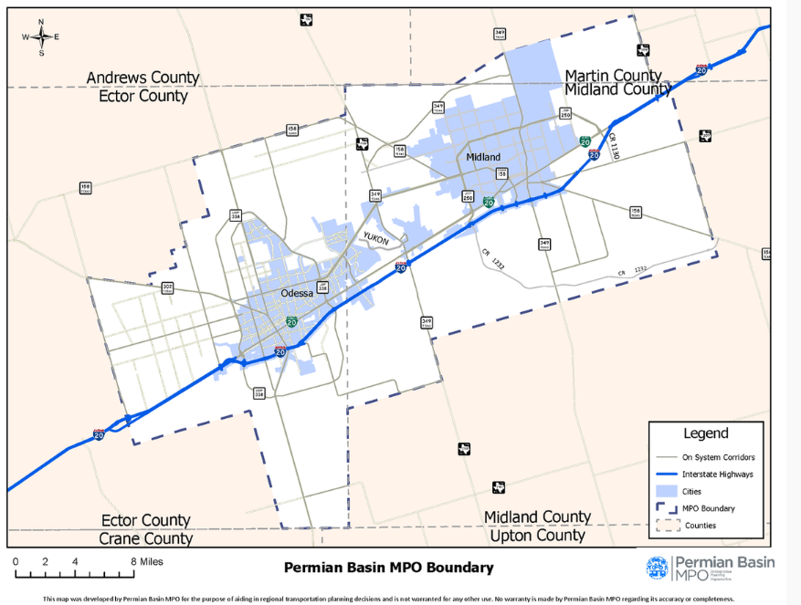
PERMIAN BASIN METROPOLITAN PLANNING ORGANIZATION
PBMPO
10

Slide 11
PERMIAN BASIN METROPOLITAN Planning organization (PBMPO)
MPO Policy Board: Local decision-making body responsible for metropolitan planning processes (required for each urban area over 50k in population)
MPO Technical Advisory Committee (TAC): Representatives from member entities with skills and specialties for long range planning.
Policy Board Members:
Ector County Commissioner Mike Gardner (Chairman)
Midland City Councilman Jack Ladd (Vice- Chairman)
Midland County Judge Terry Johnson
Odessa City Councilman Steve Thompson
Martin County Judge Bryan Cox
MOUTD (EZRider) General Manager Kayleen Hamilton
TxDOT Odessa District Engineer Eric Lykins, P.E.
TAC Members:
Cameron Walker, AICP, MPO
Robert Ornelas, P.E., TxDOT
Chad Windham, P.E. TxDOT
Andrew Avis, Midland County
Jeffrey Avery, Ector County
Taha Sakrani, P.E., City of Midland
Joe Tucker, P.E., City of Odessa
Landon Ochoa, City of Midland
Jose Ortiz, City of Midland
Adrian Acosta, City of Midland
Lindsey Adams, City of Midland
11

Slide 12
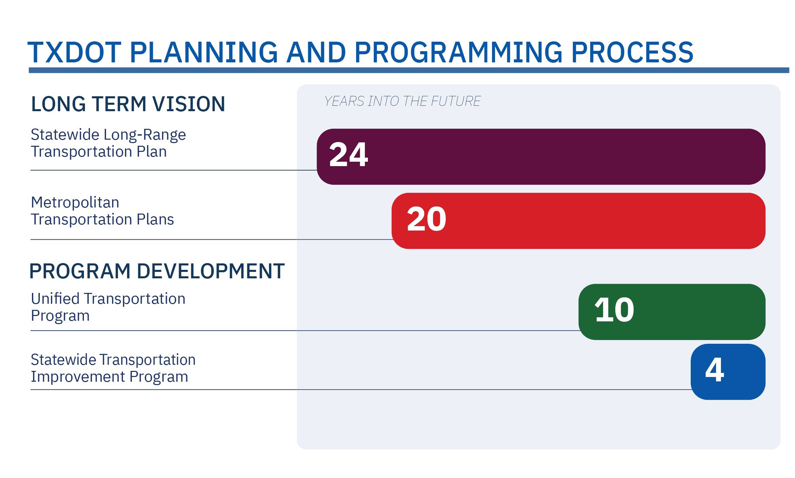
TXDOT Planning process – mpo process
(MTP)
(UTP)
(STIP)
12
Notes:
Talk about how projects move through this process-
Fiscally restrained for UTP
Discuss things such as capacity at TXDOT and letting windows (Todd Dr. ex)

Slide 13
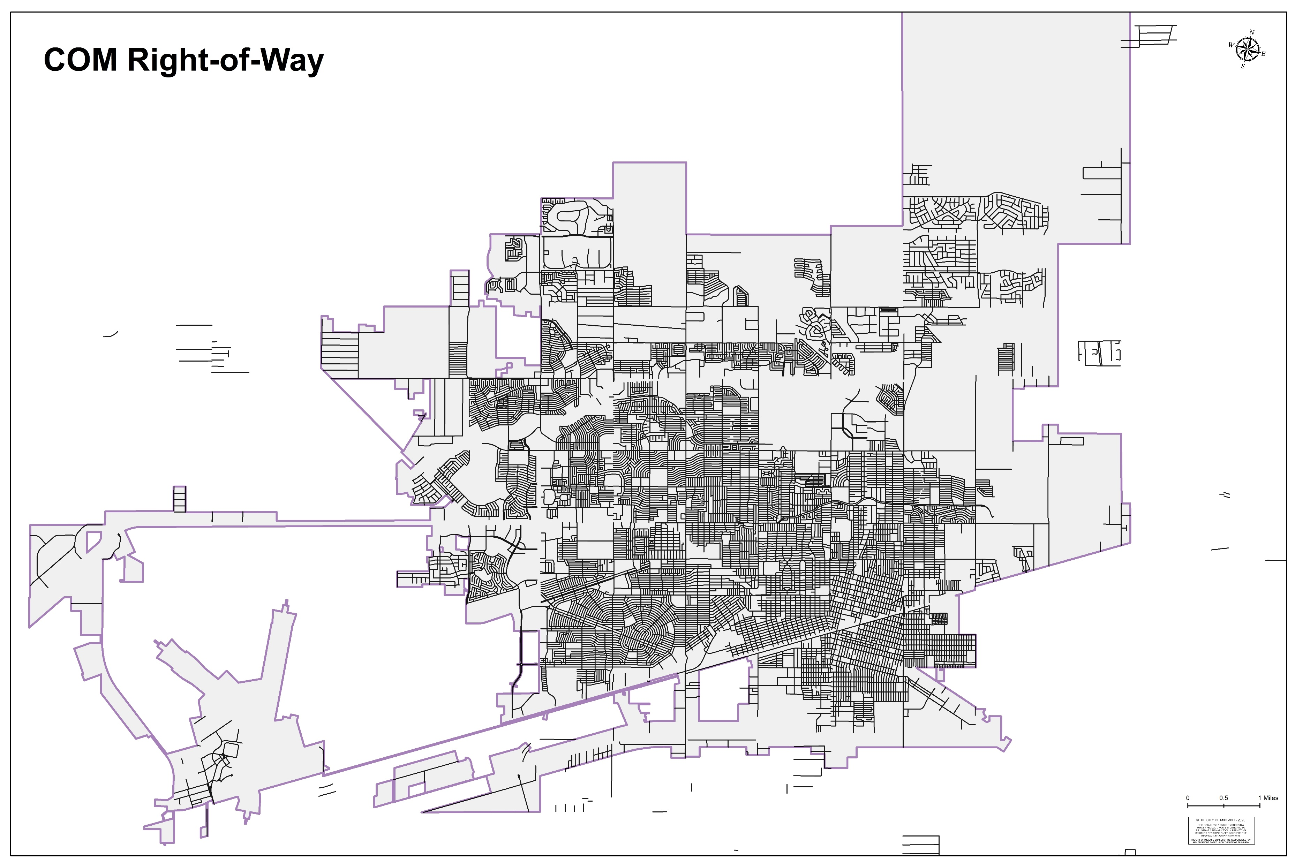
CITY OF MIDLAND RIGHT-OF-WAY (OFF SYSTEM)
670 miles of paved roads
FY 25 $6.5 million operations
Approx $1 billion pavement network value
13

Slide 14
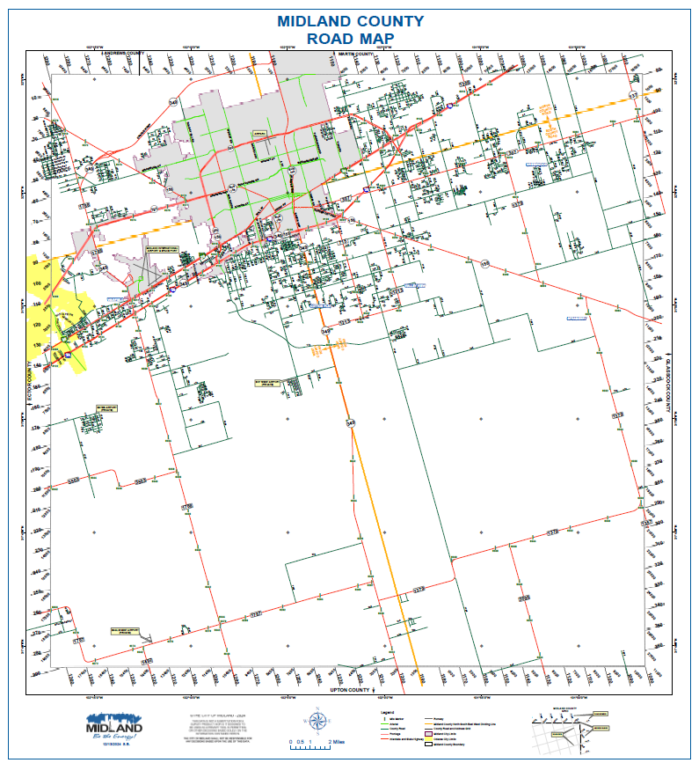
MIDLAND COUNTY
Close Partners with City
City limits inside the County are the responsibility of the City
14

Slide 15
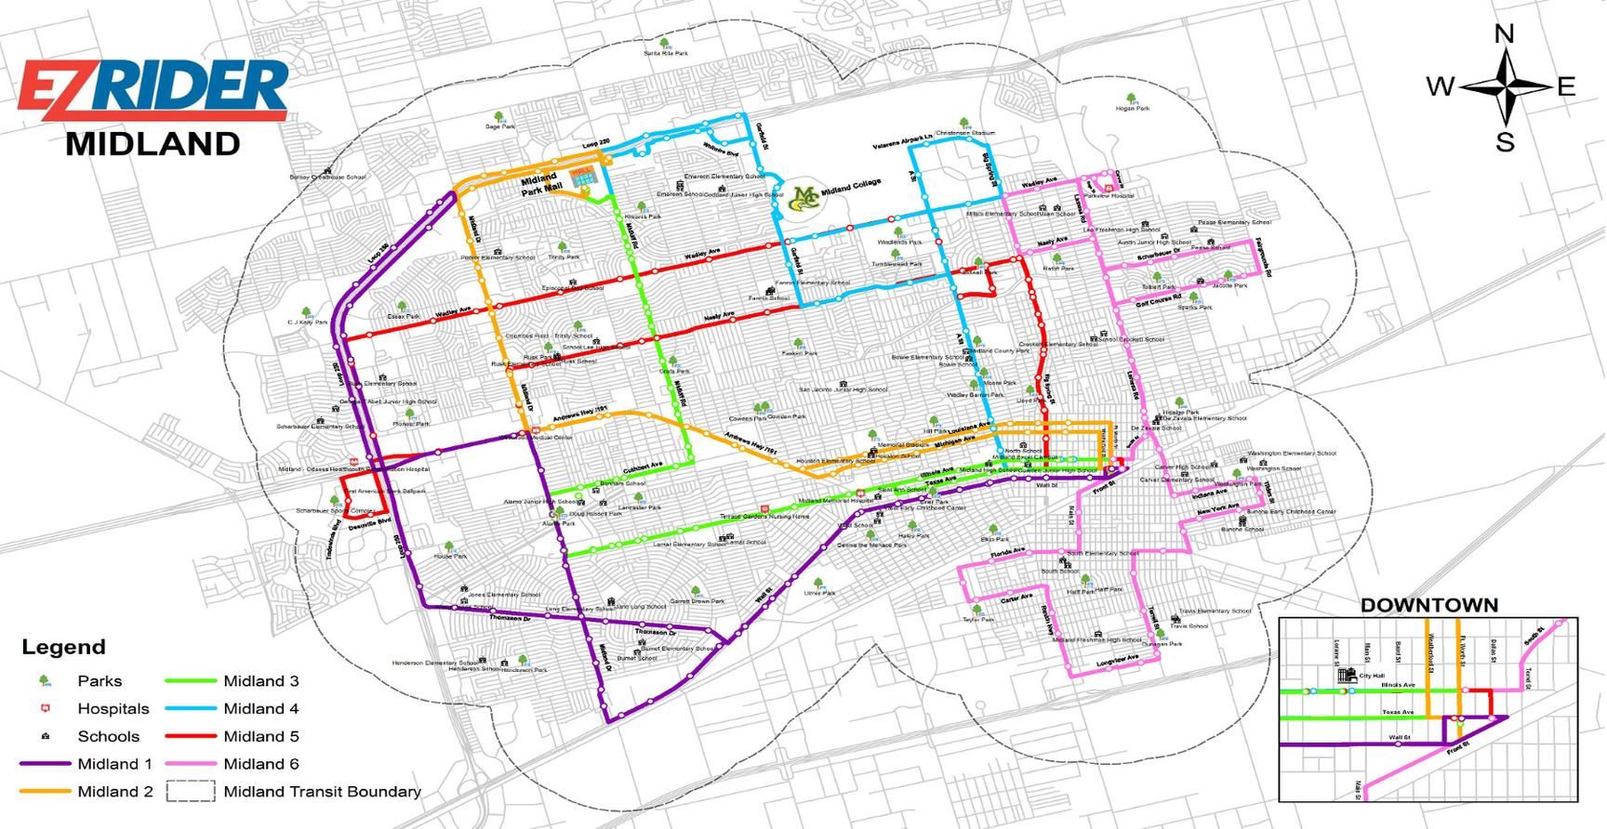
MIDLAND-ODESSA URBAN TRANSIT DISTRICT (MOUTD- EZRIDER)
It is the mission of Midland Odessa Urban Transit District (EZ-Rider) to provide safe, reliable, affordable, and efficient public transportation with quality customer service to the Midland Odessa urban area.
15

Slide 16
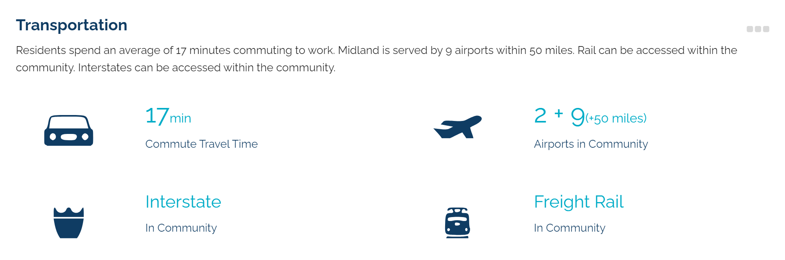
MIDLAND DEVELOPMENT CORPORATION (MDC)
16

Slide 17

Advocacy
The success of transportation planning includes advocacy at regional, state and federal levels in order to create holistic partnership and approaches. This advocacy is critical in determinations such as:
Specific route selection
Funding allocations for planning, design, ROW acquisition and construction
Economic Growth based on route selection with importance of highlighted corridors
17

Slide 18
CURRENT ADVOCACY
PBMPO Board Representation
PBMPO TAC Representation
Meetings with TXDOT- Local and State Staff
Permian Strategic Partnership (PSP)
Texas Transportation Commission
Midland Odessa Transportation Alliance (MOTRAN)
18

Slide 19


Permian Strategic Partnership (PSP)
Coalition of 28 leading Permian Basin energy companies and higher education institutions
Working together to address current and future challenges to the responsible development of the vast oil and natural gas resources of the Permian Basin
One of their main pillars is Road Safety
Identifying road infrastructure initiatives that can be accelerated through public-private partnership
19
Notes:
Debra ☺ Great partner to us!

Slide 20
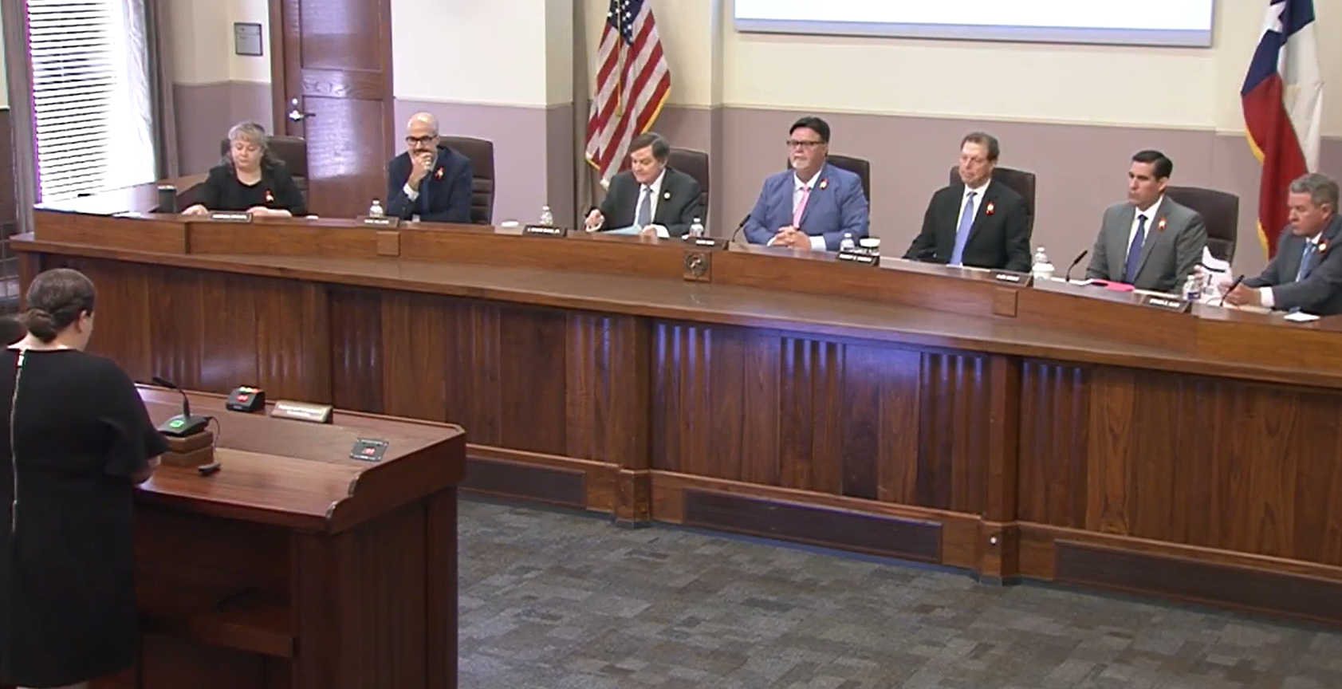
TEXAS TRANSPORTATION COMISSION (TTC)
Governing body of TXDOT (5 members & executive director )
Responsible for:
planning and making policies for the location, construction and maintenance of state highways,
overseeing the design, construction, maintenance and operation of the state highway system,
developing a statewide transportation plan that contains highways and turnpikes, aviation, mass transportation, railroads, high-speed railroads and water traffic,
awarding contracts for the improvement of the state highway system,
fostering and assisting in the development of public and mass transportation in the state, and
adopting rules for the operation of the department.
20

Slide 21
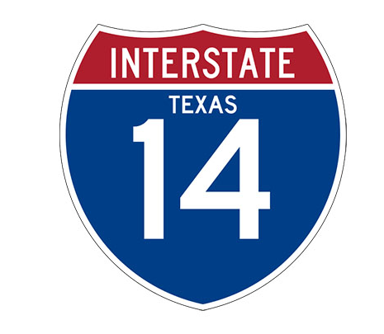
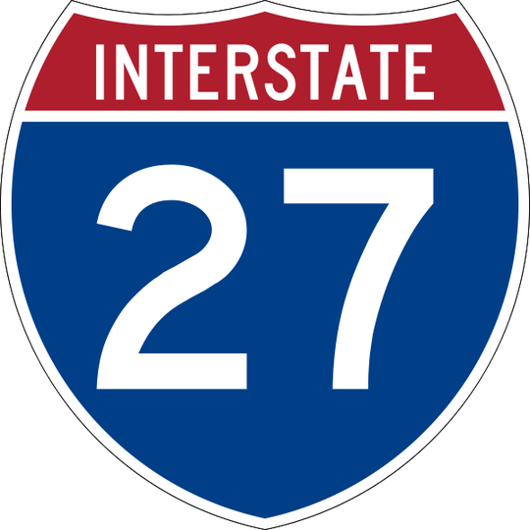
FUTURE OF TRANSPORTATION IN MIDLAND
21

Slide 22

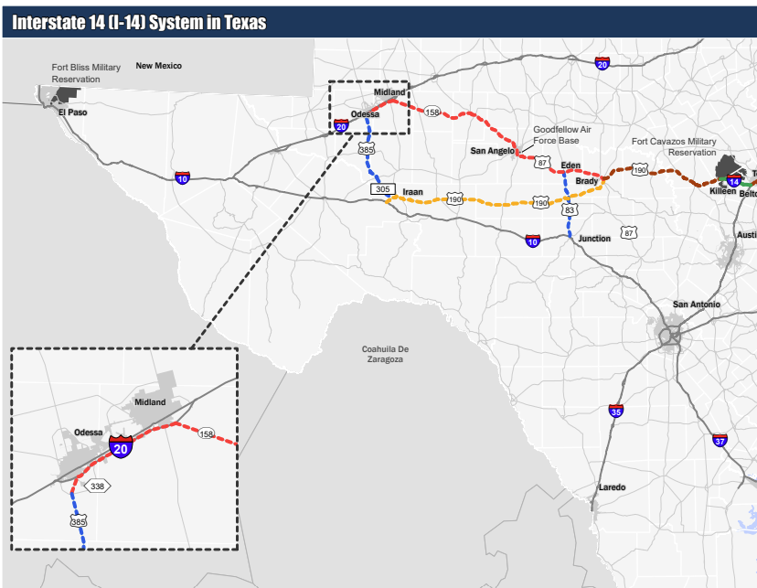
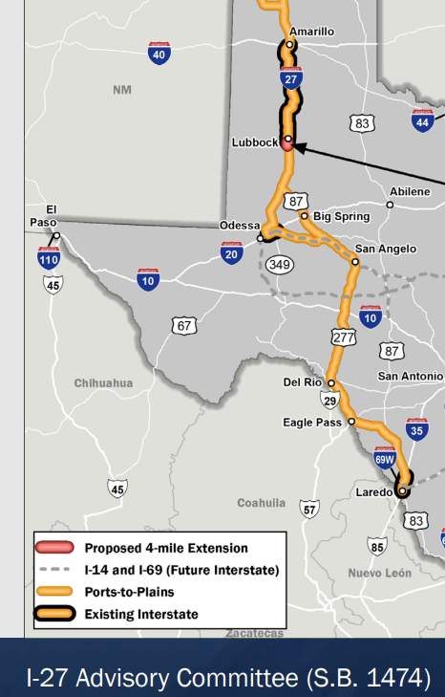
New Corridors
The I-27 and I-14 Corridors have received national designation, but significant work remains in terms of planning, route selection, and securing funding for these essential corridors.
Currently, TxDOT has advisory committees for both corridors which includes various stakeholders from across the corridors that meet to provide fair, reliable and comprehensive advice and recommendations on a variety of transportation issues.
22
Notes:
I- 27 is North South corridor from Laredo to Alberta
I-14 is an East West Corridor with North South Connection in Midland

Slide 23
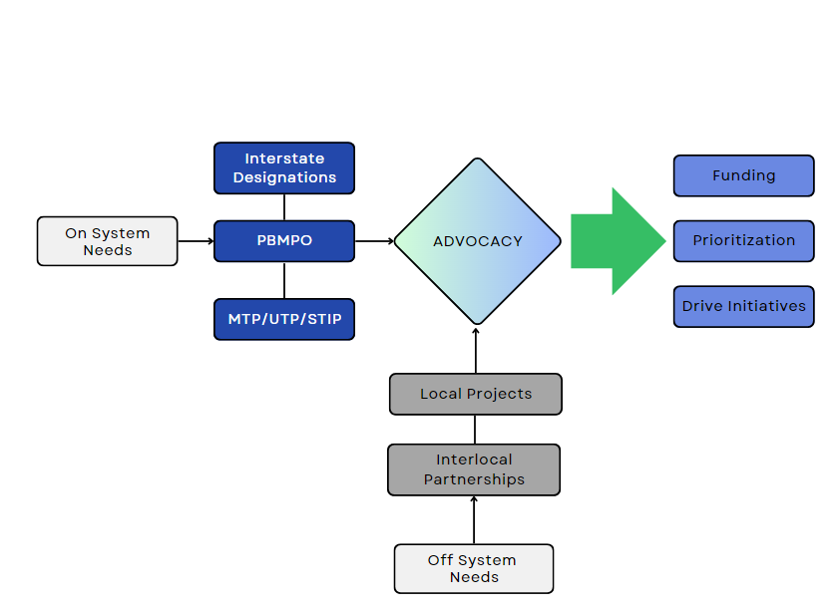
IT ALL ADDS UP
23

Slide 24
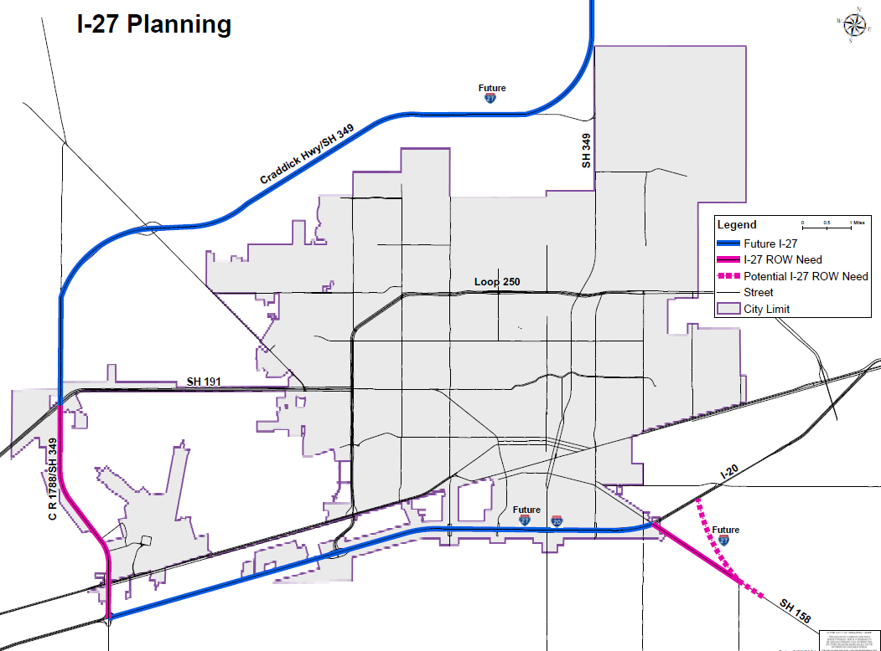
24

Slide 25

ADVOCACY: MOTRAN
MIDLAND ODESSA TRANSPORTATION ALLIANCE
MDC Economic Development Agreement:
$142,500 annually
Approved by MDC & City Council
MOTRAN advocates for the Midland-Odessa area for projects and initiatives related to transportation, economic growth and more.
MOTRAN played an instrumental role in the I-14 designation
25
Notes:
Yearly term- expires on Sept 30th of each year- in place since 2010 and matched by ODC- not membership dues, but covers entirety of Motran operating expenses.

Slide 26

Ports to Plains Alliance
Currently do NOT have a membership
Annual Membership: ~$85,000 per year based on population
Membership Benefits:
Eligible for election on Ports-to-Plains Alliance Board of Directors
Participation in all Policy Development, Events and Organization Activities
Invitation to join us at our annual Washington DC Fly-in to meet with federal legislators
One year of regular Membership including general listing on www.portstoplains.com
Membership registration rate for all representatives to all Ports-to-Plains Events
Subscription to Ports-to-Plains newsletter, updates and action alerts
26

Slide 27

MISSION
Deliver exceptional services and promote a high quality of life and place for ALL our citizens.

