Slide 1

MIDLAND COUNTY MOU
ITEM 18
OFFICE SPACE UTILIZATION
February 25, 2025
TITLE HERE
TITLE HERE

Slide 2

STRATEGIC GOAL CONNECTIONS
Goal #2: Set the Standard for a Safe and Secure City
2.1 Be the safest city in West Texas: Enhance public safety programs.
Goal #6: Strengthen and Sustain our Infrastructure
6.3 Streamline and consolidate City Facilities: Create synergy for improved services.
2

Slide 3

PRESENTATION OUTLINE
PROJECT OVERVIEW
PROJECT BENEFITS
3

Slide 4

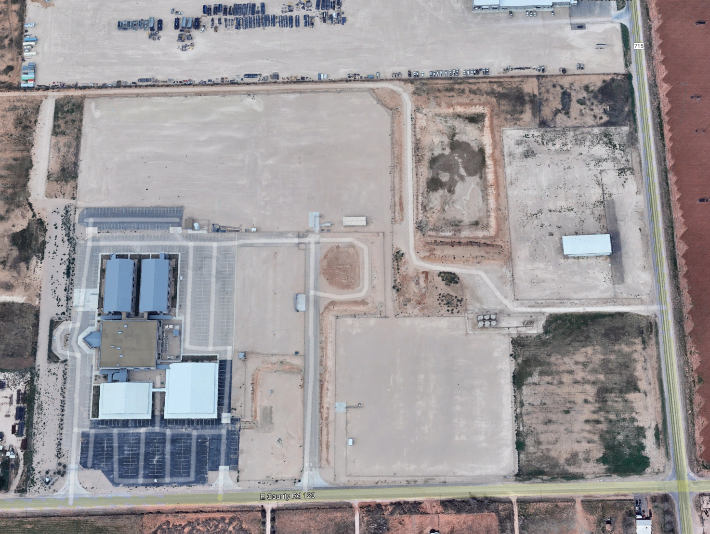
PROJECT OVERVIEW
Move the Following Divisions
Fire Department
Fire Marshal’s Office
Emergency Management
Health Department
Health & Environmental Inspectors
Public Health Preparedness Coordinator
4

Slide 5

PROJECT BENEFITS
Much Needed Office Space
Emergency Management Collaboration
Food Truck Permitting Coordination
Environmental Accessibility
5

Slide 6

OFFICE SPACE
Fire Marshall's Office & Health Inspectors are currently operating out of cramped spaces.
6

Slide 7
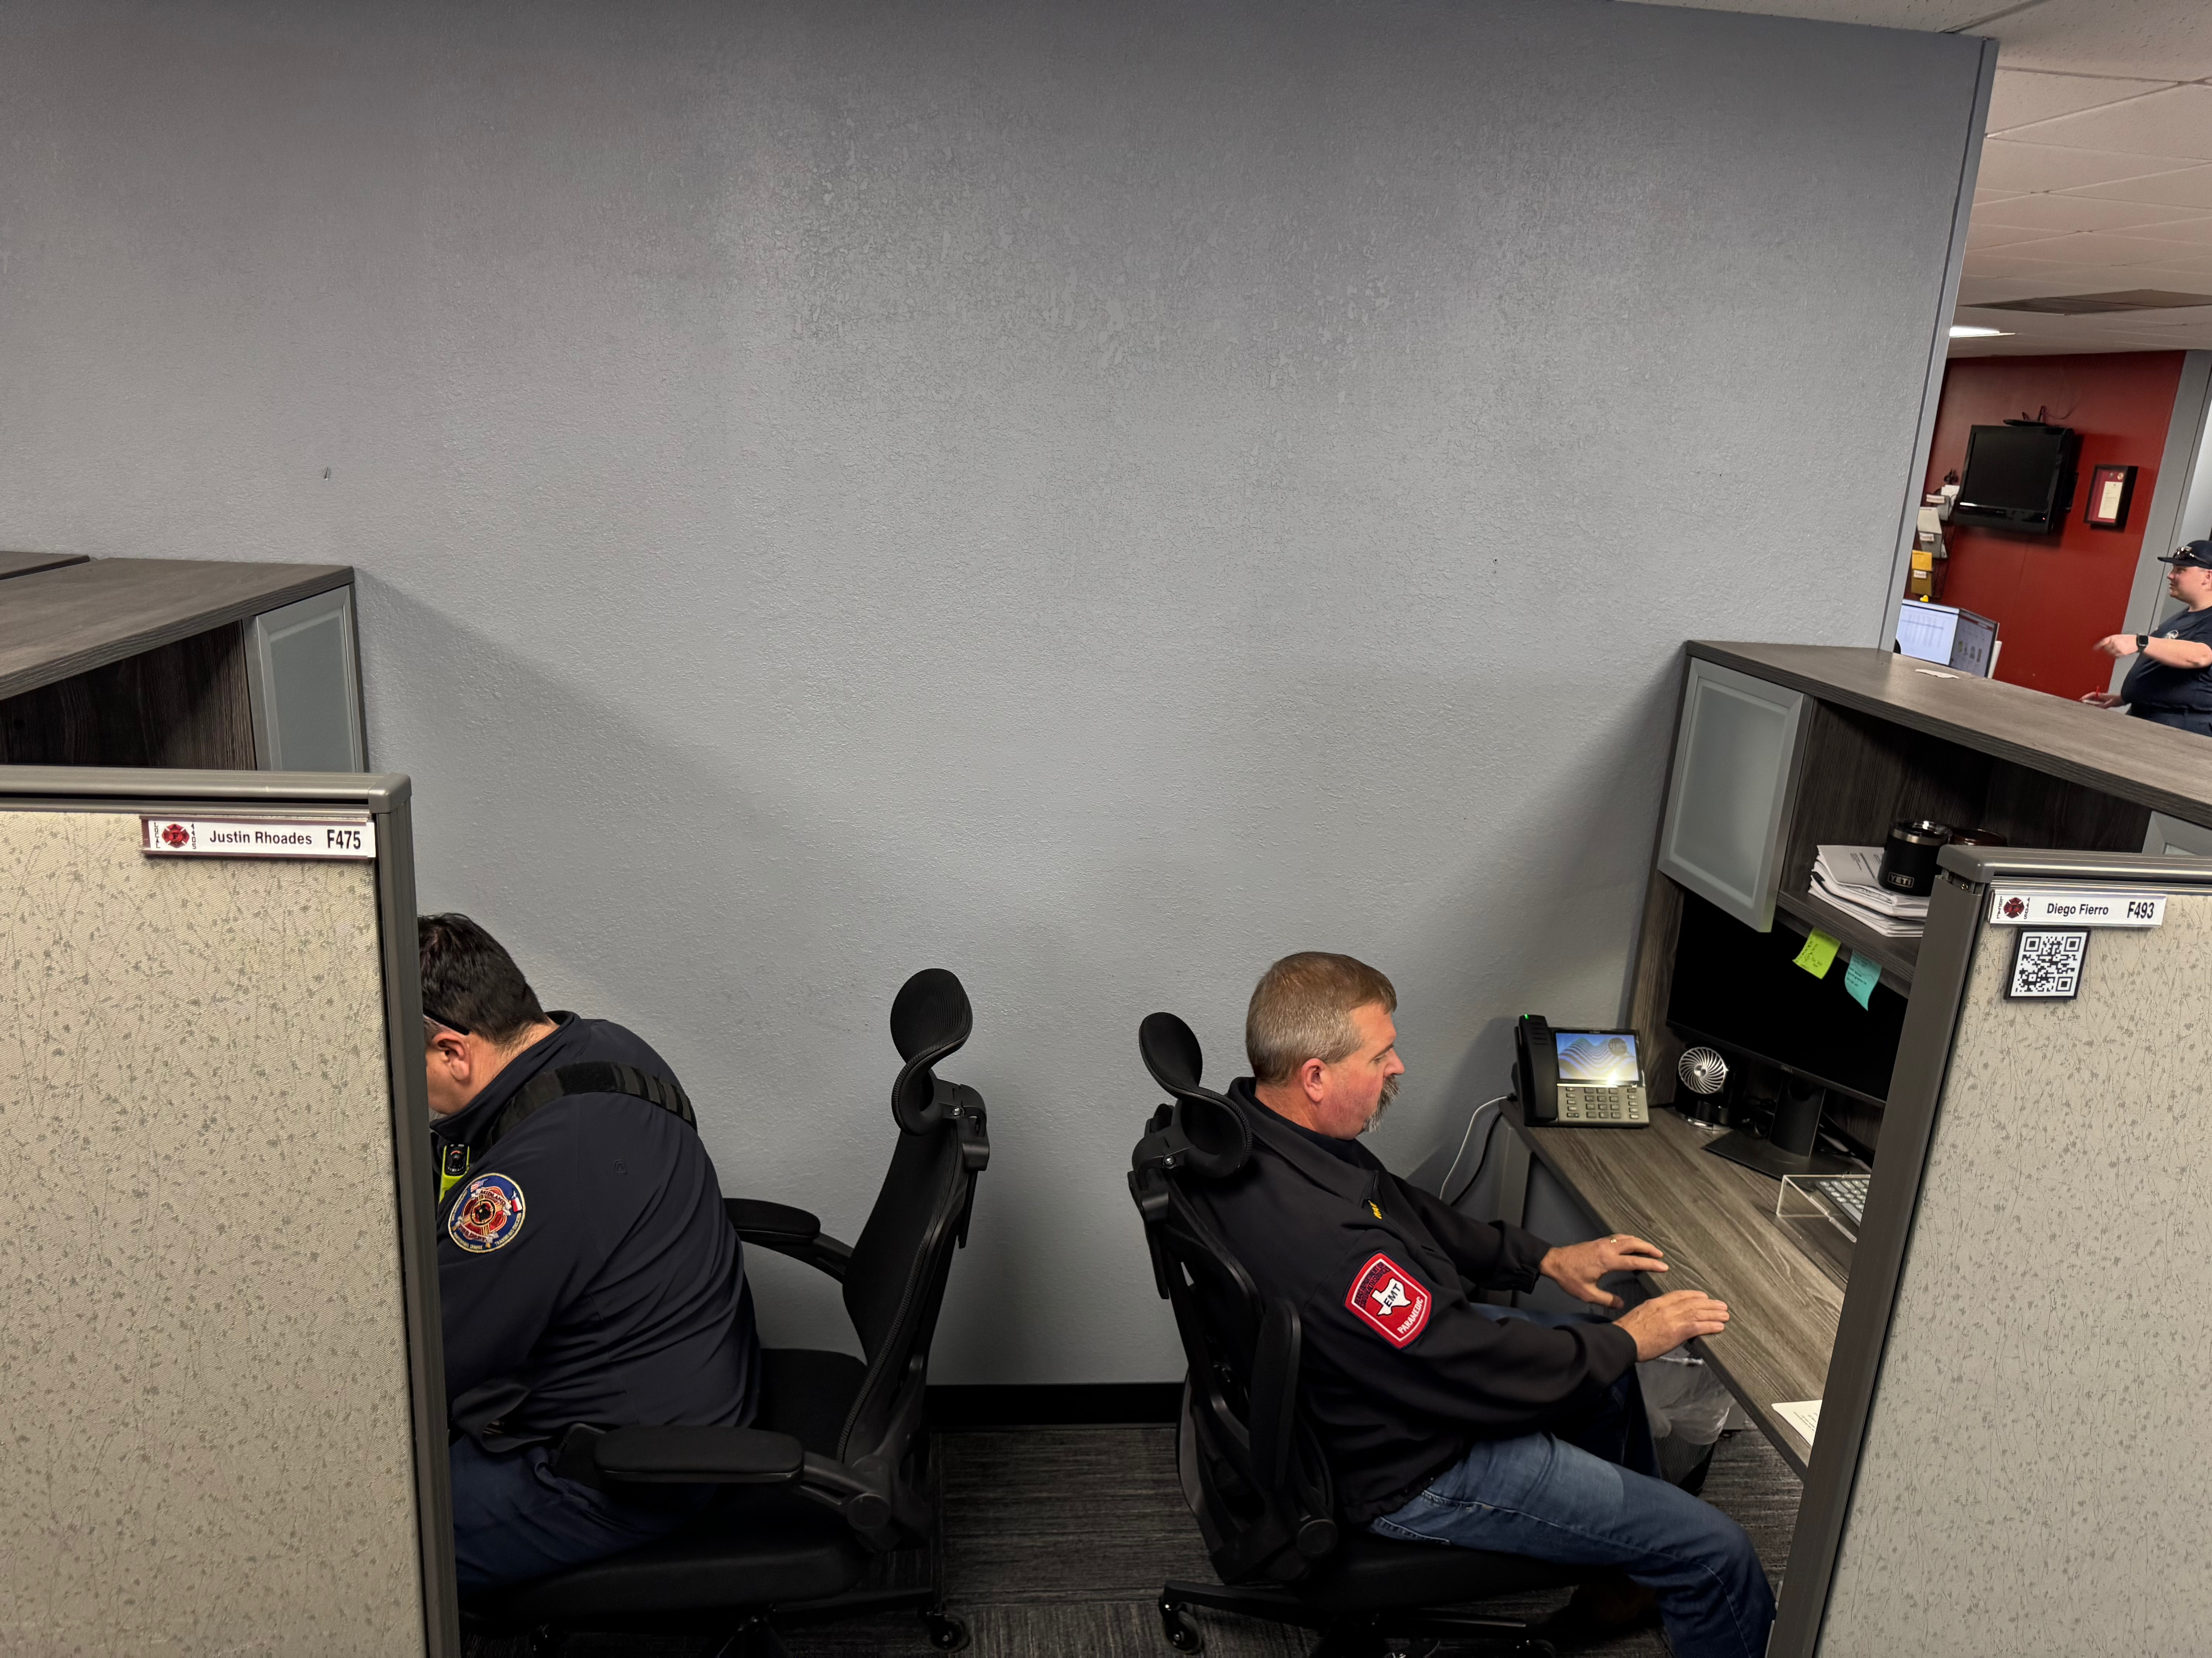
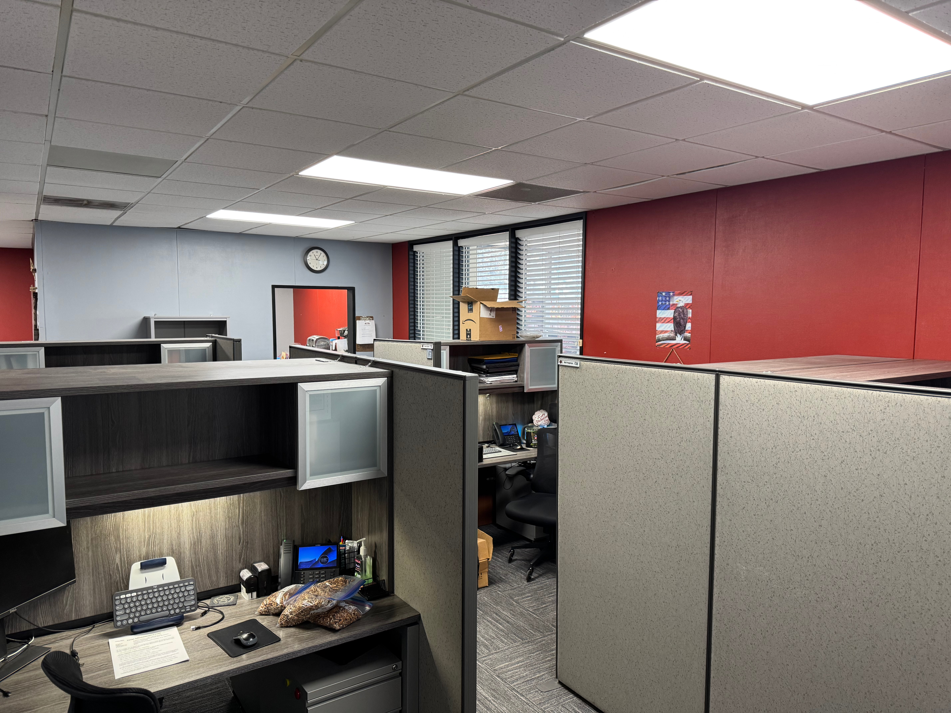
OFFICE SPACE
Fire Marshall Office Current Working Space
7

Slide 8
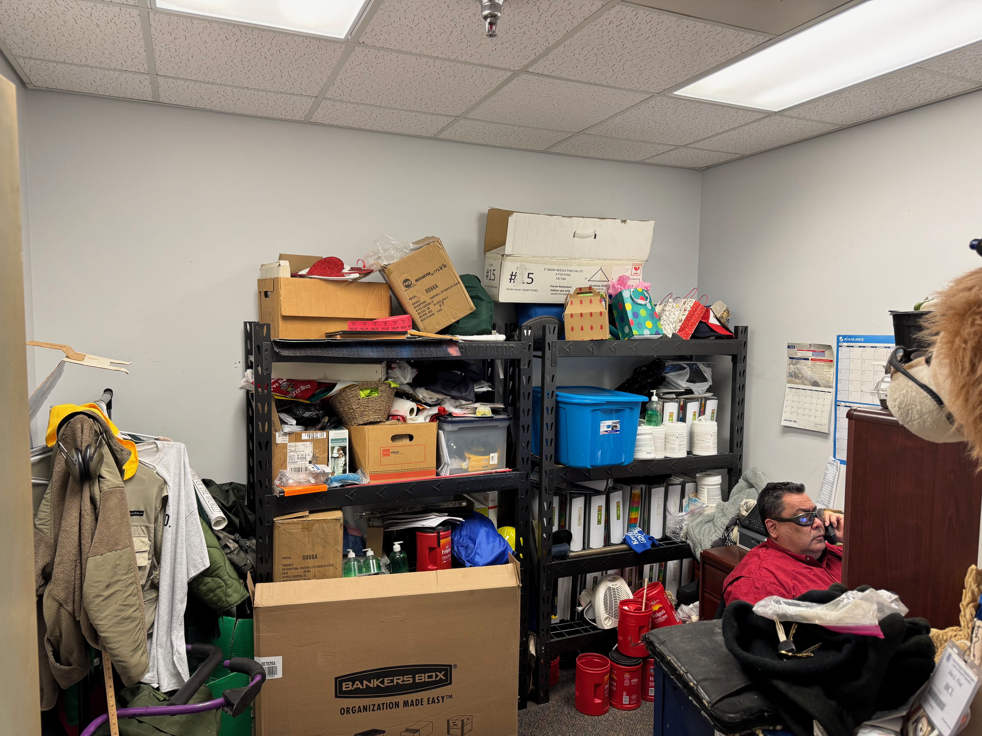
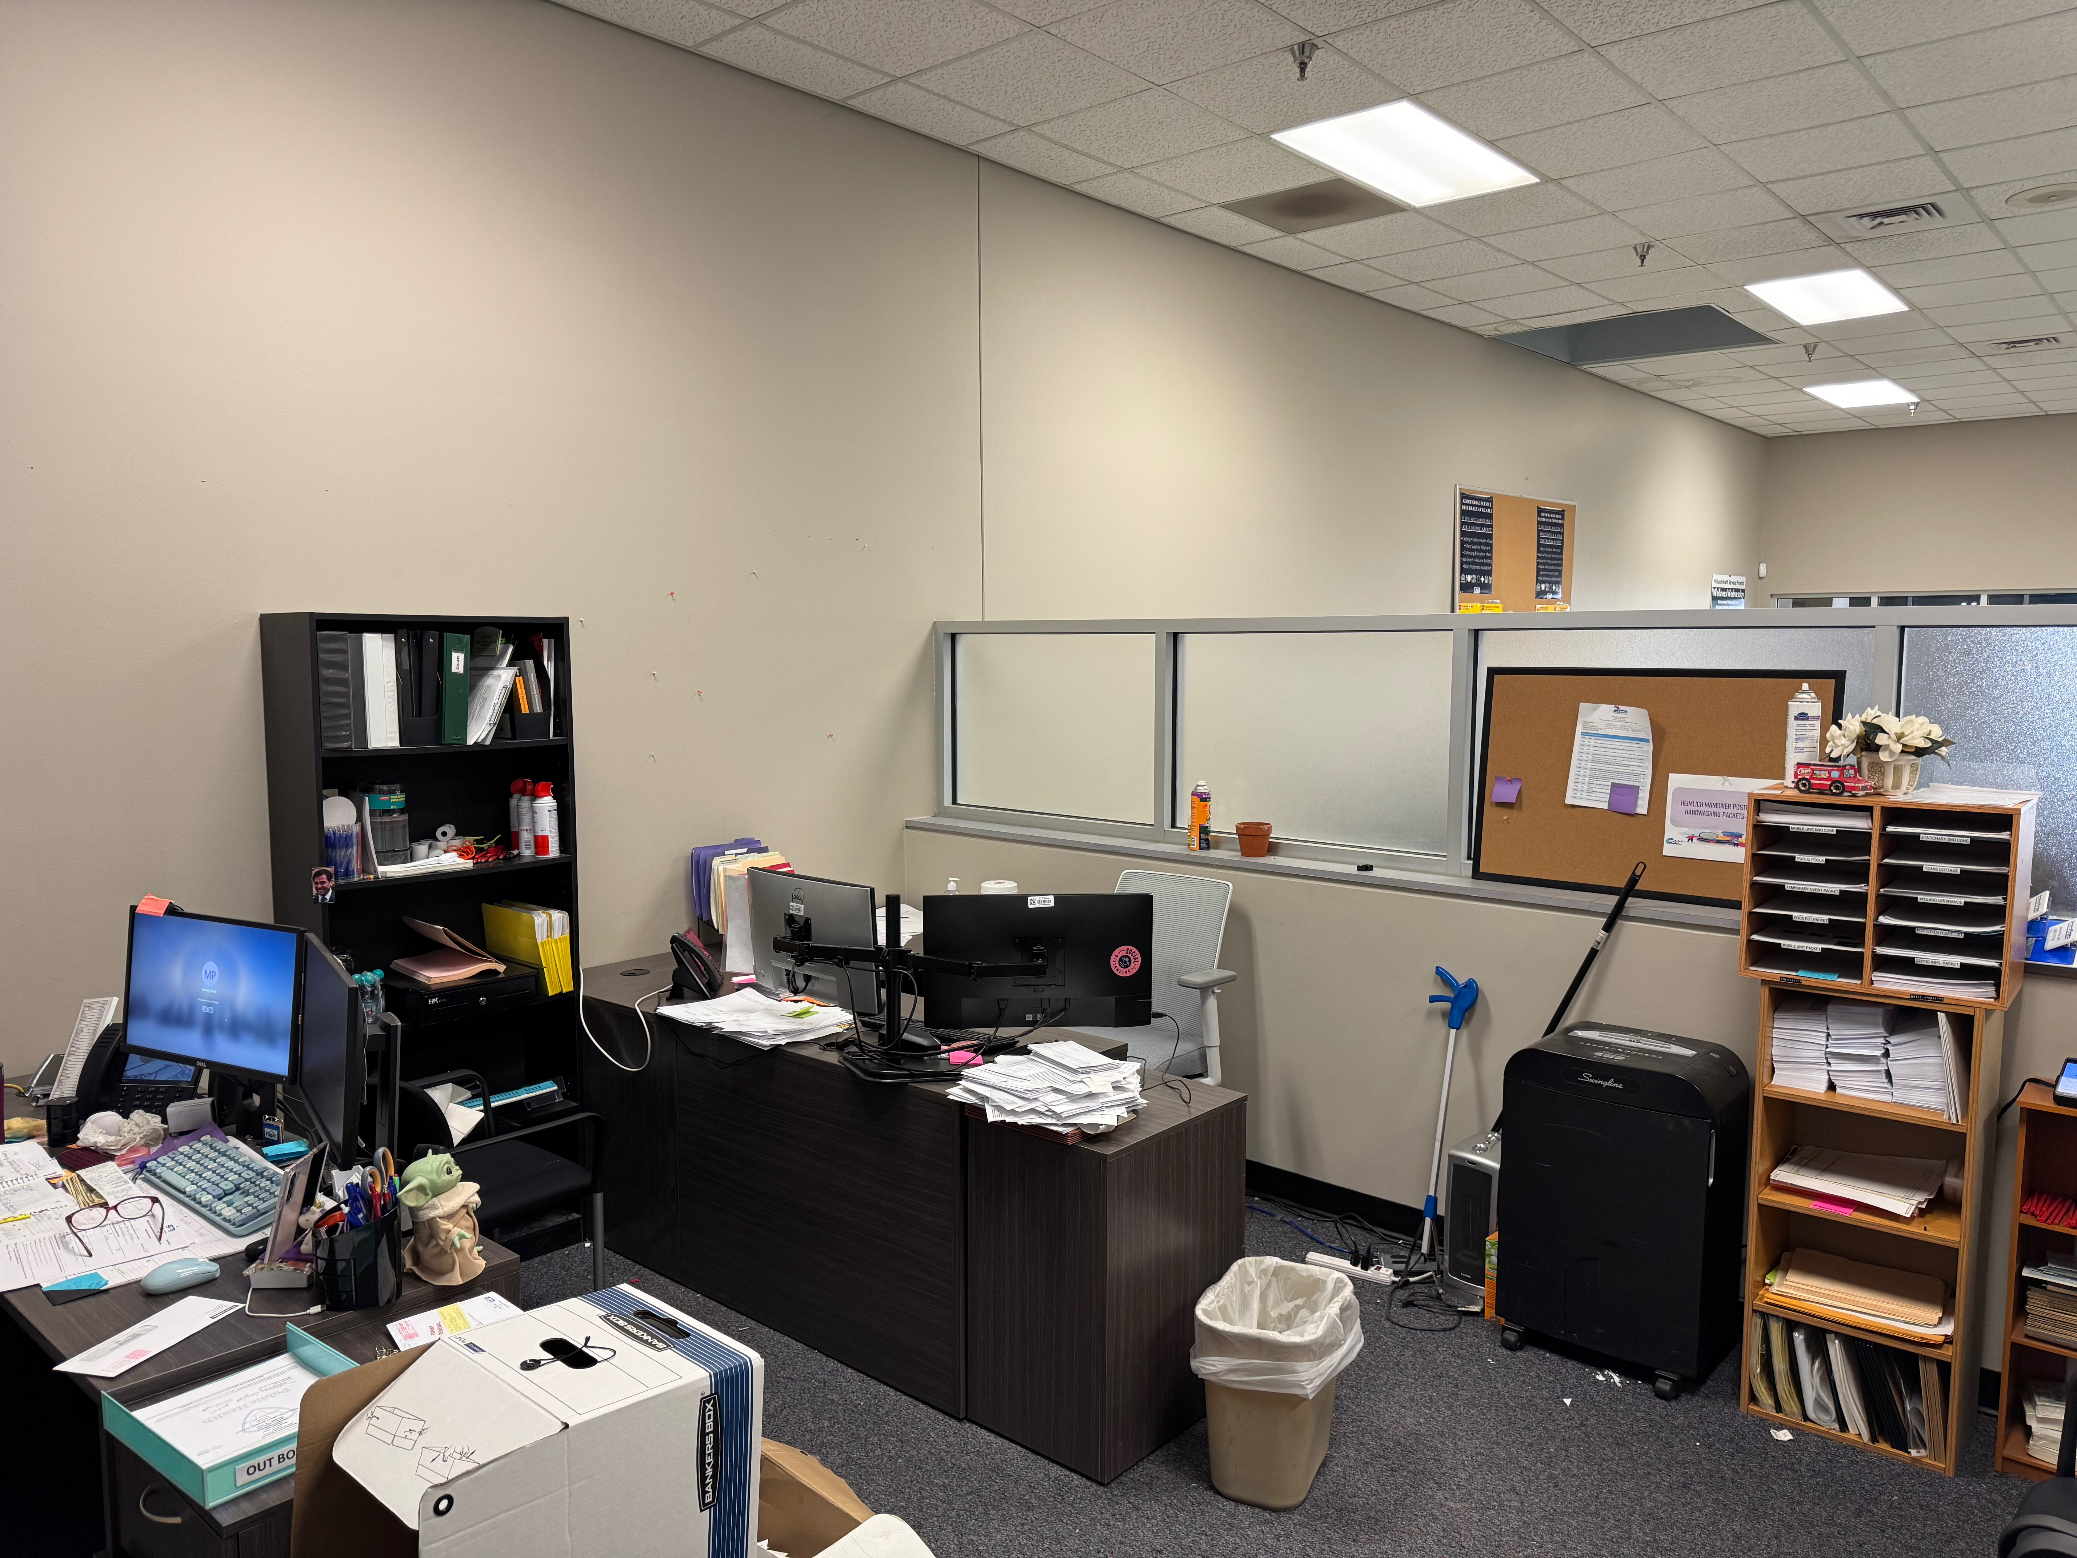
OFFICE SPACE
Health Department Current Office Space
8

Slide 9
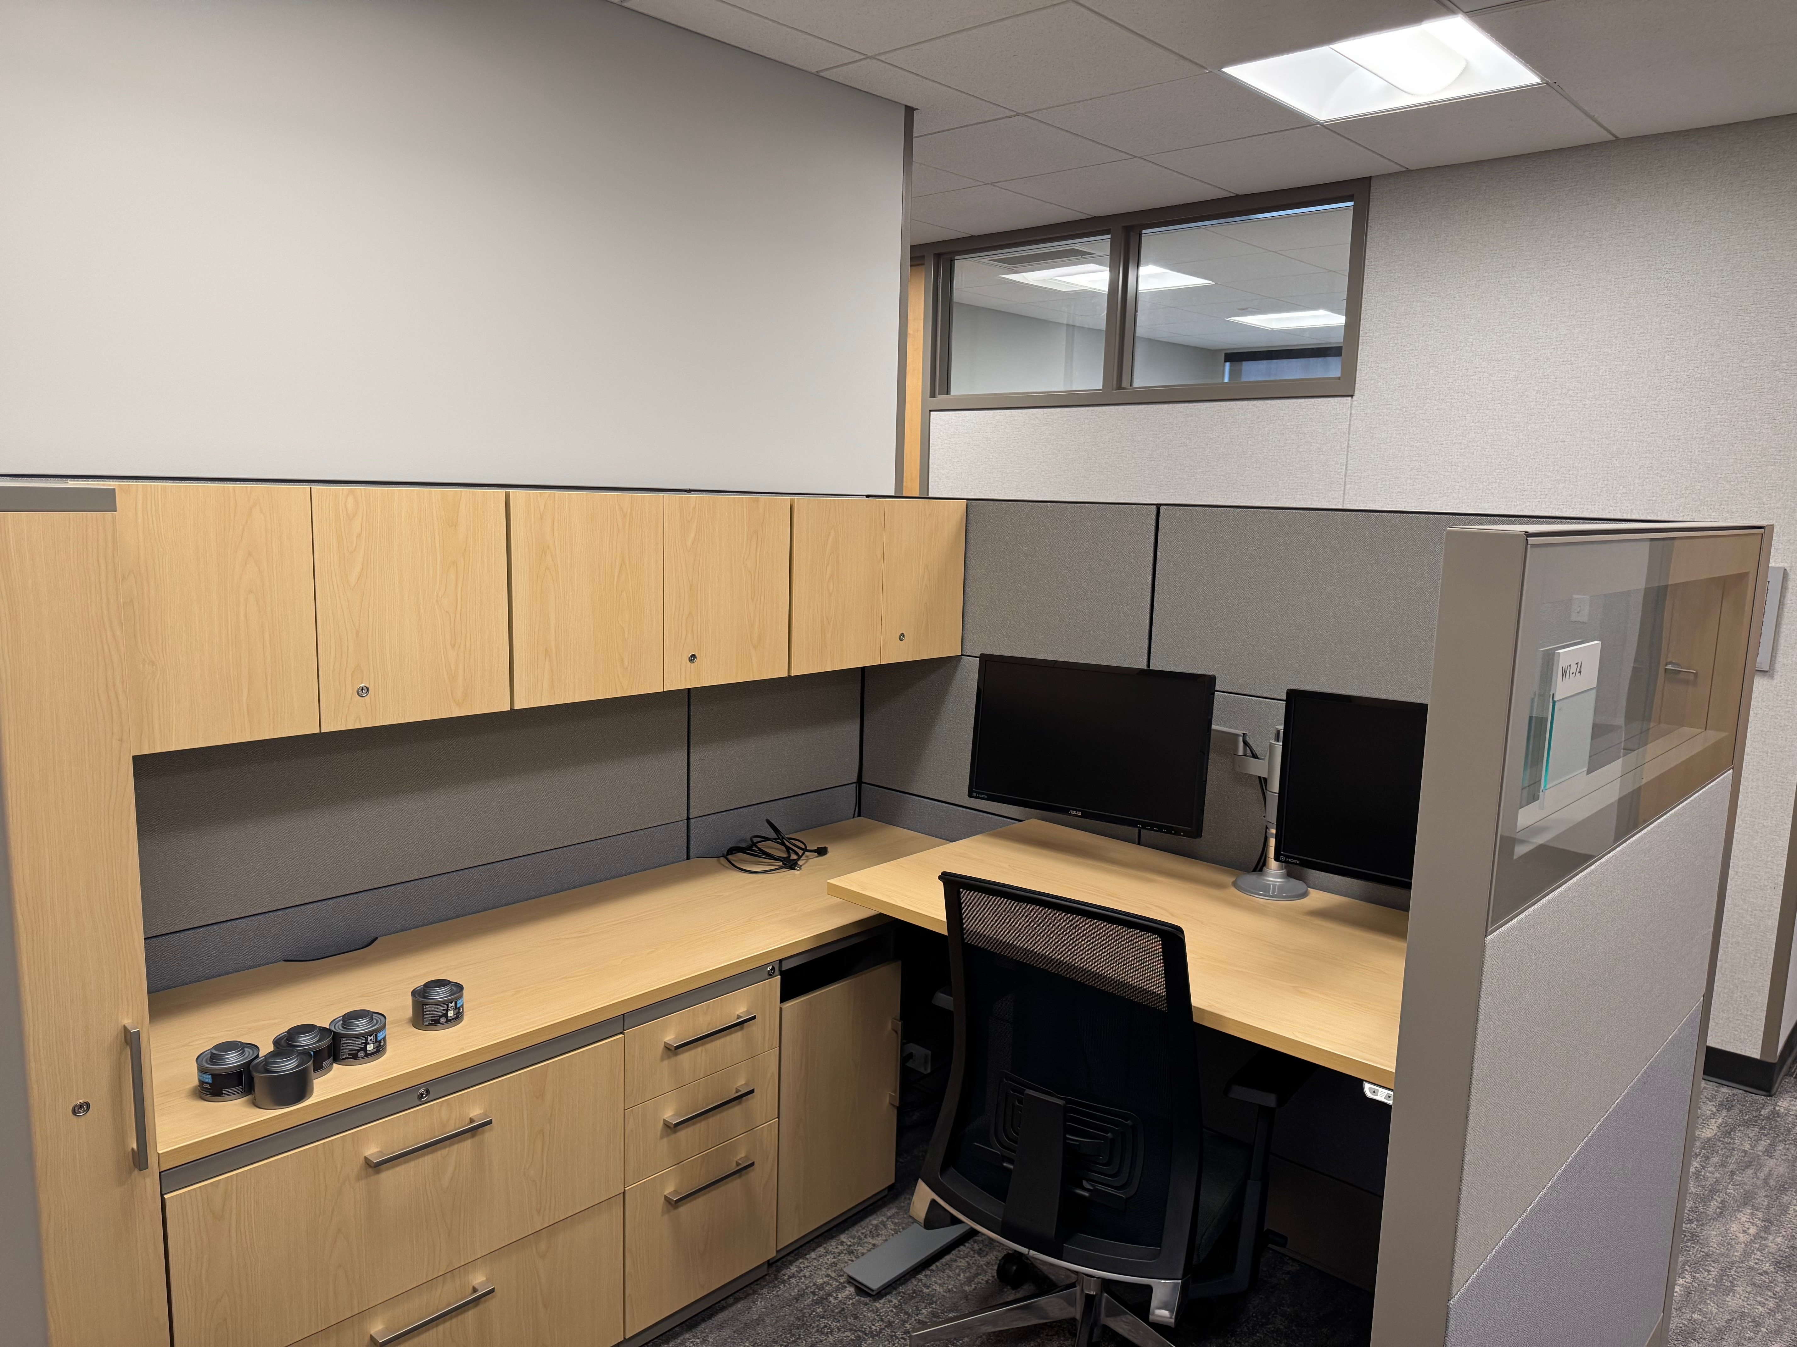
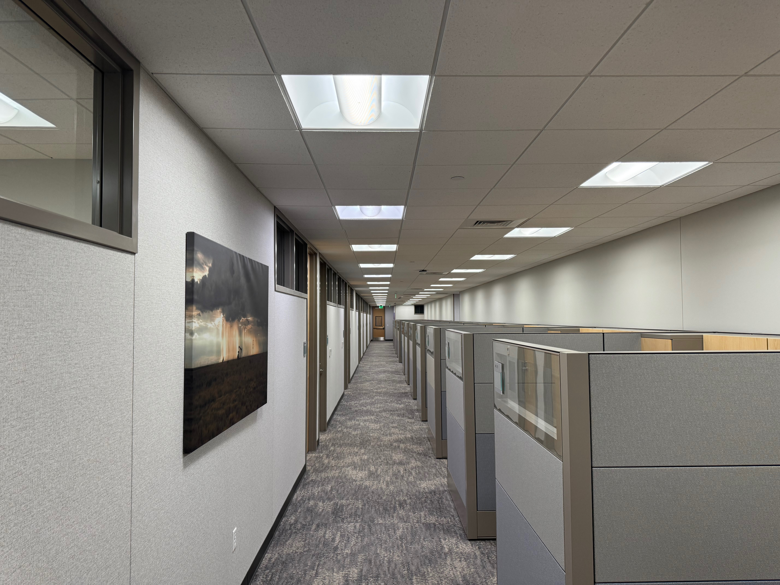
OFFICE SPACE
New County Facility Space
9

Slide 10
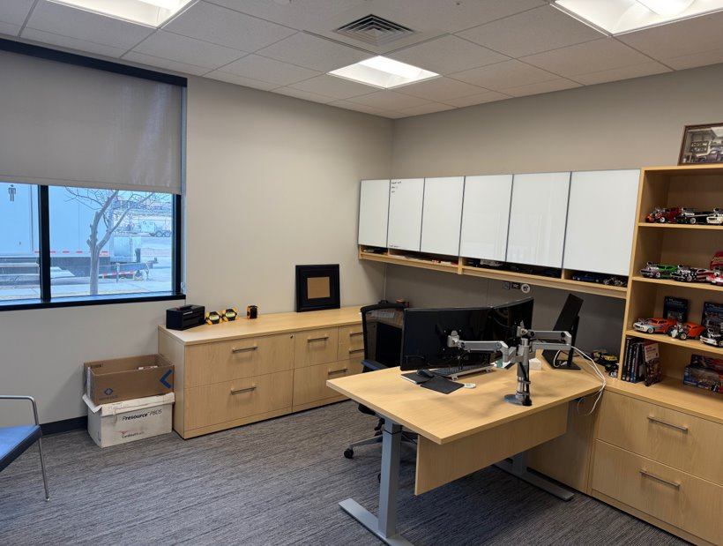
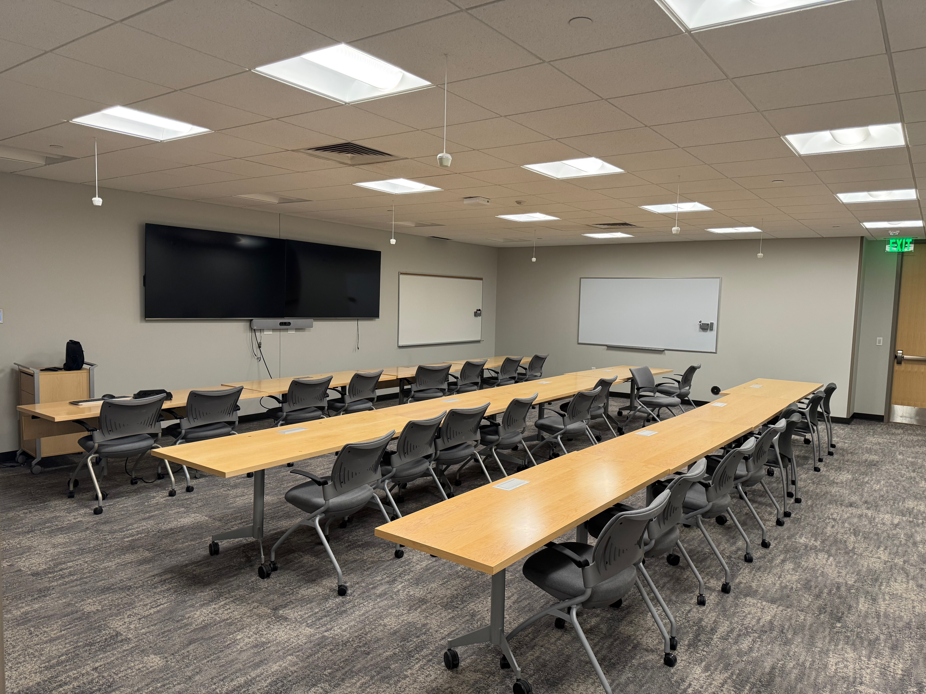
OFFICE SPACE
New County Facility Space
10

Slide 11




COLLABORATION
City & County Emergency Management teams – One location
11

Slide 12
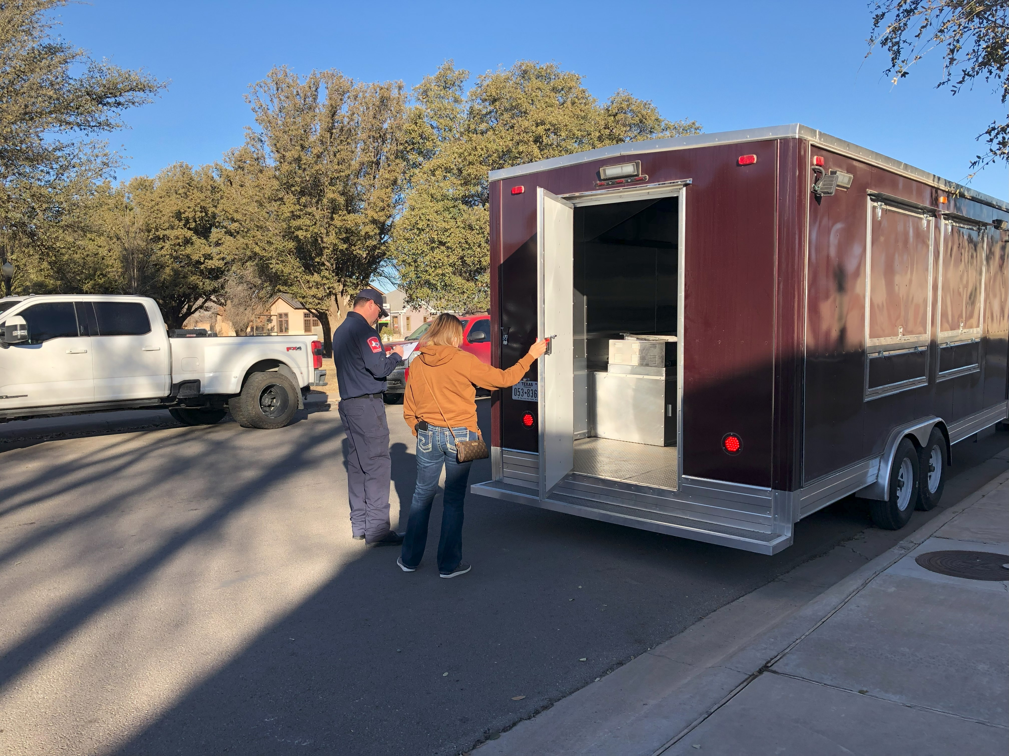

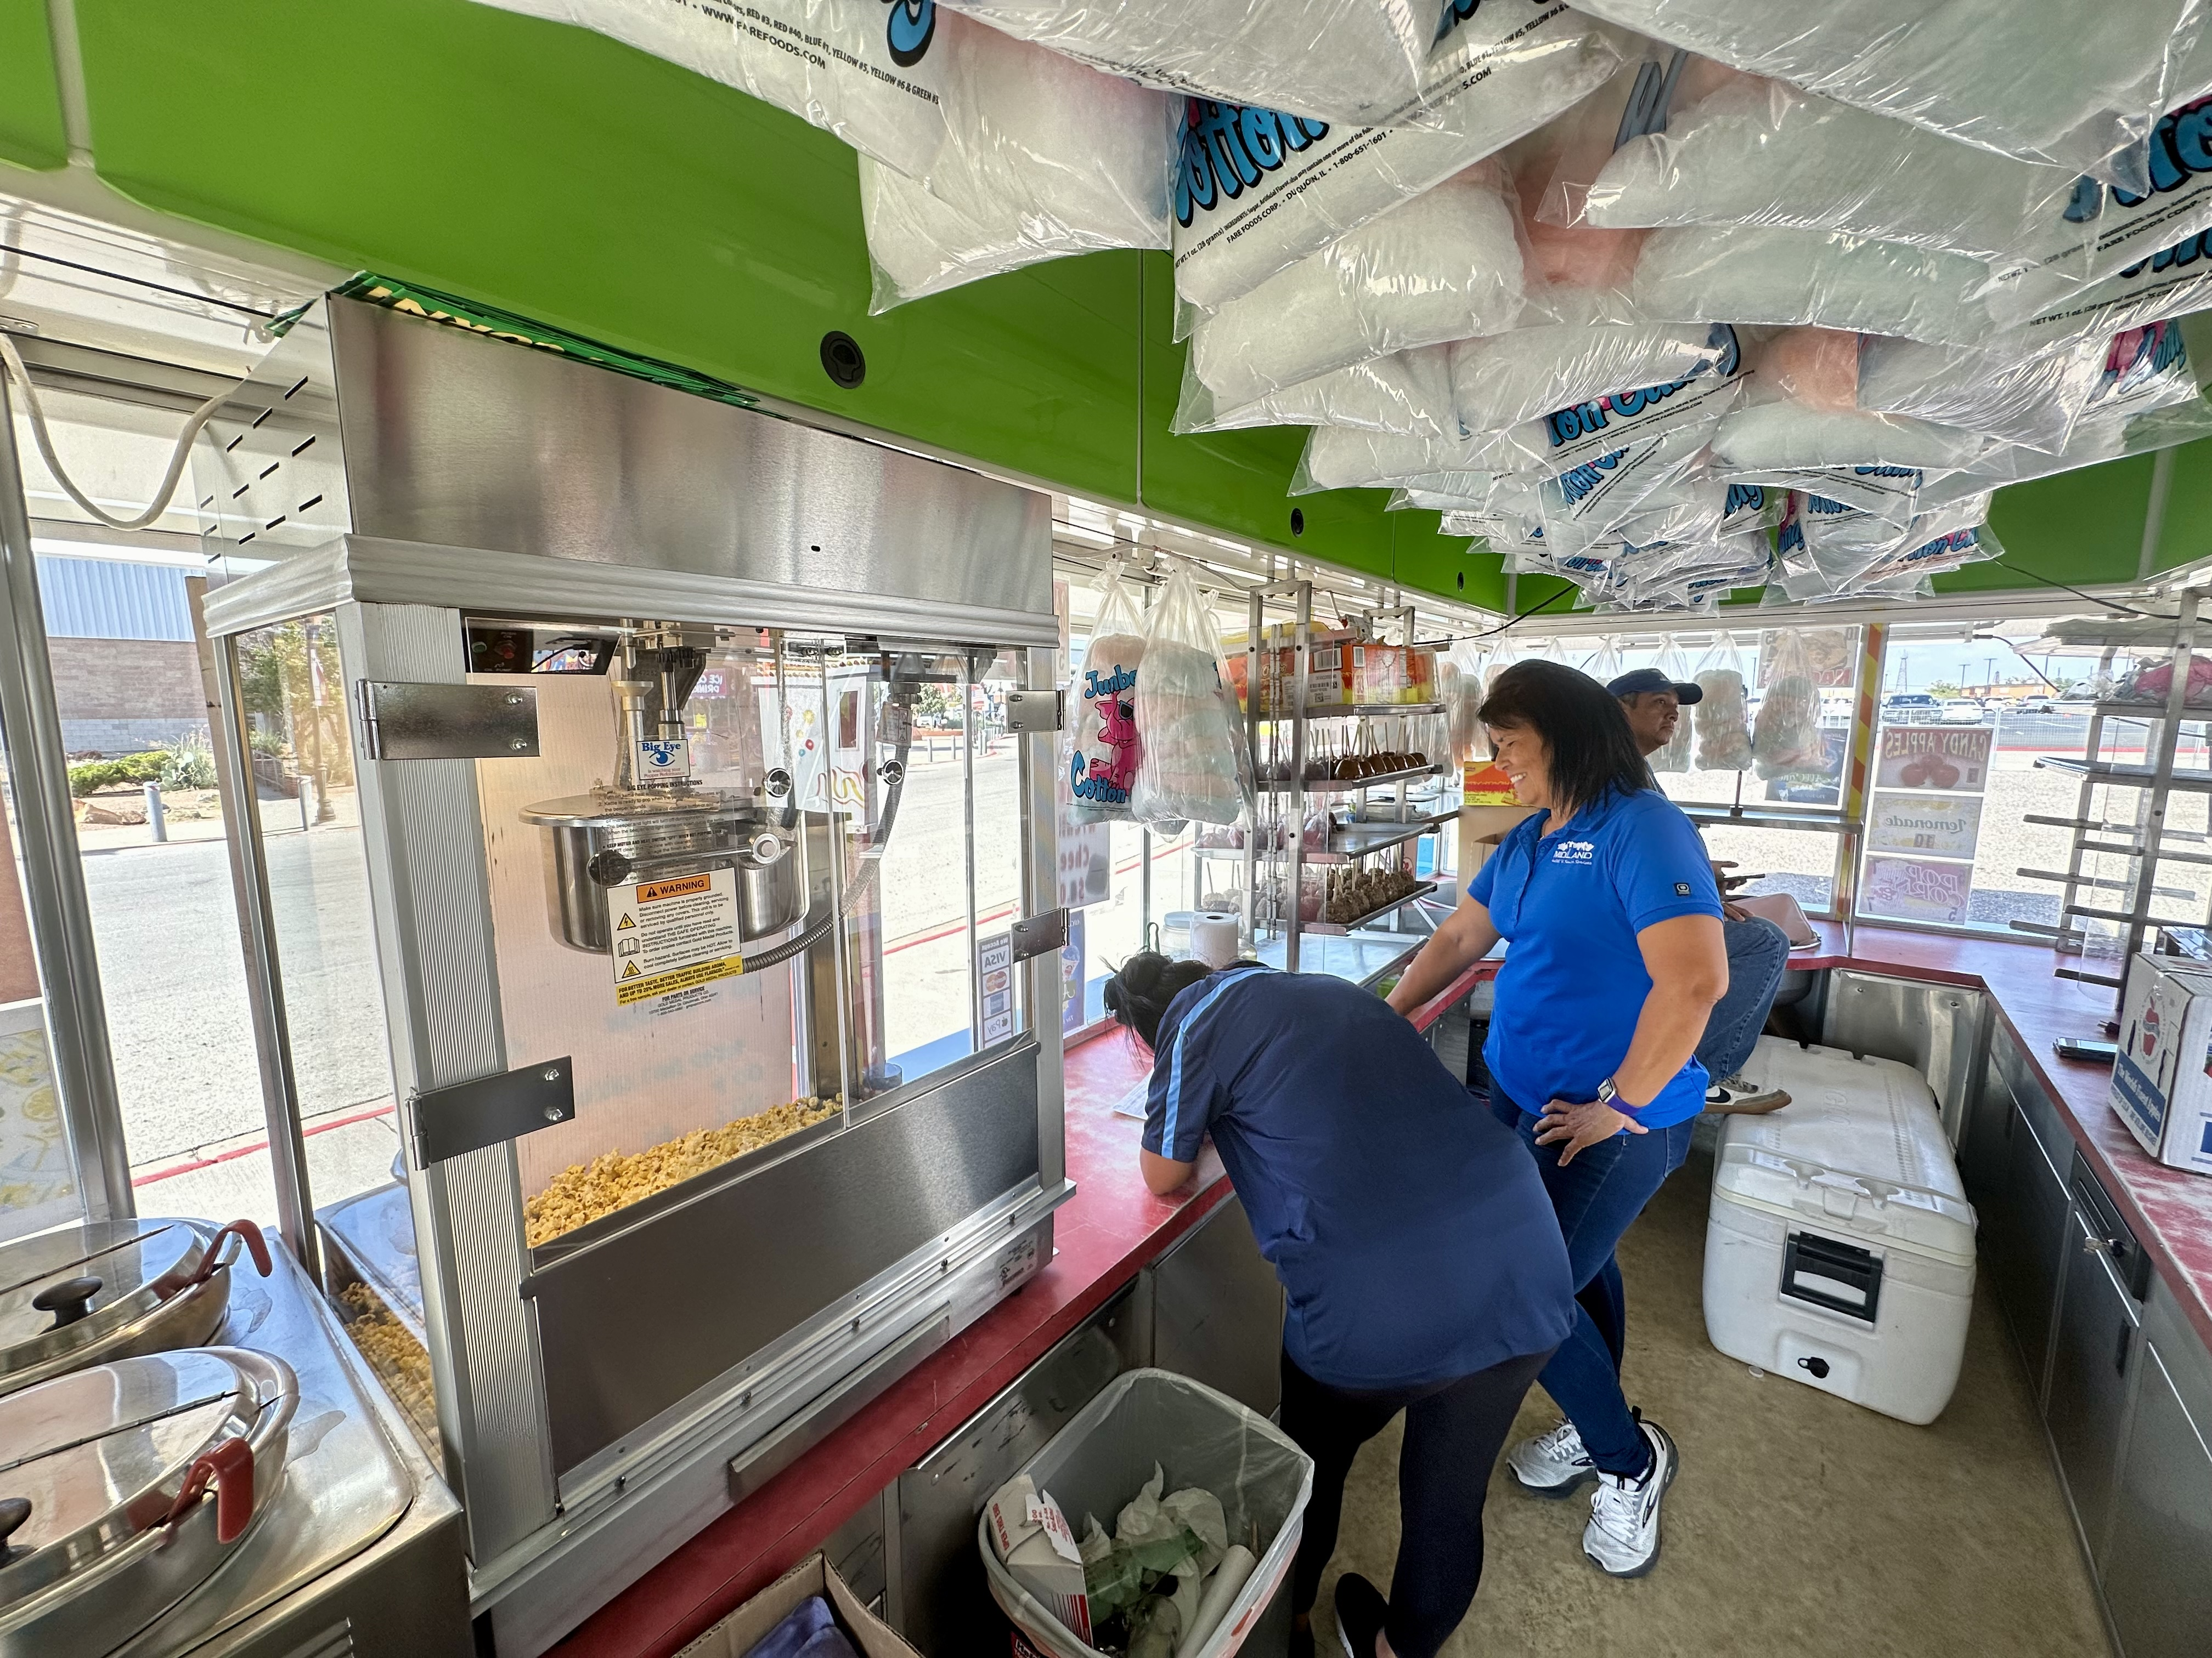
FOOD TRUCK PERMITTING COORDINATION
Current Situation:
Health Inspection at Health Dept.
During lunch everyday
Fire Inspection at Fire Dept.
Monday Morning by appointment
Frustrating & Dangerous
12

Slide 13
FOOD TRUCK PERMITTING COORDINATION
Future Plan
One-Stop shop
Same day every week
Added inspection space for customer and employee safety
Easier and more convenient for our Customer!
13

Slide 14

ENVIRONMENTAL ACCESSIBILITY
Environmental inspectors serve as the county’s designated septic inspectors.
New office location centralizes them near most septic operations, which are in the county, improving efficiency.
14

Slide 15

MISSION
Deliver exceptional services and promote a high quality of life and place for ALL our citizens.

