Slide 1
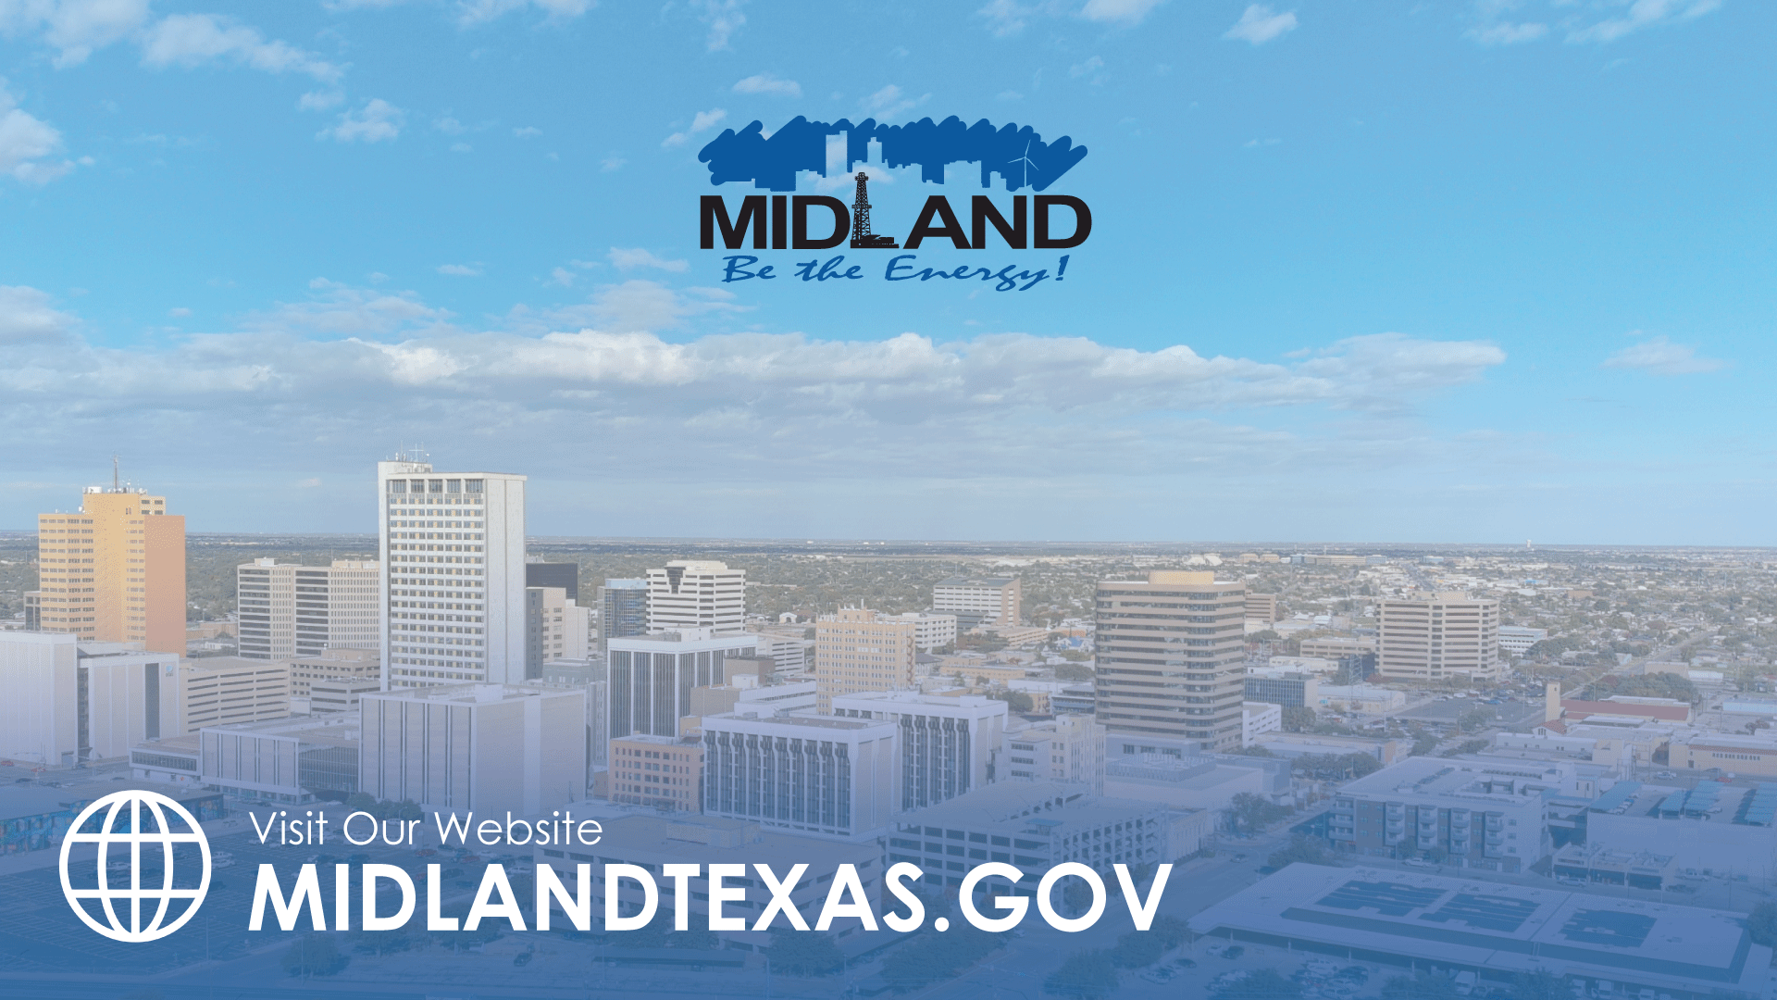
INVESTING IN MIDLAND’S ROADS
TITLE HERE
TITLE HERE

Slide 2
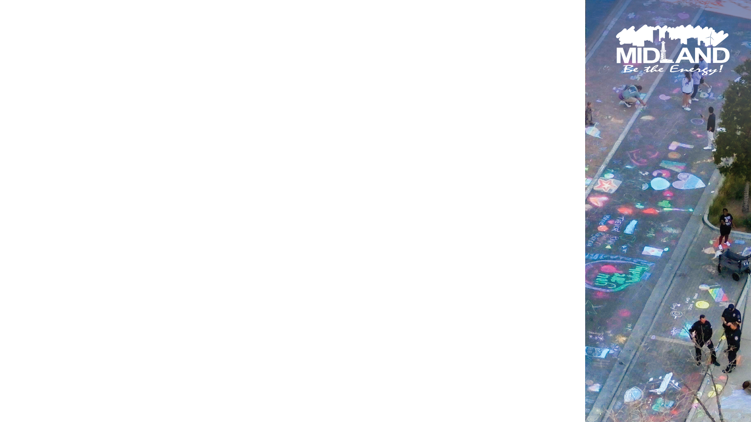
STRATEGIC GOAL CONNECTIONS
Goal 3: Quality of Life & Place
3.2 Foster relationships with foundations and outside businesses: Collaborate to create worldclass facilities and amenities.
3.3 Create an attractive and inclusive living environment: Develop and enhance live, work, and play opportunities for our citizens.
Goal 5: Provide Sound Governance and Fiscal Management
5.7 Ensure continued financial stability and accountability: Maintain financial transparency.
Goal 6: Strengthen and Sustain Our Infrastructure
6.2 Enhance infrastructure for economic growth: Improve competitiveness through infrastructure investments that includes collaboration with neighboring jurisdictions and exemplary peer agencies.
6.5 Implement a funding stream for infrastructure: Establish reliable funding for continual improvements.
6.6 Strategize for and monitor City Growth: Develop proactive responses to growth rather than reactive.
6.7 Develop and Implement Comprehensive Road Planning and Maintenance Initiatives: Ensure safe and maintained roads for existing and new developing areas and main thoroughfares
2

Slide 3
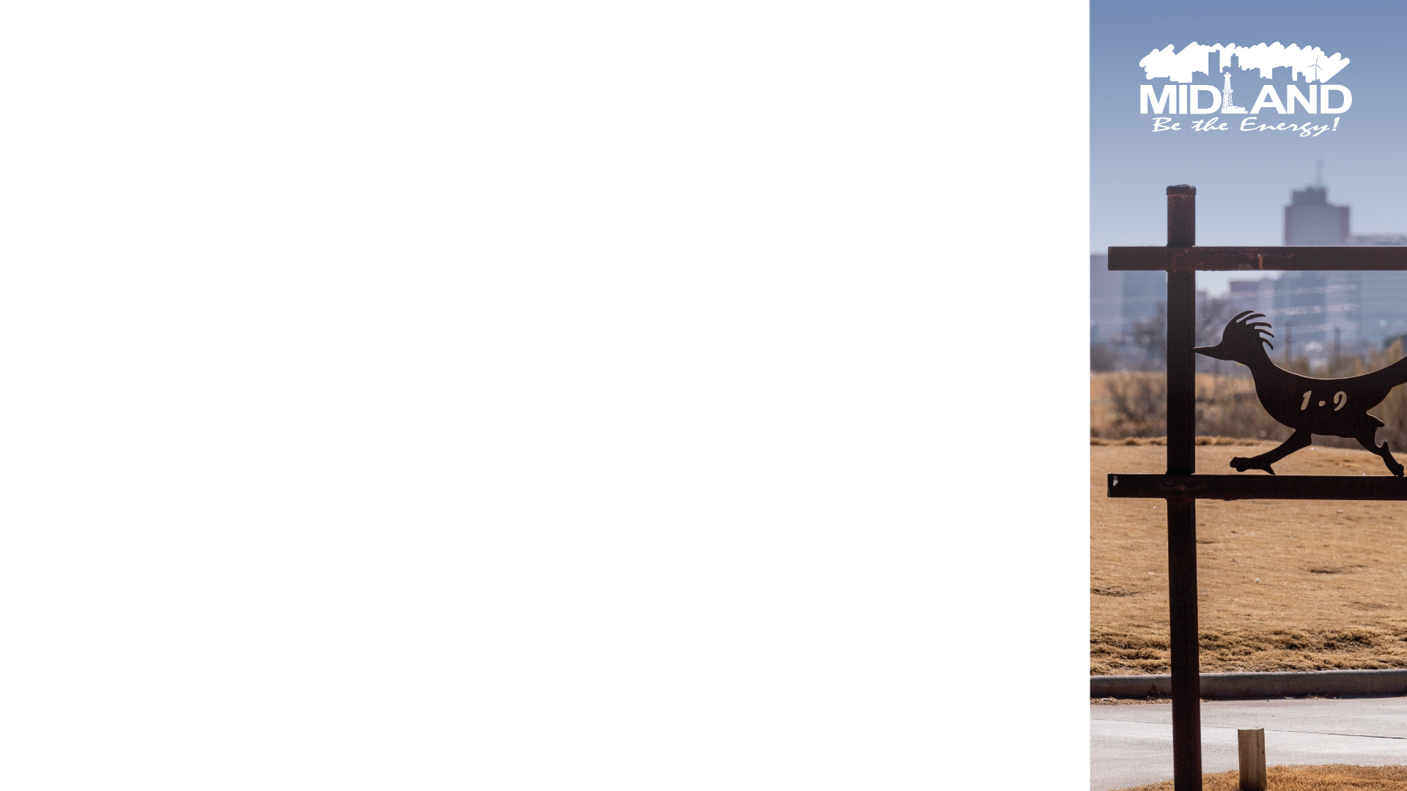



PARTNERSHIPS
Enhance Resource Sharing
Improve Infrastructure Through Joint Efforts
Promote Synergistic Development
Fast-track Project Timelines
Shared Goals (Vision Zero)
Keeping Up With Growth
3

Slide 4

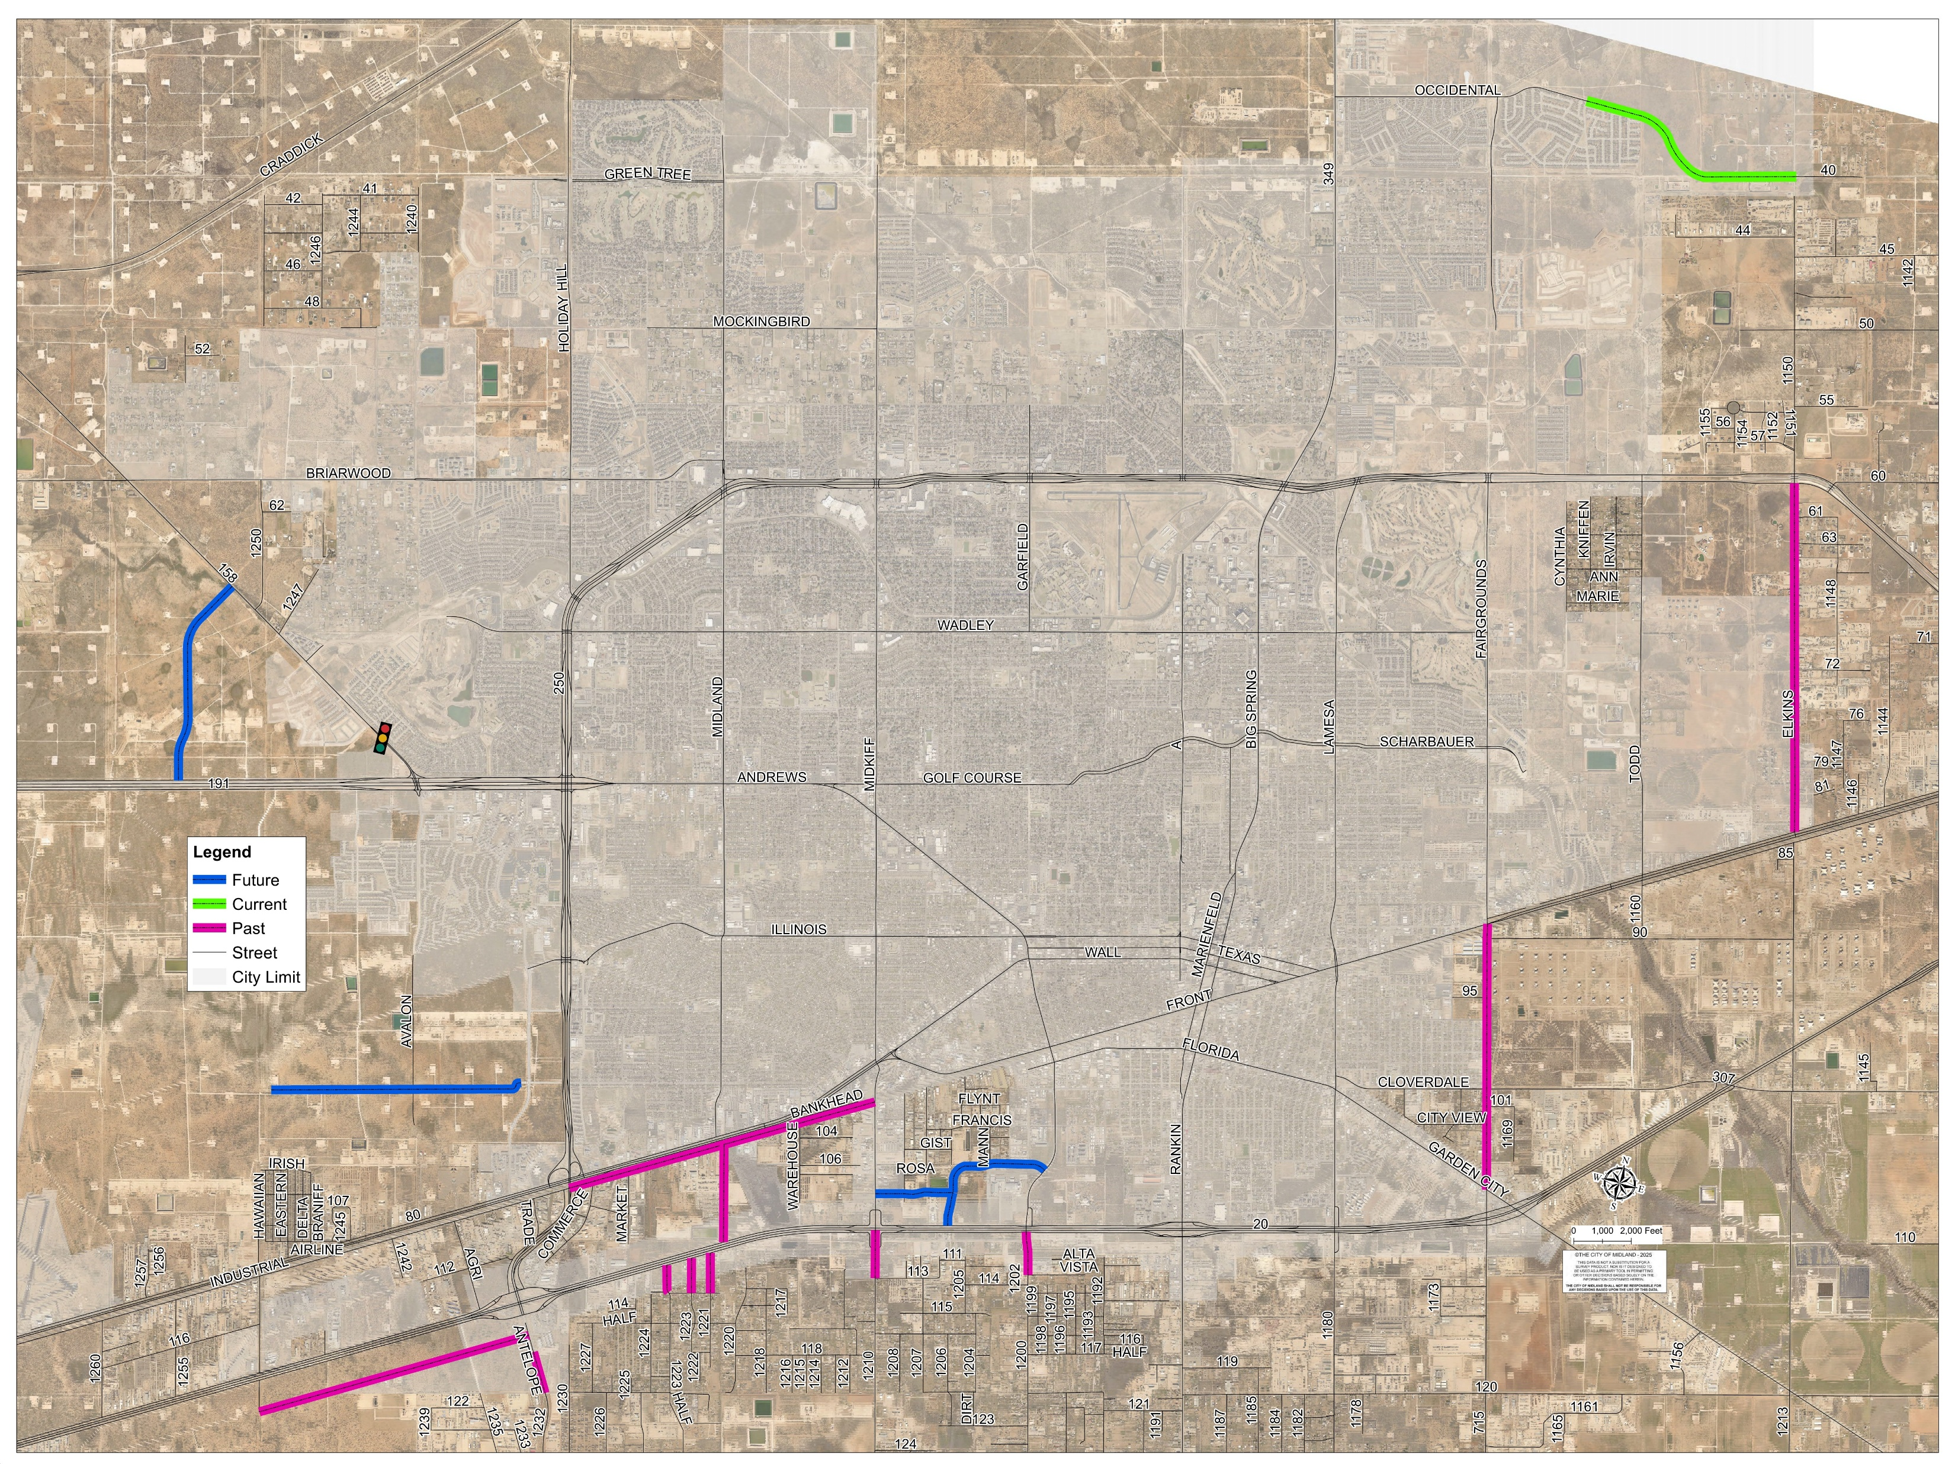
PARTNERSHIPS – MIDLAND COUNTY
16 Projects since 2018
Total Value: $19 Million

Slide 5
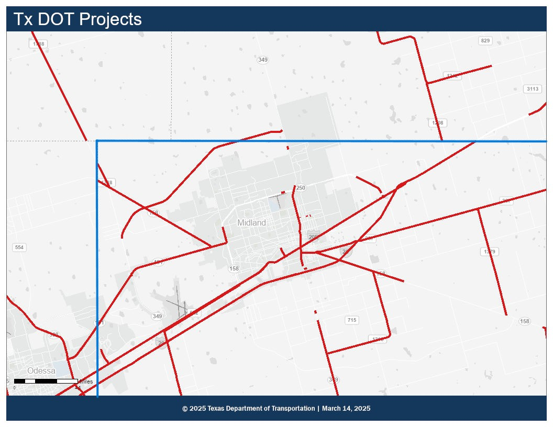
PARTNERSHIPS – TXDOT
$40 million in projects designed by the City and constructed by TXDOT
Assisted with moving timelines forward for critical projects
All projects are in the PBMPO Boundary
TXDOT total project value is $698,076,777, including maintenance

Slide 6
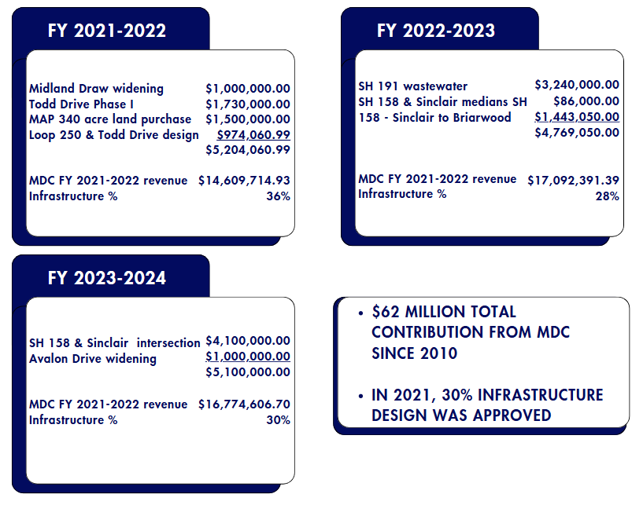
PARTNERSHIPS - MDC
Notes:
$62 million total contribution since 2012

Slide 7
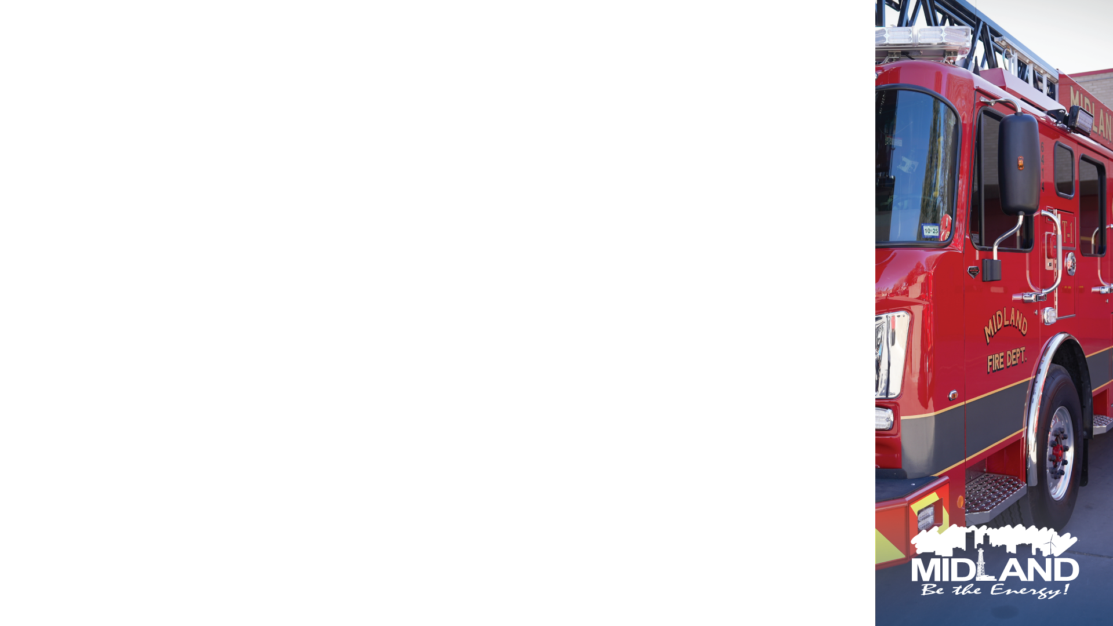
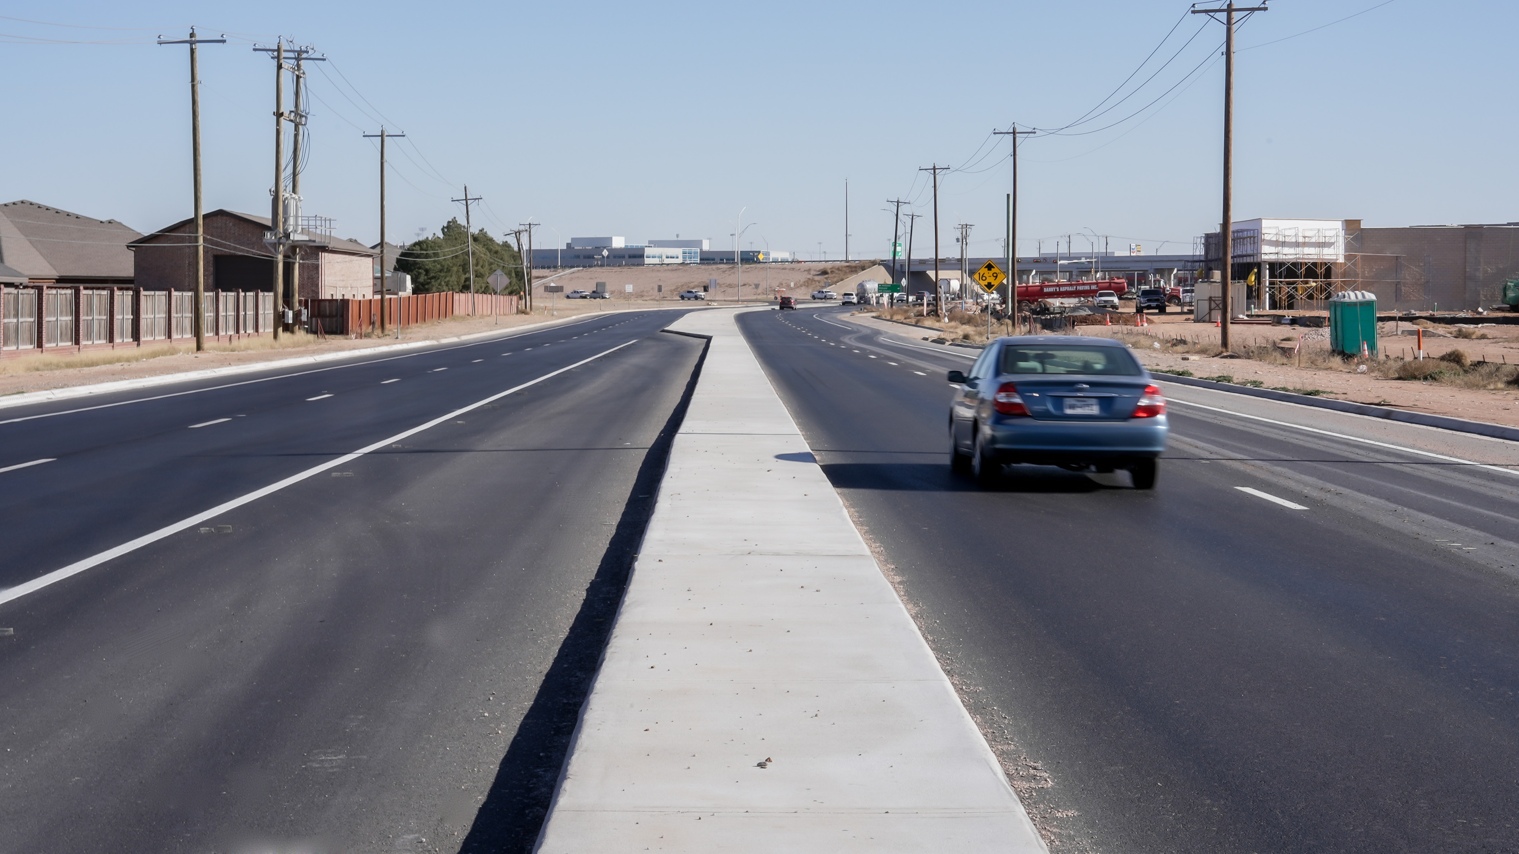
CITY OF MIDLAND
From FY 2022 to 2024, COM awarded an average of $25 million in construction contracts annually.
SH158- widening and repaving project
7

Slide 8

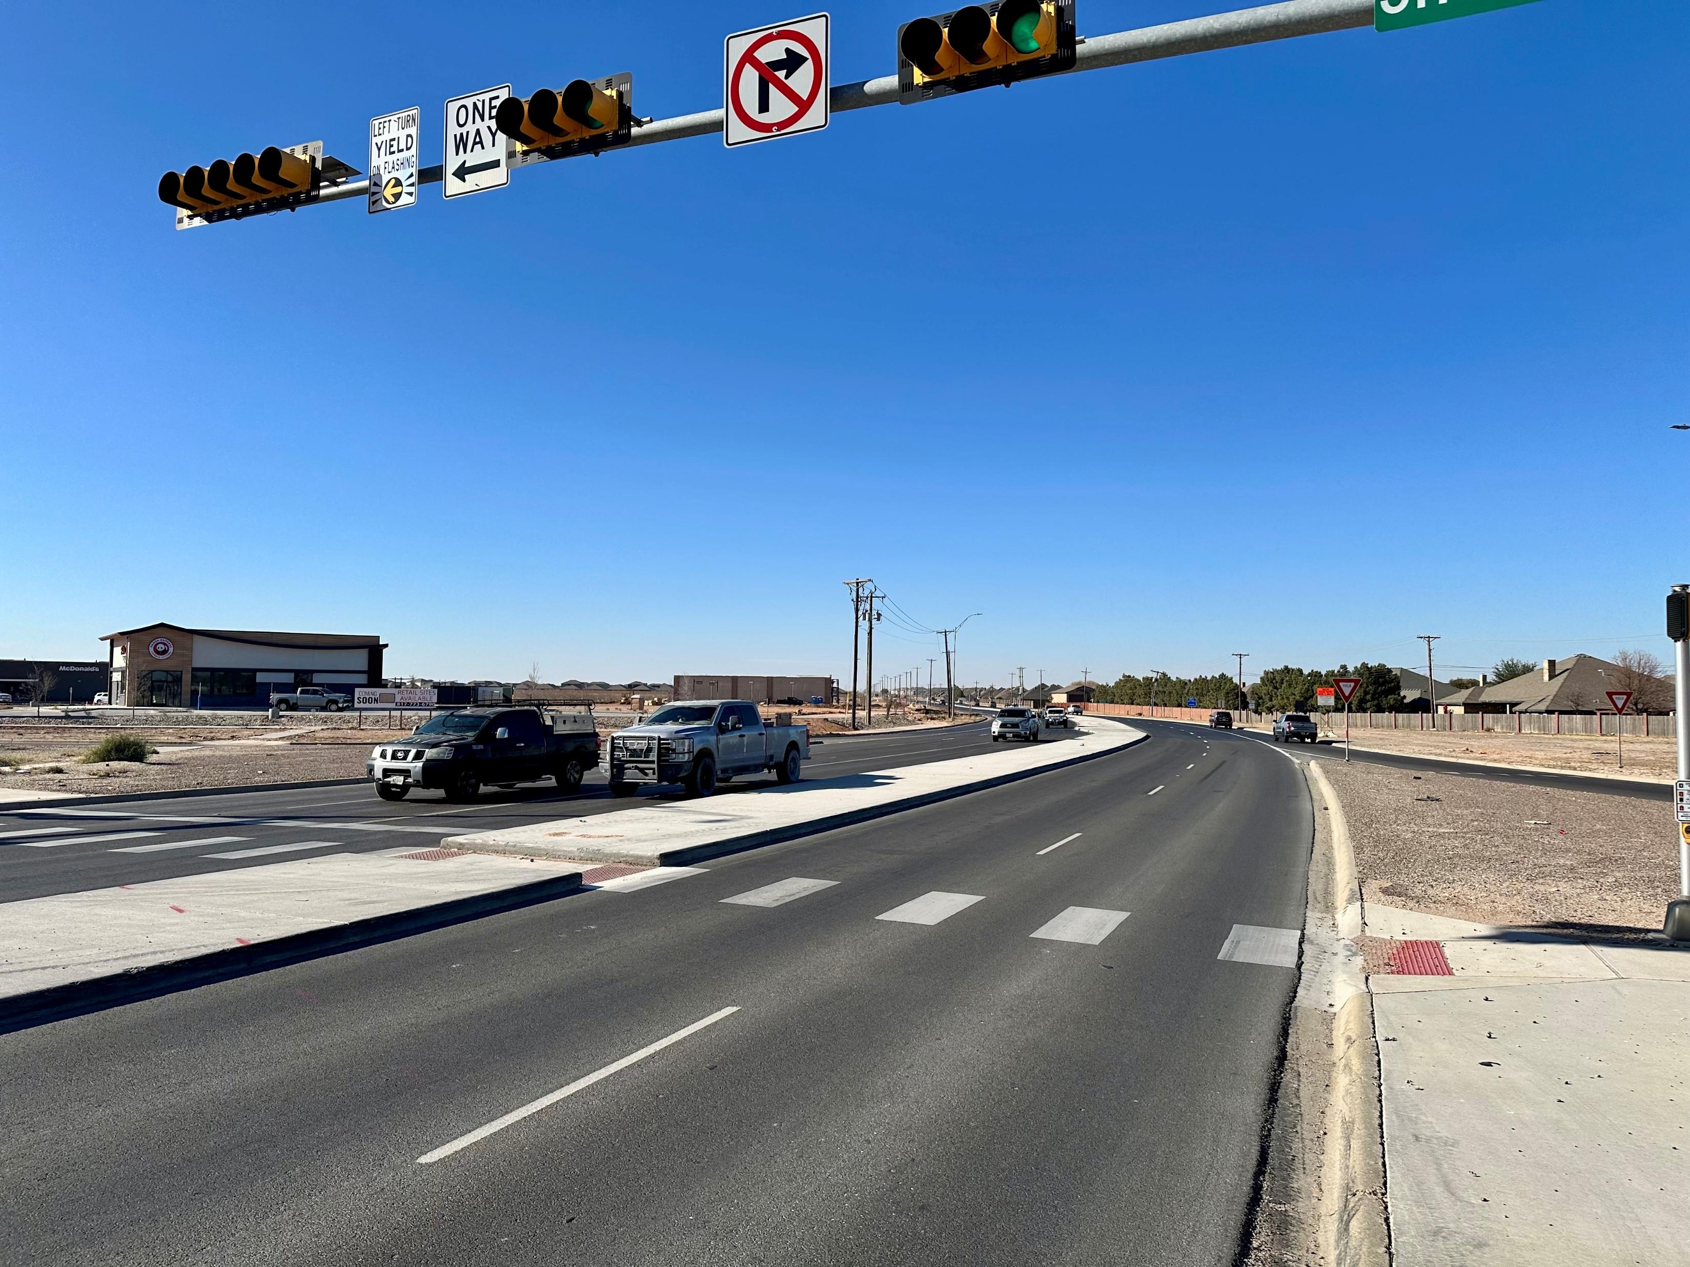
CITY OF MIDLAND LOOK AHEAD
The City of Midland is investing $52 million to improve roads across Midland over next 2 years.
Includes Operations dollars and Bonds.
Does not include MDC pledges.
8
SH158- widening and repaving project
Notes:
City of Midlnad Projects we are projecting over the next two years approximately 52 million of roadway projects. Operations dollars and bonds

Slide 9
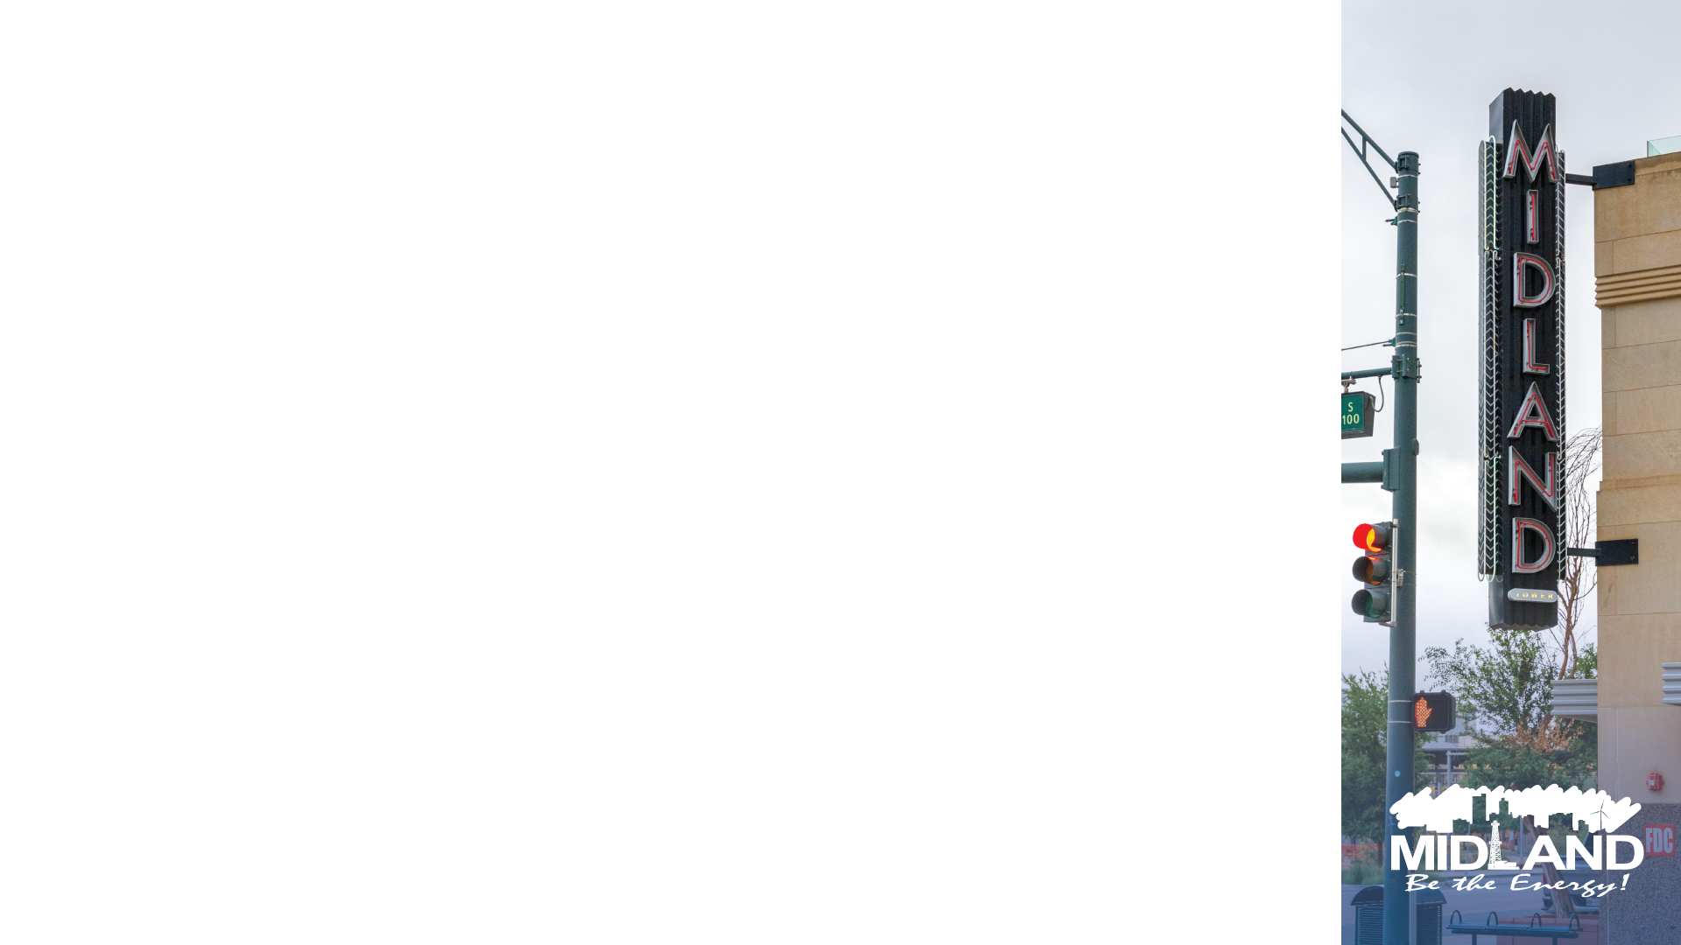
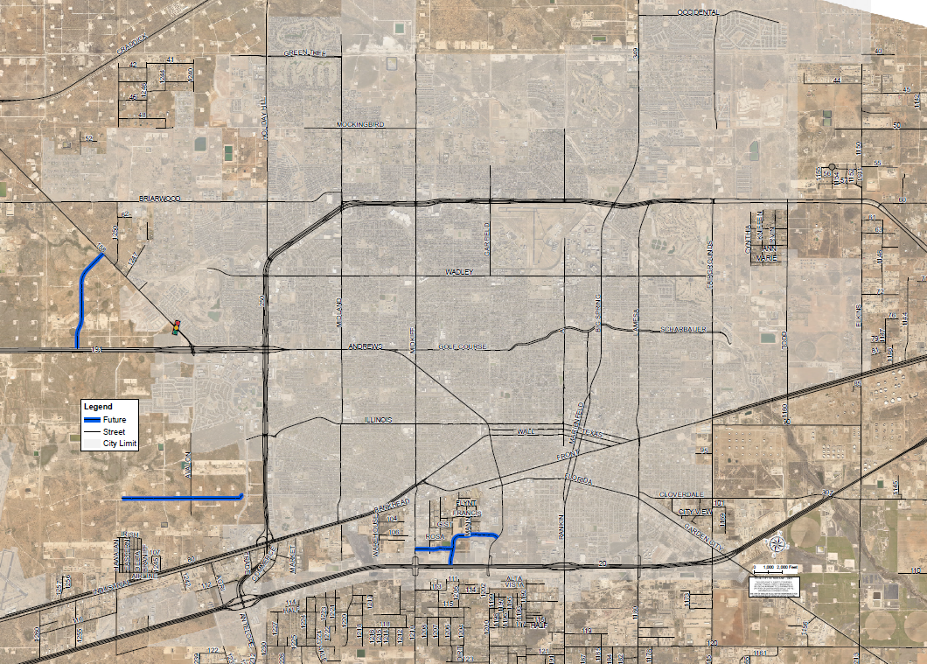
MIDLAND COUNTY INVESTMENT
Midland County invests approximately $34–$40 million annually in construction and design on their ROW, a consistent trend since 2020.
9

Slide 10
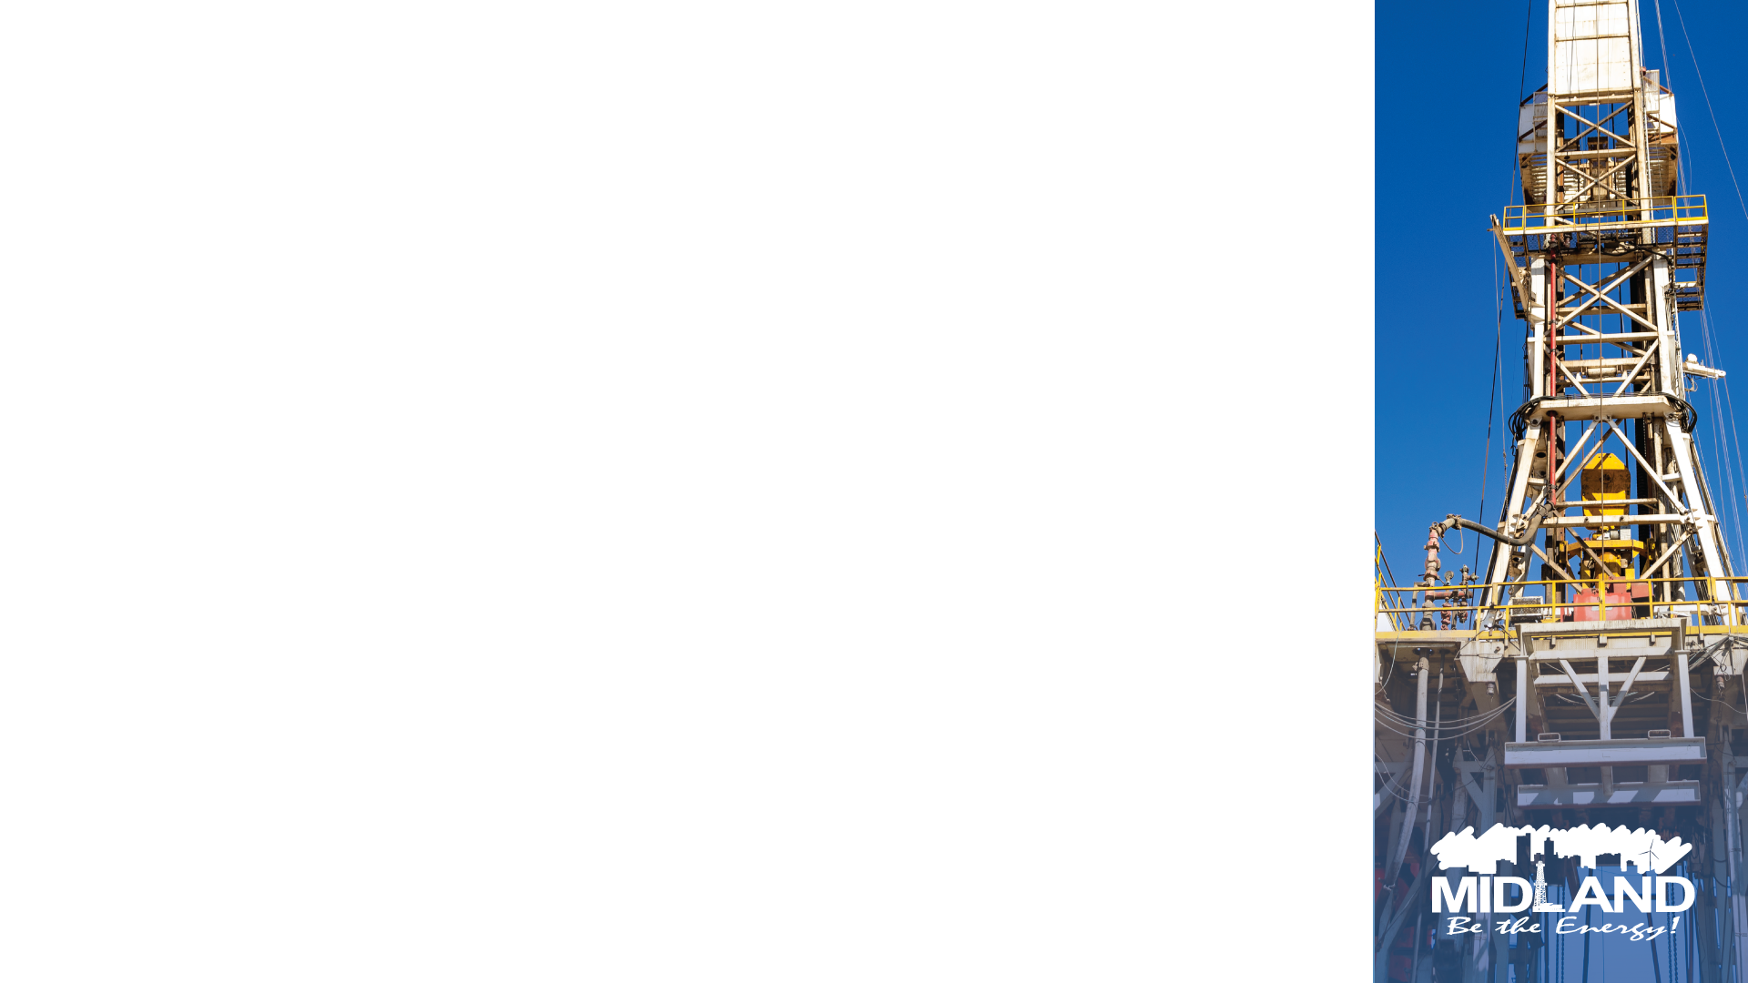
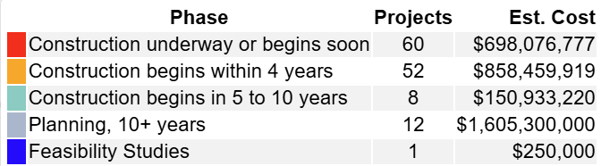
TXDOT LOOK AHEAD
City will continue complete design for projects that benefit our community.
10

Slide 11

PROGRESS
Since 2017
$200 Million in transportation and drainage have been constructed or are currently under construction
$100 Million Bond (Addresses deferred maintenance/neglect)
Increased maintenance funding from $1 Million to an average of $9 Million annually since 2021
11
Notes:
MDC invested total of $62 million since 2010

Slide 12

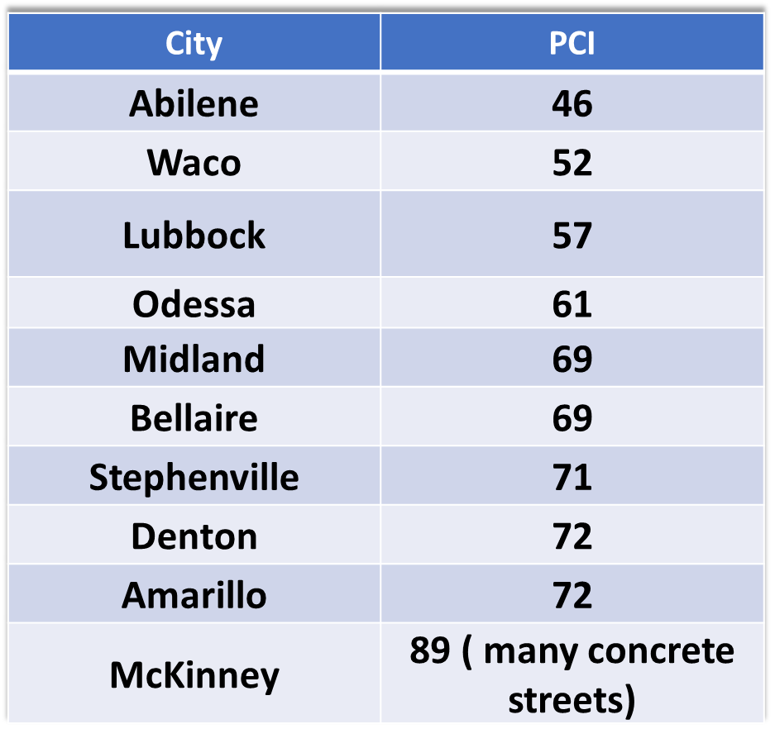
KEEPING MOMENTUM
With the increased investment in transportation and drainage:
Pavement Condition Index (PCI) increased, from 65 in 2017 to 69 in 2023
Improved quality of life
Proactive approach to maintenance reduces future expenditures and burdens
12

Slide 13
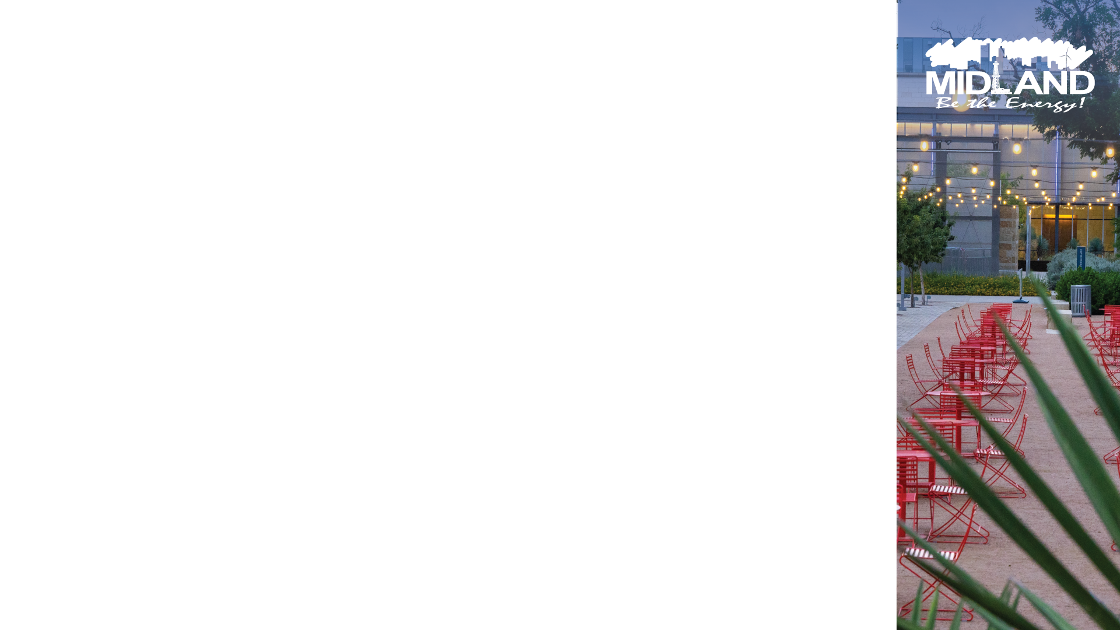
SHARED COMMITMENT
Leveraged funds to maximize CDBG, COMPASS, and ARPA funds for local roads, operating budget
Partnered with Midland Co, TXDOT, MDC, & Developers
Continued shared commitments will allow for a more holistic approach and will further enhance transportation infrastructure networks in the region
13

Slide 14

MISSION
Deliver exceptional services and promote a high quality of life and place for ALL our citizens.

Slide 15

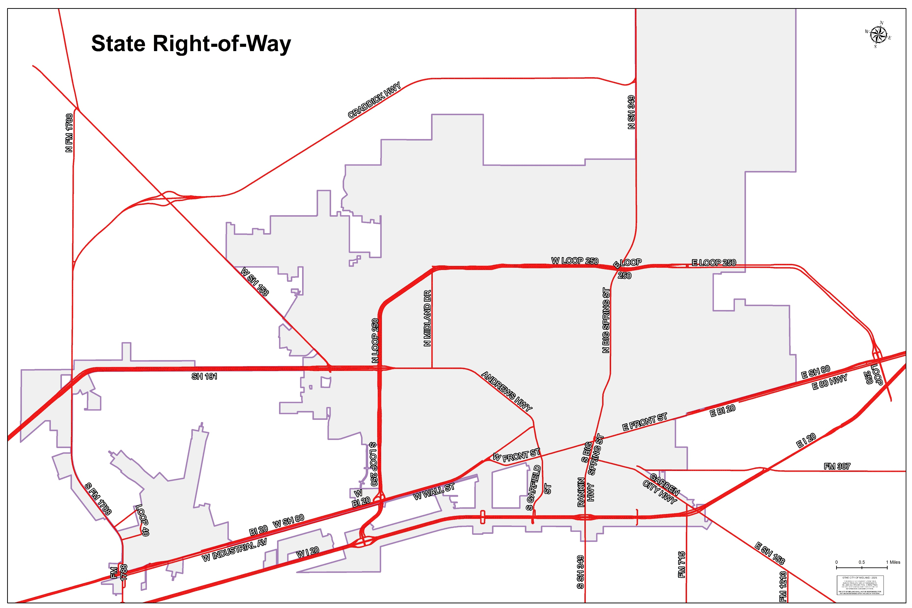
TXDOT ROW

Slide 16
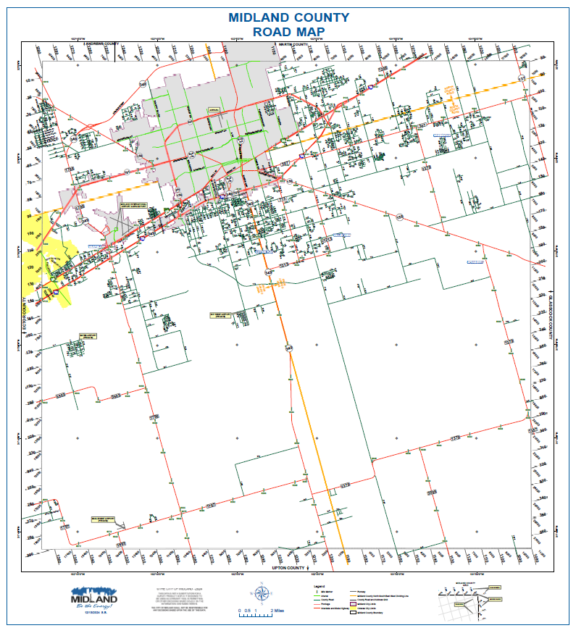
MIDLAND COUNTY

Slide 17
TXDOT ROW
17

Slide 18
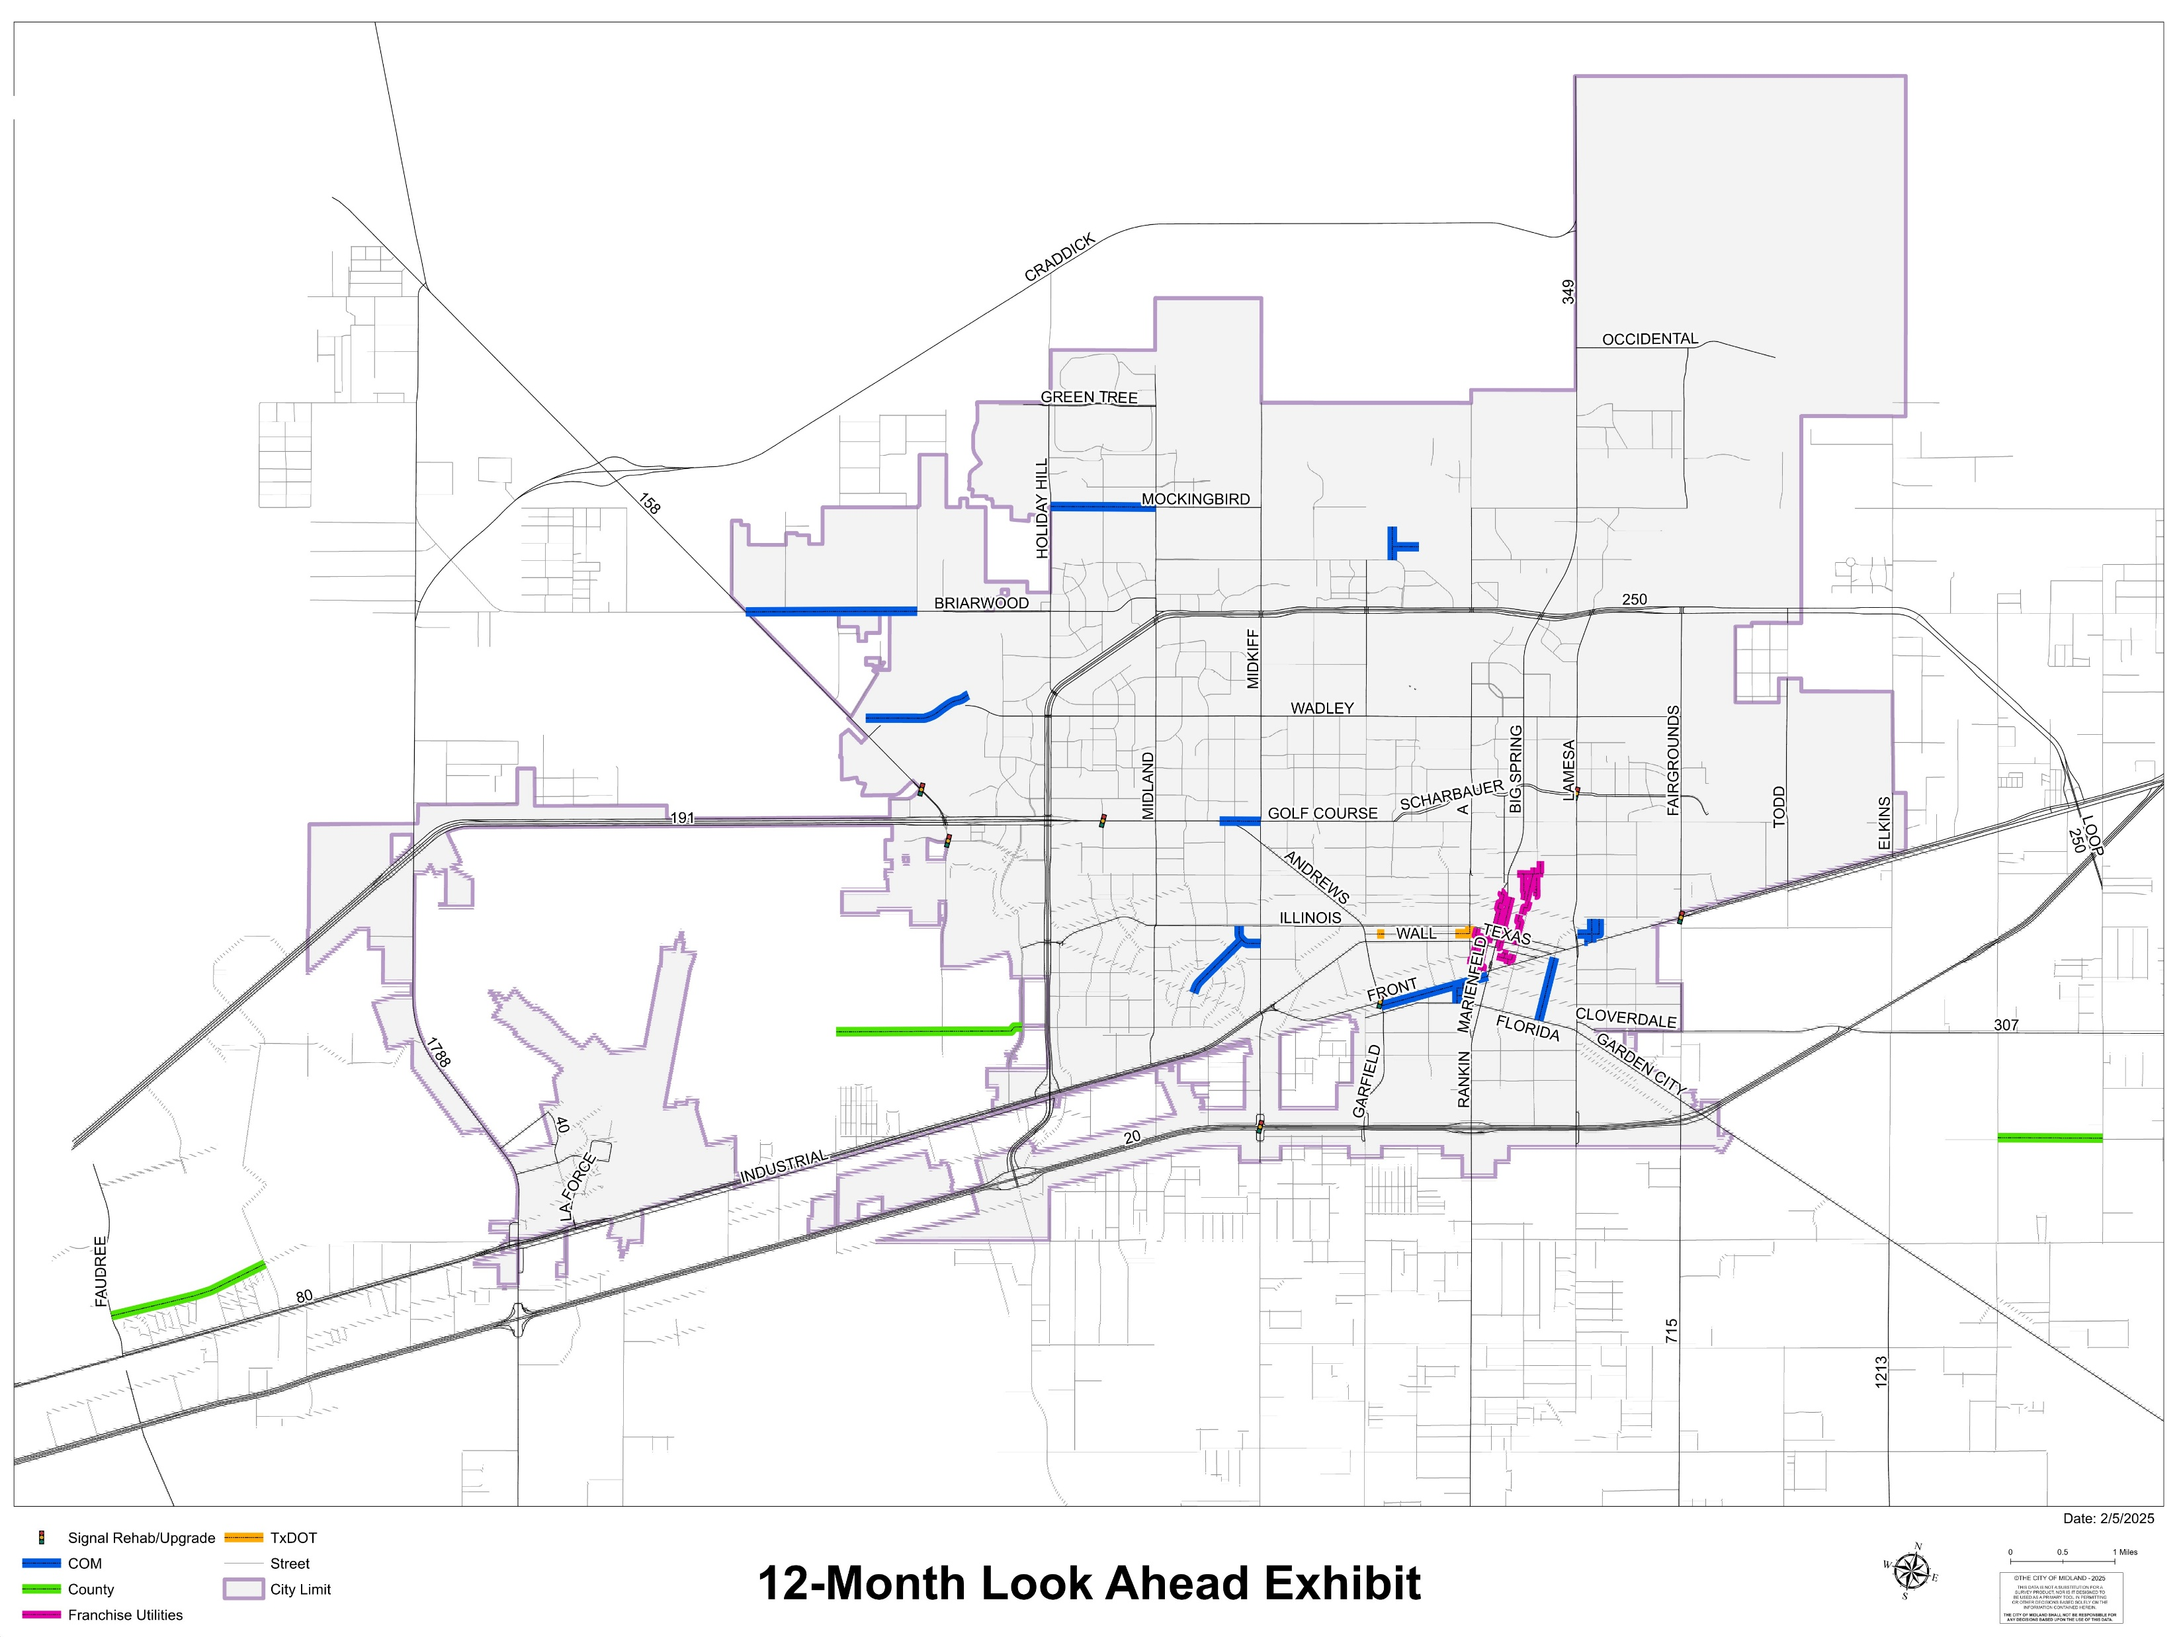
REGIONAL LOOK AHEAD

Slide 19
SHARED COMMITMENT
Maintaining and improving our roads requires a collaborative effort. This presentation highlights the annual investment made by the City of Midland, Tx. D.O.T., and Midland County – demonstrating our shared commitment to ensuring safe, reliable infrastructure for our community. Together, we are making significant strides in road repairs and enhancements across the region
19

Slide 20

SHARED COMMITMENT
A strong road network requires collaboration. This presentation outlines the annual investments by the City of Midland, Tx. D.O.T., and Midland County – demonstrating our commitment to improving roads across our community.
20

