Slide 1

FUNDING OUR CITY
MARCH 18, 2025
TITLE HERE
TITLE HERE

Slide 2

FUNDING OUR CITY
FY2025 City Budget
Fixed Costs Drivers
Unfunded Mandates
Stabilization Fund
Steady Diet of Projects
Outside Entity Projects
2

Slide 3

STRATEGIC PLAN
Goals 1 through 6, but primarily
Goal 5: Provide Sound Governance & Fiscal Management
5.7 Ensure Continued Financial Stability and Accountability: Maintain Financial Transparency.
3

Slide 4

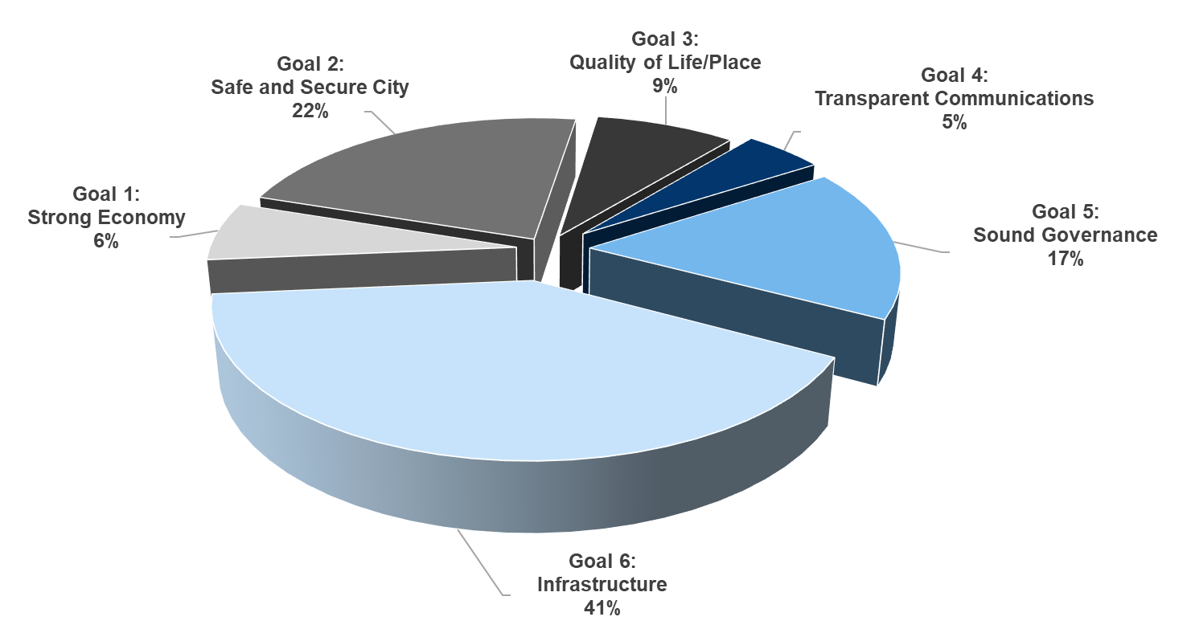
FY2025 ALL CITY FUNDS
OPERATING BUDGET $454 Million
4

Slide 5

FIXED COSTS
Personnel and Benefits – Wages, Health Insurance
IT Software – Cybersecurity, Functionality, ease of use for Citizens
Utility Costs – Electricity and Gas, past and potential increases
Annual Operational Costs – Chemicals, Sanitation roll offs, service contracts (i.e. mowing, temporary help, liability insurance)
Maintenance – Facility, Vehicle and Equipment
Bank and Credit Card Fees – City absorbing these costs
5
Notes:
Personnel General Fund: $114,423,722/ Total General Fund 176,339,702 = 64.8%
Maintenance of City: 19,052,100
Maintenance of GF: 6,297,023

Slide 6

WHAT AFFECTS FIXED COSTS
Inflation
Anticipate changing costs from inflation to pay for fixed costs
Inflation
Anticipate changing costs from inflation to pay for fixed costs
Supply Chain
Increased demand or lack of supply can result in higher costs or delays
Supply Chain
Increased demand or lack of supply can result in higher costs or delays
Growth
Account for additional maintenance and personnel for new capital and population growth
6

Slide 7

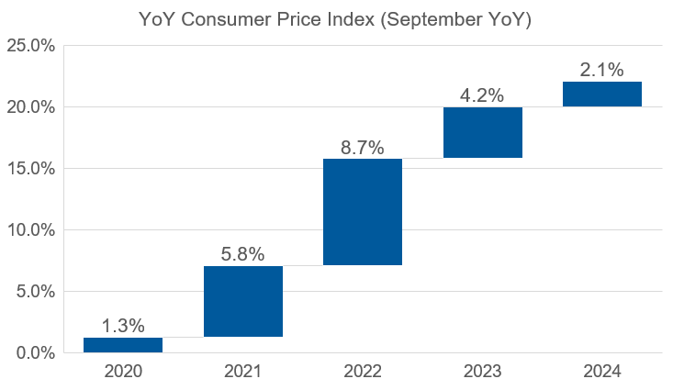
REGIONAL INFLATION
7

Slide 8
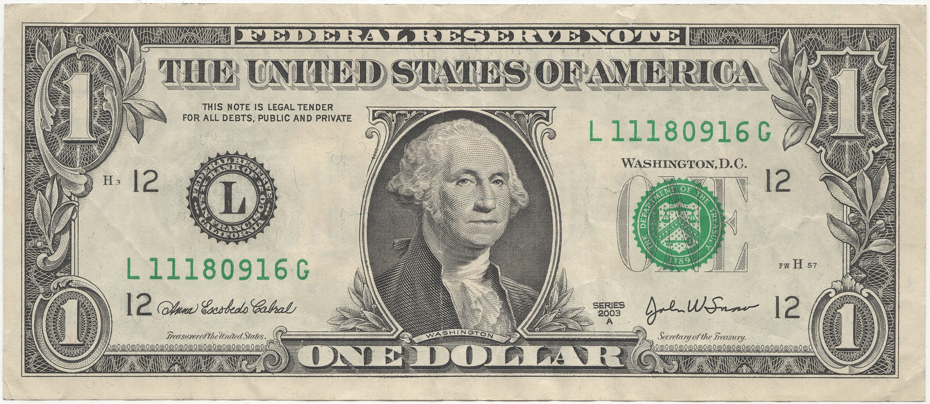

2020
2024
2028…?
8

Slide 9

UNFUNDED MANDATES
IMPACT
Imposition of government requirements with no funding for implementation
Reallocating tax dollars from critical services like public safety, infrastructure, and community programs
Forces city to stretch limited resources
9

Slide 10
UNFUNDED MANDATES CURRENT AND POTENTIAL
Notices & elections
Publication requirements (Print, Television, Website)
Election costs
Landfill Emissions
Annual limit on NMOC emissions
Gas Flare System: $5,500,000
HB No. 2127
Regulatory Consistency Across State, responsibility on City
10
Notes:
Notices & Elections
Publishing requirements for legal notices
Publishing requirements for budget and tax rate notices
Elections costs for City Secretary
Publishing requirements for purchasing and development services
Landfills
Federal emission guidelines require existing landfills to calculate the annual non-methane organic compounds (NMOC) emission rate.
Limit is 34 Mg/Yr.
must construct a gas control system to manage the landfill gas
Expected to exceed 34 Mg/Yr by 2025
Gas Flare System Construction Costs: $5,500,000

Slide 11
UNFUNDED MANDATES CURRENT AND POTENTIAL
I-27 & I-14
State to build Interstates, Cities to purchase Right-of-Way
HB No.165 - Property Tax Eradication- FY25 Budgeted Revenue $75.5 million
Creation of Interim Committee
Comprehensive study of alternative methods of taxation
11
Notes:
Notices & Elections
Publishing requirements for legal notices
Publishing requirements for budget and tax rate notices
Elections costs for City Secretary
Publishing requirements for purchasing and development services
Landfills
Federal emission guidelines require existing landfills to calculate the annual non-methane organic compounds (NMOC) emission rate.
Limit is 34 Mg/Yr.
must construct a gas control system to manage the landfill gas
Expected to exceed 34 Mg/Yr by 2025
Gas Flare System Construction Costs: $5,500,000

Slide 12
STABILIZATION FUND PURPOSE
Allows for Proactive vs Reactive budget development process
Minimize tax rate increases and changes to charges for services/fees
Aligns with 5-year CIP spending plan and other long-term planning
Dollars to have a designated purpose and goal
Contingency – a Back up to the Back up
Greater Credit Rating
12

Slide 13
STABILIZATION FUND
EXISTING AND POTENTIAL
Existing:
Parks Maintenance Fund – Set aside for the maintenance of both renovated and future parks
Potential
Cash Reserve Fund – General Fund’s “Rainy day fund” with cap based on annual operating expenses
Stabilization Fund – Surplus revenue, for the purpose of offsetting costs that would have otherwise increased the Debt Tax Rate
Roads Maintenance Fund – Percentage of revenue for the purpose of maintaining and improving City roads
13
Notes:
Names are place holders

Slide 14

CURRENT AND FUTURE PROJECTS TOTAL INVESTMENT
ROADS: $37.0 million
PARKS: $61.5 million
WATER: $102.3 million
SANITATION: $23.9 million
AIRPORT: $158.0 million
GOLF: $24.5 million
TOTAL: $407.2 Million
14
Notes:
$404.7 million is the investment to upgrade and provide new infrastructure in Midland.
Roads includes Bond Projects, Road Resurfacing and City-Wide Concrete Project

Slide 15
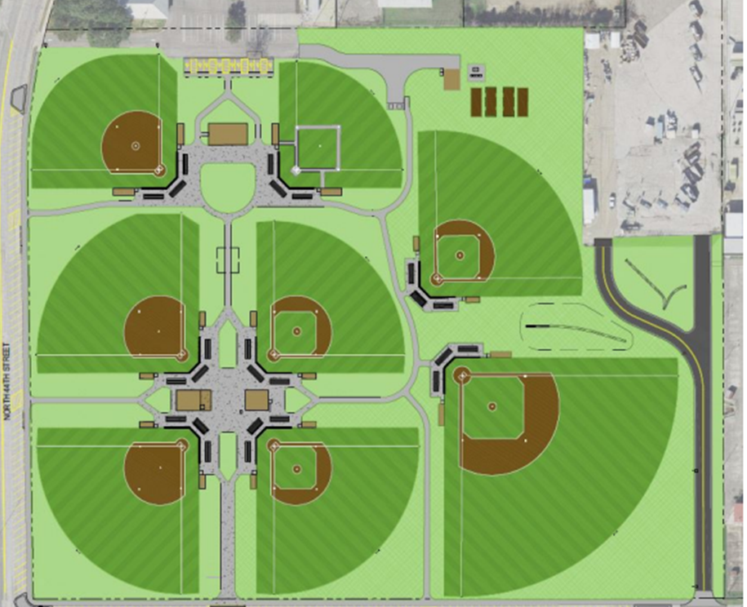
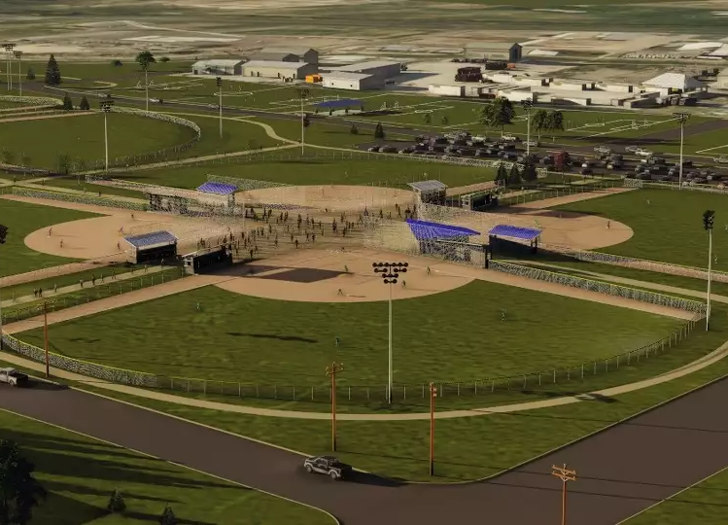
WACO
MIDLAND
$9 Million (2022)
8 New fields
New Lighting
Concession and Restrooms
$16.2 Million (2023)
6 New fields
New Lighting
Concession and Restrooms
Parking
15

Slide 16
WACO
MIDLAND
$9 Million (2022)
8 New fields
New Lighting
Concession and Restrooms
$16.2 Million (2023)
6 New fields
New Lighting
Concession and Restrooms
Parking
16

Slide 17
CASH VS BOND
Reduces Debt burden/risk and helps credit rating
No Interest or Premium costs
If funds are already in reserves, it allows for quicker project implementation
Allows more of annual budget allocated toward operating expense rather than debt payment
Sets a rigid timeline for projects based on steady build up of cash reserves
Preserves Cash Reserves for urgent and unforeseen needs
Interest rates could be cost savings compared to inflation
Projects can be funded based on need rather than
Predictable expense spread out over the term of the loan
Addressing both backlogged and future needs in the same funding source in a shorter span of time
17

Slide 18


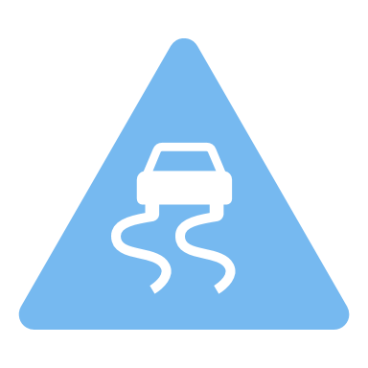

BALANCING PROJECTS
18
Notes:
Many of these entities use the same contractors as the City. To avoid artificially increasing the price of projects we need to be aware of what projects are lined up not just in the City but also for surrounding entities.

Slide 19





PROJECT IMPLEMENTATION
19
Notes:
With our current and growing list of Midland needs and wants, we also need to make sure not to bog down – available contractors and without causing too much disruption with citizens.

Slide 20
PROJECT IMPLEMENTATION
20
Notes:
Projects need to be implemented strategically based on need, funding and traffic impact

Slide 21
PROJECT IMPLEMENTATION
Operations
Maintenance
21
Notes:
While also being cognizant of the annual Maintenance and Operating needs of the City

Slide 22
SURROUNDING GOVT ENTITY
MISD | County
Midland College | TXDoT
22
Notes:
There are current and incoming projects in the are surrounding Midland by other Government entities: MISD, Midland County, Midland College and TXDoT. The City will be expected to coordinate with or support some of these projects

Slide 23
OTHER GOVT ENTITY PROJECTS
MISD
Two new High Schools
New Elementary School
Convert old High Schools into new Middle Schools
Middle School and Elementary renovations with improved security
County
Midland County Detention Center ($171 M contract as of Jan 2025)
Master Thoroughfare Plan - upcoming Occidental PKWY extension
Flood Planning Framework 2021 (No Update) – Multi-entity Coordination
Midland College
Three new buildings (Applied Tech, Health Sciences and Conference Center)
Modernization and enhancement of housing, security and community spaces
TXDoT
I-20
I-27 & I-14
23
Notes:
MISD - https://midlandbond2023.com/
New Midland and Legacy High
Abell, Alamo, Goddard and San Jacinto Middle School Renovations. Convert old MHS and LHS to new Middle Schools.
Renovate Santa Rita, Bush, Scharbauer, and De Zavala Elementary Schools. New Lone Star Trails Elementary
Improve School Safety and Security, and Radio Repeater Communication.
County
https://co.midland.tx.us/1021/Capital-Facility-Project-Updates
Midland County Detention Center – Contract Value $171,180,883 as of January 2025
Flood Planning Framework Adopted Dec 2021 “Ambitious drainage system that will be decades in completion [...] Will need to coordinate with two cities, TxDOT, numerous landowners and an array of oil and gas interests to implement the recommendations”
Master Thoroughfare Plan – includes Occidental PKWY Extension to Elkins (just north of Mockingbird Ridge and 349 Ranch Estates, feeding traffic away from Big Spring)
Midland College
https://www.midland.edu/news/february-2025/mc-bond-2025.php#sthash.UtytjPH5.dpbs
https://www.midland.edu/news/november-2024/campus-revitalization.php#
280,000 sq. ft. Applied Technology Buildings housing energy and heavy industry programming
47,000 sq. ft. Health Sciences Facility housing critical programming to support health care
53,000 sq. ft. Conference Center to support energy education, college operations, and culinary arts
Modernization of Legacy Structures and Campus Core with an emphasis on safety and security
Upgraded Student Housing including flexible living spaces, common kitchens, and study rooms
Enhanced Community Spaces including recreational fields, tennis, pickleball, and walking trails
TXDot
https://ftp.txdot.gov/pub/txdot/get-involved/oda/i-20/082923-tabloid-5.pdf
https://www.newswest9.com/article/traffic/construction-midland-odessa-2025/513-22281f6e-e3cb-480d-ae86-d100ad68fa2e
I-20 – Improvements from Odessa to Midland. $424M planned as of Jan 2025

Slide 24
OTHER GOVT ROAD PROJECTS
I-20 Backage (Phase 1) - Garfield Rd to Midkiff Rd | County
Fairgrounds Rd/Outer Loop to 349 | County, MDC, TxDOT
I-20 Backage (Phase 2) - Garfield to Rankin HWY | County, MDC
Scharbauer Drive - Fairgrounds Rd to Todd Rd | County, MDC, Developer
Occidental Pkwy - Midkiff Rd to BS 349* | County, MDC, Developer
Midkiff Rd - Passage Way to Occidental Pkwy | County, MDC, Developer
CR 1250 - SH158 - Reliever Route | MDC, Developer, County
24

Slide 25
BALANCE
25
Notes:
Many of these entities use the same contractors as the City. To avoid artificially increasing the price of projects we need to be aware of what projects are lined up not just in the City but also for surrounding entities.

Slide 26

MISSION
Deliver exceptional services and promote a high quality of life and place for ALL our citizens.

Slide 27
FY2025 OPERATING BUDGET
FY2025 Budget $454 Million
27

