Slide 1
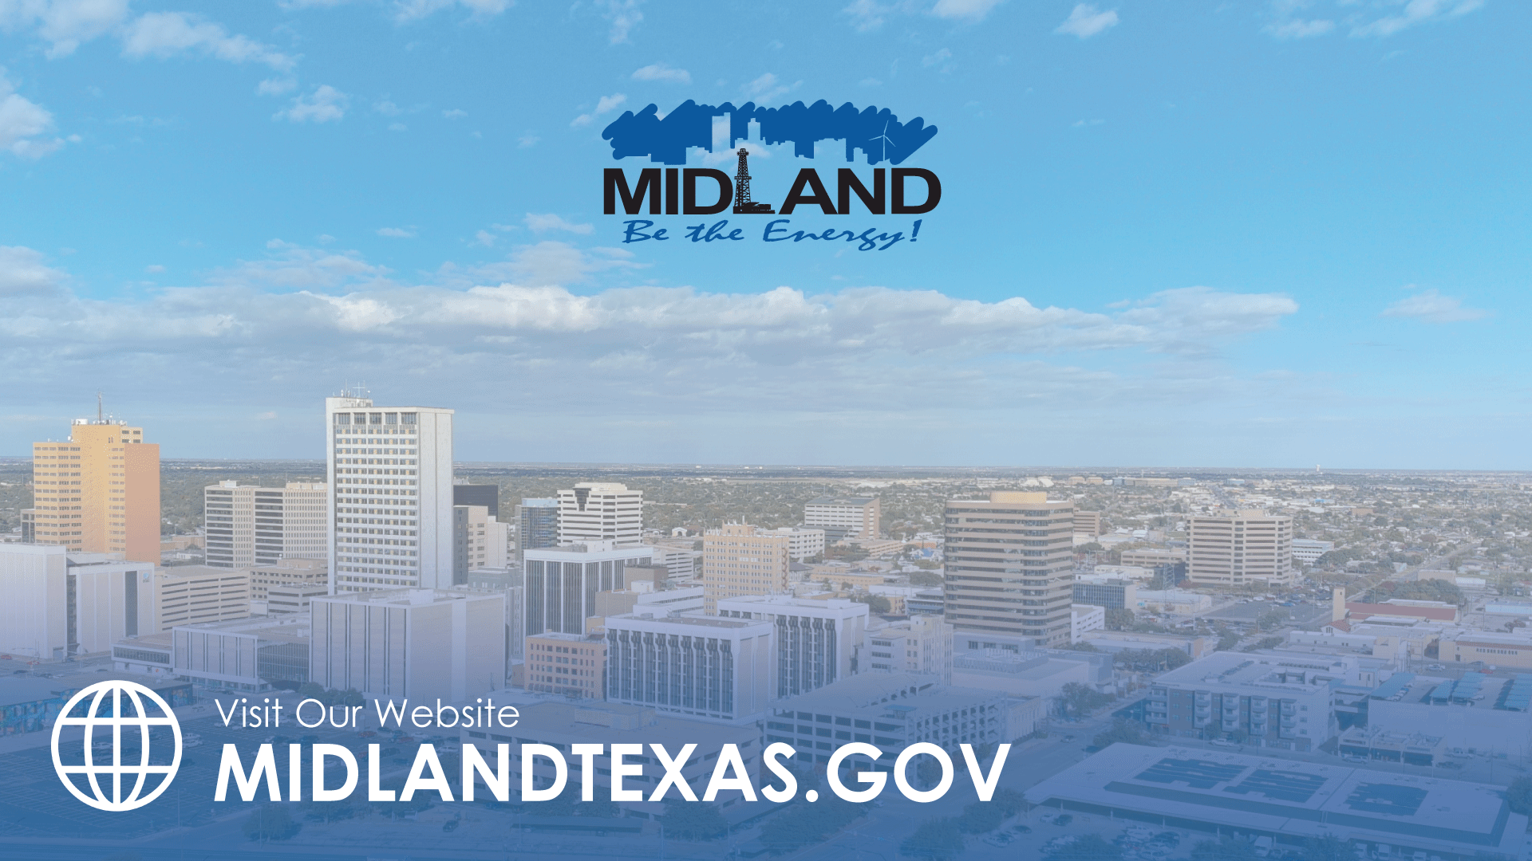
WATER DEBRIEF
MARCH 18, 2025
TITLE HERE
TITLE HERE

Slide 2
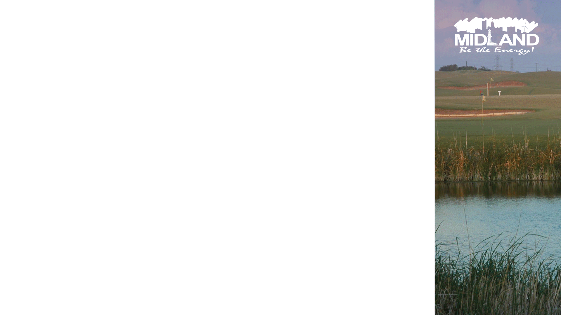
STRATEGIC GOAL CONNECTIONS
Goal 6. Strengthen and Sustain our Infrastructure
6.1 Provide reliable and sustainable utilities: Guarantee water supply and distribution systems security and longevity
2

Slide 3
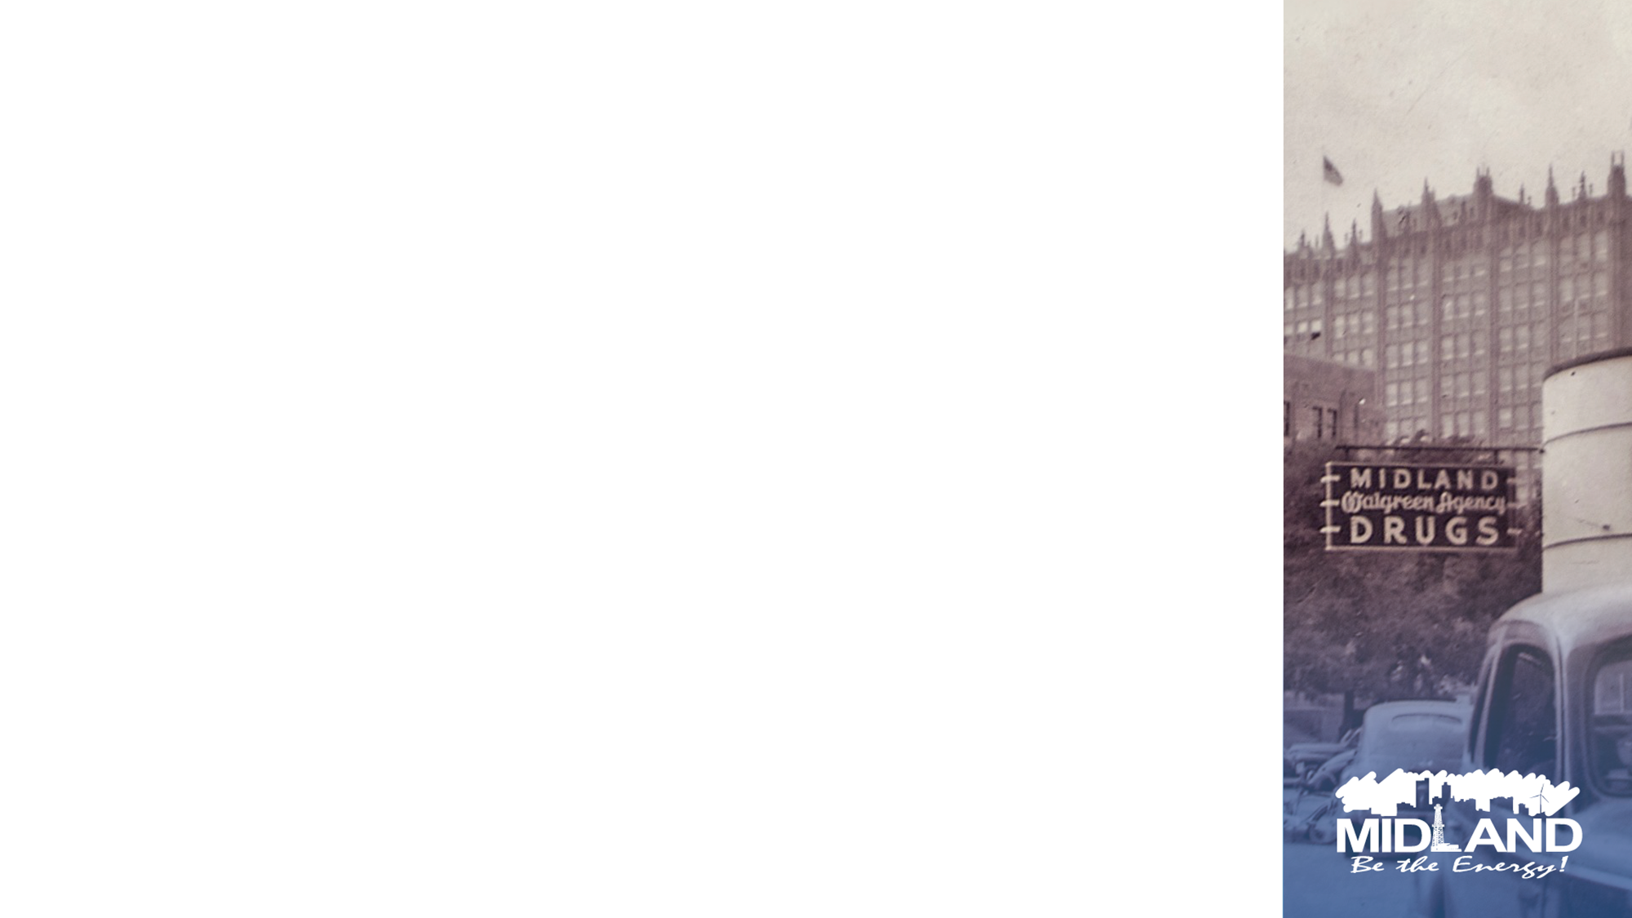
WHY ARE WE HERE TODAY?
Proper Use of Risk Analysis
Chain of Command Communication
Operational Weaknesses/Protocols
Zebra Mussel Impact
Water Treatment Plant Repairs & Maintenance
Valve Components Replacement
But First – Discuss Water Supply
3

Slide 4
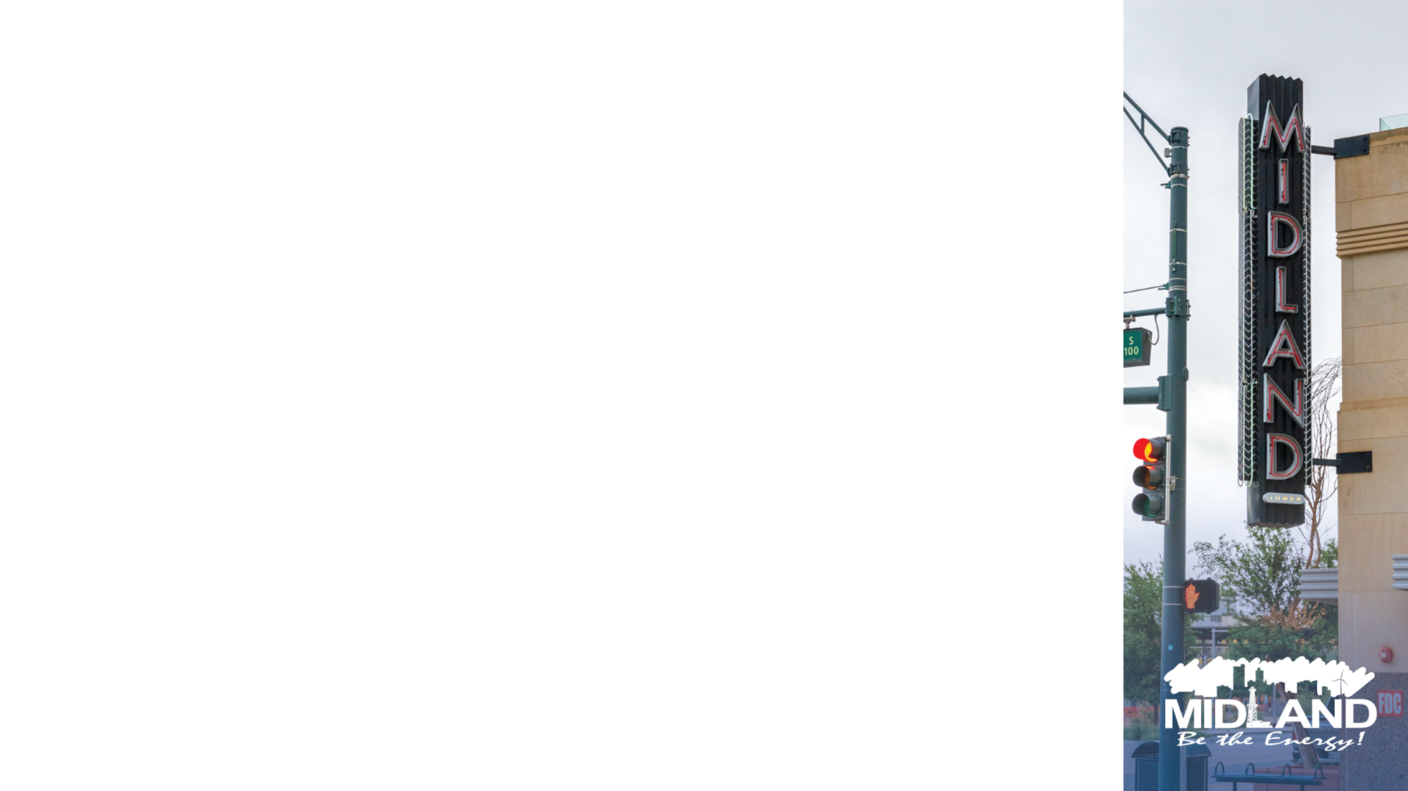
Midland’s Water Systems
Midland relies on both groundwater and surface water sources to supply potable drinking water to our community
Surface water facility
CRMWD
Two groundwater facilities
T-Bar Ranch
Paul Davis Well Field (Not currently in use)
4

Slide 5
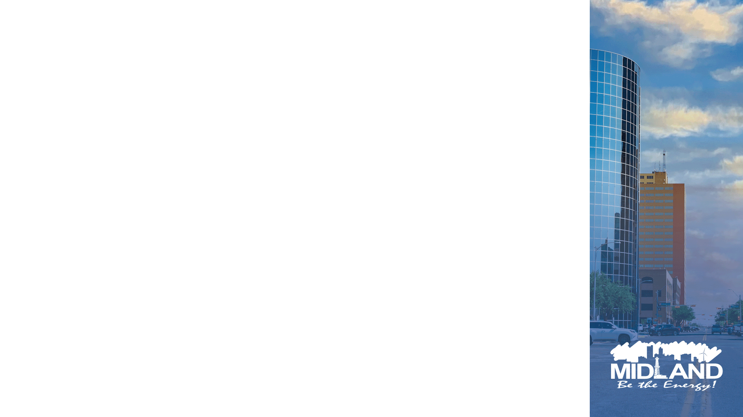
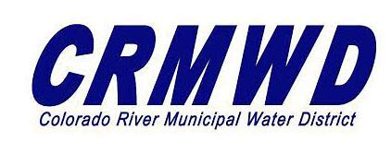
Colorado River Municipal Water District (CRMWD)
Colorado River Municipal Water District (CRMWD) provides surface water to 36 counties
Surface water is distributed from Lake J.B Thomas, E.V. Spence Reservoir, and O.H. Ivie Reservoir
CRMWD Water goes to Midland's Water Treatment Facility - primary source of potable water provides average of 70% Midland’s water supply
Max Take or Pay supply is 17.5 MGD (Million Gallons per Day)
5

Slide 6

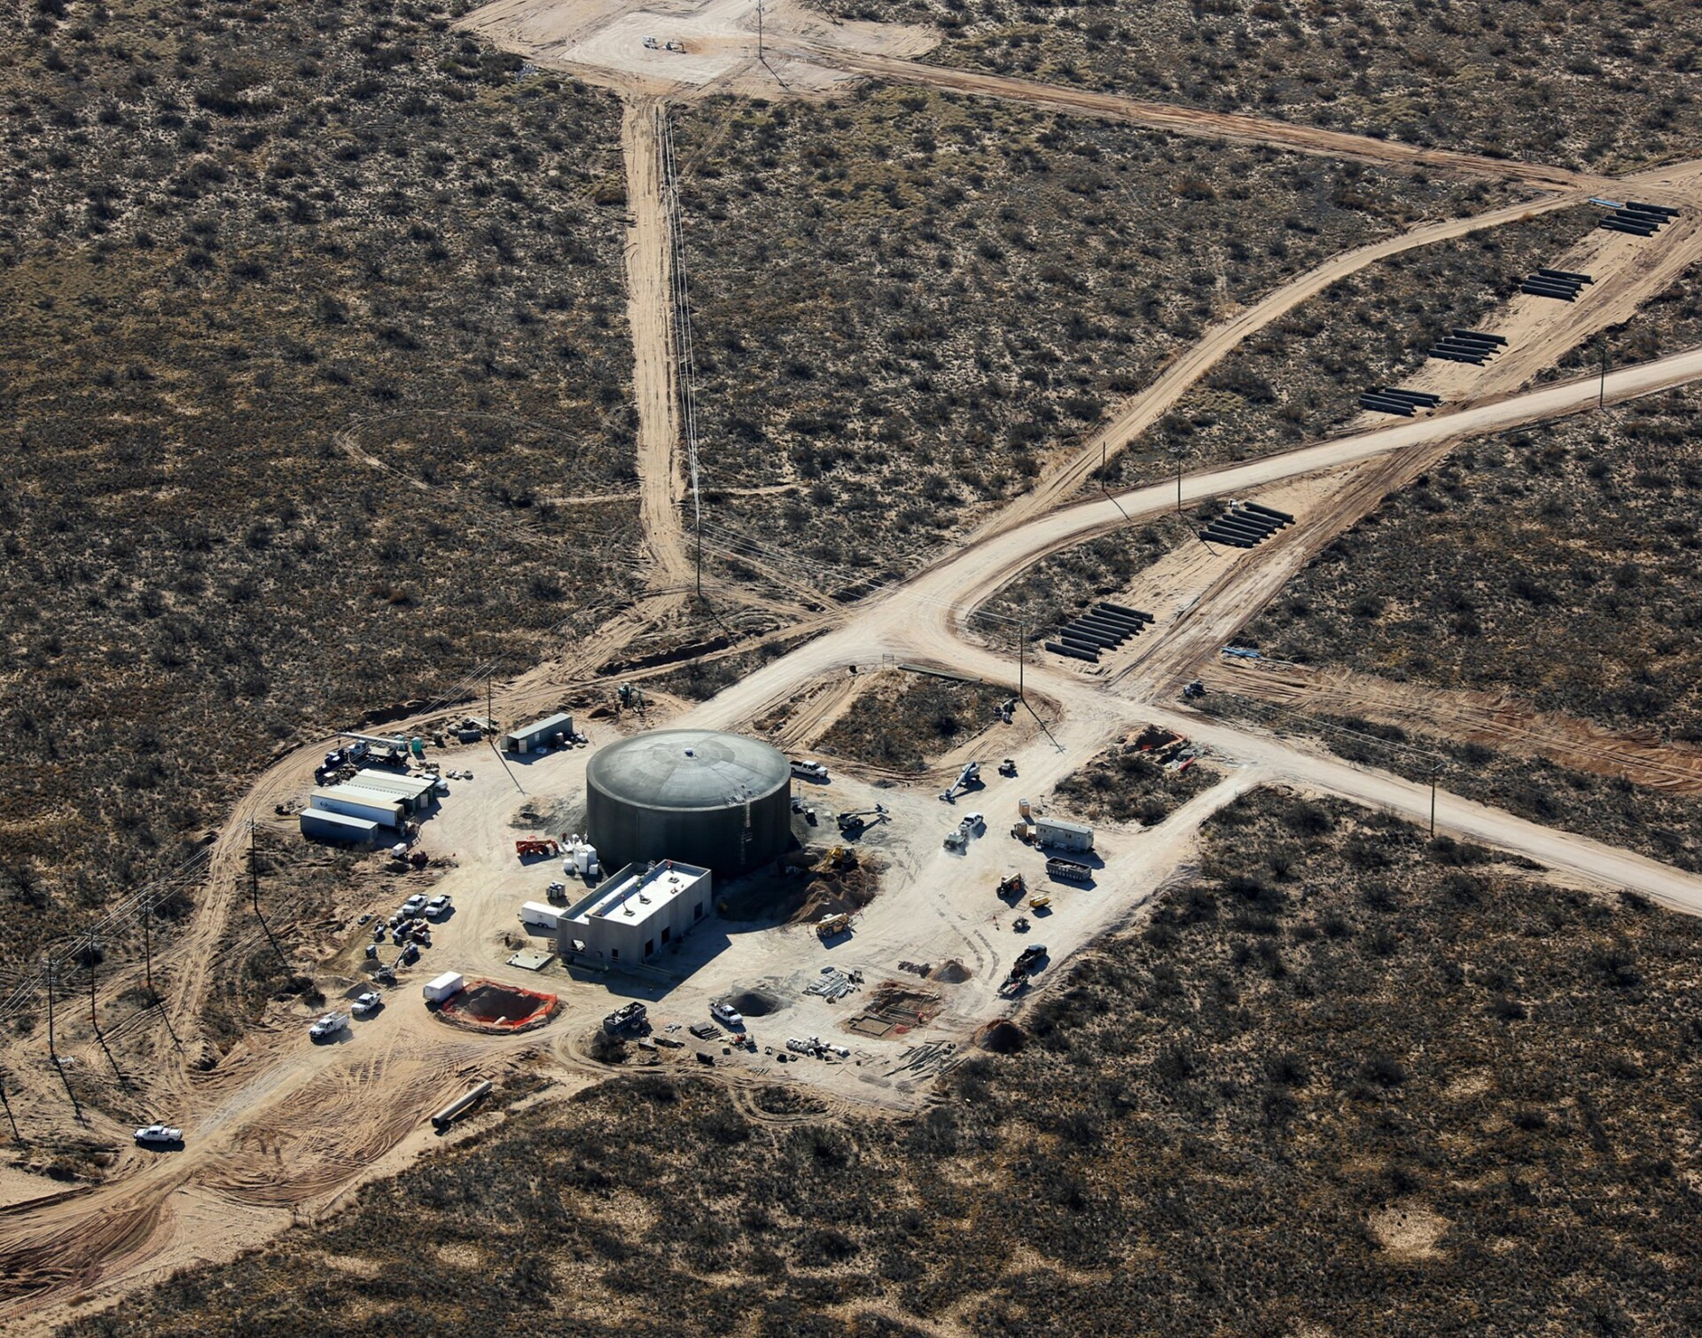
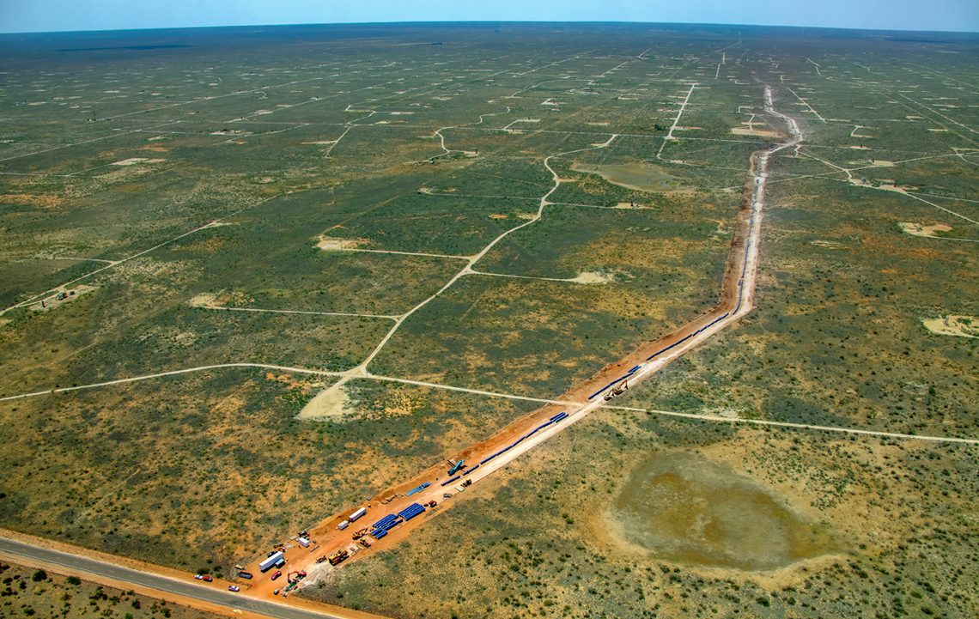
T-Bar Ranch
Purchased in 1965 public partnership with Midland County Freshwater Supply District No. 1 - serves as supplemental groundwater source to Water Treatment Facility
Located in Loving and Winkler County ~70-75 miles west of Midland
Produce up to 20 MGD
Went into operation in 2012
6

Slide 7
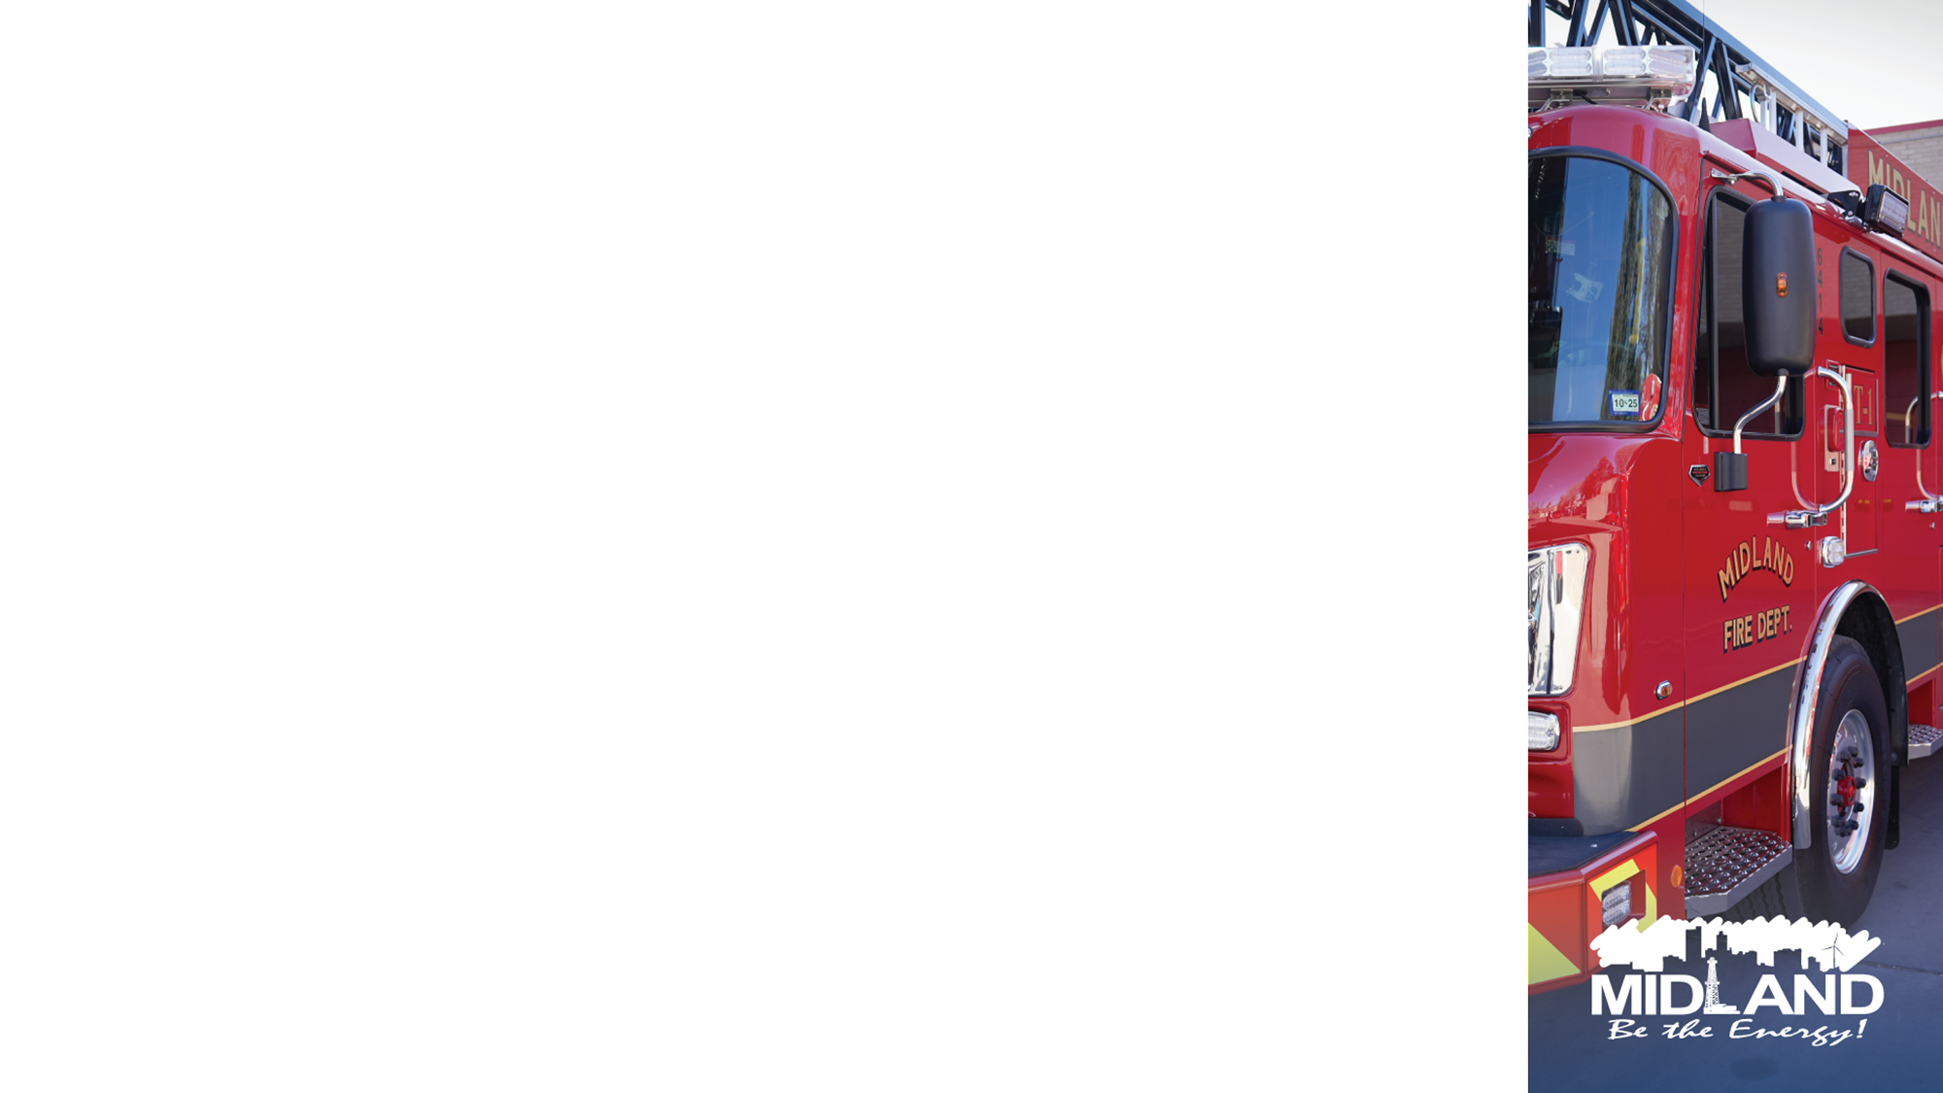
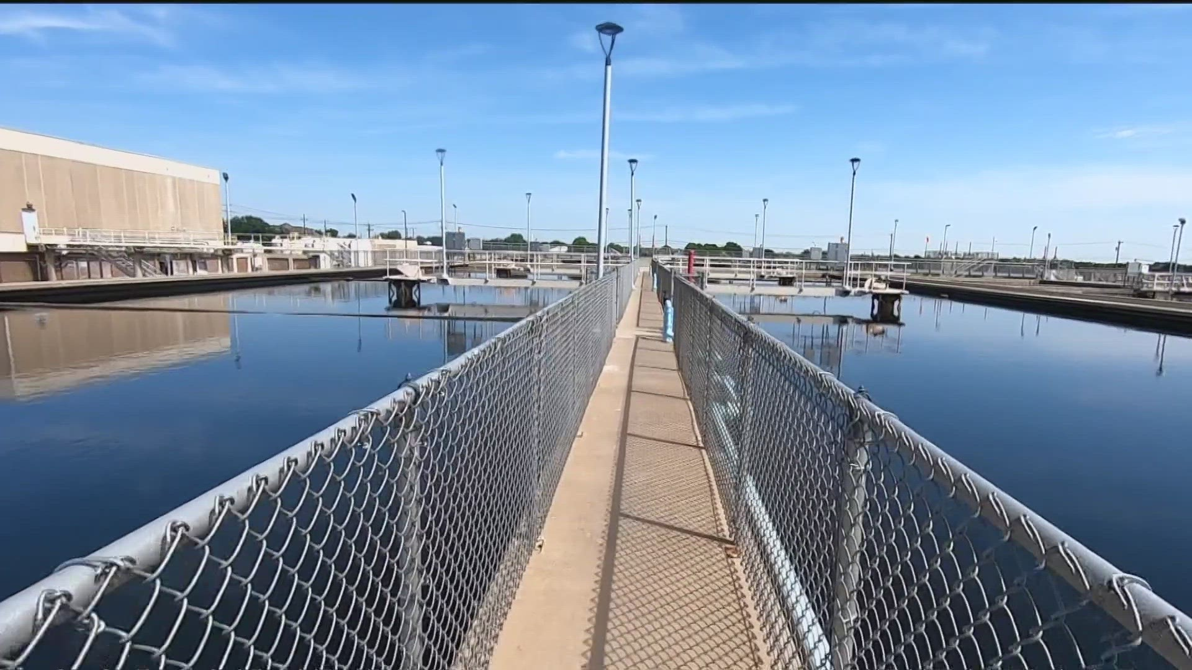
North Midland Water Treatment Facility (5000 Midland Drive)
Receives water intake from CRWMD for treatment, storage, and distribution
Ability to treat up to 32 MGD at this facility
7

Slide 8
WHY ARE WE HERE TODAY?
Need for Proper Use of Risk Analysis
Chain of Command Communication
Operational Weaknesses/Protocols
Zebra Mussel Impact
Water Treatment Plant Repairs & Maintenance
Valve Components Replacement
8

Slide 9
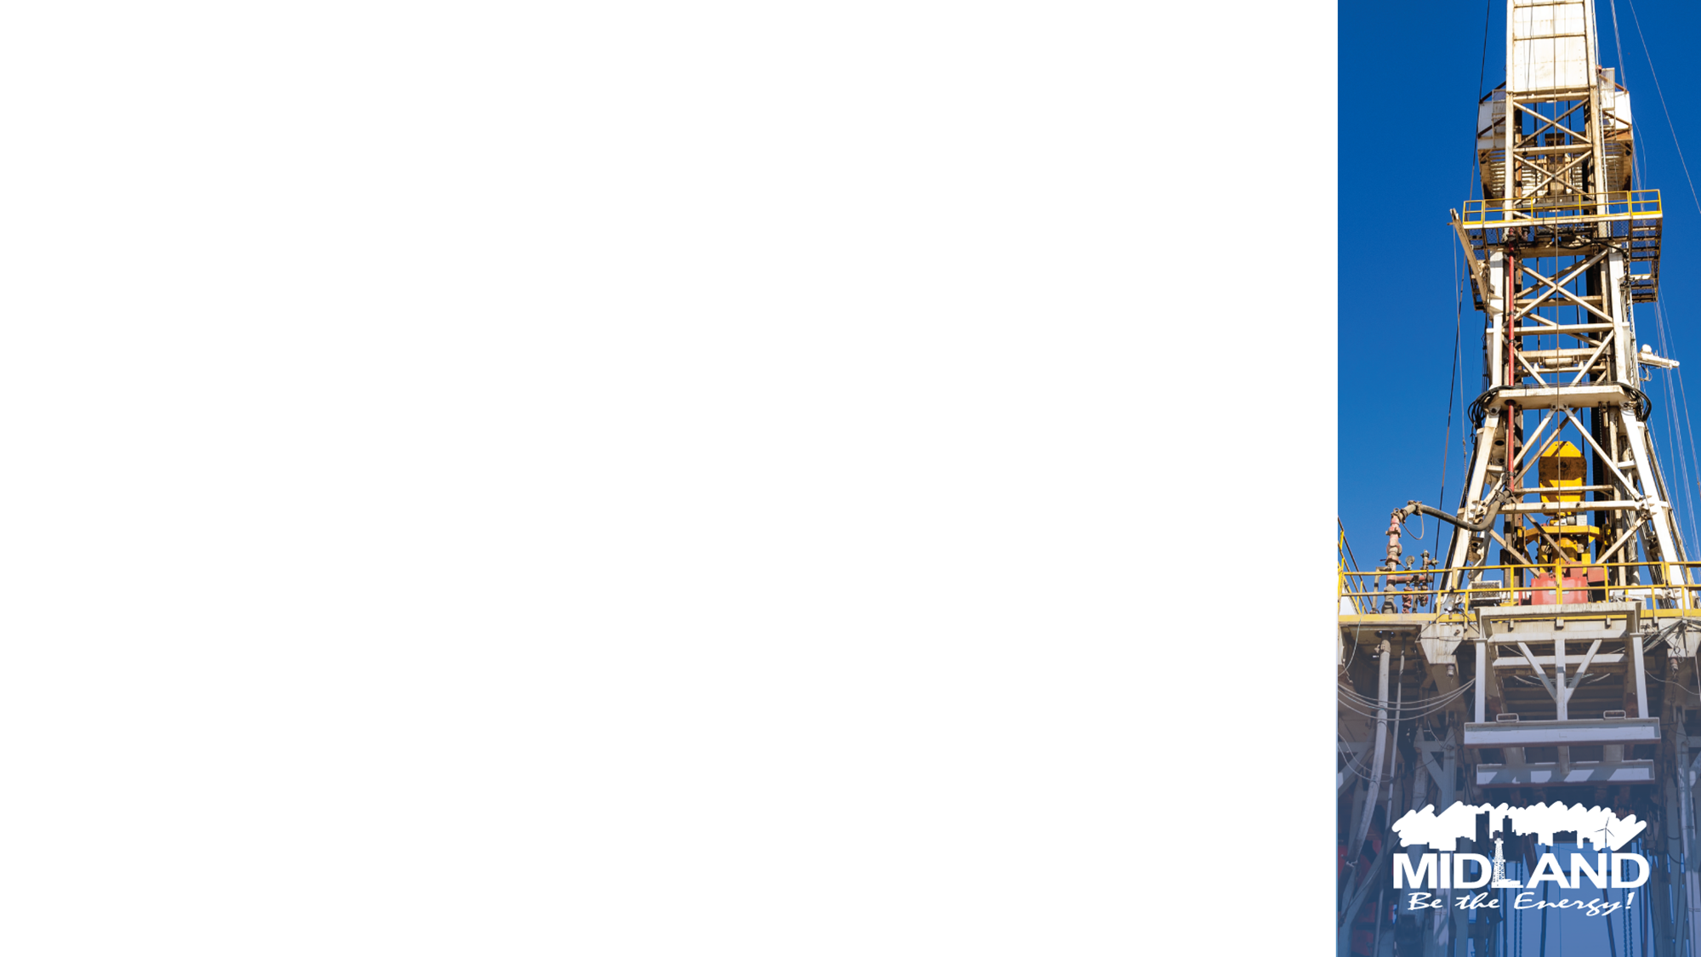
WHAT LED TO THIS EVENT?
Lack of a Proper Risk Analysis
Communication Flow
Operational Weaknesses/Protocols
Zebra Mussels Impact
Water Treatment Plant Contractor Damages (Reduced to half of the capabilities-16 MGD)
Staff Took Down Third Train for Maintenance (Reduced water treatment capabilities to 8 MGD).
Valve Malfunction at SH 158 within City Limits worsened the matter
9

Slide 10
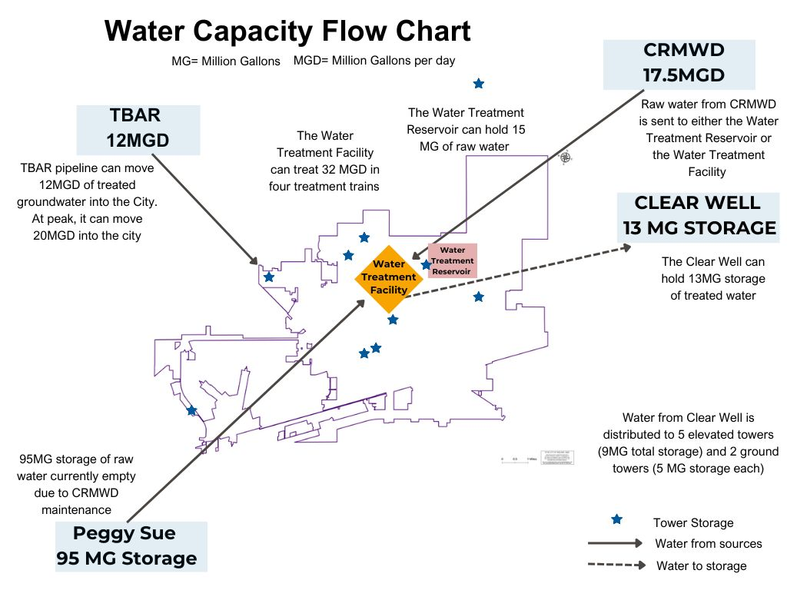

Slide 11
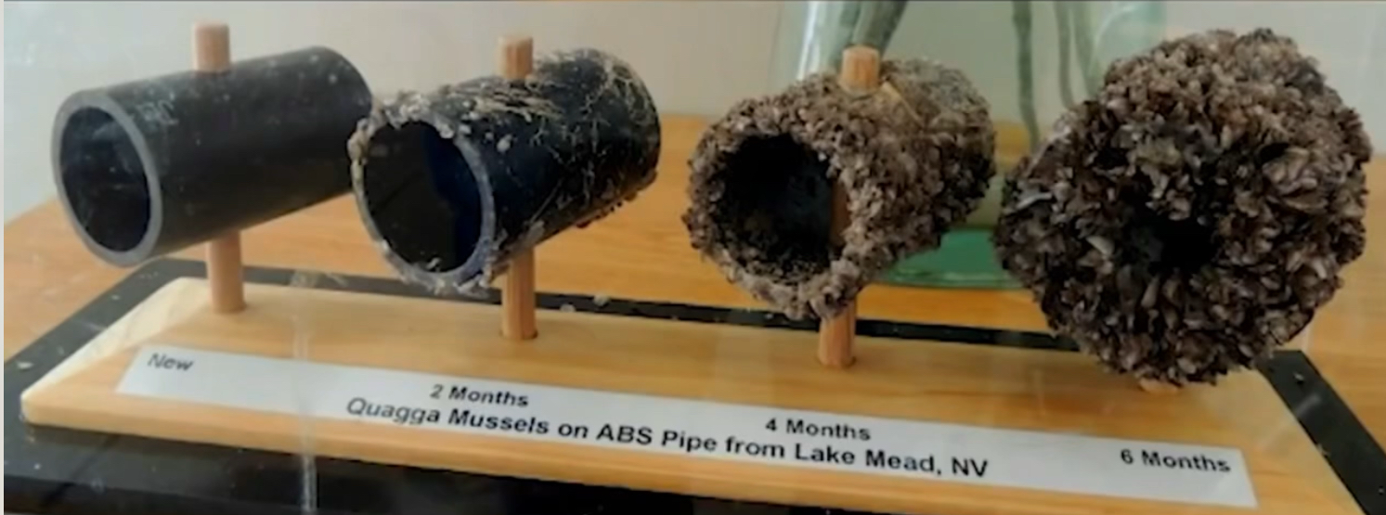
Zebra Mussels
Zebra Mussel first observed by CRMWD in 2019. City of Midland began to mitigate at treatment plant in Nov 2022, notified residents (media releases and town halls)
Treatment began in reservoirs w/copper sulfate in the spring of 2023
CRMWD has recently implemented (Spring 2025) copper sulfate treatment at Lake Ivie
Further treatment at source helps decrease number of mussels and larvae further reducing infestation
11
https://www.firstalert7.com/2024/02/21/invasive-zebra-mussels-growing-concern-texas-lakes-water-systems/
HyFlow Water Solutions- What are Zebra Mussels
Notes:
Treated in spring 2023 (during their breeding cycles, hence the waiting period for best results of treatment).
This treatment keeps the mussels from growing rapidly, but it is impossible to keep them completely out of our pumps without treatment directly at the water source (Lake Ivie).
This is not a Midland only problem, it is affecting the entire country.

Slide 12
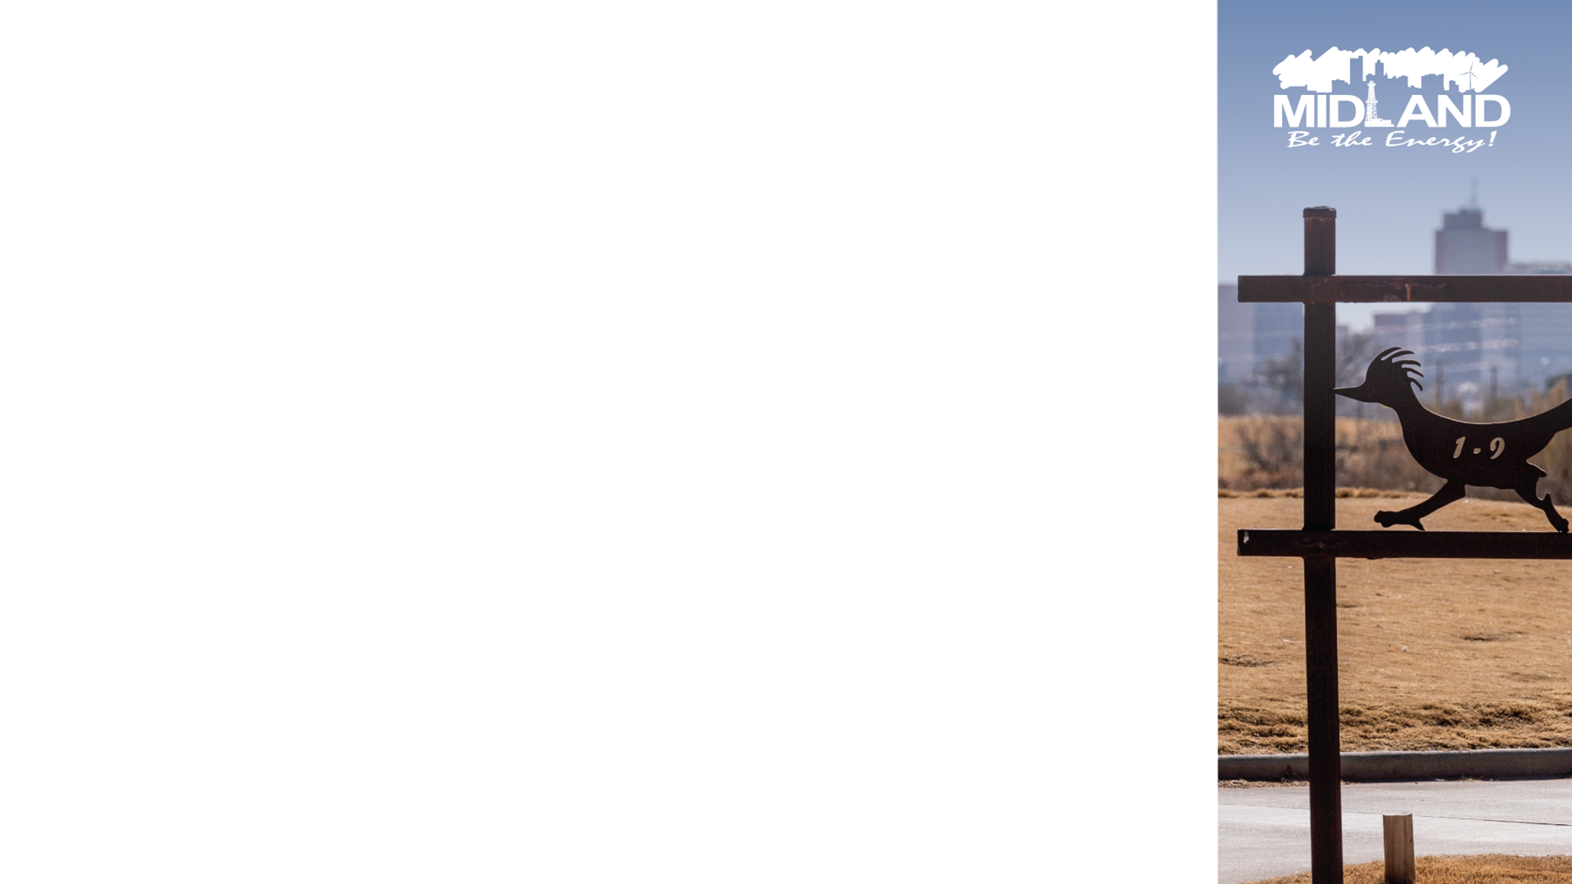
T-BAR VALVE COMPONENT REPLACEMENT
Repairs needed to valve (PRV) component at T-Bar pipeline (SH 158) contributed to reduced pressure and flow throughout city but other factors at play
Replacement of internal valve components were ordered March 1st and delivered and installed March 6th
Valve Replacement March 6th, 2025 Update
Installation of Replacement Valve March 6th, 2025
12
Notes:
Part ordered from Canada-only place to source it from. Had to be a food grade part for a very specific and particular Singer Valve
Was caught in customs. Parts should have been here on Tuesday. Delayed a day.

Slide 13
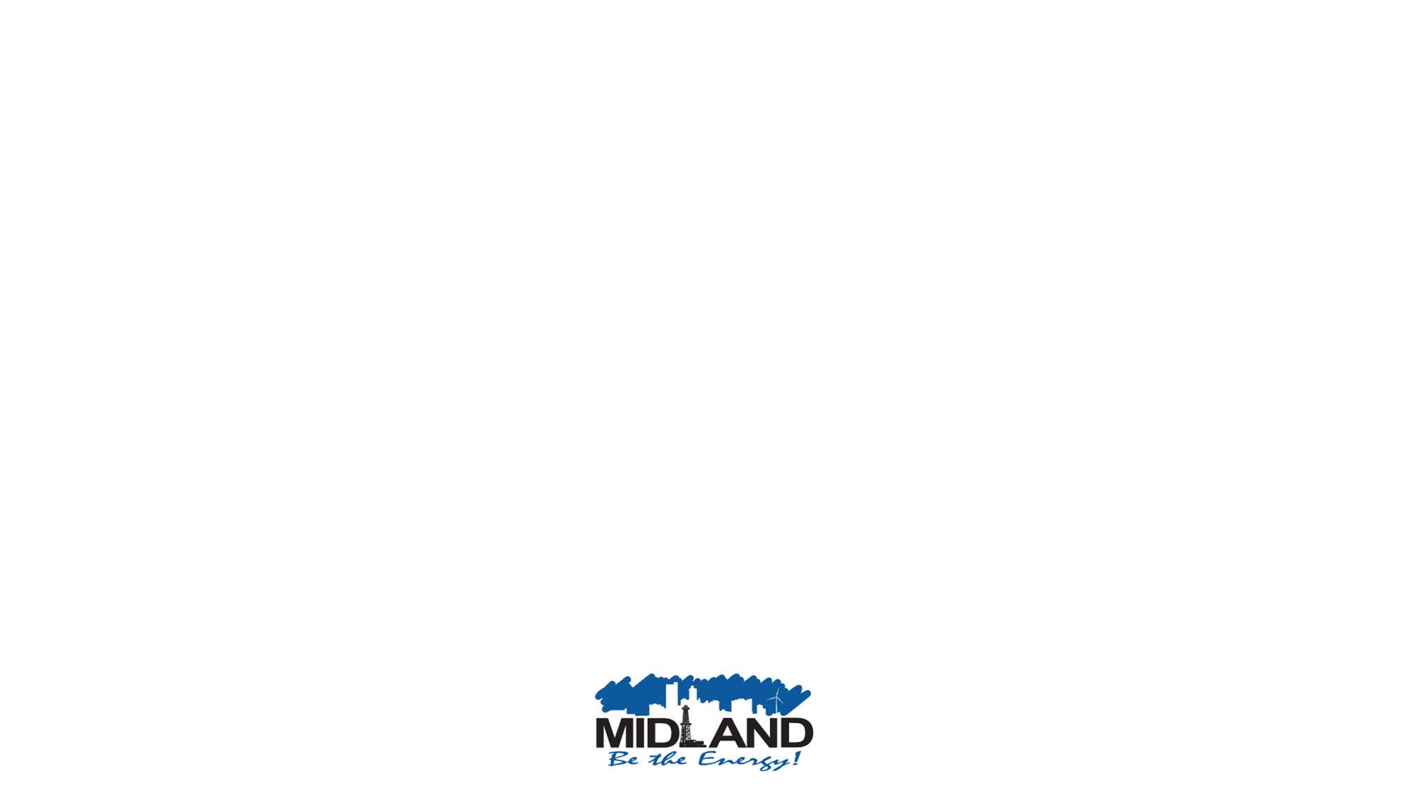
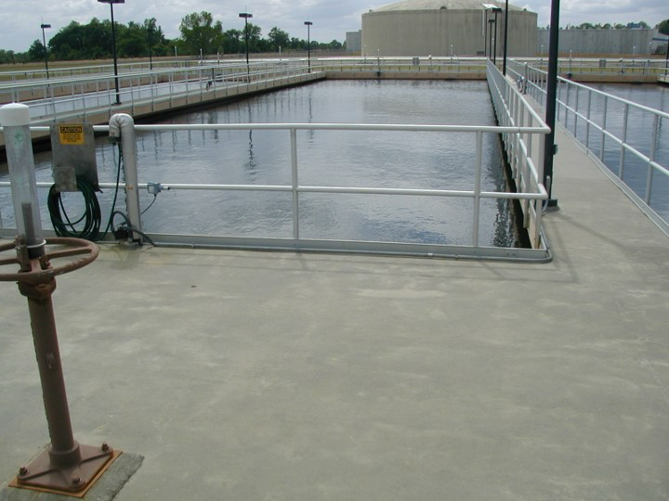
Water Treatment Facility
Midland’s Water Treatment Facility uses 4 trains to treat and store surface water
Two trains downed for maintenance of sump pump system that pulls out waste solids (increase in waste solids due to zebra mussels) and contractor flooded electrical system rendering trains inoperable
Staff took Third train down due to maintenance
The plant was only operating at 8 MGD instead of its full capacity of 32 MGD
Solution identified of routing T-BAR (treated) water directly into Water Treatment Plant clear well- MFD laid two hydrant lines to fill water treatment facility to get back to necessary 16 MGD
13

Slide 14
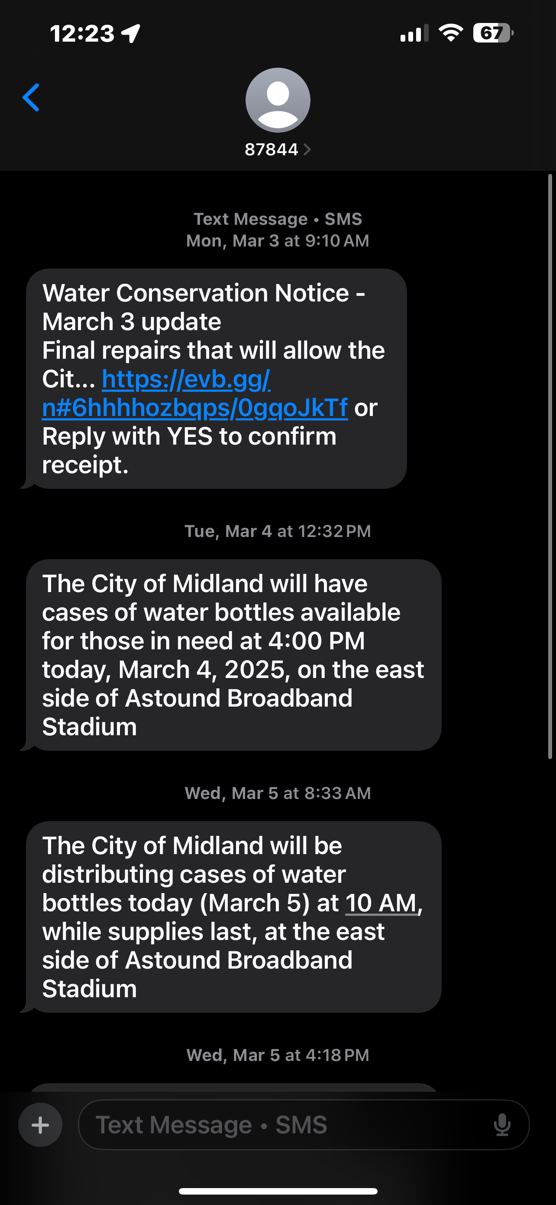
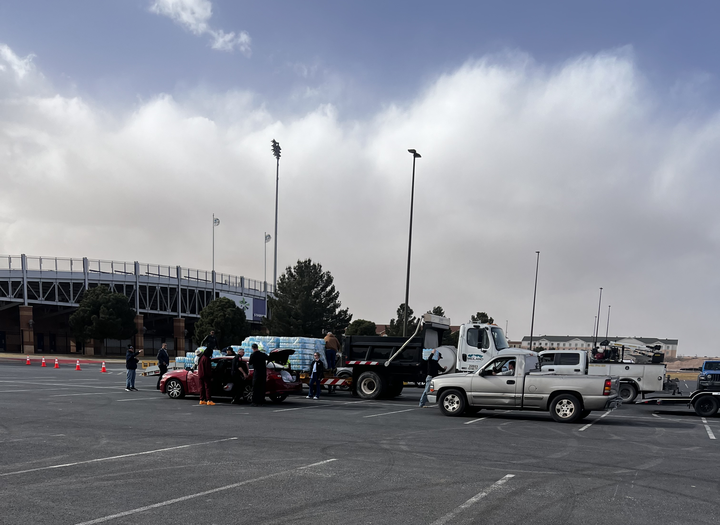
COMMUNITY ENGAGEMENT & WATER DISTRIBUTION
Eight Alert Midland notices were sent
Four press conferences were held, including live TV broadcast March 3, 2025
36 social media posts kept the public updated on status and water conservation needs - Facebook Live March 6
Between March 1-5, City staff distributed over 90 pallets of water to community at Astound Stadium and limited delivery
14

Slide 15


AFTER ACTION REVIEW
WENT WELL
Grit – Faced Up to Challenges
Public Outreach
Water Distribution
Did not require Water Boil Notice (remained compliant with TCEQ fire flow requirements)
DIDN'T GO WELL
Lack of a Proper Risk Analysis
Communication Flow
Operational Weaknesses/Lack of Protocols
15
Notes:
Communication with Leadership: City leadership was notified on February 26, 2025, and coordination with key water users (MISD, Midland College, etc.) was effective. Also, notified council and stayed in constant contact with them.
Public Outreach: The City’s social media and press efforts were successful in informing the public and garnering support for water conservation and distribution efforts.
Water Distribution: The prompt distribution of water to affected residents helped mitigate the impact of the water flow disruption.
Delay in Notifying Leadership: The valve was a problem for quite some time as is evidenced by the valve on order for May 2025 delivery. When valve failed at what staff described as 80% problem on February 26, 2025 – that is when city leadership was notified. This was worsened by inadvertent valve closure at 02:30 AM on February 28 that was not communicated to leadership until 9:00 AM, which exacerbated the problem and delayed decision-making.
Contractor Accountability: The original contractor, Charger, caused damage that further delayed the restoration of water capacity. This contractor was not replaced soon enough.
Lack of EOC Structure: The decision to not activate an Emergency Operations Center (EOC) could have provided more order to the response efforts. Although, and EOC structure was not set up, we functioned as one as the CM office being the command structure for decision making closely tied to the water department actions. Council was informed throughout the process. In the future, a more structured approach would be best.
Limited Communication Across Departments: Internal communication between city departments and other major organizations (like Midland Memorial) could have been more proactive and streamlined.

Slide 16

KEY TAKEAWAYS
Improved Coordination: Future incidents should include clear communication protocols and EOC structure
Contractor Management: More stringent process to better manage contractors and shorter notice for non-performance
Redundancy in Water Systems: Additional infrastructure redundancy - bypass lines and more robust intake systems prioritized to avoid vulnerabilities
Regular Risk Analysis: Risk analysis should be conducted to anticipate system weaknesses and potential failures
16
Notes:
Hiring a contract manager; job is posted. Will help all departments, especially enterprise accounts.

Slide 17
Moving forward
Immediate Actions:
Ensure critical valves and treatment systems are checked and maintained regularly to prevent future failures (Contract on Agenda)
Expedite backup systems for water treatment plant and automated sensors for water line monitoring
Established internal Water Committee to manage ongoing water system risks and repairs.
Developing an external Water Committee.
Policy and Operational Improvements:
Establish clear, enforceable contractor performance metrics and timelines. Contractors placed "DO NOT HIRE" list if they fail to meet requirements
Activate EOC structure immediately during future emergencies to coordinate efforts and streamline communication
Formalize communication protocols to ensure stakeholders (public and internal) are informed regularly
17

Slide 18
Moving forward
Policy and Operational Improvements:
Developed Policy for Proper Risk Analysis
Work on Agreements with Fabricators and Distributors of Specialized Equipment and Parts
Develop Training for new policies and protocols so these practices are embedded in how we operate
Prepare Bid Documents for Bypass Line from SH 1250 to Water Well at Water Treatment Facility for Additional Water Supply Back-up
Prepare Bid Documents to Grow Water Treatment Capability – Paul Davis Groundwater or Growing Our Capability within the City Limits
18

Slide 19
Moving forward
Long-Term Goals:
Develop water sustainability plan that includes improving infrastructure (like bypass lines) and build additional water treatment capacity
Implement a more resilient water treatment infrastructure that accounts for potential breakdowns in system including multiple redundancies
Invest in automated monitoring systems and sensors to detect and address issues in real-time. Some of these items are already ordered and should be in place within a week (as of today, 3/18/25)
Zebra Mussel Management:
CRMWD is installing a copper sulfate treatment system this year for zebra mussels
This method has been successful in Georgetown, Texas
Midland Water Treatment facility will continue to mitigate Zebra Mussels with copper sulfate and other proven methods
19
Zebra mussels ‘no longer a concern’ for Brushy Creek water facilities, thanks to copper | KXAN Austin

Slide 20

MISSION
Deliver exceptional services and promote a high quality of life and place for ALL our citizens.

Slide 21
21

Slide 22
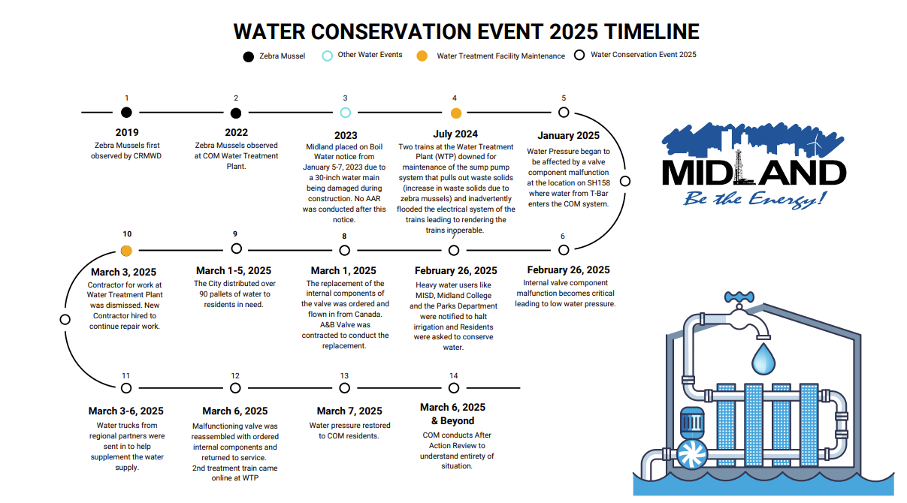
22

Slide 23
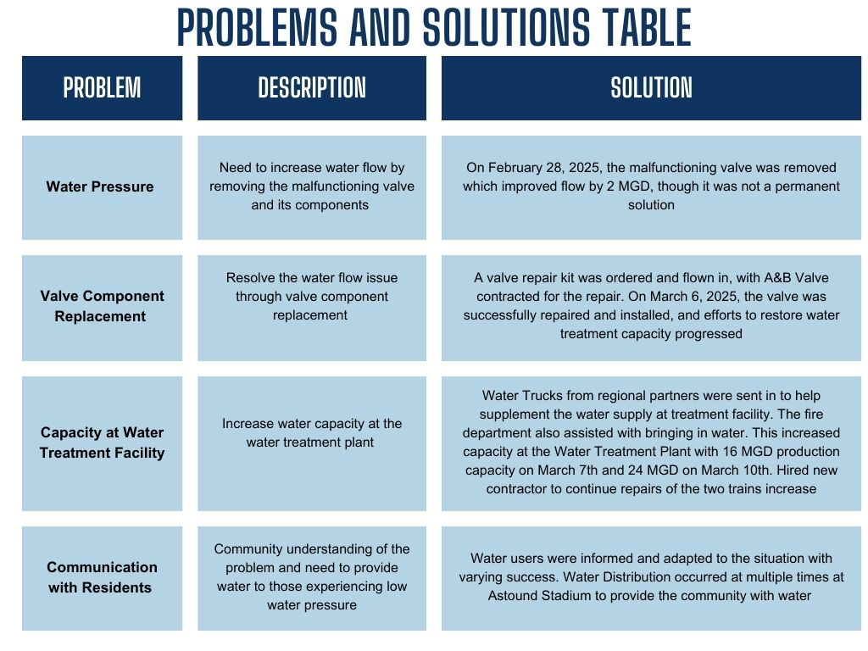
23

Slide 24
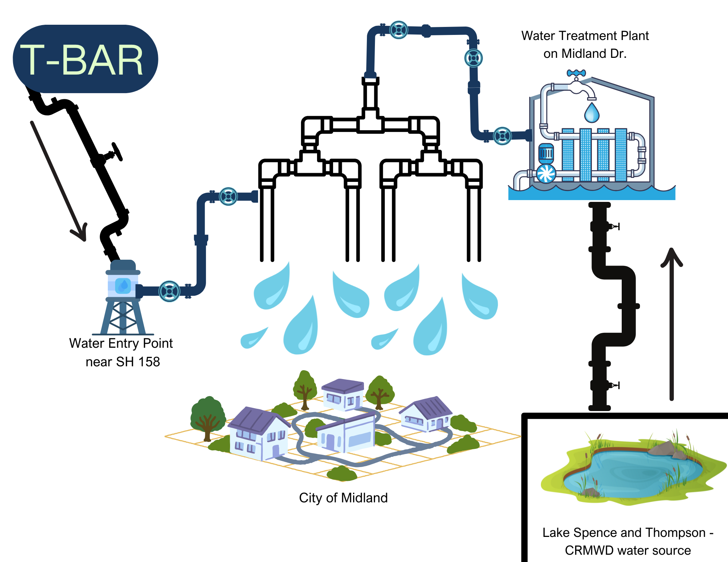
24

Slide 25

WHAT LED TO THIS EVENT?
Due to a pressure reducing valve (PRV) malfunction at the location where water from T-Bar feeds into the COM water system, and ongoing maintenance and repairs occurring at the Water Treatment Facility, residents experienced a drop in water pressure and the City requested all residents to conserve water.
Staff advised in late February 2025 the valve malfunction appeared to be exacerbated by below-freezing weather conditions.
25

