Slide 1

BULL MOUNTAIN LLC
SPECIFIC USE DESIGNATION WITHOUT TERM
ITEM 20
TITLE HERE
TITLE HERE

Slide 2

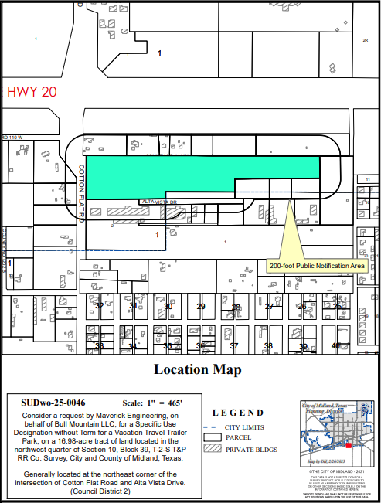
APPLICATION SUMMARY
Property Owner & Developer: Bull Mountain LLC
Representative: Ashlee Devine, with Maverick Engineering
Application Type: Specific Use Designation Without Term for Vacation Travel Trailer Park
Address: Generally located at the northeast corner of the intersection of Cotton Flat Road and Alta Vista Drive (District 2 and ETJ)

Slide 3
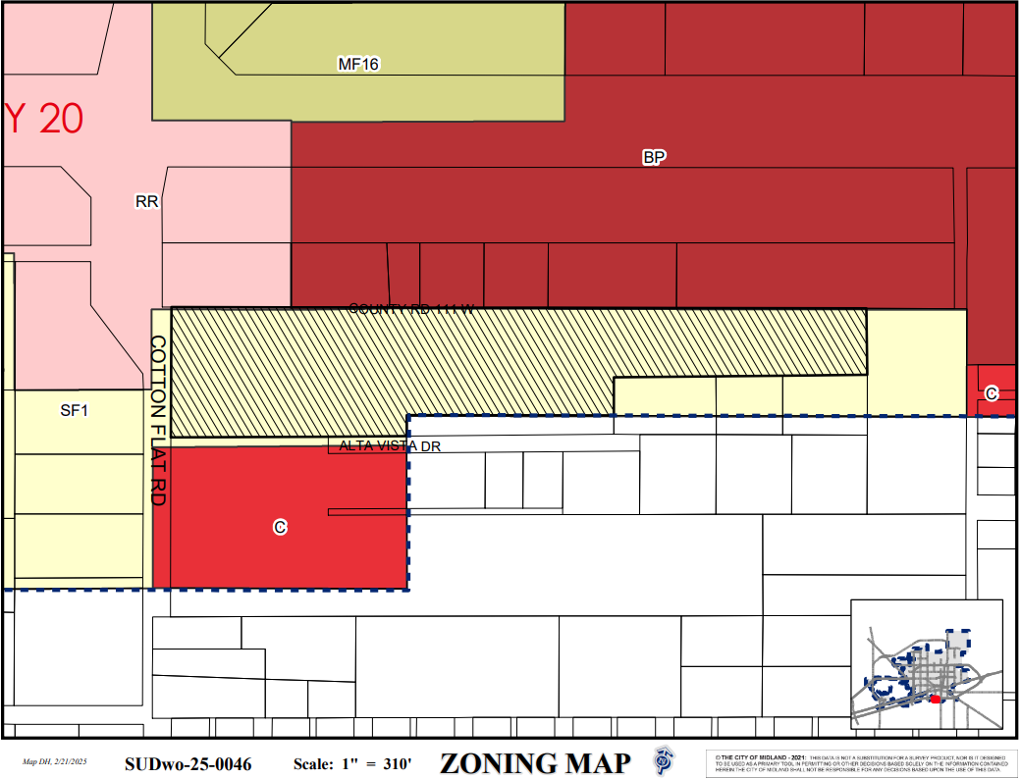
ZONING
Current Zoning: SF-1, Single-Family Dwelling District
Surrounding Zoning:
North: RR, Regional Retail District, and BP, I-20 Business Park District
South: C, Commercial District and ETJ, Extraterritorial Jurisdiction

Slide 4
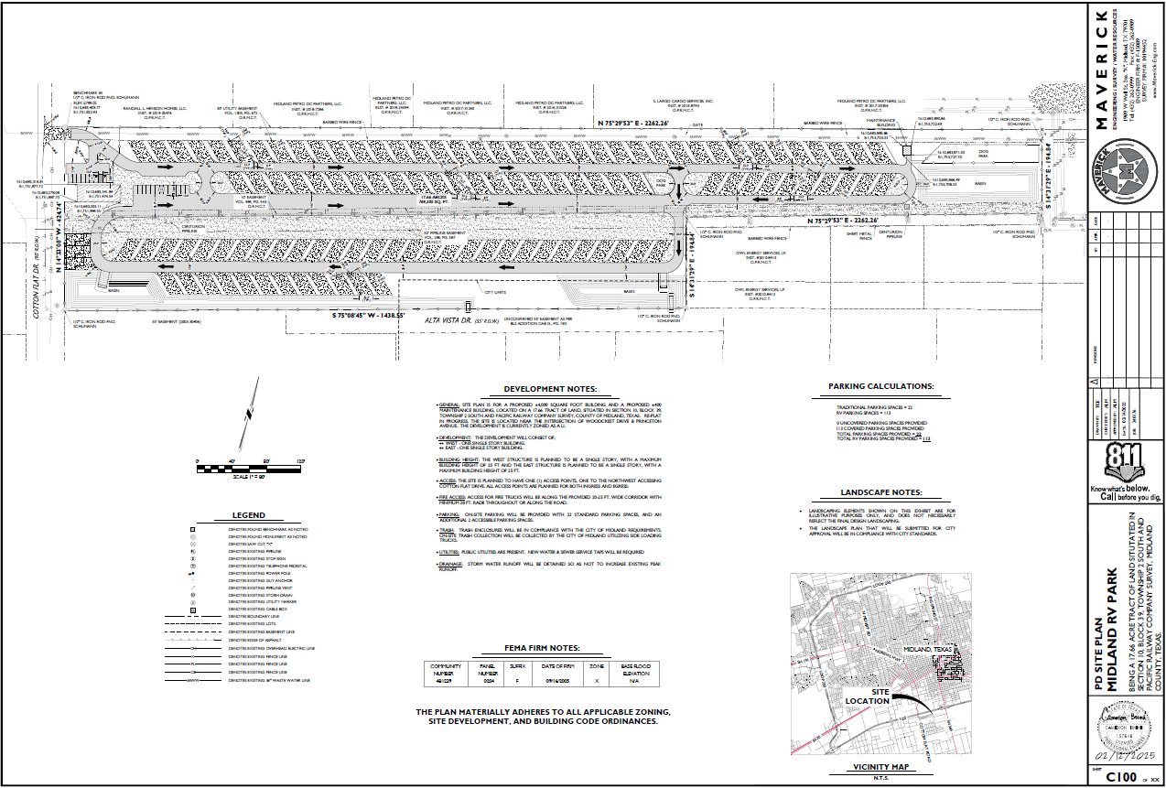
SUD DETAILS
Proposed Days and Hours of Operation and of SUD:
Monday - Sunday all day
113 RV Parking Spaces
22 Standard Parking Spaces
2 dog parks

Slide 5
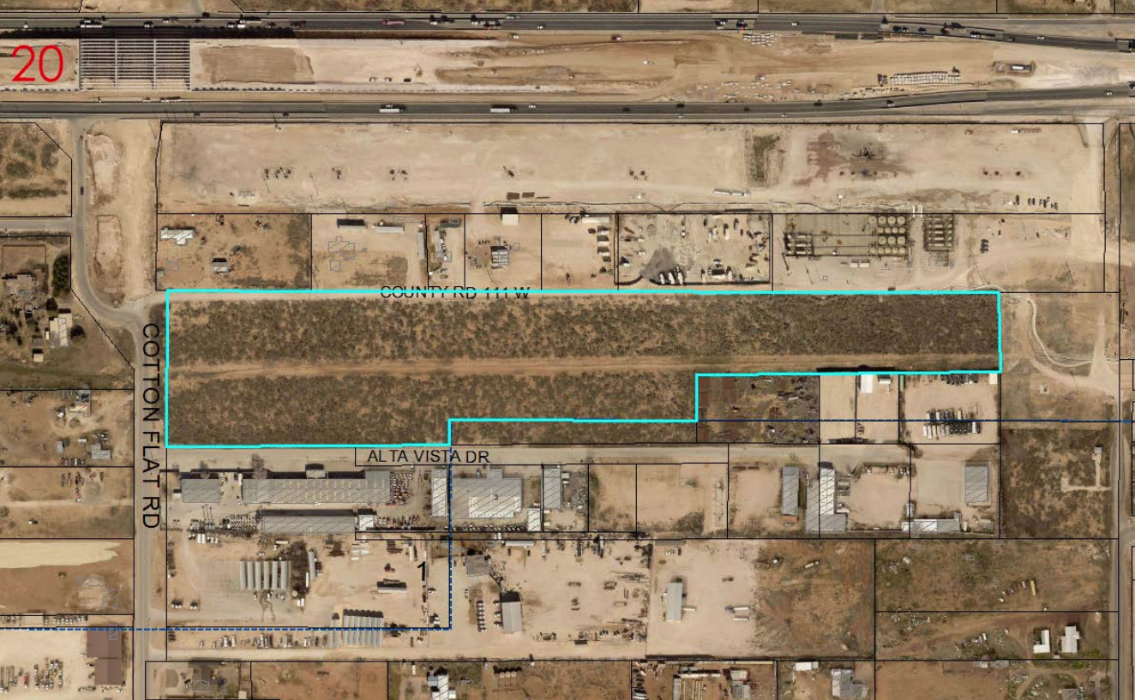
LAND USE
Current Use: Vacant lot
Proposed Use: Vacation Travel Trailer Park
Surrounding Uses:
North: Oil field, single-family residential and vacant lots
South: Water well drilling services and vehicle dent repair services
East: Vacant lot
West: Single-family residential

Slide 6

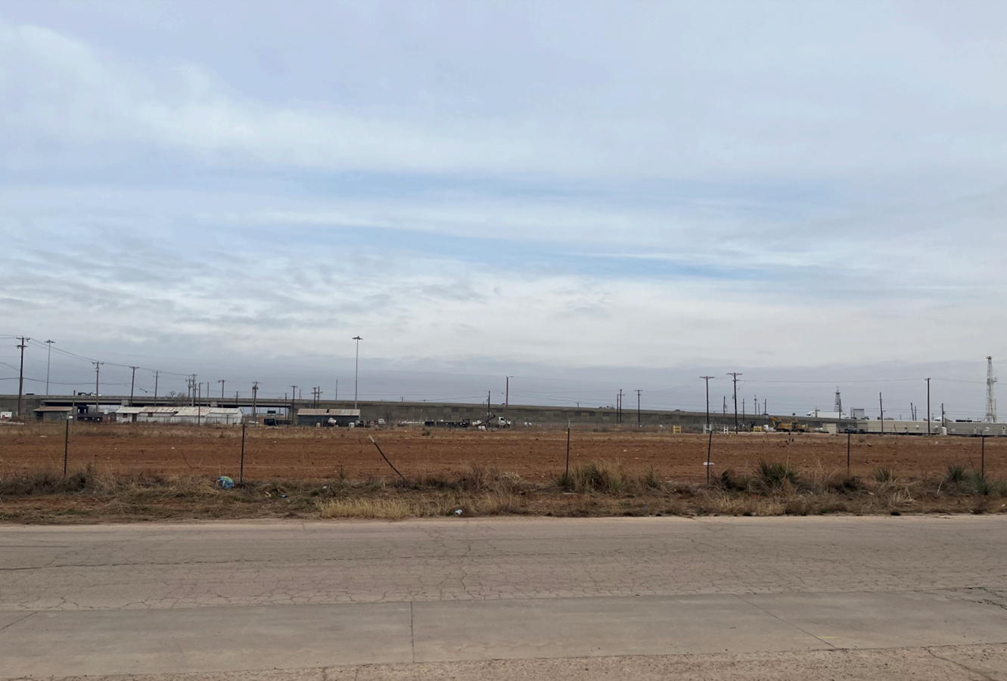
SITE PHOTO
On Cotton Flat Road, Looking East

Slide 7
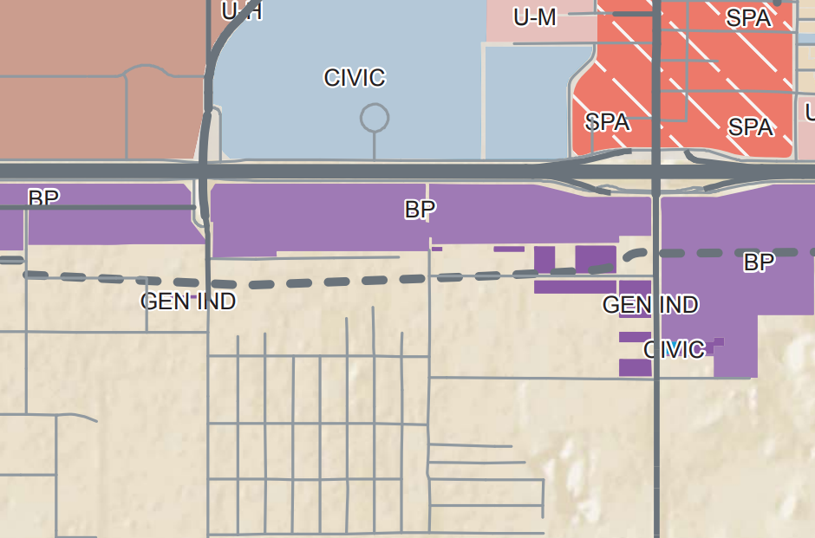

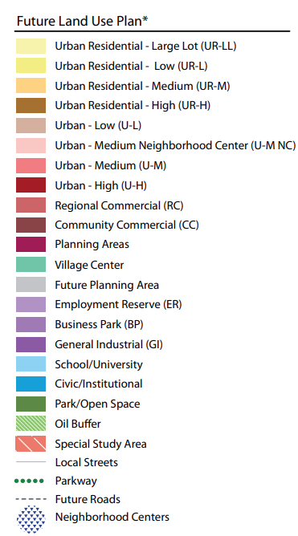
COMPREHENSIVE PLAN ANALYSIS
TCT Land Use Designation:
Business Park I-20 (BP)
Supported Uses:
Warehousing and distribution
Larger scale visitor services located at the major intersections

Slide 8
COMPREHENSIVE PLAN ANALYSIS
Multifamily may be appropriate when integrated as part of a holistic development that incorporates retail and office uses.
Land use is compatible with surrounding area & TCT Plan

Slide 9

RELATED ITEMS
The sketch plat associated with this request was submitted on January 24, 2025.
This request was recommended for approval by the Planning & Zoning Commission on March 3, 2025.
9

Slide 10

STAFF’S RECOMMENDATION
Staff recommends approval of the request of the Specific Use Designation without Term for a Vacation Travel Trailer Park, subject to Conditions A through F.
10

Slide 11
STAFF’S RECOMMENDATION
That the use and development of the Property for the Establishment shall significantly conform to the site plan, which is attached hereto as Exhibit B and incorporated herein for all purposes. For the avoidance of doubt, this condition shall not apply to any portion of the land shown in Exhibit B that is not located within the boundaries of the City.
That the Establishment may be operated Monday through Sunday, 24 hours per day.
11

Slide 12
STAFF’S RECOMMENDATION
That a person shall not operate the Establishment on the Property without first applying for and obtaining a license in accordance with Section 11-1-4.04.A.2 of the City Code.
That a person shall not operate the Establishment on the Property unless the person complies with all applicable requirements of Section 11-1-4.04.A.2 of the City Code and all other applicable City ordinances and state laws, rules, and regulations.
12

Slide 13
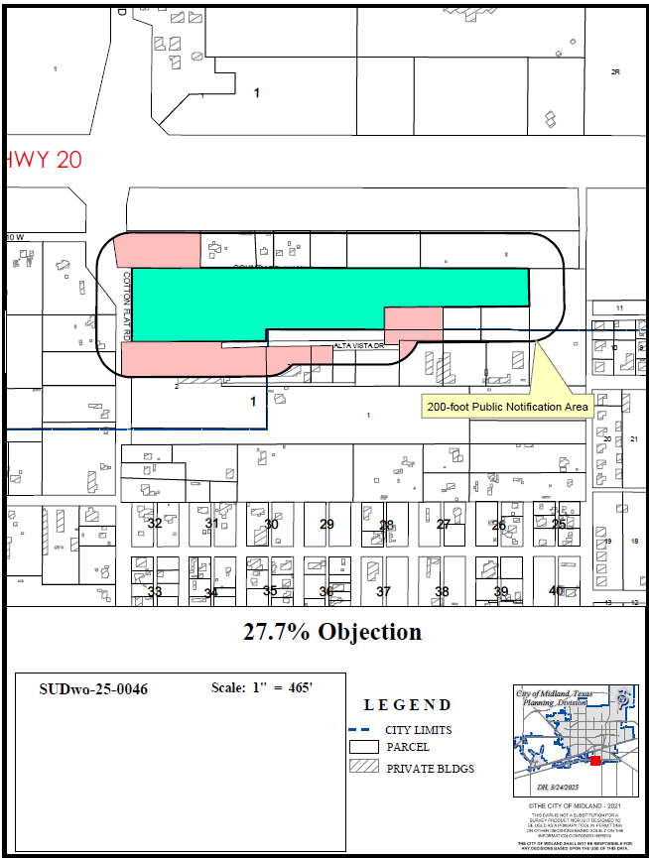
OBJECTIONS
5 were received resulting in 27.7% objection.
Objectors expressed a concern for an increase in traffic as well as whether the utilities would impact their property.
Per 11-1-9.02.E of the Zoning Ordinance, a three-fourths vote is required for approval.

Slide 14
STAFF’S RECOMMENDATION
That this ordinance does not permit, approve, authorize, or allow the extension of or the provision of City utilities, including water and wastewater, to any portion of the Establishment that is not located within the boundaries of the City.
That the operator of the Establishment shall obtain a Certificate of Occupancy prior to using the Property for the Specific Use to ensure that the conditions of this Specific Use Designation Without Term are satisfied.
14

Slide 15

MISSION
Deliver exceptional services and promote a high quality of life and place for ALL our citizens.

