Slide 1
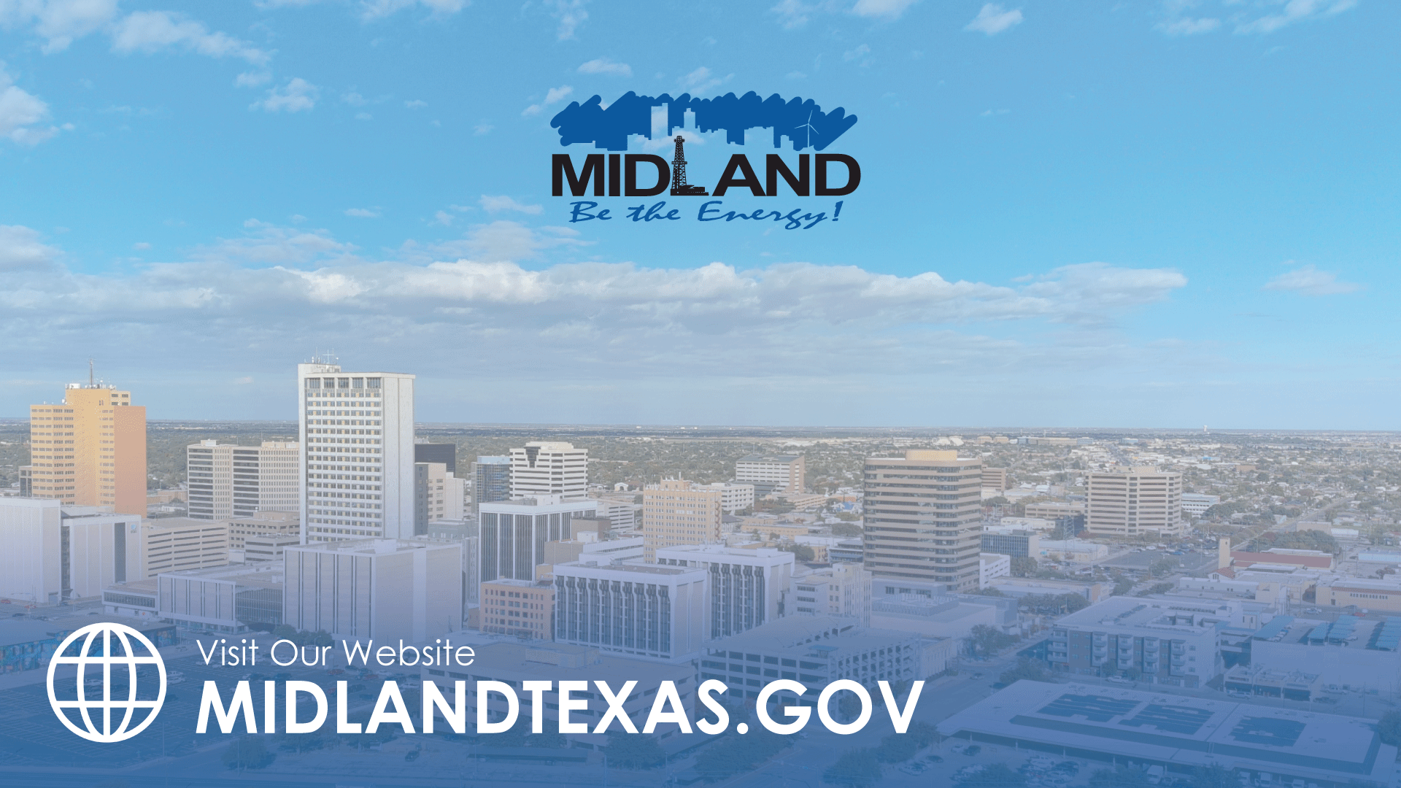
FY 2024 AUDIT RESULTS – MIDLAND DEVELOPMENT CORPORATION
TITLE HERE
TITLE HERE

Slide 2

WHAT WE WILL COVER
Results of Annual Audit
Required Communication to Those Charged with Governance
2

Slide 3
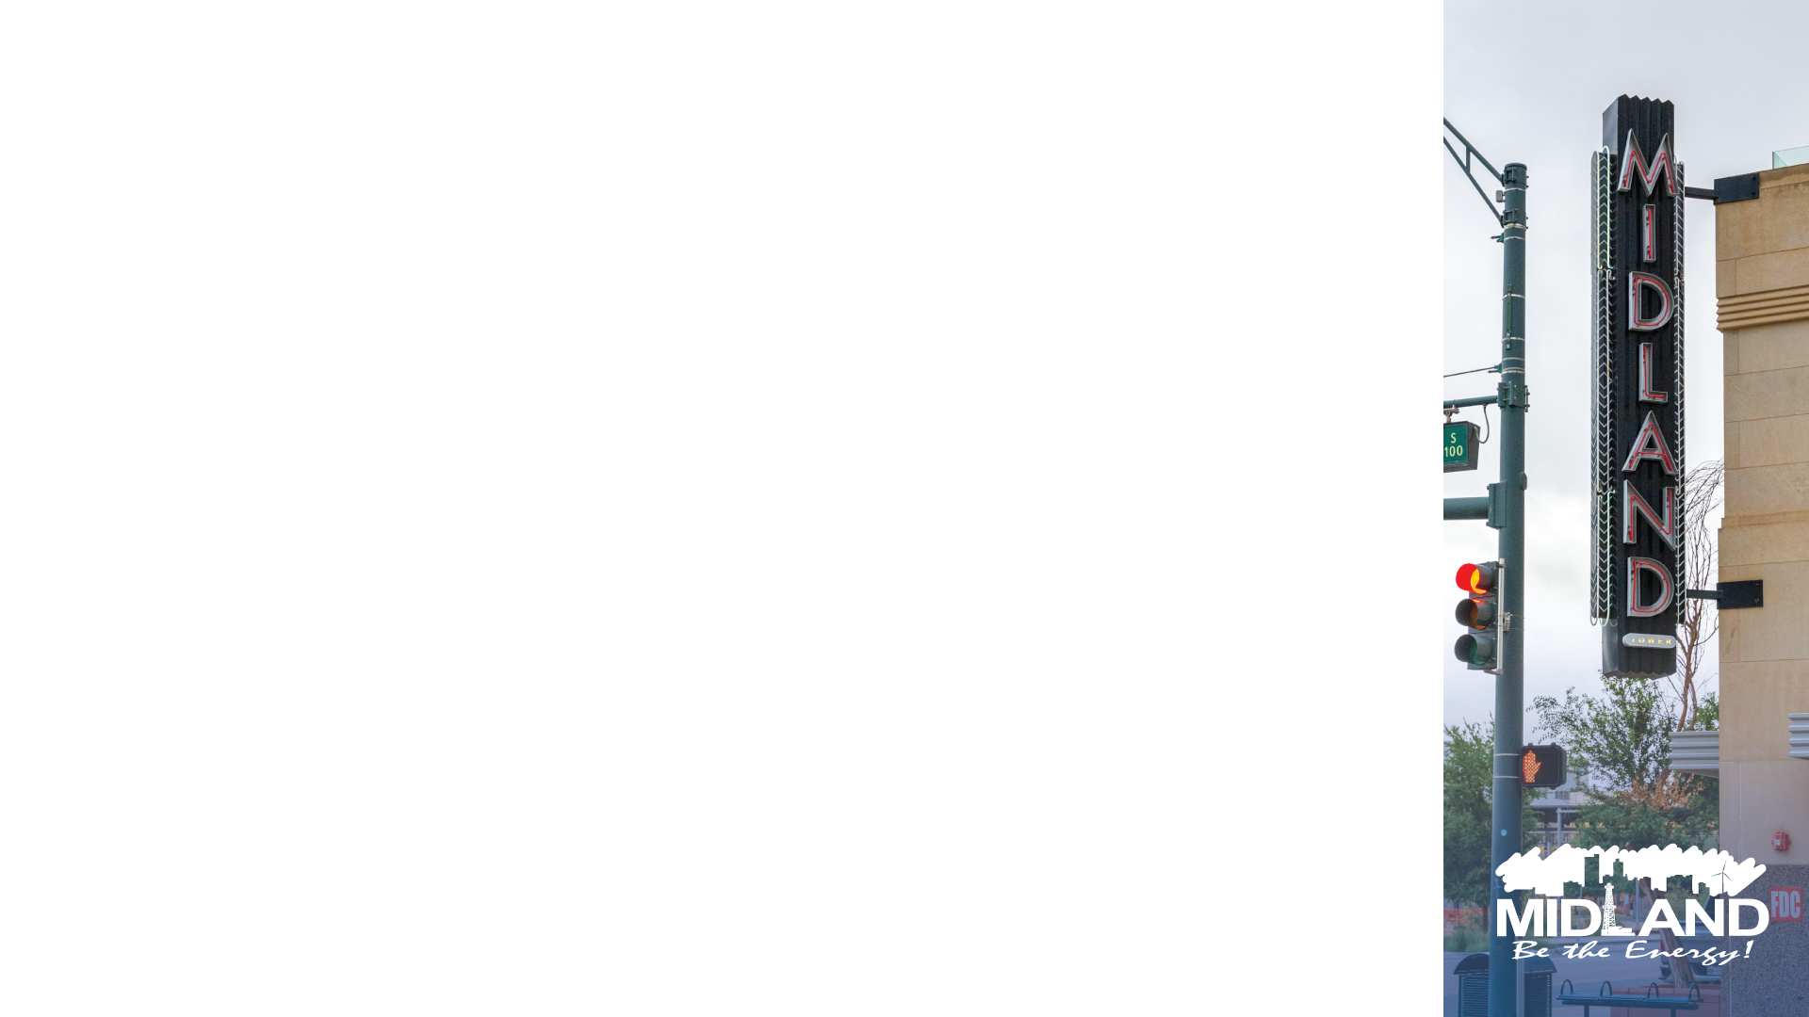
ANNUAL AUDIT RESULTS
Clean Bill of Health – Zero Findings
Finances and operations are being managed in compliance with applicable laws, regulations and accounting standards
Internal Controls – protect the assets of the Corporation
3

Slide 4

ANNUAL AUDIT RESULTS
CASH and INVESTMENTS BALANCE $40.4M
$12.0 million increase over 2023
FUND BALANCE $69.5 M
$9.2 million increase over 2023
4

Slide 5

REQUIRED COMMUNICATIONS
Scope
Responsibilities of auditors / City
Reasonable Assurance
Performed using Government Auditing Standards
5

Slide 6

MISSION
Deliver exceptional services and promote a high quality of life and place for ALL our citizens.

